Slide 1
Project: IEEE P802.15 Working Group for Wireless Personal Area Networks (WPANs)
Submission Title : Long Range extension of the 802.15.4-2020 OFDM PHY
Date Submitted : July 28th, 2025
Source : Thomas Almholt (Texas Instruments, Inc), Tomas Motos (Texas Instruments, Inc)
Re : TG4ad Next Generation SUN PHYs
Abstract : This contribution describes a new long range extension of the SUN 802.15.4 OFDM PHY with high degree of re-use of existing OFDM PHY.
Purpose: Long Range technology proposal
Notice: This document has been prepared to assist the IEEE P802.15.4ad It is offered as a basis for discussion and is not binding on the contributing individual(s) or organization(s). The material in this document is subject to change in form and content after further study. The contributor(s) reserve(s) the right to add, amend or withdraw material contained herein.
Release: The contributor acknowledges and accepts that this contribution becomes the property of IEEE and may be made publicly available by P802.15.
Slide 1
Notes:
Jul 12, 2010
Page 1

Slide 2
Joint Proposal
1) Flexible STF Scheme
2) Enhanced Coding Scheme for PHR and PSDU
Enhanced Coding Scheme
Flexible STF
scheme

Slide 3
Flexible STF scheme
The mandatory STF is 80 bits encoded to 160 chips, on a single sub-carrier
Two additional STFs can be optionally employed in some network configurations
A simpler network based on point-to-point battery operated nodes would typically only employ one mandatory STF
A more advanced network can employ the two additional STFs to facilitate synchronization in the present of fading and/or perform early coarse channel estimation
STFs follow the standard LCGa, LCGb random sequence
Receivers shall listen to the mandatory STF and optionally listen to the additional STFs (if configured to be present)
The ability to receive, synchronize, equalize to multiple STFs is left for receiver implementations and design tradeoffs

Slide 4
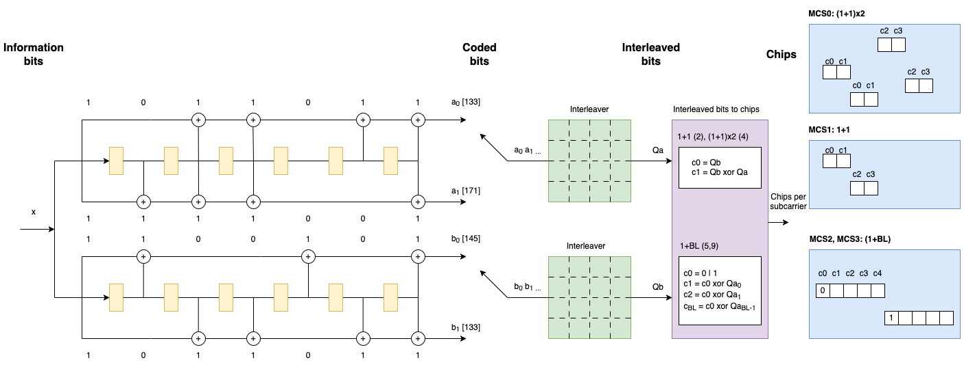
Enhanced Coding Scheme for PHR and PSDU
Bird’s view: MCS0, MCS1, MCS2, MCS3 defined in following slides

Slide 5
Enhanced Coding Scheme for PHR and PSDU
There are 4 coded bits generated per incoming bit (a0,a1) and (b0,b1)
The output of the a-branch (a0,a1) are serialized and fed into the 4x4 a-interleaver
The output of the b-branch (b0,b1) are serialized and fed into the 4x4 b-interleaver.
The interleaved-bits-to-chip has two modes of operation, resulting in MCS0, MCS1 and MCS2, MCS3, respectively
MCS0, MCS1 Modes (mandatory)
MCS0: (1+1)x2 mode
    In this mode, two chips are generated and mapped to the same sub-carrier
    The first chip (c0) is directly the output (Qb) of the b-interleaver
    The second chip (c1) is the xor of the Qa and Qb
    Differential receivers shall only look at the information coded into c1, by computing diff (c0, c1), which is Qa (1/2 coding)
    Coherent receivers can extract information of both Qa and Qb, thus having additional redundancy available (1/4 coding)
    An additional repetition of c0, c1 is inserted on the following channel. This adds channel diversity to the encoding.
  MCS1: (1+1) mode
  As above, but a single repetition of c0, c1 is employed

Slide 6
Enhanced Coding Scheme for PHR and PSDU
MCS2, MCS3 Modes (optional)
MCS2: (1+BL), with BL=4
In this mode, In this mode, 5 chips are generated and mapped to the same sub-carrier
The first chip c0 is a pilot chip, with alternating 0 and 1 values
The rest 4 chips are generated and c0 xor Qai (i = 0..3)
Qb is not employed in MCS2 mode
MCS3: (1+BL), with BL=8
In this mode, In this mode, 9 chips are generated and mapped to the same sub-carrier
The first chip c0 is a pilot chip, with alternating 0 and 1 values
The rest 8 chips are generated and c0 xor Qai (i = 0..7)
Qb is not employed in MCS3 mode
In MCS2, MCS3 modes, only differential decoding is available to receivers, which results in an effective 1/2 coding. These modes employ a single pilot per sub-carrier, thus increasing the overall effective data rate.

Slide 7
Enhanced Coding Scheme for PHR and PSDU
Information Encoding Factor and Effective Data Rates
*Note that upper bound for encoding factor is 0.5, given by the FEC encoder
* SymDur=120 us is available for O1, O2, O3, O4, providing 104, 56, 24, 12 active tones, respectively. SymDur=120 us requires stricter +/-10 ppm XTAL accuracy (+/-20 ppm both ends)
** SymDur={60,30,15} us maintains current +/-20 ppm XTAL accuracy (+/-40 ppm both ends)
 | MCS0 | MCS1 | MCS2 | MCS3
Enc Factor | 1/8 0.125 | ¼ 0.25 | (4/5)/2 0.4 | (8/9)/2 0.44
Effective Rate | MCS0 | MCS1 | MCS2 | MCS3
SymDur=120 us | 1.04 kbps | 2.08 kbps | 3.33 kbps | 3.7 kbps
SymDur= 60 us | 2.08 kbps | 4.16 kbps | 6.66 kbps | 7.4 kbps
SymDur=30 us | 4.16 kbps | 8.33 kbps | 13.33 kbps | 14.81 kbps
SymDur=15 us | 8.33 kbps | 16.66 kbps | 26.6 kbps | 29.63 kbps

Slide 8
SymDur=120 us Modes
Parameter | Option 1 | Option 2 | Option 3 | Option 4
Nominal bandwidth (kHz) | 1100 | 550 | 280 | 156
Channel Spacing (kHz) | 1200 | 800 | 400 | 200
DFT size | 128 | 64 | 32 | 16
Active tones | 104 | 52 | 26 | 12
Pilot tones | 0 | 0 | 0 | 0
Data tones | 104 | 52 | 26 | 12
MCS0 (kbps) | 1.04 | 1.04 | 1.04 | 1.04
MCS1 (kbps) | 2.08 | 2.08 | 2.08 | 2.08
MCS2 (kbps) | 3.33 | 3.33 | 3.33 | 3.33
MCS3 (kbps) | 3.70 | 3.70 | 3.70 | 3.70

Slide 9
SymDur=60 us Modes
Parameter | Option 1 | Option 2 | Option 3 | Option 4
Nominal bandwidth (kHz) | 1100 | 550 | 280 | 156
Channel Spacing (kHz) | 1200 | 800 | 400 | 200
DFT size | 64 | 32 | 16
Active tones | 52 | 24 | 12
Pilot tones | 0 | 0 | 0
Data tones | 52 | 24 | 12
MCS0 (kbps) | 2.08 | 2.08 | 2.08
MCS1 (kbps) | 4.16 | 4.16 | 4.16
MCS2 (kbps) | 6.66 | 6.66 | 6.66
MCS3 (kbps) | 7.40 | 7.40 | 7.40

Slide 10
SymDur=30 us Modes
Parameter | Option 1 | Option 2 | Option 3 | Option 4
Nominal bandwidth (kHz) | 1100 | 550 | 280 | 156
Channel Spacing (kHz) | 1200 | 800 | 400 | 200
DFT size | 32 | 16
Active tones | 24 | 12
Pilot tones | 0 | 0
Data tones | 24 | 12
MCS0 (kbps) | 4.16 | 4.16
MCS1 (kbps) | 8.33 | 8.33
MCS2 (kbps) | 13.3 | 13.3
MCS3 (kbps) | 14.81 | 14.81

Slide 11
SymDur=15 us Modes
Parameter | Option 1 | Option 2 | Option 3 | Option 4
Nominal bandwidth (kHz) | 1100 | 550 | 280 | 156
Channel Spacing (kHz) | 1200 | 800 | 400 | 200
DFT size | 16
Active tones | 12
Pilot tones | 0
Data tones | 12
MCS0 (kbps) | 8.33
MCS1 (kbps) | 16.66
MCS2 (kbps) | 26.6
MCS3 (kbps) | 29.63

Slide 12
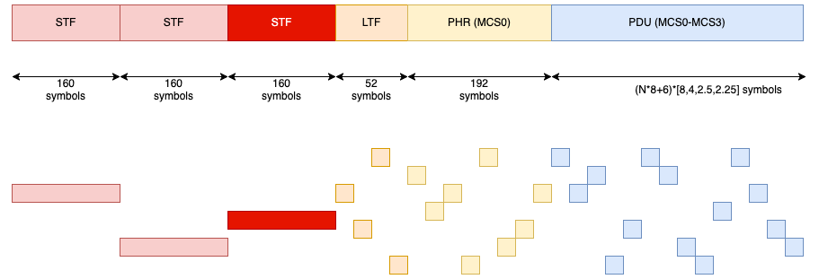
Packet Structure and Duration

Slide 13
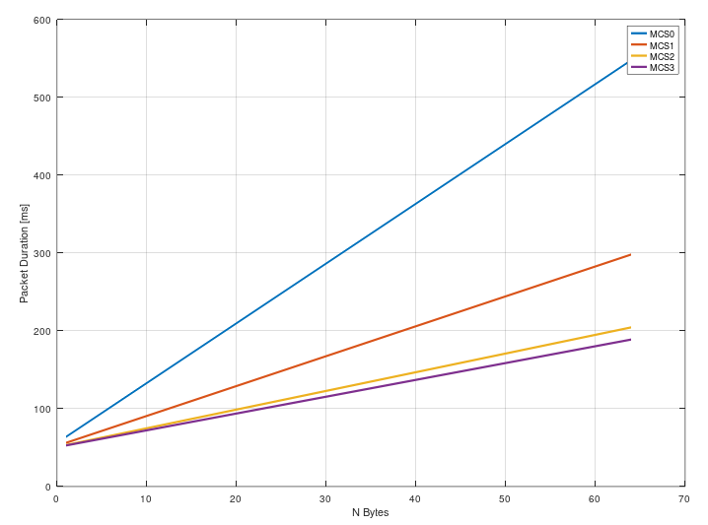
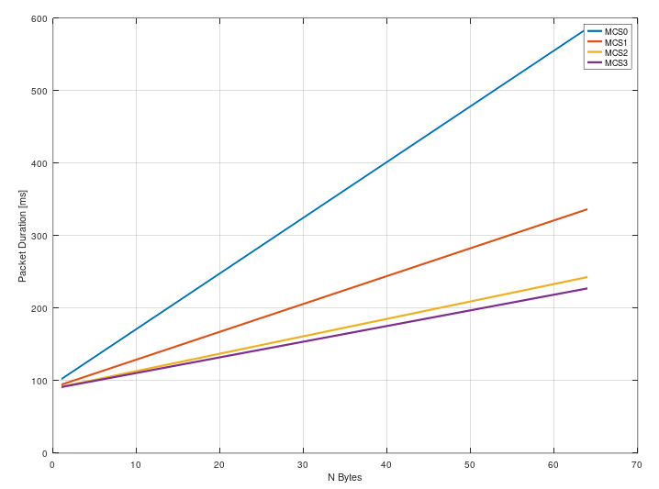
SymDur = 120 us
STF =1
STF =3
Insight: there is very little practical difference between MCS2 and MCS3, simplify to one? (BL=8)

Slide 14


SymDur = 60 us
STF =1
STF =3

Slide 15
Conclusions
This material presents a common framework supporting
Additional synchronization opportunities across up to 3 channels
  Improves fading resilience and provides longer sequences for coherent implementations
Additional MCS and coding schemes
  Enables ¼ encoded coherent detection for advanced receivers
  Allows faster code rates (MCS2, MCS3) for higher data rates outside FCC regulatory regimes

