Slide 1
Project: IEEE P802.15 Working Group for Wireless Personal Area Networks (WPANs)
Submission Title: IG Access July 2025 Meeting Slides
Date Submitted: 28 Jully 2025
Source: Benjamin A. Rolfe (Blind Creek Associates)
Contact:
Voice: +1 408 395 7207, E-Mail: ben.rolfe @ ieee.org
Re: Wireless Next Generation
Abstract: Agenda and Meeting Slides for the July 2024 802 plenary session Interest group access
Purpose: Support the illusion of organization.
Notice: This document has been prepared to assist the IEEE P802.15. It is offered as a basis for discussion and is not binding on the contributing individual(s) or organization(s). The material in this document is subject to change in form and content after further study. The contributor(s) reserve(s) the right to add, amend or withdraw material contained herein.
Release: The contributor acknowledges and accepts that this contribution becomes the property of IEEE and may be made publicly available by P802.15.
Notes:
Jul 12, 2010
Page 1

Slide 2
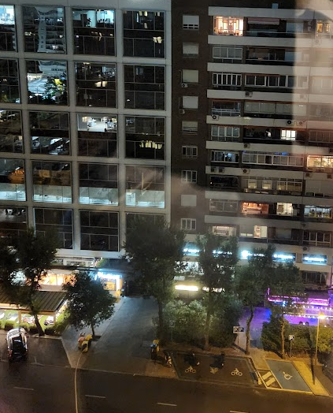
May 2025 802 Wireless Interim Session
Interest Group, Spectrum Channel Access
Live from Madrid, Spain
And remote around the world

Slide 3
Hybrid Meeting
Registration is required
Please remember to enter your attendance in IMAT
Reminder:
This is a non-PAR activity
All the rules of conduct apply https://grouper.ieee.org/groups/802/sapolicies.shtml

Slide 4
Agenda 13 May 2025
Opening and Meeting Reminders
Overview of Interest Group
Technical Discussion
  ED thresholds for suspendable CSMA-CA
Any other business
Adjourn

Slide 5

Opportunity and problem consideration
Overview of Interest Group

Slide 6
Opportunity Statement
Need to share spectrum
  Need to share with uncoordinated access
  Need multiple sharing methods
  Sharing through coexistence is essential
Need to accommodate reality
A systems view of coexistence will help to advance
  With over 5 decades of wireless channel access experience a lot has been learned
  We can do more than what we’ve already done!

Slide 7

Technical Contributions

Slide 8
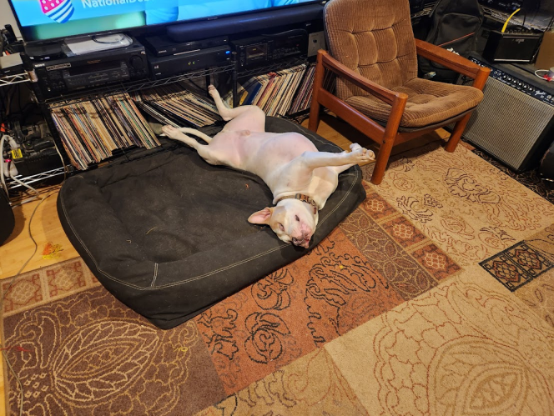
Discussion

Slide 9
Next Steps
[to be discussed]

Slide 10

Any Other Business

Slide 11
Adjourned

Slide 12
Minutes

Slide 13
IG Attendance

