Slide 1
Synchronization Sequences Lengths
Date: 2025-07-28

Slide 2
Abstract
802.16t describes usage of the Gold sequence for the synchronization purpose. There are various length of Gold sequences like 31,63,127 etc. The standard also describes various repetition factors such as 2,4,8 up to 128. The preamble detection and synchronization has to be robust enough to support these repetition factors and for ease of interoperability it will be good to specify the preamble length for each repetition factor.
This contribution presents an analysis of the synchronization performance based on the ideal Synchronization algorithm. Based on the ideal performance, selection of the sequence length can be done for No repetition Vs Repetition cases.

Slide 3
Ideal Synchronization Method
Let y[n] be the received data and x[n] be the reference preamble.
Select a set of possible frequency offsets f_1, f_2… f_k.
For each frequency offset calculate the frequency shifted data
  yk[n] = y[n]*exp(-1i*2*pi*f(k)/Fs*n)
Correlate the shifted data yk with the reference preamble x.
This results in the two-dimensional array of correlation values with respect to time and various frequency offsets.
Find the peak of this correlation matrix. This peak will be maximum likelihood estimate of the time and frequency offset.
For each SNR multiple iterations are run and RMSE is calculated.

Slide 4
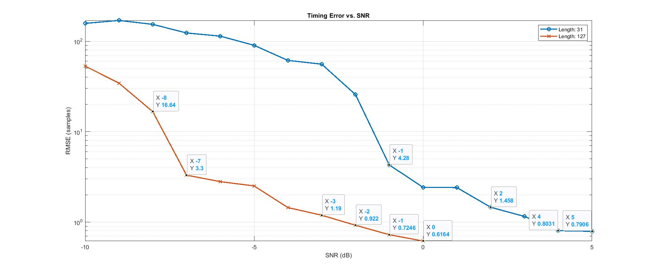
Time Estimation Results

Slide 5
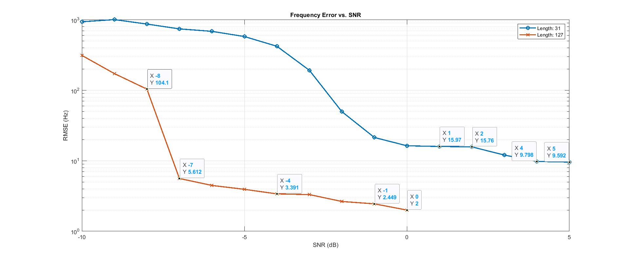
Frequency Estimation Results

Slide 6
Summary
  Analysis shows the Time and Frequency estimation performance of 31 and 127 length preamble sequence.
  31 length timing RMSE is less than 4 samples for SNR more than -1 dB and for frequency error it is less than 16 Hz.
  127 length timing RMSE is less than 4 samples for SNR more than -7 dB and for frequency error it is less than 6 Hz.
  We can see around 6 dB gain between these gain as expected.
  This analysis can be base for the other higher length sequences, Matlab simulations script is added here.

