Slide 1
        DOC: 15-25-0327-00-04ab
Project: IEEE P802.15 Working Group for Wireless Personal Area Networks (WPANs)
Submission Title: Clarification of Timing Offset Between NB and MMS
Date Submitted: July 2025
Source: Xiliang Luo, Vinod Kristem, Moche Cohen (Apple)
Address: One Apple Park Way, Cupertino, CA 95104, USA
E-Mails: xiliang_luo@apple.com
Abstract: Provide a clear description of the timing gap between the NBA packet and the MMS UWB in the case of NBA MMS UWB.
Purpose: Clarify the timing definition to ensure smooth interop tests of NBA MMS UWB.
Notice: This document has been prepared to assist the IEEE P802.15. It is offered as a basis for discussion and is not binding on the contributing individual(s) or organization(s). The material in this document is subject to change in form and content after further study. The contributor(s) reserve(s) the right to add, amend or withdraw material contained herein.
Release: The contributor acknowledges and accepts that this contribution becomes the property of IEEE and may be made publicly available by P802.15.

Slide 2
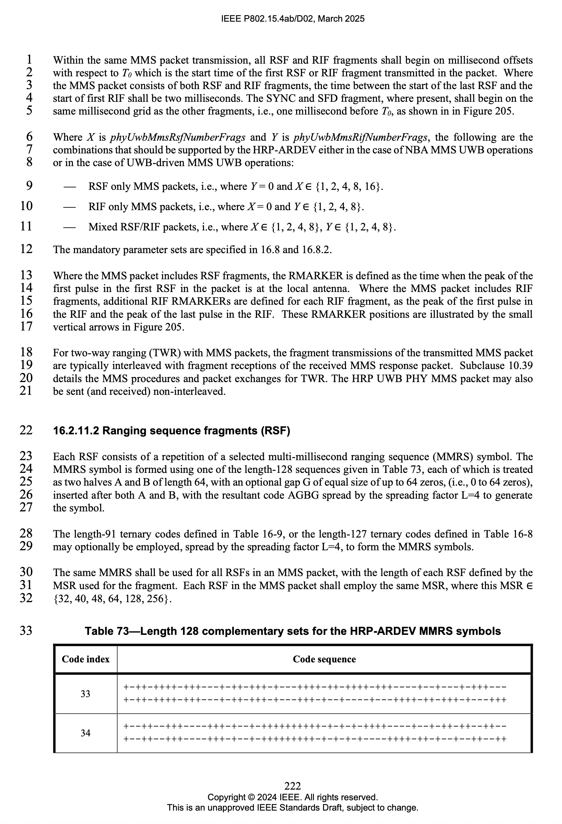
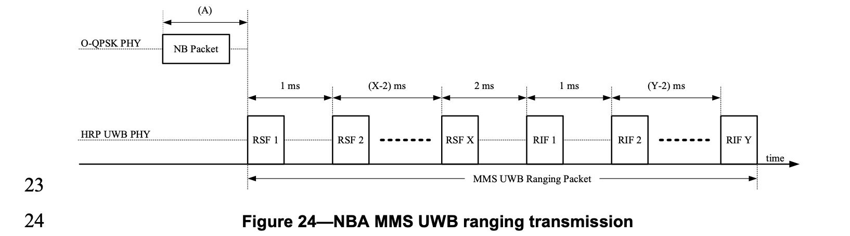
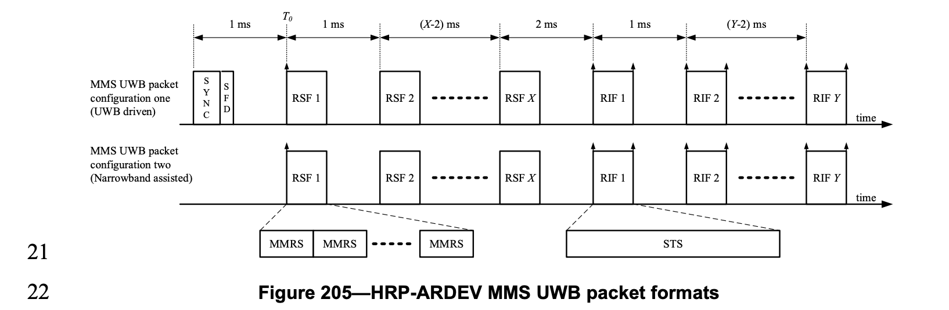
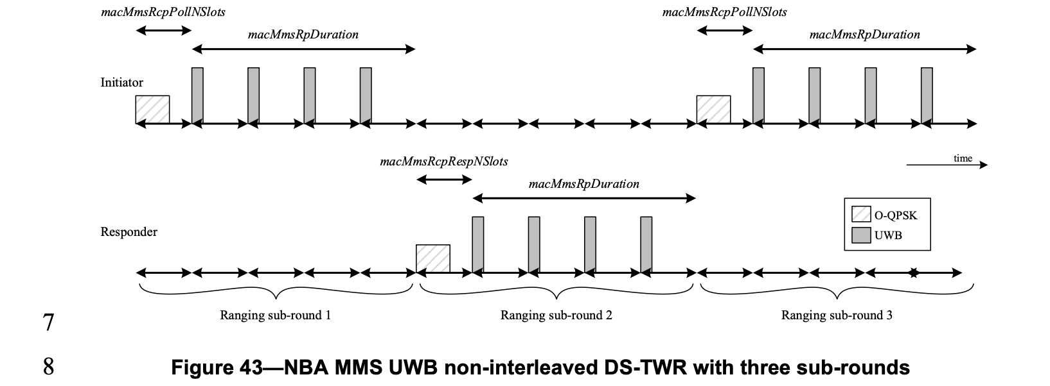
Proposed Resolution to CID: 144 in Doc #326
        DOC: 15-25-0327-00-04ab
In Figure 205, the start time of each fragment refers to the peak of the pulse in the first chip of that fragment and the start time of the MMS UWB packet is the start time of the first fragment. One time interval of 1 ms corresponds to 499200 chips.
In Figure 24, the start time of the NB packet is defined as the start of the first half-sine pulse transmitted in the in-phase branch. The start of one half-sine pulse refers to the timing which is one Tc=0.5us before the peak of that half-sine pulse.
In interleaving mode as in Figure 40, the time interval A corresponds to (macMmsRcpPollNSlots + macMmsRcpRespNSlots) ranging slots. Each ranging slot is specified in the unit of RSTU. One RSTU corresponds to 416 chips. In non-interleaving mode as in Figure 43, the time interval A corresponds to macMmsRcpPollNSlots ranging slots or macMmsRcpRespNSlots ranging slots.

Slide 3
More on Start of NB Packet
        DOC: 15-25-0327-00-04ab
Start time of NB packet
1
1
1
1
I-Phase
0
0
0
0
1
1
1
1
1
Q-Phase
0
0
0
Tc=0.5us

Slide 4
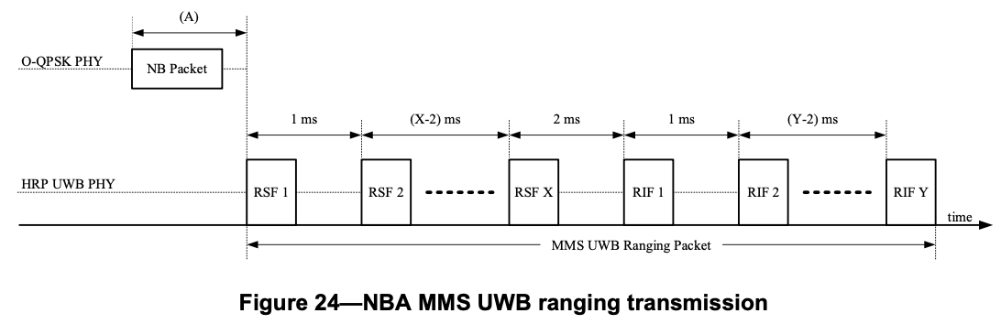
More on Time Interval btw NBA and MMS UWB
        DOC: 15-25-0327-00-04ab
Time gap between NBA and MMS UWB
Time interval (A) in Figure 24:
Time interval between the start of the packet in the control phase and the start of the MMS packet in the ranging phase
I-Phase
Q-Phase
MMS UWB
NBA
Start of 1st Half-Sine Pulse in I-Phase
Peak of 1st UWB Pulse

