Slide 1
Project: IEEE P802.15 Working Group for Wireless Specialty Networks (WSN)
Submission Title: TG4ab May 2025 Closing Report
Date Submitted: 15 May 2025
Source: Benjamin A. Rolfe (Blind Creek Associates)
Contact:
Voice: [deprecated],
E-Mail: ben.rolfe @ ieee.org
Re: Task Group 4ab: 802.15.4 UWB Next Generation
Abstract: Closing report May 2025
Purpose: Continue project progress and continue the illusion of organization
Notice: This document has been prepared to assist the IEEE P802.15. It is offered as a basis for discussion and is not binding on the contributing individual(s) or organization(s). The material in this document is subject to change in form and content after further study. The contributor(s) reserve(s) the right to add, amend or withdraw material contained herein.
Release: The contributor acknowledges and accepts that this contribution becomes the property of IEEE and may be made publicly available by P802.15.

Slide 2
Task Group 15.4ab Next Generation UWB Amendment
May 2025
802 Wireless Interim Session
Mixed Mode
Live from
Warsaw, Poland

Slide 3
Agenda
https://mentor.ieee.org/802.15/dcn/25/15-25-0190-12-04ab-tg4ab-detailed-agenda-may-2025.xlsx

Slide 4
Project Information

Slide 5
5.2.b Scope of the project (As approved):
This amendment enhances the Ultra Wideband (UWB) physical layers (PHYs) medium access control (MAC), and associated ranging techniques while retaining backward compatibility with enhanced ranging capable devices (ERDEVs). Areas of enhancement include:
additional coding, additional coding, preamble and modulation schemes to support improved link budget and/or reduced air-time relative to IEEE Std 802.15.4 UWB;
additional channels and operating frequencies;
interference mitigation techniques to support greater device density and higher traffic use cases relative to the IEEE Std 802.15.4 UWB;
improvements to accuracy, precision and reliability and interoperability for high-integrity ranging; schemes to reduce complexity and power consumption;
definitions for tightly coupled hybrid operation with narrowband signaling to assist UWB;
enhanced native discovery and connection setup mechanisms;
sensing capabilities to support presence detection and environment mapping;
and mechanisms supporting low-power low-latency streaming as well as high data-rate streaming allowing at least 50 Mb/s of throughput.
Support for peer-to-peer, peer-to-multi-peer, and station-to-infrastructure protocols are in scope, as are infrastructure synchronization mechanisms. This amendment includes safeguards so that the high throughput data use cases do not cause significant disruption to low duty-cycle ranging use cases.
https://development.standards.ieee.org/myproject-web/app#viewpar/9081

Slide 6
Near Term Working Milestones
 | Current Schedule
First letter ballot | June 2024
Initial LB comment resolution | Start: July 2024
First recirculation | March 2025
Recirculation comment resolution | April-May 2025
Second recirculation | May-June 2025
Recirculation comment resolution | July-Sept 2025
First SA-Ballot | November 2025
SA-Ballot comment resolution | December 2025 to ….
We are here

Slide 7
SA Ballot and Beyond
 | Current Schedule
First SA-Ballot | November 2025
SA-Ballot comment resolution | January 2026
First recirculation | April 2026
Recirculation comment resolution | May 2026
Second recirculation | July 2026
Recirculation comment resolution | August 2026
Final comment resolution | Sept 2026
Third and final recirculation | Oct 2026
REVCOM and SASB | Nov 2026
Update!
New and… Improved

Slide 8
Goals for the week
Improve draft D02
Resolve comments through friendly and producting collaboration
Work on outstanding issues
Us ad hoc time to work on convergence

Slide 9
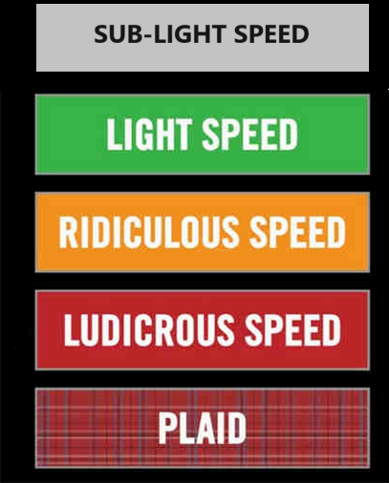
Comment Resolution

Slide 10
Stats before and after
 |  | Before | After
Technical/ General | Total | 452 | 452
 | Addressed | 63 | 151
 |  | 13.94% | 33.41%
 | Ready | 0 | 70
 |  | 0.00% | 15.49%
 | Done | 59 | 60
 |  | 13.05% | 13.27%
 | N/A | 4 | 21
 |  | 0.88% | 4.65%
 | To Be Addressed | 389 | 301
 |  | 86.06% | 66.59%
 | Assigned | 389 | 301
 |  | 86.06% | 66.59%
 | Proposed Resolutions | 0 | 8
 |  | 0.00% | 1.77%
 | Need Proposals | 389 | 293
 |  | 86.06% | 64.82%
 | Not Assigned | 0 | 0
 |  | 0.00% | 0.00%
452 technical comments
Pre-session: 63 resolved
Post-session: 151 resolved
Total 33% of technical comments resolved

Slide 11
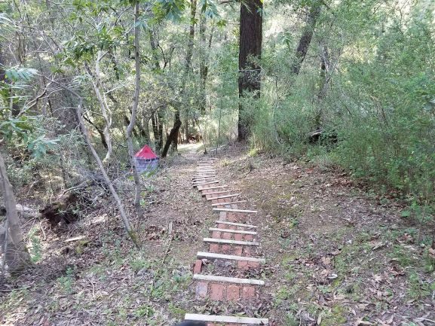
Next Steps

Slide 12
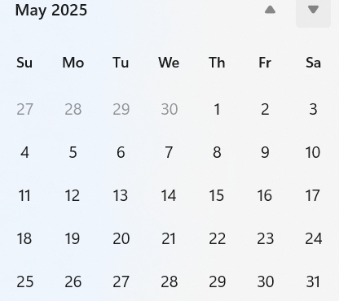
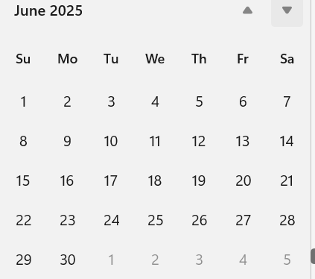
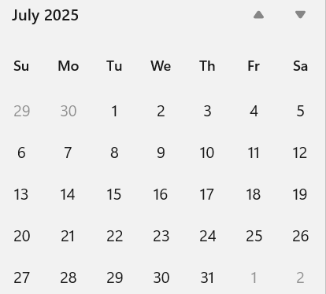
Telecom/Webex Schedule
Plenary starts on 27th July 2025
First call 27th May 2025 through 22nd July 2025
Once per week, 1 hour each,
Tuesday 06:00
Agenda: Resolve comments

Slide 13
Plan for Madrid
Resolve remaining comments
Initiate recirculation

Slide 14
Thank you for listening!

