Slide 1
Project: IEEE P802.15 Working Group for Wireless Personal Area Networks (WPANs)
Submission Title: [Updated Simulation Results for the OFDM LR-Mode]
Date Submitted: [14 May, 2025]
Source: [Joerg ROBERT] Company [FAU Erlangen-Nuernberg/ Fraunhofer IIS]
Address []
Voice:[], FAX: [], E-Mail:[Joerg.Robert@ieee.org]
Re: []
Abstract: []
Purpose: [Presentation in TG 802.15.4ad]
Notice: This document has been prepared to assist the IEEE P802.15. It is offered as a basis for discussion and is not binding on the contributing individual(s) or organization(s). The material in this document is subject to change in form and content after further study. The contributor(s) reserve(s) the right to add, amend or withdraw material contained herein.
Release: The contributor acknowledges and accepts that this contribution becomes the property of IEEE and may be made publicly available by P802.15.

Slide 2
Updated Simulation Results for the OFDM LR-Mode
Joerg Robert (FAU/Fraunhofer IIS)

Slide 3
Motivation
TG4ad decided to compare the performance of the different proposals in 15-25-0240-00
An update on the FAU/Fraunhofer IIS proposal was presented in 15-25-0199-00
This presentation gives simulation results for the updated proposal in the AWGN, TDL-B, and TDL-D channel
All data given for 20 bytes and payload bit-rate of 2.083kBit/s
Theoretical limit is given by -142.4 dBm
Realistic synchronization is not considered here

Slide 4
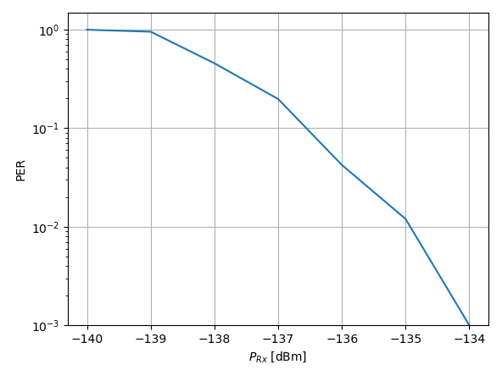
AWGN Channel
10% PER at -136.5 dBm → 4.9dB gap to theoretical limit
1% PER at -135 dBm → 7.4dB gap to theoretical limit

Slide 5
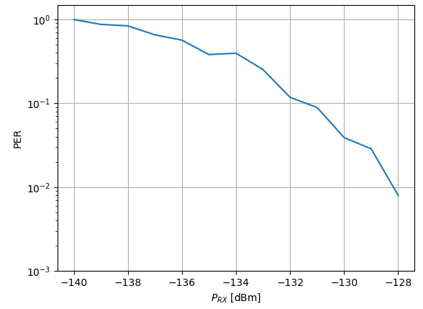
TDL-B Channel
10% PER at -132 dBm → 10.4dB gap to theoretical limit
1% PER at -128 dBm → 14.4dB gap to theoretical limit

Slide 6
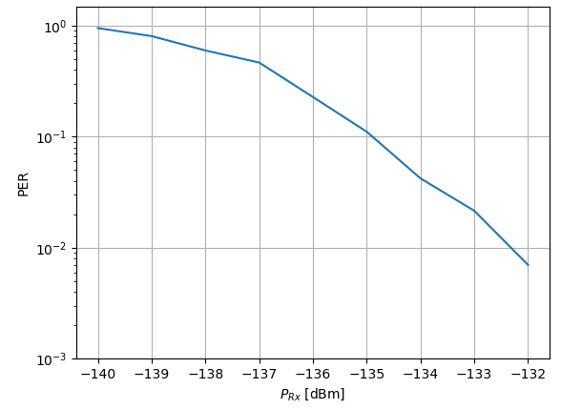
TDL-D Channel
10% PER at -135 dBm → 7.4dB gap to theoretical limit
1% PER at -132.3 dBm → 10.1dB gap to theoretical limit

