Slide 1
IEEE 802.16t Point to multipoint MAC performance analysis

Slide 2
Analysis Goal
To analyze the 802.16t MAC layer in narrowband scenarios
To understand the tradeoffs between overhead, latency and throughput under diverse traffic
To inform potential MAC improvements, such as more efficient scheduling algorithms or reduced overhead in control frames

Slide 3
Key analysis areas
MAC Efficiency: slot utilization; quantify scheduling overhead.
Diverse Traffic Testing: Simulate different traffic scenarios with different number of MSs with mixed demand.
Performance Measurement: Calculate average/max latency, deadline misses; slot usage and fairness
Frame-Level Scheduling Visualization: Track per frame allocations to locate source and reason for overhead and latencies

Slide 4
Characteristics of railroad application traffic
Low data volume
Most messages are short packets (20–500 bytes), but require timely and reliable delivery
Periodicity:
Periodic telemetry (e.g., status, health) and event-driven alerts
Long idle periods punctuated by bursts (e.g., fault reports, emergency commands, diagnostics)
Latency:
Some messages are delay-tolerant, others safety-critical with strict latency (<100–200 ms)
Asymmetric:
uplink usually higher than downlink

Slide 5
MAC Controllable parameters and tradeoffs
BW Requests polling periodicity and scheduling cycle
Polling too often consumes bandwidth; too infrequent leads to traffic starvation. Needs tuning per MS traffic class.
CDMA based BW requests
Scheduling window: fixed / sliding; fixed size / adaptive size
Frame duration
Bulk vs. Request based
Prioritization and QoS enforcement
Serving urgent traffic may starve low-priority MSs in tight bandwidth;
Fairness mechanisms should be tuned for mission profile
MAPs vs dynamic allocations

Slide 6
Analysis Tool
Non real time
Time is simulated by slots
Runs on a single device
Configurable PHY characteristics
No real traffic communication

Slide 7
Analysis Tool Inputs
PHY configuration
Channel bandwidth, frame duration, UL/DL ratio
Number of MSs
Traffic profiles:
Changing MCS profile
Random error rate profile
One or more Traffic Scenarios are defined to simulate realistic network activity
A Traffic Scenario describes the transmission behavior of a group of MSs and consists of a mix of traffic patterns.
Each Traffic Pattern is characterized by the following parameters:
Traffic period and timing: interval between transmissions and the precise start time of the pattern.
Data Packet size (fixed / random)
Packet periodicity (fixed/random)
QoS limitations

Slide 8
Measurement outputs
Summary Measurements:
Throughput
Slots distribution: management (IR, PR, Req etc); data; unused
Latency (average / max / restriction violations)
For deeper analysis:
Frame by frame slots assignment visualization
Example of output for uplink scenario:
Channel BW: 125 kHz; Frame duration 100 msec
MS-1 to MS-4: 512 bytes every 500 msec, MCS 64QAM ¾
MS-5 to MS-8: 67 bytes every 220-250 msec, MCS 16QAM ½
MS-8 to MS-12: 75 bytes every 200 msec, MCS 64QAM ¾

Slide 9
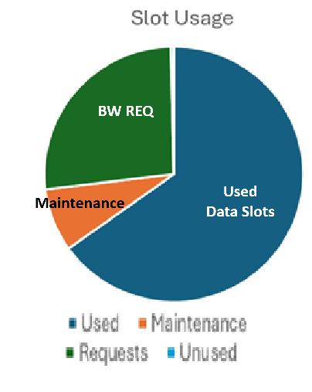
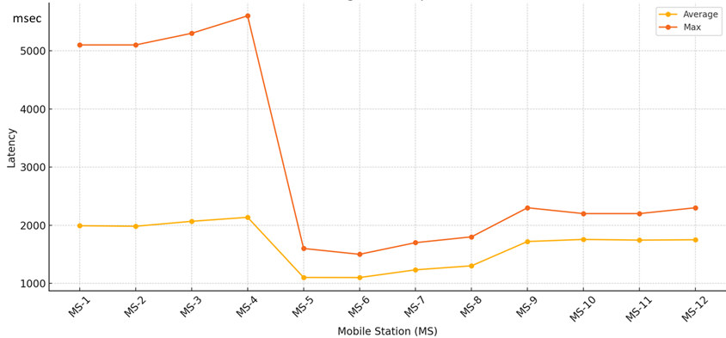
Example for Uplink Output
Average and Max Latency

Slide 10
Per Frame Allocations
Frame |  | MS-1 |  |  |  | MS-2 |  |  |  | MS-3 |  |  |  | MS-4 |  |  |  | MS-5 |  |  |  | MS-6
 |  | In | Data | Maint |  | In | Data | Maint |  | In | Data | Maint |  | In | Data | Maint |  | In | Data | Maint |  | In | Data | Maint
0 |  | 19 | 4 | 3 |  | 0 | 4 | 0 |  | 0 | 4 | 0 |  | 0 | 4 | 0 |  | 0 | 4 | 0 |  | 6 | 4 | 0
1 |  | 0 | 21 | 0 |  | 19 | 3 | 3 |  | 0 | 3 | 0 |  | 0 | 3 | 0 |  | 0 | 3 | 0 |  | 0 | 3 | 0
2 |  | 0 | 10 | 0 |  | 0 | 17 | 0 |  | 19 | 1 | 3 |  | 0 | 1 | 0 |  | 0 | 1 | 0 |  | 0 | 1 | 0
3 |  | 0 | 5 | 0 |  | 0 | 1 | 0 |  | 0 | 19 | 0 |  | 19 | 1 | 3 |  | 0 | 1 | 0 |  | 6 | 1 | 0
4 |  | 0 | 2 | 0 |  | 0 | 1 | 0 |  | 0 | 1 | 0 |  | 0 | 19 | 0 |  | 6 | 1 | 3 |  | 0 | 7 | 0
5 |  | 19 | 2 | 0 |  | 0 | 2 | 0 |  | 0 | 2 | 0 |  | 0 | 2 | 0 |  | 0 | 9 | 0 |  | 6 | 2 | 3
6 |  | 0 | 14 | 0 |  | 19 | 1 | 0 |  | 0 | 1 | 0 |  | 0 | 1 | 0 |  | 0 | 4 | 0 |  | 0 | 5 | 0
7 |  | 0 | 5 | 0 |  | 0 | 17 | 0 |  | 19 | 1 | 0 |  | 0 | 1 | 0 |  | 6 | 2 | 0 |  | 0 | 2 | 0
8 |  | 0 | 1 | 0 |  | 0 | 3 | 0 |  | 0 | 16 | 0 |  | 19 | 1 | 0 |  | 0 | 5 | 0 |  | 6 | 1 | 0
9 |  | 0 | 1 | 0 |  | 0 | 1 | 0 |  | 0 | 3 | 0 |  | 0 | 15 | 0 |  | 6 | 1 | 0 |  | 0 | 6 | 0

