Slide 1
Project: IEEE P802.15 Working Group for Wireless Personal Area Networks (WPANs)
Submission Title: [Live video streaming in the Japanese VHF band using an off-the-shelf SUN FSK radio module]
Date Submitted: [May. 2025]
Source: [Susumu Ishihara¹, Shugo Kajita², Arata Kato², Tetsushi Ikegami³ , Masakatsu Ogawa⁴, Mineo Takai⁵, Masanori Uno⁶]
Company [¹Shizuoka University, ²Space-Time Engineering Japan, Inc., ³Meiji University, ⁴Space-Time Engineering, LLC., ⁵Sophia University, ⁶e-trees.Japan Inc.]
Address []
Voice:[], FAX: [], E-Mail:[ishihara.susumu@shizuoka.ac.jp, skajita@spacetime-eng.com, ikegami@meiji.ac.jp, akato@spacetime-eng.com, m-ogawa@sophia.ac.jp, mineo@ieee.org, uno@e-trees.jp]
Re: [Response to TG 802.15.4ad Call for Proposals (IEEE 802.15-24/0488r1)]
Abstract: [This document includes additional reports on the SUN FSK in the VHF bands previously presented as part of IEEE 802.15-25/0007r3.]
Purpose: [To present the empirical examples for live video streaming on SUN FSK in the VHF bands]
Notice: This document has been prepared to assist the IEEE P802.15. It is offered as a basis for discussion and is not binding on the contributing individual(s) or organization(s). The material in this document is subject to change in form and content after further study. The contributor(s) reserve(s) the right to add, amend or withdraw material contained herein.
Release: The contributor acknowledges and accepts that this contribution becomes the property of IEEE and may be made publicly available by P802.15.
Slide 1

Slide 2
Abstract
In response to the TG 802.15.4ad Call for Proposals [1], we have developed a partial proposal [2] aimed at extending the existing SUN FSK technology to two Japanese VHF bands where the use of SUN PHYs has not been defined yet.
SUN FSK currently defines only low data rates (2.4 kbps – 9.6 kbps) in the VHF band, but the technology should be able to achieve higher data rates as they are defined in the UHF bands.
We performed field experiments using an off-the-shelf SUN FSK radio module in the VHF-High Band (210 MHz) in Ebino city, Miyazaki, Japan.
This slide deck presents experimental results including live video streaming at 150 kbps - 300 kbps, demonstrating the existing SUN FSK high data rate capability in the VHF bands.
Slide 2

Slide 3
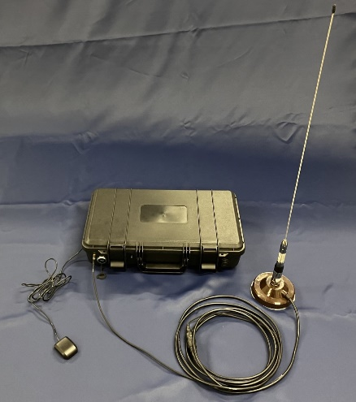
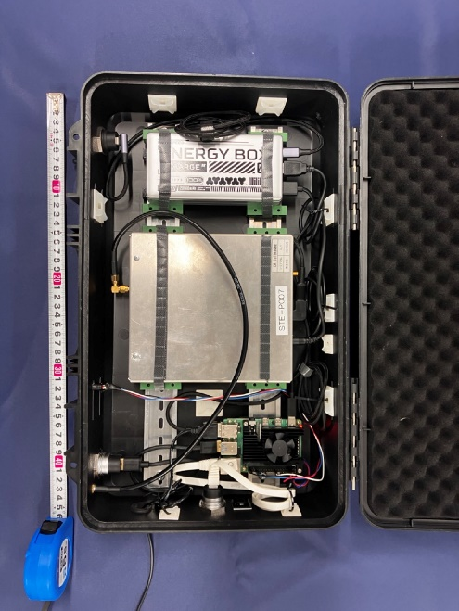
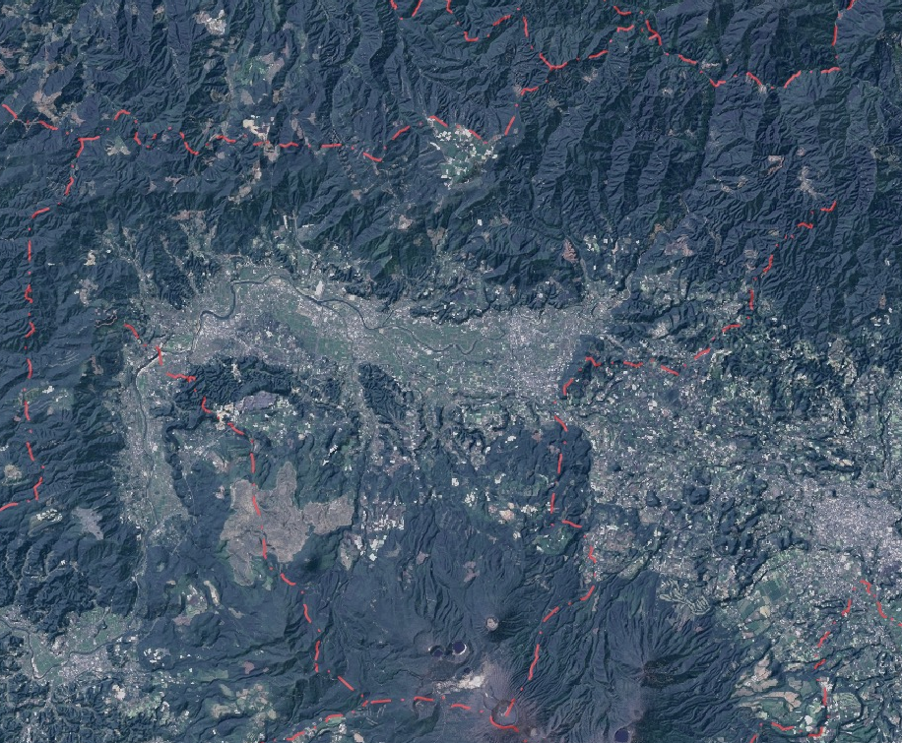
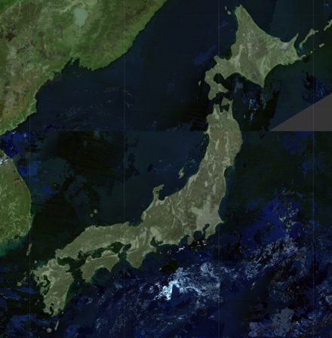
Experimental configurations
Location: Ebino city, Miyazaki, Japan
- Ebino city is located in a basin surrounded by mountains.
- We set up a stationary station at the Ebino fire station
Hardware:
- Prototype radios [3] implemented with a commercial off-the-shelf SUN chipset and licensed for experimental use in the VHF bands.
RF configurations:
- Center frequency: 210 MHz/211 MHz
- Bandwidth and data rate
- 150 kbps (200 kHz bandwidth) (for live streaming)
- 300 kbps (400 kHz bandwidth) (for live streaming from UAV
- 5 kbps (for Location tracking)
- Tx power: 5 W (except for UAV), 1 W (for UAV)
- Other RF PHY configurations follow our partial proposal in [2] without notes.
Fire station located at the center of city area.
Ebino
Slide 3

Slide 4
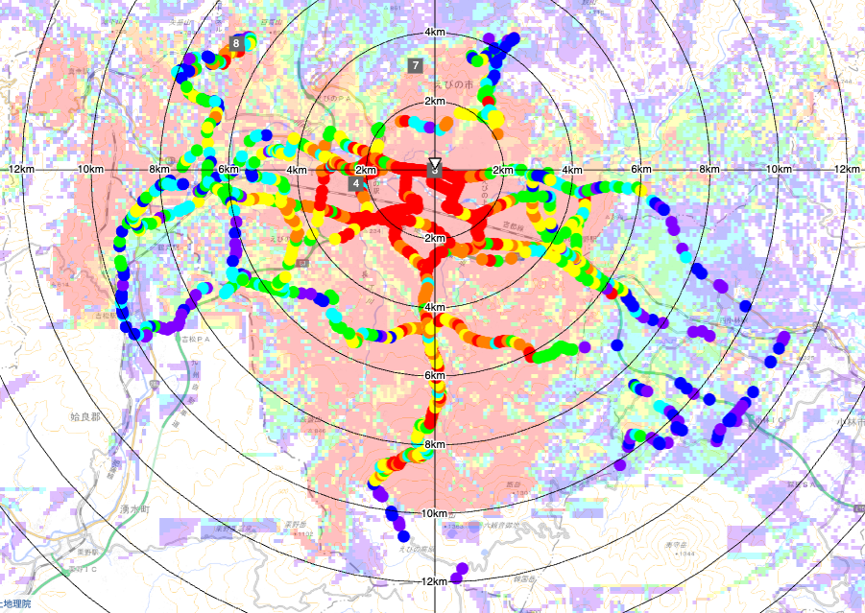
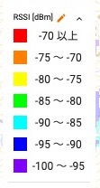
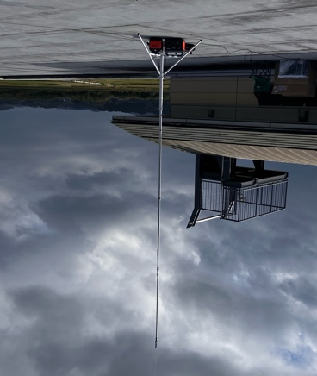
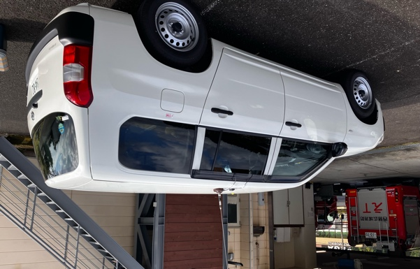
Location tracking (5 kbps) around Ebino fire station
Location tracking for the VHF band is a key application to on-site video surveillance by drones [6].
We have confirmed that the system covers the entire city area, which spans 10 km radius from the fire station and can be used for location tracking.
RX: Ebino Fire Department office
Configurations:
Center frequency: 210 MHz
Antenna gain (Tx/Rx): 2.15 dBi
Antenna height:
Rooftop: 11.5 m (Rx)
Vehicle: 1.4 m
Tx power: 5 W
Data rate: 5 kbps
A signal reached to the station from a point 12 km away.
Slide 4

Slide 5
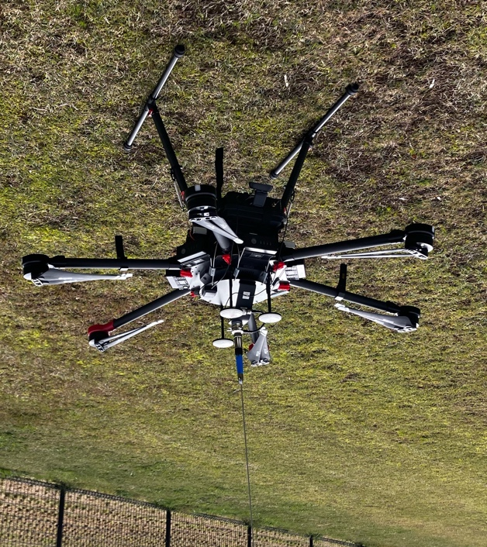
Live video streaming (300 kbps) from a UAV to Ebino fire station
A UAV streamed QVGA video on a 300 kbps channel to a stationary station at the Ebino fire station (6.9 km away).
Live streaming is one of the key public safety applications to monitor accident/disaster sites from safe areas remotely.
TX (UAV)
6.9 km
RX
VHF omni antenna
Experiment configurations:
- Carrier frequency: 210 MHz
- Antenna type: Omni-directional
- Antenna Gain: 2.15 dBi (Tx/Rx)
- Antenna Height (from the ground):
- 149 m (UAV), 11.5 m (RX)
Tx power: 1 W
Data rate: 300 kbps
Video format: H.264, QVGA (320x240), 5 fps
RX Omni antenna
Webcam and radio
Slide 5

Slide 6
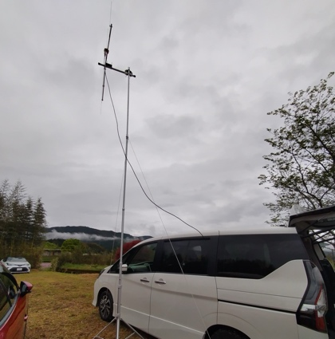
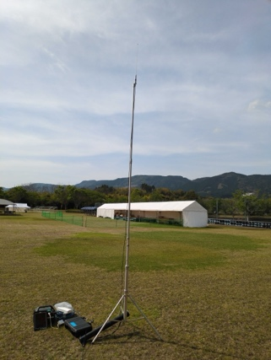
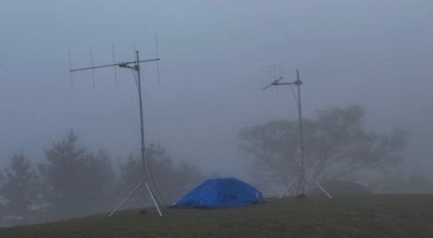
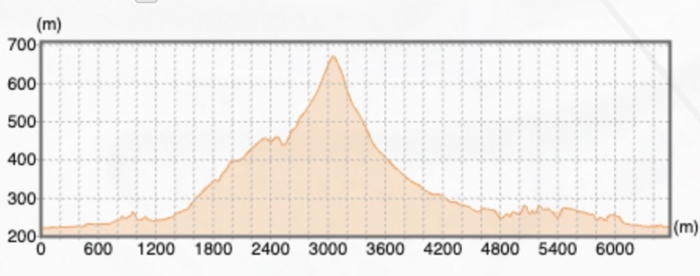
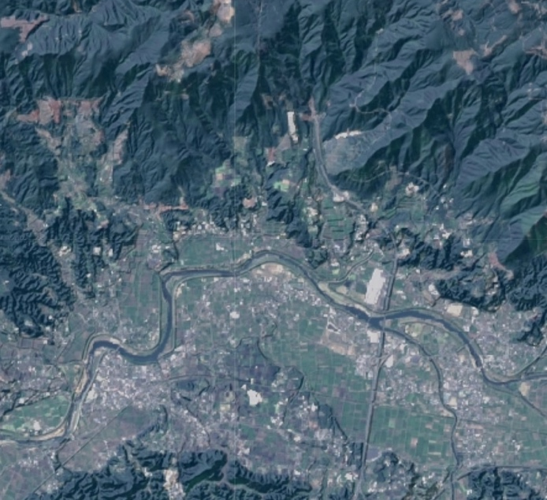
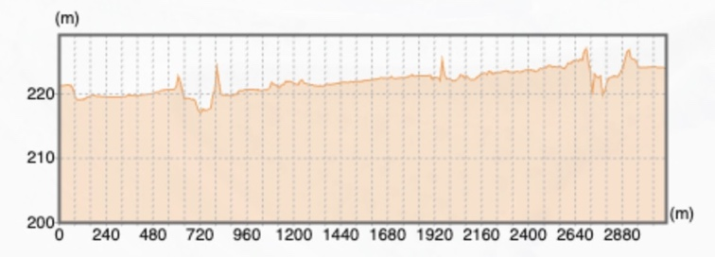
Live video streaming (150 kbps) in Ebino-Kyomachi Marathon
We provided live streaming in Ebino Marathon 2025 event to monitor an aid station. TX station (at the aid station) and RX station (at the medial headquarters of the event) that did not have a line of sight and communicated live streamed video via a relay station at about 300 m higher than the stations.
TX (Yagi) 11.15 dBi
RX (Omni) 2.15 dBi
2 ANTs at the relay point (Yagi)
11.15 dBi
Experiment configurations:
- Carrier frequency: - 210 MHz (Tx to relay), 211 MHz (Relay to Rx)
- Antenna Type and Gain: - Yagi, 11.15 dBi (Tx, Relay) - Omni, 2.15 dBi (Rx)
- Antenna Height (from sea level):
- 219 m (TX), 664 m (relay station), 224 m (RX)
Tx power: 5 W
Data rate: 150 kbps (200 kHz bandwidth)
Video format: H.264, QVGA (320x240), 5 fps (All frames were configured to key frames (I frames).)
Relay
Relay
TX
RX
3.0km
3.5km
Elevation profile among the radio stations
RX
TX
Elevation profile between TX and RX
Slide 6

Slide 7
Conclusions
The empirical examples of the SUN PHYs in the Japanese VHF High Band has been presented, following our partial proposal in [2].
Our proposal targets the use of off-the-shelf SUN FSK radio modules in Japanese VHF bands, with higher data rates intended for short-range communications under favorable channel conditions.
Slide 7

Slide 8
References
[1] P. Beecher, “TG 802.15.4ad Call for Proposals,” IEEE 802.15-24/0488r1.
[2] S. Kajita, S. Kitazawa, T. Ikegami, S. Ishihara, A. Kato, T. Matsuda, R. Miura, M. Ogawa, M. Takai, M. Uno, “Partial proposal on adding SUN FSK to two Japanese VHF bands,” IEEE 802.15-25/0007r3.
[3] M. Takai, S. Kitazawa, S. Kajita, “Diversified Range IoT (DR-IoT) for Disaster Response Applications,” IEEE 802.15-24/0507r1.
[4] Ministry of Internal Affairs and Communications, “Consultation on the regulatory rules of the VHF-High Band,” (Japanese).
[5] Information and Communications Council, “Report on the regulatory rules of the 169 MHz band systems,” (Japanese).
[6] Public Safety Radio Communications Office, Radio Depart., Ministry of Internal Affairs and Communications (MIC), Japan, “IoT for Public Protection and Disaster Relief”, IEEE 802.15-25/0250-00-wng0
Slide 8

