Slide 1
Project: IEEE P802.15 Working Group for Wireless Personal Area Networks (WPANs)
Submission Title: Towards NB Channel Access Convergence (CID 988)
Source: Carlos Aldana (Meta)
Address : [1 Hacker Way, Menlo Park, CA 94025]
E-Mail: [caldana (at) meta.com]
Re: Study Group 4ab: UWB Next Generation
Abstract: [This provides slides to aid discussion towards convergence on CID 988 resolution (NB Coex) from Draft 1.0]
Purpose: [For information]
Notice: This document has been prepared to assist the IEEE P802.15. It is offered as a basis for discussion and is not binding on the contributing individual(s) or organization(s). The material in this document is subject to change in form and content after further study. The contributor(s) reserve(s) the right to add, amend or withdraw material contained herein.
Release: The contributor acknowledges and accepts that this contribution becomes the property of IEEE and may be made publicly available by P802.15.
Notes:
Jul 12, 2010
Page 1

Slide 2
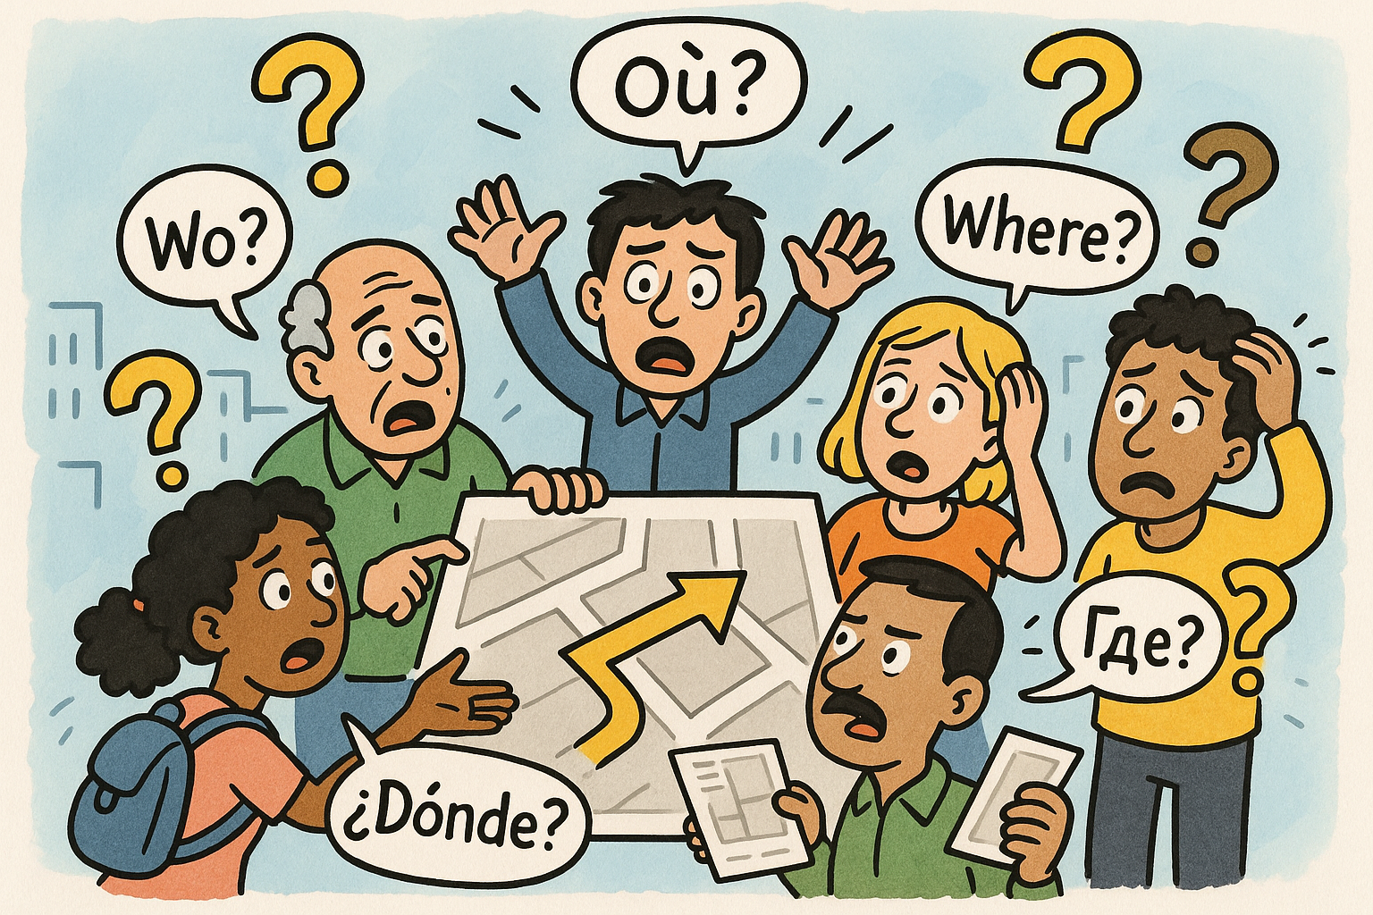
March towards a baseline channel access mechanism
While many options excel individually, their synergy often falters without a harmonized mechanism to guide progress.

Slide 3
Summary of Previous Discussions
6 Options discussed at a previous meeting:
Accept 15-24-407-07-4ab as is to resolve CID 988 and other coex related CIDs: 204, 275, 276, 967, 996, 977, 978, 979, 1356, 1358, 1359, 150, 94, 12, 13
  Consistent with both FCC and ETSI.
2 . Consider a second LBT within 50us (on another NB channel) if CCA is busy (Menzo)
  Consistent with FCC & ETSI and an improvement on 1. above
3. If Tx duty cycle < Y%, EDT is fixed at -75 dBm/MHz (regardless of Tx Power) else follow EDT in Slide 2
LBT as specified in 15-24-407-07-4ab doc is mandatory for NB operation in Section 10.38.7.3 (NBA UWB MMS) and 10.43.2 (UWB data offload to NB) except for device with Tx duty cycle less than X%.
If DC> 1/15%, then NB use frequency hopping over more than 15 channels to spread the interference over the full spectrum (Mickael)
  Similar to NXP proposal at ETSI, which allows for 6% duty cycle over 480 MHz, which was not accepted.
LBT mandatory for NB operation in Section 10.38.7.3 (NBA UWB MMS) and 10.43.2 (UWB data offload to NB) except for device with Tx duty cycle less than X% (Bin Tian)

Slide 4
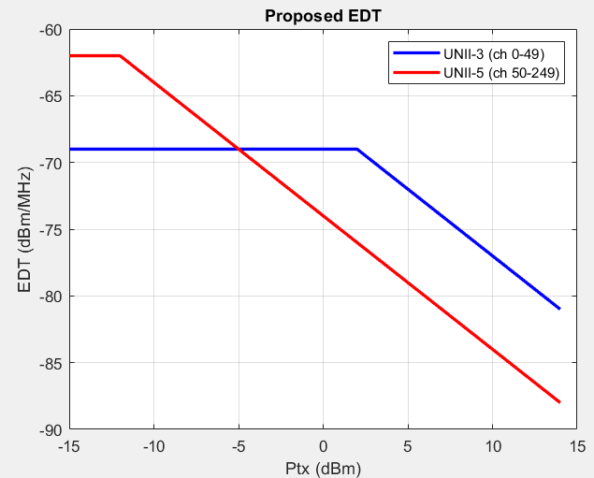
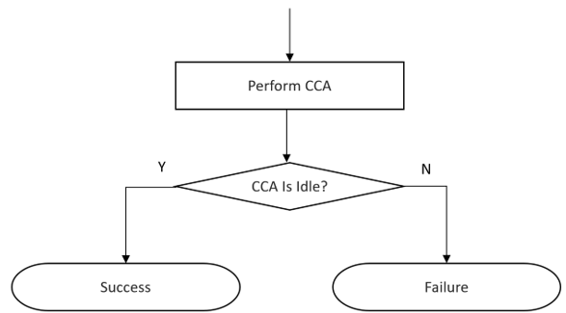
Summary of 15-24-407-07-4ab
Propose to use single CCA before every NB transmission

Slide 5
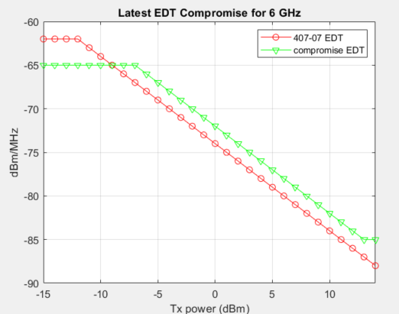
Latest EDT Compromise 6 GHz
EDT=max(-85 dBm/MHz, min(-65 dBm/MHz,-72 dBm/MHz – P_{tx}))

Slide 6
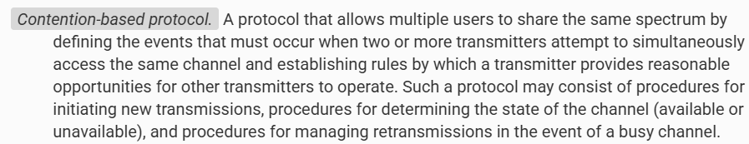
FCC
FCC mandates Contention Based Protocol (CBP) in FCC 15.407(d.6) (see Appendix)
  Part 15, Subpart E, Section 15.403
2. FCC website points to guides for obtaining certification
  only KDB 987594 is listed

Slide 7
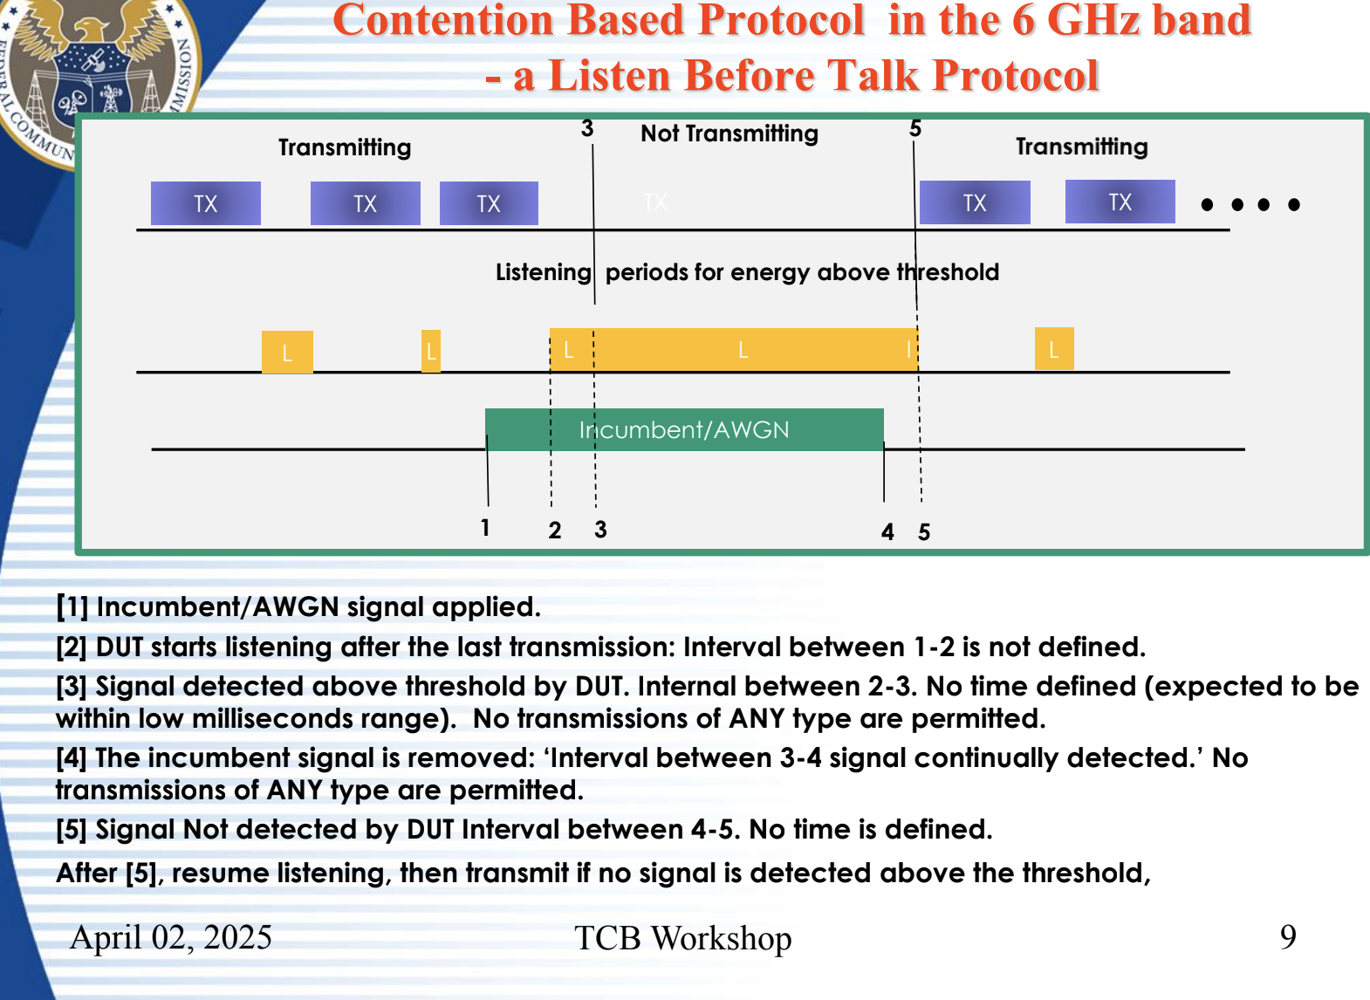
TCB Workshop April 2025

Slide 8
Evacuation time in FCC CBP
May 2025
        doc.: IEEE 15-25-0248-01-04ab
Incumbent 10 MHz AWGN signal turned on
with >= -62 dBm
time
Evacuation Time (ET)
EUT Traffic
With LBT, packets shown in red would not be transmitted but scanning based algorithms like eDAA may allow them (depending on how fast scans are done).
LBT in 802.11 may allow for ET ~5.484ms while latest eDAA has ET ~500ms.
Evacuation Time may be specified in future versions of KDB 987594 document.

Slide 9
Preferred NB channels shown in blue for US+EU
May 2025
        doc.: IEEE 15-25-0248-01-04ab
US only
Europe only
US and Europe
5150
5170
5250
8 ch
Potentially occupied by Wi-Fi
5850
UNII-3
UNII-4
5730
5735
5835
5875
5895
2
ch
Potentially occupied by Wi-Fi (up to ch 165)
6 ch
10 ch
(EU)
10 ch (US?)
8 ch?
5925
5945
NOTE: Figures not drawn to scale
6425
Potentially occupied by Wi-Fi
8 ch
9
In preferred channels, we can have relaxed LBT rules

Slide 10
Preferred NB channels for Japan
May 2025
        doc.: IEEE 15-25-0248-01-04ab
5150
5170
5330
5350
8 ch
Potentially occupied by Wi-Fi
8 ch
Available
5470
5490
5730
8 ch
Potentially occupied by Wi-Fi
5925
5945
NOTE: Figures not drawn to scale
6425
Potentially occupied by Wi-Fi
8 ch
10
In preferred channels, we can have relaxed LBT rules

Slide 11
Example of Simple Channel Access using Preferred channels
Denote NP = Non-preferred channel and P=preferred channel.
Assume device attempts to use NP channel
If CCA is idle, TX
else Hop to preferred channel and TX (subject to relaxed LBT rules in P channels)

Slide 12
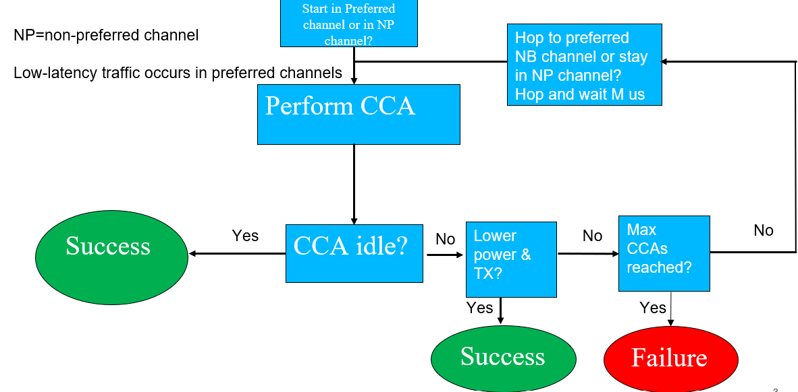
General Block Diagram

Slide 13
Discussion
802.15.4ab needs to define a harmonized baseline channel access mechanism that should be LBT-based with additional considerations:
Energy detection threshold (one value or dynamic) (15-24-407-07 or compromise EDT)
Single CCA or allow for second CCA on another channel within 50us (15-25-99-01)
Use of Preferred channels to expedite channel access and allow for relaxed LBT parameters

Slide 14
Appendix

Slide 15
ETSI BRAN Developments
5% duty cycle no-LBT (BRAN(24)125012) is not accepted
2. eDAA proposed by Apple (BRAN(25)128007) is not accepted
3. Low Duty Cycle no-LBT proposed by NXP (BRAN(25)128008r1) is not accepted
4. Accepted Minutes (BRAN(25)128016r1) of ETSI BRAN #127 show that LBT-based channel access proposal in BRAN(24)124017r3 is accepted
  It is the only accepted NB channel access mechanism that allows for any kind of frames (e.g., data frames) to be TX.

Slide 16
ETSI BRAN Developments (ctd)
5. eDAA proposal by Apple (BRAN(25)129011) again not accepted.
6. Removal of NBE-LBT text proposal by Apple not accepted. (BRAN (25)129014)

