Slide 1
Project: IEEE P802.15 Working Group for Wireless Personal Area Networks (WPANs)
Submission Title: [CCA modes for suspendable CSMA-CA]
Date Submitted: [13 May. 2025]
Source: [Susumu Ishihara¹, Masakatsu Ogawa², Tetsushi Ikegami³, Shugo Kajita⁴, Arata Kato⁴, Mineo Takai⁵]
Company [¹Shizuoka University, ²Sophia University, ³Meiji University, ⁴Space-Time Engineering Japan, Inc., ⁵Space-Time Engineering, LLC]
Address []
Voice:[], FAX: [], E-Mail:[ishihara.susumu@shizuoka.ac.jp, m-ogawa@sophia.ac.jp, ikegami@meiji.ac.jp, skajita@spacetime-eng.com, akato@spacetime-eng.com, mineo@ieee.org]
Re: []
Abstract: [This document discusses issues in the CCA modes for suspendable CSMA-CA]
Purpose: [Discussing the issues in the CCA modes for suspendable CSMA-CA in the coexistence of different modulations]
Notice: This document has been prepared to assist the IEEE P802.15. It is offered as a basis for discussion and is not binding on the contributing individual(s) or organization(s). The material in this document is subject to change in form and content after further study. The contributor(s) reserve(s) the right to add, amend or withdraw material contained herein.
Release: The contributor acknowledges and accepts that this contribution becomes the property of IEEE and may be made publicly available by P802.15.

Slide 2
Topics in this presentation
Dynamic ED threshold for co-existence
How to determine the threshold?
CCA modes for suspendable CSMA-CA
Mode 1: Carrier sense only (CS)
Mode 2: Energy above threshold (ED)
Mode 3: {3a: CS and ED, 3b: CS or ED}

Slide 3
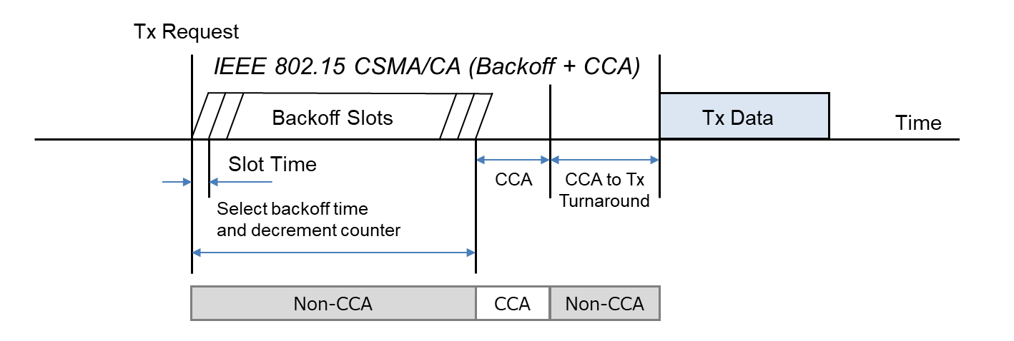
IEEE 802.15.4 CSMA-CA
IEEE 802.15.4 CSMA-CA does not perform carrier sense to minimize power consumption until the CCA (Clear Channel Assessment) period just before transmission, while IEEE 802.11 CSMA/CA always performs carrier sense during the backoff slots.
Cited from IEEE 802.19-25/0006r0 [1]

Slide 4
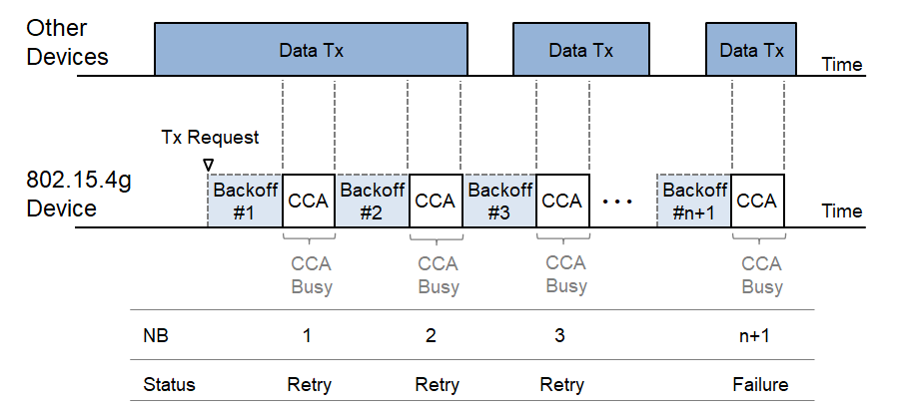
IEEE 802.15.4 CSMA-CA leads to low throughput
IEEE 802.15.4 CSMA-CA does not suspend backoff during the backoff slots.
CCA Busy is found after the backoff slots.
If the network is congested, Number of Backoffs (NB) tends to reach the specified threshold macMaxCSMABackoffs, and leads to backoff failure.
This leads to low throughput [1].
Cited from IEEE 802.19-25/0006r0 [1]

Slide 5
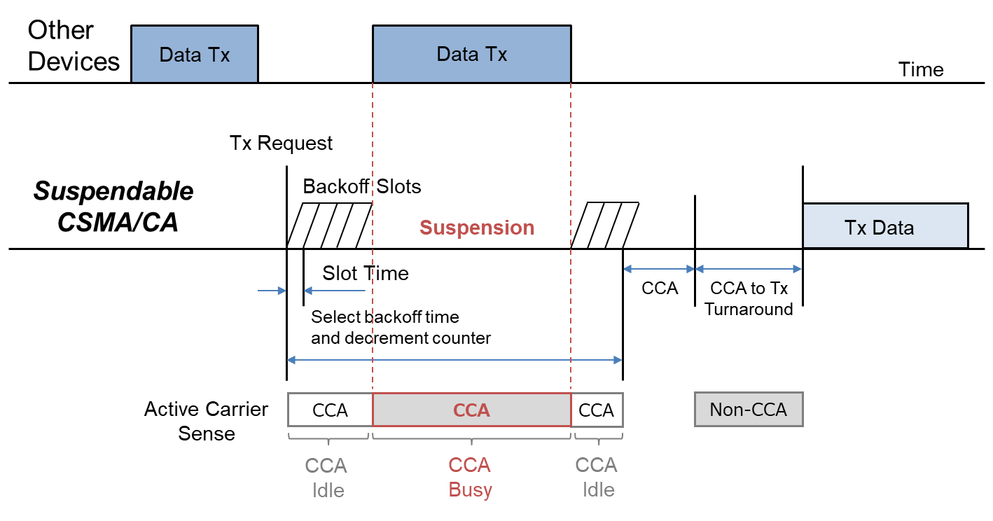
Suspendable CSMA-CA introduced in IEEE 802.15.4-2024 [2]
If CCA is busy during the backoff delay period, the backoff timer shall be suspended until sensing the channel indicates that the channel is clear or macSuspendedCsmaMaxTime is exceeded. Upon CCA detecting clear, the backoff time shall resume.
If macSuspendedCsmaMaxTime is exceeded, backoff ends in “Failure” and CSMA-CA algorithm terminates with a channel access failure.
Cited from IEEE 802.19-25/0006r0 [1]

Slide 6
Operations in CCA Mode 3
CCA Mode3 = {3a: CS and ED, 3b: CS or ED}
CS: Carrier Sense, ED: Energy Above Threshold
Can IEEE 802.15.4 devices perform CS-CCA and ED-CCA simultaneously?
We could not find chips with Mode 3 on the market
Sequential operation would be realistic. However, the order is not defined.
In the context of Suspendable CSMA-CA, we can select CCA for each slot.
What CCA do we use for each slot?
e.g.
What ED threshold in ED-CCA?
Fixed value vs. Dynamic selection of ED threshold
If we use a Dynamic threshold, how do we select the threshold value?
CS
CS
CS
CS
ED
CS
ED
CS
ED
CS
ED
ED
CS
CS
CS
ED

Slide 7
Problems in Mode 1 and Mode 2
Mode 1’s problem (CS only)
If multiple groups of IEEE 802.15.4 devices use different modulations in the same band, each device cannot detect transmissions from other groups.
e.g. A: SUN-FSK operating mode #1 (50 kbps, channel spacing: 100 kHz ) B: SUN-FSK operating mode #2 (100 kbps, channel spacing: 200 kHz)
Mode 2’s problem (Energy above threshold)
The behavior is determined by the threshold setting.
Too low: Transmissions may be unnecessarily suppressed even when they are permissible.
Too high: Transmissions may occur even when they should be avoided.
In the presence of strong background noise, ED may fail to function correctly regardless of how the threshold is configured.

Slide 8
Determining ED threshold for realizing the fairness (1/2)
Select from some candidate values
e.g. Two levels: High and Low, Many levels, Calculation
How should the value be selected?
We need to understand the environment.
Spectrum Resource Measurement (SRM, 802.15.4s) will help select the value.
e.g. Sharing RF sensing data in the network to configure the ED threshold.
Seeking the best value:
e.g., N rounds in Low threshold, then switches to High threshold

Slide 9
Determining ED threshold for realizing the fairness (2/2)
What is the reason for selecting the threshold?
Congestion (How many devices are around me? How often do they send packets?)
Own channel mode vs. others’ channel mode
FSK vs. OFDM, occupation bandwidth, airtime
Distribution of frame length, etc.

Slide 10
Effect of ED threshold and CS/ED difference on the fairness
Low threshold: Conservative - Small chance to send (others always win!)
High threshold: Aggressive – Easy to obtain TX opportunity
Definition of the threshold. W or W/Hz (Depends on the local regulations)
CS CCA: Competition in the same group (small difference in airtime)
ED CCA: Competition between different groups
Slower group will constrain others’ performance. Does this ensure fairness?
Do all devices in the same network use the same configuration?
Small star topology: May be Yes.
Large tree topology: No. The surrounding conditions are different at different positions.
Then, how do we determine the configuration?

Slide 11
Summary
There are various options for realizing suspendable CSMA-CA
CS or ED for each backoff slot
ED threshold
Understanding the environment is important to determine the suitable configuration
SRM would be useful for the purpose
What should be included in the standard?
Simulation and Analysis are needed, assuming typical applications.

Slide 12
References
[1] T. Sumi, Y. Nagai, J. Guo, P. Orlik, K. Parsons, IEEE 802.11ah and IEEE 802.15.4g SUN OFDM PHY Coexistence Simulation for Case 1-3 with Suspendable CSMA/CA, DCN: 802.19-25/0006r0
[2] IEEE Standard for Low‐Rate Wireless Networks, IEEE Std 802.15.4-2024.

