Slide 1
Project: IEEE P802.15 Working Group for Wireless Personal Area Networks (WPANs)
Submission Title: IG Access May 2025 Meeting Slides
Date Submitted: 13 May 2025
Source: Benjamin A. Rolfe (Blind Creek Associates)
Contact:
Voice: +1 408 395 7207, E-Mail: ben.rolfe @ ieee.org
Re: Wireless Next Generation
Abstract: Agenda and Meeting Slides for the May 2024 Wireless Interim Session Interest group access
Purpose: Support the illusion of organization.
Notice: This document has been prepared to assist the IEEE P802.15. It is offered as a basis for discussion and is not binding on the contributing individual(s) or organization(s). The material in this document is subject to change in form and content after further study. The contributor(s) reserve(s) the right to add, amend or withdraw material contained herein.
Release: The contributor acknowledges and accepts that this contribution becomes the property of IEEE and may be made publicly available by P802.15.
Notes:
Jul 12, 2010
Page 1

Slide 2
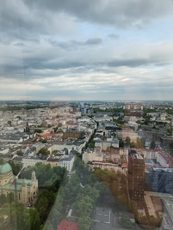
May 2025 802 Wireless Interim Session Interest Group, Spectrum Channel Access
Live from Warsaw, Poland
And remote around the world

Slide 3
Hybrid Meeting
Registration is required
Please remember to enter your attendance in IMAT
Reminder:
This is a non-PAR activity
All the rules of conduct apply https://grouper.ieee.org/groups/802/sapolicies.shtml

Slide 4
Agenda 13 May 2025
Opening and Meeting Reminders
Overview of Interest Group
Technical Discussion
Channel access topics: dynamic ED threshold and CCA modes
Any other business
Adjourn

Slide 5
Opportunity and problem consideration
Overview of Interest Group

Slide 6
Opportunity Statement
Need to share spectrum
Need to share with uncoordinated access
Need multiple sharing methods
Sharing through coexistence is essential
Need to accommodate reality
A systems view of coexistence will help to advance
With over 5 decades of wireless channel access experience a lot has been learned
We can do more than what we’ve already done!

Slide 7
Basis Realities for this IG
There are many 802 wireless technologies
All are important
Diversity of uses is an important metric for spectrum efficiency
Diversity of technologies is a strength of 802
There are non-802 technologies using spectrum
Won’t abide by our rules
Must abide by regulations
There are many different regions with different rules
802 is not a regulatory body
Our scope of impact is implementers who chose to use our standards

Slide 8
Foundation: Sharing
Different needs
There are a lot of different use cases, RF environments,user dynamics, and demands driving different (and often dynamic) requirements
There can be overlapping requirements and conflicting requirements (trade-offs)
Different kinds of sharing
Sharing can mean different things
Avoidance is a traditional and familiar tool
Separation in time, frequency or geography
Avoidance alone is unsustainable
Sharing by enabling mutual successful operation is better
This is a working definition of sharing by coexistence
Coexistence is complicated
No single method works always, everywhere, for everyone
We need a collection of sharing and coexistence tools

Slide 9
Technical Contributions

Slide 10
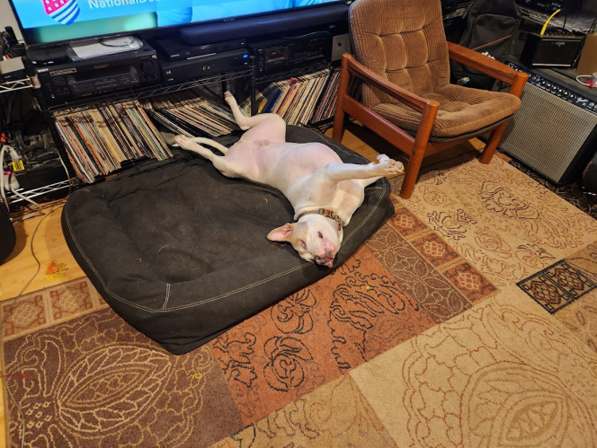
Discussion

Slide 11
Next Steps
[to be discussed]

Slide 12
Any Other Business

Slide 13
Adjourned

