Slide 1
Project: IEEE P802.15 Working Group for Wireless Personal Area Networks (WPANs)
Submission Title: [Proposal for the Performance Evaluation of the LR-Mode]
Date Submitted: [13 May, 2025]
Source: [Joerg ROBERT] Company [FAU Erlangen-Nuernberg/ Fraunhofer IIS]
Address []
Voice:[], FAX: [], E-Mail:[Joerg.Robert@ieee.org]
Re: []
Abstract: []
Purpose: [Presentation in TG 802.15.4ad]
Notice: This document has been prepared to assist the IEEE P802.15. It is offered as a basis for discussion and is not binding on the contributing individual(s) or organization(s). The material in this document is subject to change in form and content after further study. The contributor(s) reserve(s) the right to add, amend or withdraw material contained herein.
Release: The contributor acknowledges and accepts that this contribution becomes the property of IEEE and may be made publicly available by P802.15.

Slide 2
Proposal for the Performance Evaluation of the LR-Mode
Joerg Robert (FAU/Fraunhofer IIS)

Slide 3
Shannon Hartley Theorem ( I / II )
The maximum achievable payload bit-rate in a channel is given by the Shannon-Hartley Theorem:
where S/N is the signal-to-noise ratio and B is the bandwidth
We can also replace the noise power N by the noise power spectral density N₀:

Slide 4
Shannon Hartley Theorem ( II / II )
We can now try get the minimum E_{b}/N₀ required. This is achieved when B goes to infinity and C_{R} goes to zero. This results in:
Hence, as N₀ is known (given by the thermal noise), we now the required energy per payload bit E_{b} . Expressed in dB we get:
with N₀=-174dBm/Hz

Slide 5
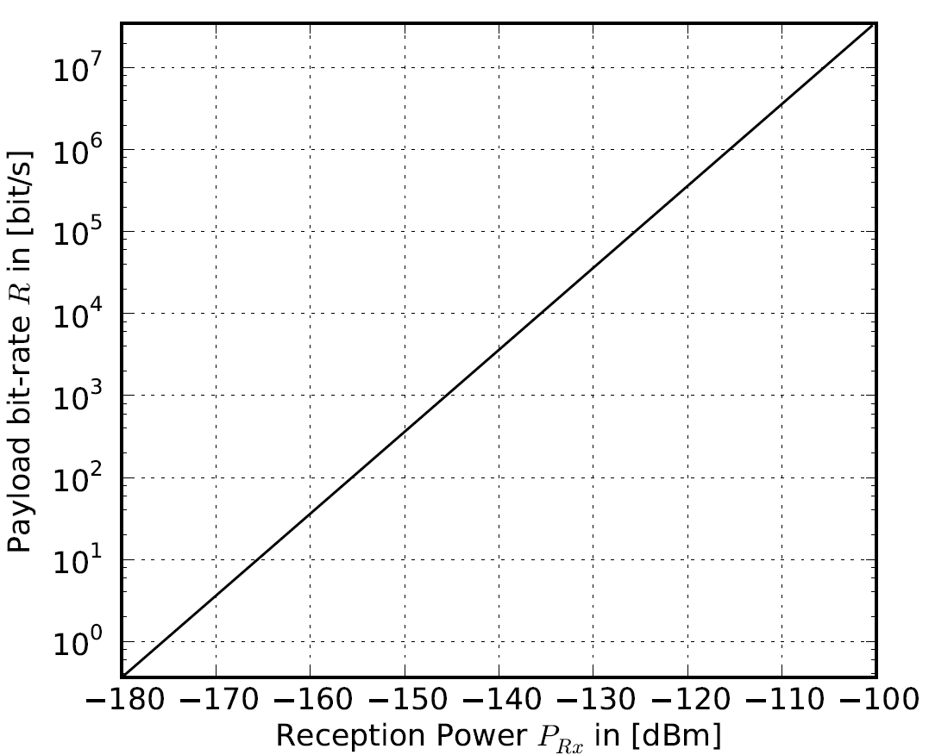
Maximum Achievable Rate

Slide 6
Evaluation Proposal
In order to evaluate the proposal, we can now use the gap to:
Example: I have a system that requires a reception power of -120dBm for a rate payload rate of 1kBit/s. The theoretical power is P_{Rx,ideal} = -146dBm.
Hence, we have a loss of 26dB compared to the perfect system
Note: The practical gap will be at least 8dB

