Slide 1
Project: IEEE P802.15 Working Group for Wireless Personal Area Networks (WPANs)
Submission Title: [Additional Improvements for Long-Range PHY]
Date Submitted: [30 April, 2025]
Source: [Joerg ROBERT] Company [FAU Erlangen-Nuernberg/ Fraunhofer IIS]
Address []
Voice:[], FAX: [], E-Mail:[Joerg.Robert@ieee.org]
Re: []
Abstract: [Simulation results for updated 802.15.4ad proposal]
Purpose: [Presentation in TG 802.15.4ad]
Notice: This document has been prepared to assist the IEEE P802.15. It is offered as a basis for discussion and is not binding on the contributing individual(s) or organization(s). The material in this document is subject to change in form and content after further study. The contributor(s) reserve(s) the right to add, amend or withdraw material contained herein.
Release: The contributor acknowledges and accepts that this contribution becomes the property of IEEE and may be made publicly available by P802.15.

Slide 2
Additional Improvements for the
Long-Range PHY
Joerg Robert
(FAU/Fraunhofer IIS)

Slide 3
Background
Our proposal for Narrowband [3] bases on the TI proposal [4] with specific extension for improved performance
The differential modulation reduces the performance
However, the performance can be improved in a backwards compatible way
Optimized receivers could utilize this for significantly improved performance

Slide 4
Simulation Assumptions
Simulation of TDL-B/D and interference according to Technical Guidance Document [5]
Realistic channel and noise estimation
Perfect timing synchronization assumed → preambles are currently not part of the signal
1000 packets or 20 erroneous packets
Packet length of 20 payload bytes
Noise figure F=0dB
OFDM parameters are 120µs symbol duration with 108 active carriers, DSSS = 2

Slide 5
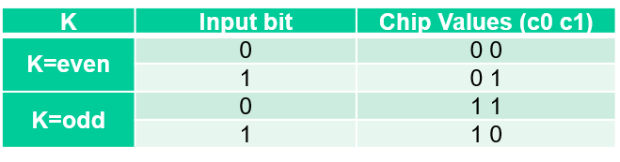
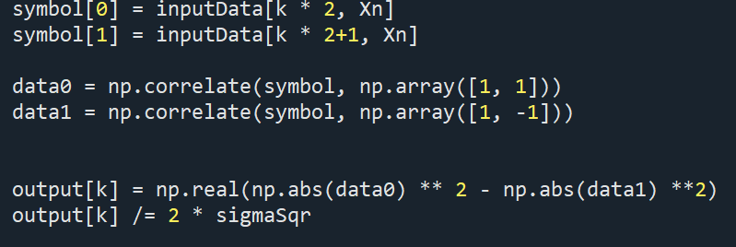
Current TI Proposal
TI Proposal [4]
The proposed code is a Walsh Code with length 2
(AlmostQ) ideal decoding
algorithm without channel
knowledge:
The output vector contains the LLR (soft-bits) used for the Viterbi decoder

Slide 6
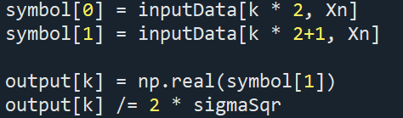
Sophisticated Decoding
Future receivers could exploit channel knowledge for improved decoding
Perfect coherent decoder for current proposal:
The first symbol of the symbol is not required for the decoding
It does not provide any information and leads to a loss of at least 3 dB as 50% of the data is not used

Slide 7
Proposal
Instead of toggling the phase of the first “reference” symbol it can also be used to transmit additional redundancy
No change to current receiver implementation
Significant additional gain for future receivers
  Information theoretical gain due to lower rate, i.e. ½ → ¼
  All transmitted symbols carry payload information
  Additional robustness for erasure channels (interference, fading)

Slide 8
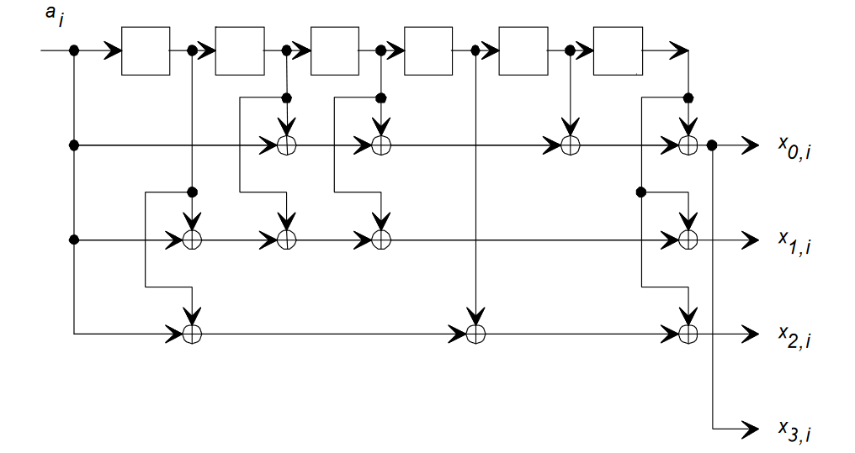
How does it Work?
Normal output as already used in the current proposal and other IEEE 802.15.4 Std
These output replace the bit toggling on slide 2. Their decoding in the receiver is optional!
Polynomial o133, o171, o145, o133

Slide 9
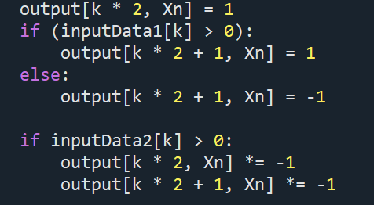
Transmitter Side Implementation
“Normal Modulation” as in current proposal
Additional bits of the convolutional code flip all output bits → no change to relative phase
Use of the currently unused phase of the signal

Slide 10
Gain of Lower Code-Rates
Lower codes provide additional gain and should be preferred compared to repetition
Repetition is linear and does not provide Eb/N0 gain
The 3dB due to the use of all bits come in addition
Details are given in [6]
Can be combined with additional iterative decoding to squeeze the last information out of the channel → >6dB gain compared to current approach without changing the RX

Slide 11
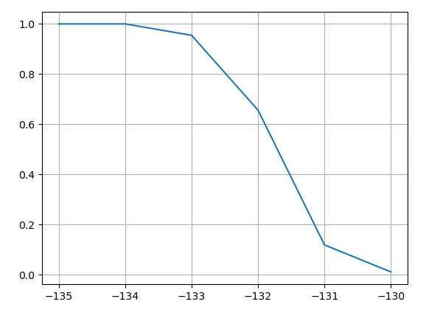
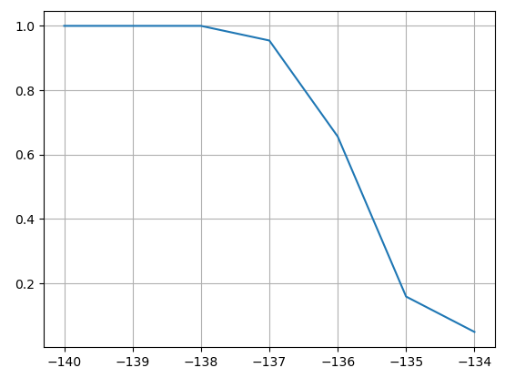
Decoding Performance in AWGN
Normal Decoder
Optimized Proposal
Decoder for proposed decoding is not optimized yet
Significantly higher gains in fading channels

Slide 12
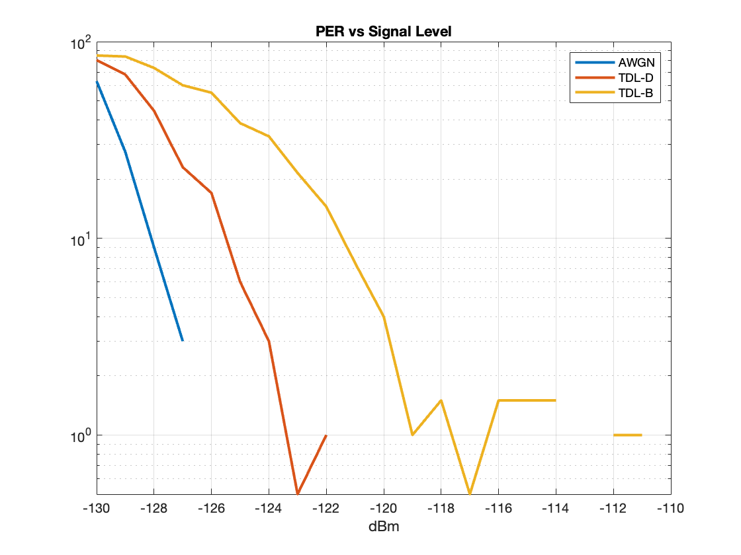
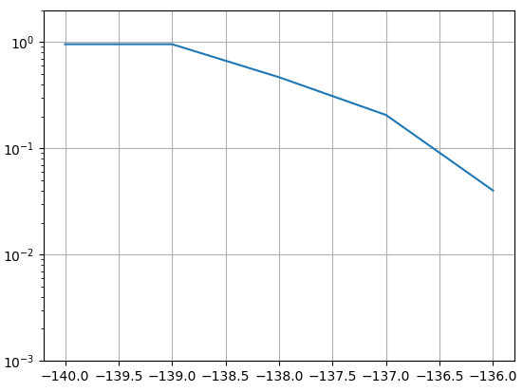
Comparison TI & Bound of Proposed Scheme
TI Proposal [4]
Bound for Optimized Approach
Bound is for AWGN channel
Bound can be reached by iterative decoder
There is no way to further optimize the system

Slide 13
Additional Remarks
The presented approach is only useful when the system hops after the transmission of a single symbol → FCC 15.247 compliant mode, i.e. the TI proposal
For countries where such fast frequency hopping is not required, multiple symbols can also be transmitted as proposed in [7, Slide 8/9]
The proposal in [7] will most likely reach similar performance figures. However, we could minimize the number of modes, e.g. use only 8 payload symbols per hop

Slide 14
Conclusions and Next Steps
This presentation shows an extension to the TI proposal
The proposal does not affect the existing TI proposal on the receiver side
Future devices will be able to exploit the additional data to achieve a performance close to the theoretical limits
The additional redundancy helps to improve the performance in case of interference
For Warsaw we will provide additional simulation results for the multi-path channels
We will also provide results on the 8 symbols proposal

Slide 15
Literature
[1] J. Robert and A. Heuberger, "LPWAN downlink using broadcast transmitters," 2017 IEEE International Symposium on Broadband Multimedia Systems and Broadcasting (BMSB), Cagliari, Italy, 2017
[2] J. Robert, J. Zoellner and M. Slimani, "Adaptive Windowing for OFDM with Dense Subcarrier Spacing in Mobile Channels," OFDM 2012; 17th International OFDM Workshop 2012 (InOWo'12), Essen, Germany, 2012
[3] FAU/Fraunhofer IIS Proposal, DCN 15-25/0049r00
[4] TI Proposal, DCN 15-24/0651r01
[5] Technical Guidance Document, DCN 15-24/0061r16
[6] S. Dolinar, et al. "Code performance as a function of block size." TMO progress report 42.133 (1998). https://tda.jpl.nasa.gov/progress_report/42-133/133K.pdf
[7] Kyoto University Proposal, DCN 15-25/158r02

