Slide 1
Project: IEEE P802.15 Working Group for Wireless Specialty Networks (WSN)
Submission Title: Interim Call Slides Jan2025 – Mar2025
Date Submitted: 25 March 2025
Source: Benjamin A. Rolfe (Blind Creek Associates)
Contact:
Voice: [deprecated],
E-Mail: ben.rolfe @ ieee.org
Re: Task Group 4ab: 802.15.4 UWB Next Generation
Abstract: Meeting Slides for the interim Webex March 2025 through May 2025
Purpose: Continue project progress and continue the illusion of organization
Notice: This document has been prepared to assist the IEEE P802.15. It is offered as a basis for discussion and is not binding on the contributing individual(s) or organization(s). The material in this document is subject to change in form and content after further study. The contributor(s) reserve(s) the right to add, amend or withdraw material contained herein.
Release: The contributor acknowledges and accepts that this contribution becomes the property of IEEE and may be made publicly available by P802.15.

Slide 2
Task Group 15.4ab Next Generation UWB Amendment
Meeting Slides for the Interim meeting
March 7th, 2025
through
May 6th 2025

Slide 3
Meeting Preamble
Stuff you need to know before we get to the meeting content

Slide 4
Task Group Rules
Discussion: Everyone present is welcome*
Straw polls: Everyone present may vote
Formal motions: WG voters
To make, second and vote
Patent policy for PAR activities applies
All the usual rules of conduct
Please identify yourself on first contact with name and affiliation
*at the discretion of the WG and TG chairs

Slide 5
IEEE-SA Patent, Copyright, and Participation Policies
See: https://grouper.ieee.org/groups/802/sapolicies.shtml
IEEE-SA Patent Slides for Standards Development Meetings (.pdf)
https://development.standards.ieee.org/myproject/Public/mytools/mob/slideset.pdf
IEEE-SA Standards Board Patent Committee (PatCom) home page
https://standards.ieee.org/content/ieee-standards/en/about/sasb/patcom/index.html
IEEE-SA Participation Policy meeting slide set - individual method (.pdf)
https://standards.ieee.org/content/dam/ieee-standards/standards/web/documents/other/Participant-Behavior-Individual-Method.pdf
Working Group Copyright Materials
https://standards.ieee.org/ipr/copyright-materials.html
https://standards.ieee.org/content/dam/ieee-standards/standards/web/documents/other/ieee-sa-copyright-policy-2019.pdf

Slide 6
Participants have a duty to inform the IEEE
Participants shall inform the IEEE (or cause the IEEE to be informed) of the identity of each holder of any potential Essential Patent Claims of which they are personally aware if the claims are owned or controlled by the participant or the entity the participant is from, employed by, or otherwise represents
Participants should inform the IEEE (or cause the IEEE to be informed) of the identity of any other holders of potential Essential Patent Claims
Early identification of holders of potential Essential Patent Claims is encouraged

Slide 7
Participants have a duty to inform the IEEE
Ways to inform IEEE
Cause an LOA to be submitted to the IEEE SA (patcom@ieee.org); or
Provide the chair of this group with the identity of the holder(s) of any and all such claims as soon as possible; or
Speak up now and respond to this Call for Potentially Essential Patents
If anyone in this meeting is personally aware of the holder of any patent claims that are potentially essential to implementation of the proposed standard(s) under consideration by this group and that are not already the subject of an Accepted Letter of Assurance, please respond at this time by providing relevant information to the WG Chair
Participants shall inform the IEEE (or cause the IEEE to be informed) of the identity of each holder of any potential Essential Patent Claims of which they are personally aware if the claims are owned or controlled by the participant or the entity the participant is from, employed by, or otherwise represents
Participants should inform the IEEE (or cause the IEEE to be informed) of the identity of any other holders of potential Essential Patent Claims
Early identification of holders of potential Essential Patent Claims is encouraged

Slide 8
IEEE 802 Ground Rules
Respect … give it, get it
NO product pitches
NO corporate pitches
NO prices
NO restrictive notices – (no confidentially notices in email)
Presentations must be openly available

Slide 9
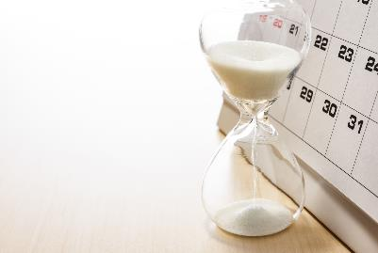
Detailed Agenda
https://mentor.ieee.org/802.15/dcn/25/15-25-0171-05-04ab-tg4ab-interim-call-details-agenda.xlsx

Slide 10
5.2.b Scope of the project (As approved):
This amendment enhances the Ultra Wideband (UWB) physical layers (PHYs) medium access control (MAC), and associated ranging techniques while retaining backward compatibility with enhanced ranging capable devices (ERDEVs). Areas of enhancement include:
additional coding, additional coding, preamble and modulation schemes to support improved link budget and/or reduced air-time relative to IEEE Std 802.15.4 UWB;
additional channels and operating frequencies;
interference mitigation techniques to support greater device density and higher traffic use cases relative to the IEEE Std 802.15.4 UWB;
improvements to accuracy, precision and reliability and interoperability for high-integrity ranging; schemes to reduce complexity and power consumption;
definitions for tightly coupled hybrid operation with narrowband signaling to assist UWB;
enhanced native discovery and connection setup mechanisms;
sensing capabilities to support presence detection and environment mapping;
and mechanisms supporting low-power low-latency streaming as well as high data-rate streaming allowing at least 50 Mb/s of throughput.
Support for peer-to-peer, peer-to-multi-peer, and station-to-infrastructure protocols are in scope, as are infrastructure synchronization mechanisms. This amendment includes safeguards so that the high throughput data use cases do not cause significant disruption to low duty-cycle ranging use cases.
https://development.standards.ieee.org/myproject-web/app#viewpar/9081

Slide 11
Near Term Working Milestones
 | Current Schedule
First letter ballot | June 2024
Initial LB comment resolution | Start: July 2024
First recirculation | March 2025
Recirculation comment resolution | April-May 2025
Second recirculation | May-June 2025
Recirculation comment resolution | July-Sept 2025
First SA-Ballot | November 2025
SA-Ballot comment resolution | December 2025 to ….
We are here

Slide 12
SA Ballot and Beyond
 | Current Schedule
First SA-Ballot | November 2025
SA-Ballot comment resolution | January 2026
First recirculation | April 2026
Recirculation comment resolution | May 2026
Second recirculation | July 2026
Recirculation comment resolution | August 2026
Final comment resolution | Sept 2026
Third and final recirculation | Oct 2026
REVCOM and SASB | Nov 2026
Update!
New and… Improved

Slide 13
Ways to accelerate schedule
Conditional LMSC approval for SA ballot in July 2025
Up to 2 WG recirculation ballots allowed after July
A recirc with no technical changes: Start initial SA ballot by 1-Aug to close before Sept interim
1 recirc with changes, 1 recirc without: start initial SA ballot in time to close before November plenary
Unconditional LMSC approval for SA ballot in July
Can start SA ballot ~ 3 August
Closes ~2-Sept
2 to 3 calls prior to Sept interim

Slide 14
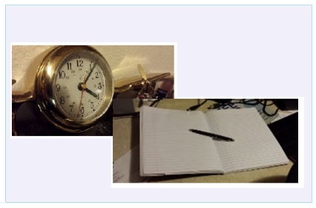
Editor’s Corner

Slide 15
Operation of Task Group (WG15 Operations Manual)
For amendments and revisions to IEEE 802.15 standards it is expected that the task group thoroughly read and understand the whole standard being modified. Specifically, the task group’s draft document shall maintain the standard’s structure and conventions, adhere to the PAR and CSD, that effort be made to reuse or leverage existing behavior whenever possible, that changes do not “break” existing behaviors, and that backward compatibility is achieved.

Slide 16
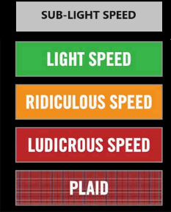
Comment resolution

Slide 17
Consolidated Comments Recirc 1
https://mentor.ieee.org/802.15/dcn/25/15-25-0174-05-04ab-consolidated-comments-draft-2-0.xlsm

Slide 18
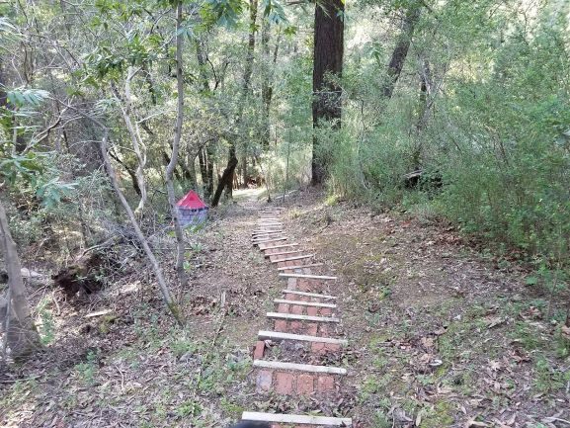
Next Steps

Slide 19
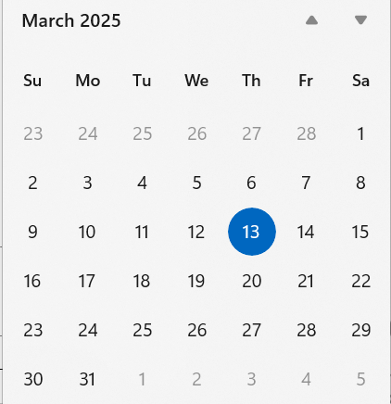
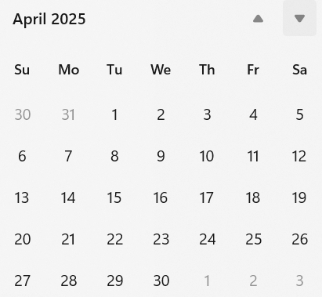
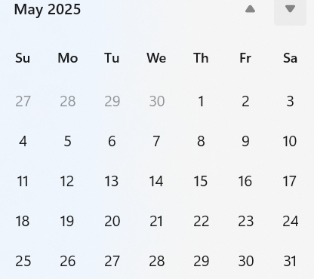
Telecom/Webex Schedule
NOW
Next
Interim session starts 12-May
First call 25-March on when the ballot closes
Twice weekly, 1 hour each,
Tuesday 06:00 and Thursday 15:00

Slide 20
Any Other Business

Slide 21
Recess
March 2025 – May 2025

Slide 22
Resume from Recess
Task Group 15.4ab Next Generation UWB Amendment

Slide 23
IEEE-SA Patent, Copyright, and Participation Policies
See: https://grouper.ieee.org/groups/802/sapolicies.shtml
IEEE-SA Patent Slides for Standards Development Meetings (.pdf)
https://development.standards.ieee.org/myproject/Public/mytools/mob/slideset.pdf
IEEE-SA Standards Board Patent Committee (PatCom) home page
https://standards.ieee.org/content/ieee-standards/en/about/sasb/patcom/index.html
IEEE-SA Participation Policy meeting slide set - individual method (.pdf)
https://standards.ieee.org/content/dam/ieee-standards/standards/web/documents/other/Participant-Behavior-Individual-Method.pdf
Working Group Copyright Materials
https://standards.ieee.org/ipr/copyright-materials.html
https://standards.ieee.org/content/dam/ieee-standards/standards/web/documents/other/ieee-sa-copyright-policy-2019.pdf

Slide 24
Participants have a duty to inform the IEEE
Participants shall inform the IEEE (or cause the IEEE to be informed) of the identity of each holder of any potential Essential Patent Claims of which they are personally aware if the claims are owned or controlled by the participant or the entity the participant is from, employed by, or otherwise represents
Participants should inform the IEEE (or cause the IEEE to be informed) of the identity of any other holders of potential Essential Patent Claims
Early identification of holders of potential Essential Patent Claims is encouraged

Slide 25
Participants have a duty to inform the IEEE
Ways to inform IEEE
Cause an LOA to be submitted to the IEEE SA (patcom@ieee.org); or
Provide the chair of this group with the identity of the holder(s) of any and all such claims as soon as possible; or
Speak up now and respond to this Call for Potentially Essential Patents
If anyone in this meeting is personally aware of the holder of any patent claims that are potentially essential to implementation of the proposed standard(s) under consideration by this group and that are not already the subject of an Accepted Letter of Assurance, please respond at this time by providing relevant information to the WG Chair
Participants shall inform the IEEE (or cause the IEEE to be informed) of the identity of each holder of any potential Essential Patent Claims of which they are personally aware if the claims are owned or controlled by the participant or the entity the participant is from, employed by, or otherwise represents
Participants should inform the IEEE (or cause the IEEE to be informed) of the identity of any other holders of potential Essential Patent Claims
Early identification of holders of potential Essential Patent Claims is encouraged

Slide 26
Adjourned

