Slide 1
Project: IEEE P802.15 Working Group for Wireless Personal Area Networks (WPANs)
Submission Title: [TG15.6ma Closing Report for March 2025]
Date Submitted: [13th March 2025]
Source: [Ryuji Kohno1,2,] [1;Yokohama National University, 2;YRP International Alliance Institute(YRP-IAI)]
Address [1; 79-5 Tokiwadai, Hodogaya-ku, Yokohama, 240-8501 Japan
2; YRP1 Blg., 3-4 HikarinoOka, Yokosuka-City, Kanagawa, 239-0847 Japan]
Voice:[1; +81-90-5408-0611], FAX: [+81-45-383-5528],
Email:[1: kohno@ynu.ac.jp, 2: kohno@yrp-iai.jp] Re: []
Abstract: [This document contains closing report for TG15.6ma for Revision of P802.15.6-2012 with Enhanced Dependability January 2025.]
Purpose: [information]
Notice: This document has been prepared to assist the IEEE P802.15. It is offered as a basis for discussion and is not binding on the contributing individual(s) or organization(s). The material in this document is subject to change in form and content after further study. The contributor(s) reserve(s) the right to add, amend or withdraw material contained herein.
Release: The contributor acknowledges and accepts that this contribution becomes the property of IEEE and may be made publicly available by P802.15.

Slide 2
IEEE 802.15 TG6ma (Revision of IEEE802.15.6-2012) Closing Report In Personal and Virtual Hybrid Plenary Session Atlanta, GA, USA March 14th, 2025 Ryuji Kohno Yokohama National University(YNU), YRP International Alliance Institute(YRP-IAI)

Slide 3
Objectives of TG 6ma – Enhanced Dependability Body Area Network (ED-BAN)
Objective: Enhancements to the BAN Ultra Wideband (UWB) physical layer (PHY) and media access control (MAC) to support enhanced dependability to a human BAN (HBAN) and adds support for vehicle body area networks (VBAN), a coordinator in a vehicle with devices around the vehicular cabin.
Action:
•Comments Resolutions for LB212 recirculation of LB210
•Review of Comments for draft D04
•Necessary Process and Documentation for Recirculation Letter Ballot such as Coexistence Assurance Document, Progess Report, Project Task List
•Performance Evaluation of Technologies in PHY; Channel Coding According to 8 QoS Levels of Packets and Coexistence Levels, Interference.
•Performance Evaluation of Technologies in MAC; Channel Management, CCA, Hybrid Contention Free/Access Protocol According to 8 QoSs and Coexistences.
•Harmonization or Commonality with 4ab in Coexistence and Feasible Implementation of 6ma and 4ab
•Feasibility of TSN of 802.1 in MAC
•WG Motion to Recirculation
Next Things to Do： Recirculation of draft D05 for 3rd Letter Ballot

Slide 4
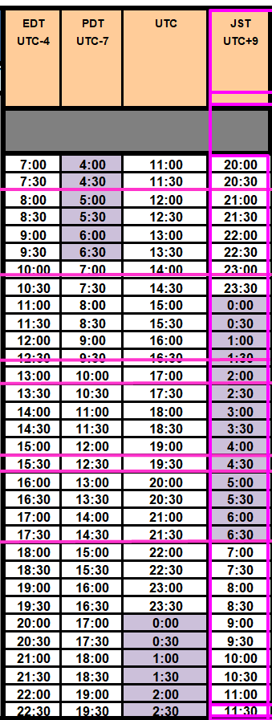
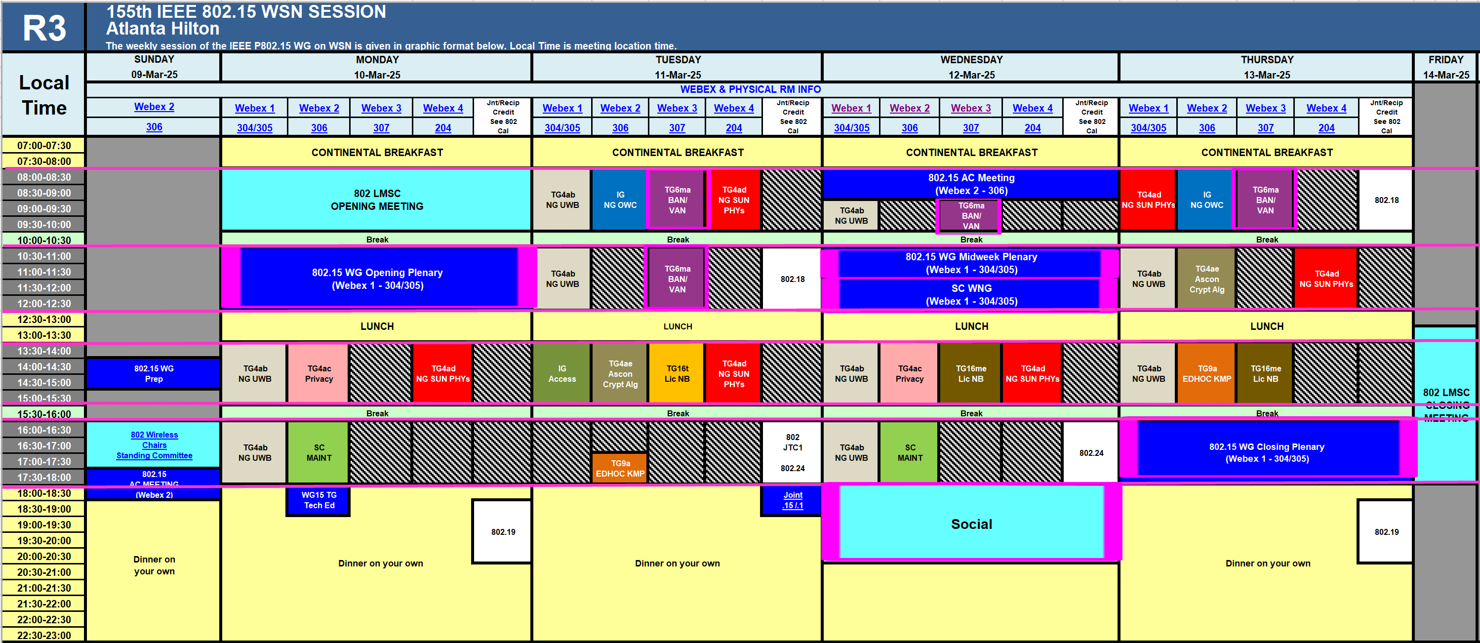
TG15.6ma Plenary Session Schedule for 9th-14th, March 2025
TG15.6ma has three own sessions such as
Session1(Virtual RM#3) AM1 8:00-10:00 March 11(TUE) in Atlanta time, 9:00-11:00AM March 11(TUE) in JST/KST
Session2(Virtual RM#3) AM2 10:30-12:30 March 11(TUE) in Atlanta time, 10:30-12;30AM March 11(TUE) in JST/KST
Session3(Virtual RM#3) AM1 9:00-10:00 March 12(WED) in Atlanta time, 10:00-11:00AM March 12(WED) in JST/KST Session1(Virtual RM#3) AM1 8:00-10:00 March 13(THU) in Atlanta time, 9:00-11:00AM March 13(THU) in JST/KST

Slide 5
Agenda items for the week
TG15.6ma meeting call to order
Call for essential patents and policies & procedures reminder doc.#15-25-0113-02-06ma
Approve last meeting minutes: TG 15.6ma Meeting Minutes for March 2025 doc.#15-25-0064-00-06ma
Agenda of TG15.6ma March 2025 doc.#15-25-0112-08-06ma
Review and Summary
Overview of IG, SG, TG15.6ma doe Dependable BAN Revision of IEEE802.15.6-2012 doc.#15-25-0033-01-06ma
Basic Consensus in MAC and PHY of Revision of IEEE802.15.6-2012(IEEE802.15.6ma) doc.#15-23-0557-07-06ma
Review of Letter Ballot(LB)210 for draft D04 doc.#15-25-0115-03-06ma
Consolidated comments & resolutions LB212 doc.#15-25-0138-04-06ma
Rescheduling Timeline doc.#15-23-0361-10-06ma
Draft P802.15.6ma_D04
Presentation
1.. Selection of Suitable Preamble Sequence Sets in UWB Wireless Communications in the Presence of Multiple Coexisting VBANs doc.#15-25-0002-01-06ma
2. Hybrid ARQ Scheme for High QoS Packets in High Class of Coexistence of IEEE 802.15.6ma #15-23-0576-07-06ma 3. Evaluation of IEEE 802.15.6 Ultra-wideband Physical Layer Utilizing Super Orthogonal Convolutional 22-0562-14-06ma
4. Ranging Accuracy Evaluation under TG6ma Communication Senarios doc.#15-24-0248-06-06ma
5. MAC Performance Evaluation of Multiple BAN Coexistence Under TG6ma Channel doc.#15-24-0246-05-06ma
7 MAC superframe structure and frames doc.#15-24-0573-03-06ma
8 15.6ma MAC time reference base for superframe and group superframe structure d0c.#15-25-0132-00-06ma
9 MAC Service Feature doc.#15-24-0356-02-06ma
10. TG Motion to Recirculation doc.#15-25-0161-00-06ma
11. Interference Mittigation Schemes in Class 3, 5, 6, and 7 of Coexisitence in TG6ma doc.#15-24-0074-07-06ma
12. Coordinator-to-Coordinator(C2C) Ranging and Communication for Multiple BAN Coexistence 15-25-0vvv-00-06ma
13. TG15.6ma Coexistence Assessment Document doc.#15-24-0348-04-06ma
14 MAC services support for IEEE P802.1ACea doc.#15-24-0594-01-006a
15..TG6ma Channel Model Document for Enhanced Dependability doc.#15-22-0519-09-06ma
16. Comments to channel-model-document doc.#15-24-0073-04-06ma
17. Progress Report of TG6ma doc8#15-23-0056-12-06ma
18. Timeline of TG6ma doc.#15.23-0056-11-06ma
19. TG15.6ma Closing Report for March 2025 doc.#15-25-0151-00-06ma
20. TG15.6ma Meeting Minutes for March 2025 doc.#15-25-0152-00-06ma

Slide 6
Preparation for 2nd Recirculation
TG motion: Approval of Comment Resolutions 25-0161-00
TG Motion to approve the formation of CRG 25-0161-00
TG6ma Coexistence Assurance Document 24-0348-04
Project Task List of 802.15.6ma 25-0062-01
Progess report of 802.15.6ma 23-0056-12

Slide 7
TG motion: Approval of comment resolutions
TG6ma Approves comment resolutions in document 15-25-0138-04-006a.
Moved by: Ryuji Kohno
Seconded by: Marco Hernandez
Result: Anonymously approved

Slide 8
TG Motion to approve the formation of CRG
Move that 802.15 WG approves the formation of a Comment Resolution Group (CRG) for the WG balloting of P802.15.6ma with the following membership: Ryuji Kohno (YNU/YRP-IAI), Marco Hernandez(CWC), Huan-Bang Li(NICT), Takumi Kobayashi (Nitech), Seong-Soon Joo (NHT). The 802.15.6ma CRG is authorized to approve comment resolutions, edit the draft according to the comment resolutions, and to approve the start of recirculation ballots of the revised draft on behalf of the 802.15 WG. Comment resolution on recirculation ballots between sessions will be conducted via reflector email and via teleconferences announced to the reflector as per the LMSC 802 WG P&P.
Moved By: Ryuji Kohno
Seconded By: Takumi Kobayashi
Motion; Anonymously approved

Slide 9
WG Motion to approve the formation of CRG
Move that 802.15 WG approves the formation of a Comment Resolution Group (CRG) for the WG balloting of P802.15.6ma with the following membership: Ryuji Kohno (YNU/YRP-IAI), Marco Hernandez(CWC), Huan-Bang Li(NICT), Takumi Kobayashi (Nitech), Seong-Soon Joo (NHT). The 802.15.6ma CRG is authorized to approve comment resolutions, edit the draft according to the comment resolutions, and to approve the start of recirculation ballots of the revised draft on behalf of the 802.15 WG. Comment resolution on recirculation ballots between sessions will be conducted via reflector email and via teleconferences announced to the reflector as per the LMSC 802 WG P&P.
Moved By: Ryuji Kohno
Seconded By: Phil Beecher
Motion; Approved
Yes 33 100.0%
No 0 0.0%
Abstain 0 0.0%
Valid 33
Unexercised 0
Total 33

Slide 10
WG Motion to start Recirculation Letter Ballot
Move that 802.15 WG start a WG Letter Ballot requesting approval of CA document 15-24-0348-04 and document P802-15-6ma_D04 (as edited in accordance with the instructions in document 15-25-0138-04) and to forward document P802-15-6ma_D05, as edited in accordance with the instructions in document 15-25-0138-04, and CA document 15-24-0348-04 to Standards Association ballot pending the completion and inclusion of the edits in the draft.
Moved by: Ryuji Kohno
Seconded by: Phil Beecher
Result: Approved
Yes 38 100.0%
No 0 0.0%
Abstain 0 0.0%
Valid 38
Unexercised 0
Tota 38

Slide 11
TG 6ma Timeline(expected)
Tech Req Doc July 2022
Presentation of proposals
May 2023
Comment Resolutionfor LB
Nov. 2024
Comment Resolutionfor LB2
Jan. 2025
EC approval to SA, SA submission
March 2025
SA recirculation
May 2025
WG PreBallot submission for Draft2.5 August 2024
SA recirculation if required
July 2025
Revcom Approve
Sept 2025
^{Draft V1,18 Com}
May. 2024
Recirculation (LB2)
Dec. 2024
RevcomSubmission
August 2025
Comment Resolution fo Draft v2.3 on WG for PreBallot July 2024
1st Letter Ballot(LB)
Sept. 2024
Conditional approval for Standard Association Ballot (SA)
February 2025
TRD,CMD
Call Proposals Sept 2022
Std. Draf V1.9 Proposals
Nov. 2023
Notes: SASB/RevCom scheduled for 2024 a guess

Slide 12
Expecting Timeline detail
Topic item | Deadline | Action items | Notes
Std Draft D2_3 WG pre-ballot recirculation. | July/2024 |  | Editorial comments from 802.15 technical editor were addressed. Still missing cross-references.
Towards the July 2024 meeting | July/2024 | Adding MAC text. Revise PHY text. Editorial revisions.
Target WG letter ballot (LB) submission: submit draft to TEG | August/2024 | Disposition of comments. | 1. Based on pre-ballot resolutions, prepare Draft D2_4 2. Request LB submission before the September meeting. Consequently, the July meeting is used to resolve comments.
TG and WG Motion to letter ballot (LB) submission: submit draft to EC | Sep/2024 | TG and WG Motion to LB | Prepare all necessary documents: Project Task List, Progress Repor, Coexistence Assurance(CA) document, TG Motion to LB, WG Motion to LB
1st LB circulation | Sep/2024 |  | Comment-resolutions to LB recirculation.
Comment Resolution for LB | Nov/2024 |  | Comment-resolutions to LB recirculation.
2nd LB recirculation | Nov/2024 |  | Comment-resolutions to LB recirculation.
Conditional approval for Stanadard Association(SA Ballot | Nov/2024 |  | Seek conditional approval for SB by the Executive Committee.
Final LB recirculation. | Jan/2025 |  | WG approval to request SB submission.
Request EC approval for SA Ballot | Jan/2025 |  | Request SB approval by the EC (conditional or not)
IEEE Standard Association(SA) Ballot submission | March/2025 |  | One month for IEEE SA editorial review.
1st SA recirculation | May/2025 |  | Comment-resolutions to SB and recirculation.
2nd SA recirculation | Jun/2025 |  | Comment-resolutions to SB and recirculation.
Request conditional/unconditional approval to RevCom | Jun/2025 |  | Submission to SASB agenda
Final SB recirculation, if required. Submission to RevCom | July/2025 |  | Submission to SASB
RevCom submission | July/2025 |  | RevCom approval
Note: the deadlines are subject to change.
Reference: doc.#15-23-0369-09-06ma

Slide 13
Contributions
・TG15.6ma opening report for March 2025 meeting 15-25-0113-02-06ma
・TG15.6ma Agenda of March 2025 Meeting 15-25-0112-08-06ma
・Progress report of 802.15.6ma 15-23-0056-08-06ma
・Consolidated comments resolutions LB212 15-25-0138-04-06ma
・Overview of IG-DEP, SG6a, TG6a ＆ TG15.6ma BAN with Enhanced Dependability15-25-0033-01-06ma
・Review of Letter Ballot(LB)212 for draft D04 15-24-0xxx-00-06ma
・Propagation Channel Parameters of UWB for Human BAN (HBAN) Use Cases 15-24-0145-04-06ma
・15.6ma MAC time reference base for superframe and group superframe structure 15-25-0132-00-06ma
・MAC Performance Evaluation of Multiple BAN Coexistence Under TG6ma Channel Model 24-246-05
・Performance Evaluation of Channel Coding with Interleaver for Some Classes of Coexistence 24-247-05
・Ranging Accuracy Evaluation under TG6ma Communication Senarios 15-24-0248-06-06ma
・Interference Mittigation Schemes in Class 3, 5, 6, and 7 of Coexisitence in TG6ma 15-24-0073-07-06ma
・Hybrid ARQ Scheme for High QoS Packets in High Class of Coexistence of IEEE 802.15.6ma 23-0576-07
・Evaluation of IEEE 802.15.6 UWB PHY Utilizing Super Orthogonal Convolutional Code 15-22-0562-11
・Coordinator-to-Coordinator(C2C) Ranging and Communication for Multiple BAN Coexistence24-0406-00・
・TG15.6ma Coexistence Assessment Document 15-24-0348-04-06ma
・Interference Mittigation Schemes in Class 3, 5, 6, and 7 of Coexisitence in TG6ma 15-24-0073-07-06ma
・Project Task List of TG6ma 15-25-0062-01-06ma
・Progress Report of TG6ma 15-23-0056-12-06ma
・Timeline of TG6ma 15.2-0361-11-06ma
・TG15.6ma Closing Report for March 2025 15-25-0151-00-06ma
・TG15.6ma Meeting Minutes for March 2025 15-25-0152-00-06ma

Slide 14
Contacts and Conference call
Chair; Ryuji Kohno, YNU/YRP-IAI
kohno@ynu.ac.jp, kohno@yrp-iai.jp
1st Vice-Chair; Marco Hernandez, CWC/YRP-IAI
marco.hernandez@ieee.org
2nd Vice-Chair; Daisuke Anzai, Nitech
anzai@nitech.ac.jp
3. Secretary; Takumi Kobayashi, Nitech/YRP-IAI
kobayashi-takumi@yrp-iai.jp, kobayashi@nitech.ac.jp
Technical Editors;
Minsoo Kim, YRP-IAI minsoo@minsookim.com
Seong-Soon Joo, NHT ssjoo@etri.sci.kr
Kento Takabayashi, Toyo U. takabayashi@toyo.jp
Marco Hernandez, CWC/YRP-IAI marco.hernandez@ieee.org

Slide 15
Thank You !
Any Questions ?

