Slide 1
Current Status of 3e Device
Keitarou Kondou
National Institute of Information and Communications Technology, Japan

Slide 2
Who am I
Background
  Started my career as a signal processing engineer for recording devices at Sony.
  Contributed to IEEE 802.15.3c standardization efforts in 2007, focusing on early mmWave communication development.
  Continued working on hardware development for mmWave technologies.
Current Focus
  Actively involved in IEEE 802.15.3e and 802.15.3d standardization.
  Led the development of SoC for IEEE 802.15.3e, enabling innovative P2P communication solutions.
Vision
  Exploring new applications tailored for mmWave and terahertz communication to unlock future possibilities.

Slide 3
Introduction
Early History of Millimeter Wave Standardization
  IEEE 802.15.3c (2009) and initial efforts within IEEE 802.15 WG.
  Related standards: IEEE 802.11ad (WiGig), ETSI activities.
Development of mmWave Hardware
  Early Adaptations: Some commercialized chips.
  802.15.3c Device Implementations: Examples of prototype and early hardware.
Transition to IEEE 802.15.3d/e
  Evolution from 3c to 3e and 3d.
  Synergies and differences in applications.
Recent IEEE 802.15.3e Devices
  Example: TransferJet X as a next-gen mmWave P2P device.
  Applications leveraging high-speed and low-power communication.
Future Prospects
  IEEE 802.15.3d and terahertz communication.
  Applications extending beyond mmWave.

Slide 4
DISCLAIMER
The use of any particular/specific brands of components, equipment, or instruments as a part of the demonstration and presentation does not constitute an endorsement of those brands by IEEE, IEEE SA, or the IEEE LMSC.

Slide 5
Early History of Millimeter Wave Standardization (1)
2006 | 2007 | 2008 | 2009 | 2010 | 2011 | 2012 | 2013 | 2014
15.3c (2003～)
WirelessHD
ECMA387(TC48)
ISO/IEC 13156
11ad
WiGig -> Wi-Fi (2013～)

Slide 6
Early History of Millimeter Wave Standardization (2)
IEEE and ISO Standards
  IEEE 802.15.3c: The first mmWave WPAN standard offering high-speed short-range communication.
  ECMA 387 (ISO/IEC 13156): A global standard focusing on interoperability for high-speed WPANs.
  IEEE 802.11ad:Implements the 802.11 MAC protocol over the mmWave spectrum for high-speed wireless LANs.
Industry Consortia Standards
  WirelessHD: Designed for uncompressed video streaming and high-definition multimedia over 60 GHz.
  WiGig: A high-speed extension of Wi-Fi for short-range data transfer and peripheral connectivity, now part of the Wi-Fi family of standards.

Slide 7
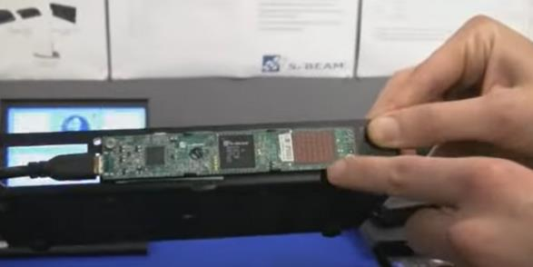
Development of mmWave Hardware(1)
2006 | 2007 | 2008 | 2009 | 2010 | 2011 | 2012 | 2013 | 2014
15.3c (2003～)
WirelessHD
ECMA387(TC48)
ISO/IEC 13156
11ad
WiGig -> Wi-Fi (2013～)
ISSCC Videos, "ISSCC 2011: 9.3 A 60GHz CMOS Phased-Array Transceiver Pair for Multi-Gb/s Wireless Communications," YouTube, Feb. 22, 2011. [Online]. Available: https://www.youtube.com/watch?v=IQ4Y6fZRyzU.

Slide 8
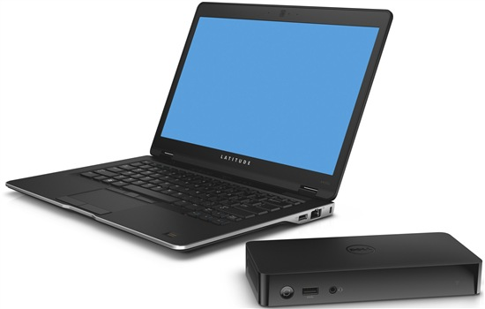
Development of mmWave Hardware(2)
2006 | 2007 | 2008 | 2009 | 2010 | 2011 | 2012 | 2013 | 2014
15.3c (2003～)
WirelessHD
ECMA387(TC48)
ISO/IEC 13156
11ad
WiGig -> Wi-Fi (2013～)
Dell Inc., "Dell introduces world’s first WiGig-based wireless dock for unparalleled convenience and connectivity," Dell Blog, Feb. 5, 2013. [Online]. Available: https://www.dell.com/en-in/blog/dell-introduces-world-s-first-wigig-based-wireless-dock-for-unparalleled-convenience-and-connectivity/.

Slide 9
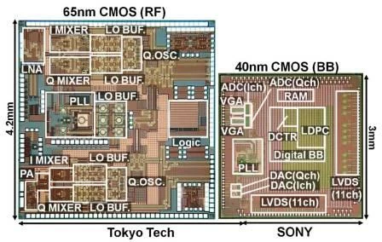
Development of mmWave Hardware(3)
The 1st mmW chipset supporting 15.3c SC-PHY [1]
[1] K. Okada et al., "Full Four-Channel 6.3-Gb/s 60-GHz CMOS Transceiver With Low-Power Analog and Digital Baseband Circuitry," IEEE J. Solid-State Circuits, 2013.

Slide 10
Development of mmWave Hardware(4)
Other Developments in mmWave Technology
Fixed Wireless Access (FWA)
  Bridging existing networks with high-speed connectivity.
  Successfully adapted to the market with available devices.
Smartphones and Routers
  Some high-end smartphones integrated mmWave technology.
  Wi-Gig solutions employed in advanced Wi-Fi routers.
VR Headset
  Prototypes and activities for transferring uncompressed video.
  Designed for low-latency, high-bandwidth applications in immersive experiences.

Slide 11
Transition to IEEE 802.15.3d/e (1)
2013 | 2014 | 2015 | 2016 | 2017
SG
TG3e
IG THz
SG
TG3d

Slide 12
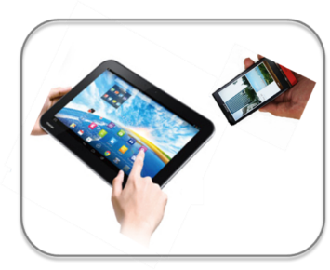
Transition to IEEE 802.15.3d/e (2)
A. Estrada, “TG3e Technical Guidance Document,“ IEEE Doc. 15-15/0109r7

Slide 13
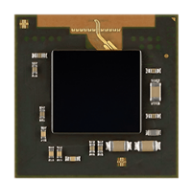
Recent IEEE 802.15.3e Devices
Standards Compliance: Fully compliant with the IEEE 802.15.3e standard.
  Implements full PHY and MAC functionality.
  Built-in RISC CPU supports automated connections.
High-Speed Capability: Supports data rates up to 6.3 Gbps for peer-to-peer communication.
Up-to-Date Connectivity:
  USB 3.1 Gen2 for flexible device integration.
  XGE to enable a high-speed wireless Ethernet link
  PCIe 3.0 available for prototyping or more
Unique Feature:
  Incorporates a UFS host architecture for direct, high-speed storage connectivity.
Compact package with integrated antenna for TransferJet X SoC
Sony Semiconductor Solutions, "LSI Compatible with TransferJet X, a High-speed Wireless Communication Technology," [Online]. Available: https://www.sony-semicon.com/en/products/lsi-ic/transfer-jet.html.

Slide 14
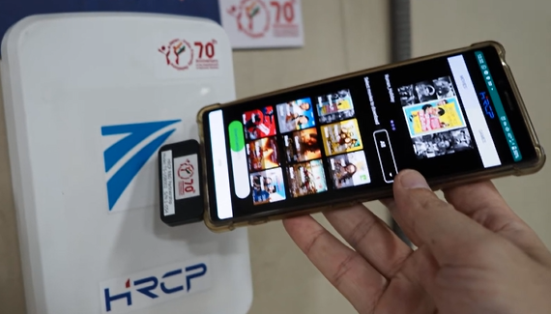
Applications leveraging high-speed and low-power communication
UFS
UFS
HRCP R&D Partnership,
"A new field trial at Delhi Metro Stations," [Online]. https://www.hrcp.jp/en/index.html.
USB

Slide 15
Future Prospects
Leveraging 3e Device for Practical Terahertz Prototyping
3d and 3e Synergy:
  Both standards share a similar MAC architecture, making it feasible to adapt existing 3e modules for 3d prototyping.
  By upconverting the 60 GHz RF to the frequencies defined in 3d, early prototyping becomes achievable.
Testing 300 GHz Applications:
  This approach allows testing the usability of 300 GHz communication with real-world applications.
  Although operating with reduced bandwidth, it remains compliant with 3d specifications (e.g., 2.16 GHz bandwidth).
Implications for Early Adoption:
  Enables developers to evaluate practical performance and explore new use cases for terahertz communication.

Slide 16
Thank you!

