Slide 1
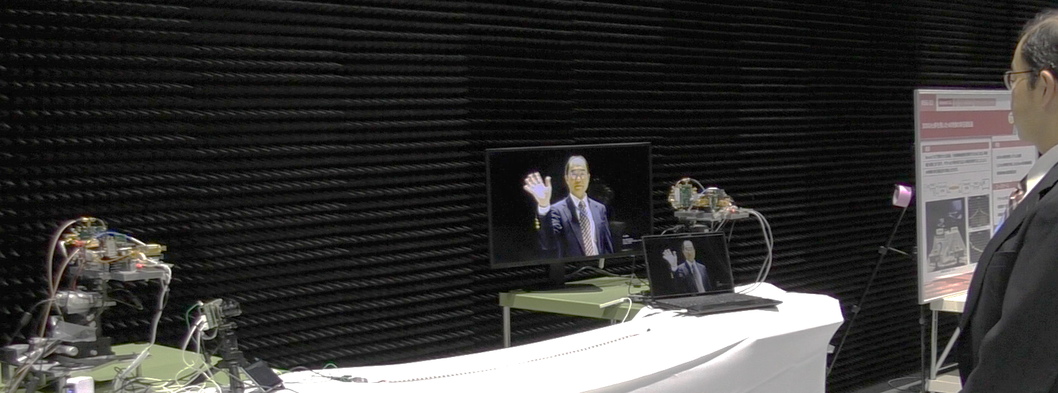
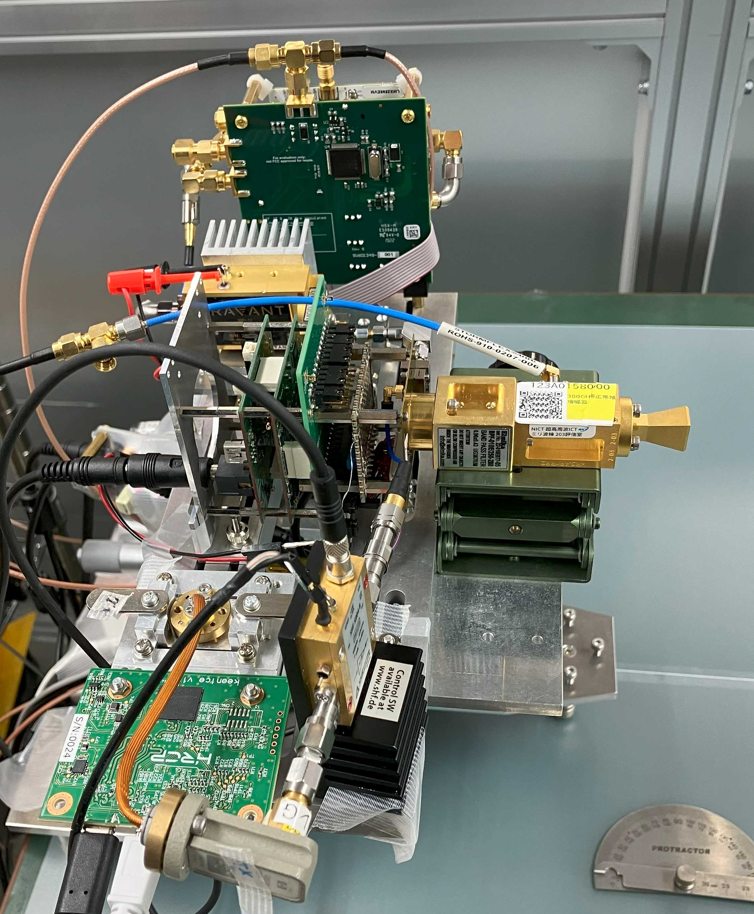
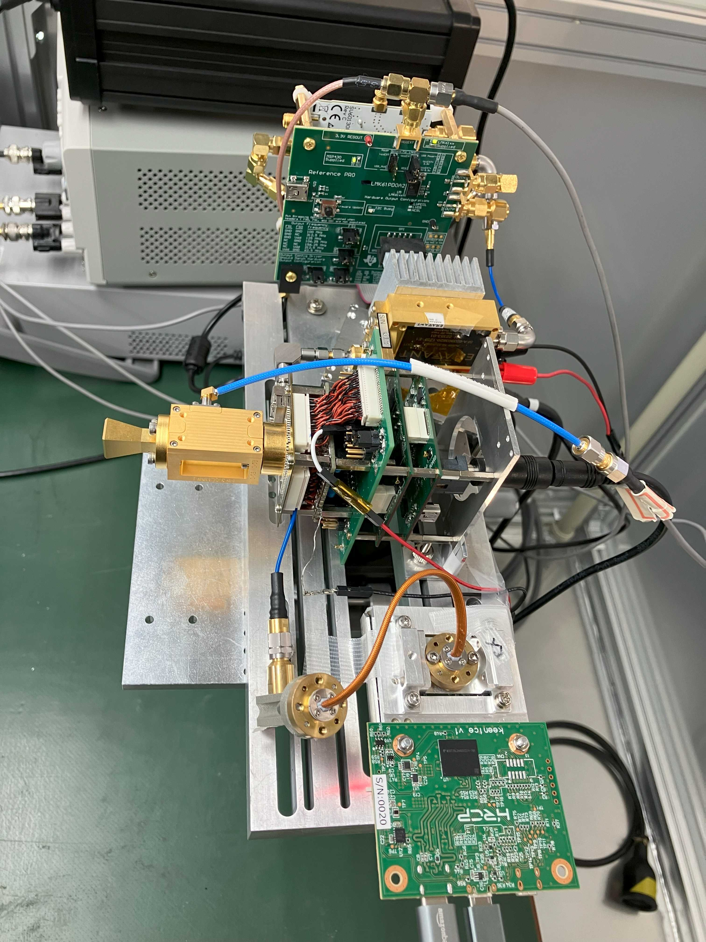


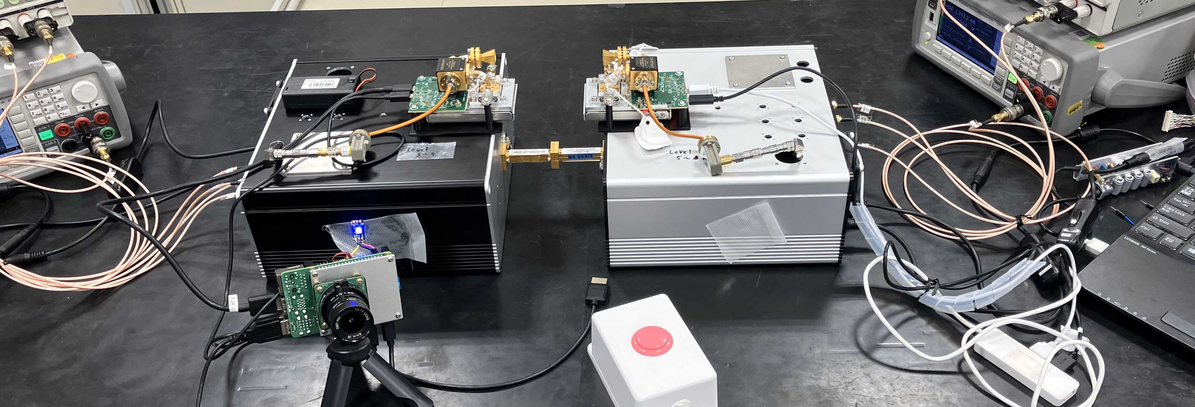
THz wave (3d) + MMW (3e) Hybrid Wireless Communication System
DISCLAIMER
The use of any particular/specific brands of components, equipment, or instruments as a part of the demonstration and presentation does not constitute an endorsement of those brands by IEEE, IEEE SA, or the IEEE LMSC.
Demonstration of THz wave (3d) + MMW (3e) Hybrid Wireless Communication System
In an anechoic chamber
Overview of the system
The recorded data was converted by the mmw transceiver into a modulated signal in the mmW band of the IEEE802.15.3e standard (CH2).
The modulated signals was up-converted to the THz-wave band of the IEEE802.15.3d standard (CH9) by THz CMOS TX.
The received signal was down-converted to a IEEE802.15.3e standard signal by THz CMOS RX, demodulated by the mmW transceiver, and output as a video data.
Control signals for sending and receiving video signals are performed between mmW transceivers.
Since the radio license is not yet obtained, THz propagation will be demonstrated using waveguide attenuators with 60 dB insertion loss.
Playback!!
THz-wave receiver
THz-wave transmitter
Down link (271.08GHz)
Up link (60.48GHz)
mmW transceiver
THz-wave receiver
THz-wave transmitter
mmW transceiver
~2.0m
Synthesizer
Synthesizer
Recording!
x6
x6
BW(GHz)
Ch9
IEEE 803.15.3d
ANT
THz CMOS TX
THz CMOS TX
ANT
2.16
Ch1~32
LNA
BPF
AMP
THz-wave transmitter
8.64
Ch49~56
THz-wave receiver
AMP
11.7GHz
Synthesizer
S. Beppu, et al., EuMIC2024
12.96
Ch57~61
Synthesizer
11.7GHz
multiplier
x6
BPF
LO
LO
BPF
multiplier
x6
mmW transceiver
mmW transceiver
THz CMOS TX
70.2GHz
17.28
Ch62~63
f _{GHz}
70.2GHz
THz CMOS RX
250
260
270
280
290
300
310
320
IC
252.72
321.84
IC
60.48GHz
x2
WG
AMP
ANT
ANT
LNA
WG
x2
60.48GHz
IF
BPF
RF
BPF
IF
271.08GHz
Down link (271.08GHz)
271.08GHz
AMP
mmW
transceiver
(Transfer Jet X)
ANT
Up link (60.48GHz)
RF
ANT
mmW
transceiver
(Transfer Jet X)
CIR
BW(GHz)
Ch2
IEEE 803.15.3e
CIR
THz + mmW
Hybrid !!
2.16
57
58
59
60
61
62
63
64
f _{GHz}
Specifications
57.24
65
66
65.88
mmW transceivers
The center frequency of THz and mmW communications were 271.08 GHz (3d, ch9) GHz and 60.48 GHz (3e, ch2), respectively.
The symbol rate and data rate were 1.76 GHz and 3.52 Gbps, respectively.
60dB ATT
THz-wave transmitter
(in case)
THz-wave receiver
(in case)
This work was supported in part by the Ministry of Internal Affairs and Communications of Japan (JPJ000254, Research and Development for Expansion of Radio Wave Resources)
Demonstration setup (@IEEE 802 Wireless Interim, Jan 15, 2025)

