Slide 1
Project: IEEE P802.15 Working Group for Wireless Personal Area Networks (WPANs)
Submission Title: Wireless Next Generation Meeting Slides
Date Submitted: 14 January 2025
Source: Benjamin A. Rolfe (Blind Creek Associates)
Contact:
E-Mail: ben.rolfe @ ieee.org
Re: Wireless Next Generation
Abstract: Meeting Slides for the January 2025 Wireless Interim Session.
Purpose: Support the illusion of organization.
Notice: This document has been prepared to assist the IEEE P802.15. It is offered as a basis for discussion and is not binding on the contributing individual(s) or organization(s). The material in this document is subject to change in form and content after further study. The contributor(s) reserve(s) the right to add, amend or withdraw material contained herein.
Release: The contributor acknowledges and accepts that this contribution becomes the property of IEEE and may be made publicly available by P802.15.
Notes:
Jul 12, 2010
Page 1

Slide 2
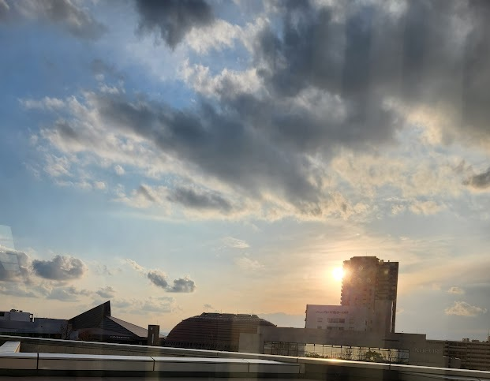
January 2025 802 Wireless Interim Kobe, Japan

Slide 3
Mixed Mode Meeting
Registration is required
Please remember to enter your attendance in IMAT
Reminder:
This is a non-PAR activity
All the rules of conduct apply https://grouper.ieee.org/groups/802/sapolicies.shtml

Slide 4
802.15 WNG Agenda
WNG Open Ben Rolfe (BlindCreek Associates) 1min
802 Chair Welcome James Gilb (GA-ASI) 1min
WG15 Overview and Agenda Phil Beecher (Wi-SUN Alliance) 4min
THz Intro Thomas Kuerner (TUB) / Iwao Hosako (NICT) 10min
Current status of 3e device, Q&A Mr. Keitarou Kondou (NICT) 20min
Progress of 3d: Results of the ThoR Project, Q&A Prof./Dr. Tetsuya Kawanishi (Waseda Univ.) 20min
Progress of 3d: New Use Case, Q&A Dr. Yozo Shoji (NICT) 20min
THz Summary Thomas Kuerner (TUB) / Iwao Hosako (NICT) 5min
15.4 Intro Phil Beecher (Wi-SUN Alliance) 1min
Latest R&D Progress in Wireless Smart Utility Networks, Q&A Dr. Hiroshi Harada (Kyoto Univ.), Q&A 20min
15.4 Summary Phil Beecher (Wi-SUN Alliance) 5min
WNG Close Ben Rolfe (BlindCreek Associates) 1min
Demos immediately following WNG, until 4pm in common/break area on 4th floor

Slide 5
References
Wi-SUN:A IoT network that has been successfully commercialized on a large scale by IEEE 802.15.4, Document 15-25-0034-00
Results of the ThoR Project, Document 15-25-0026-01
Introduction to the THz Presentations and Demonstrations at 802.15 WNG Tech Focus, Document 15-25-0001-01

Slide 6
Any Other Business

Slide 7
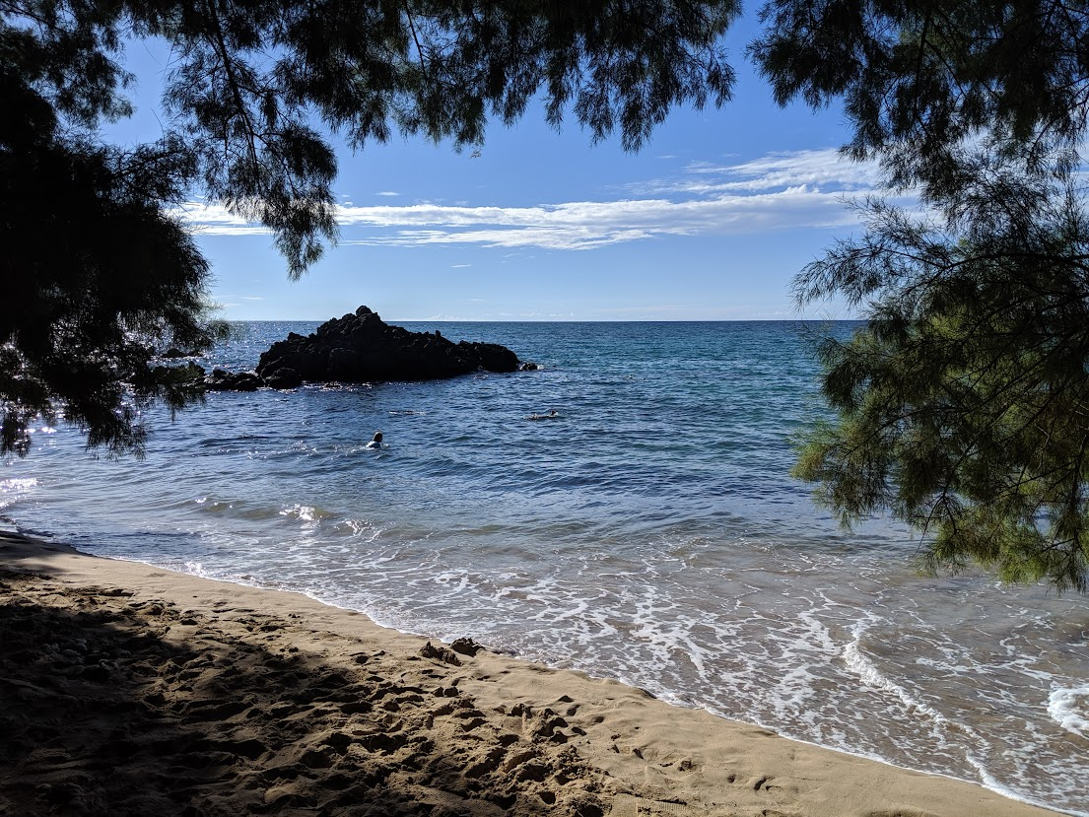
Adjourned

