Slide 1
doc.: IEEE 802.15-25-0033-02-06ma
Project: IEEE P802.15 Working Group for Wireless Personal Area Networks (WPANs) Submission Title: [Overview of Activity of IEEE802.15 TG15.6ma for Revision of IEEE802.15.6-2012 Wireless BAN with Enhanced Dependability]
Date Submitted: [July 25th 2025]
Source: [Ryuji Kohno] [1;Yokohama National University(YNU), 2;YRP International Alliance Instiitute(YRP-IAI)]
Address [1; 79-5 Tokiwadai, Hodogaya-ku, Yokohama, Japan 240-8501
2; YRP1 Blg., 3-4 HikarinoOka, Yokosuka-City, Kanagawa, Japan 239-0847 ] Voice:[1; +81-90-5408-0611], FAX: [+81-45-383-5528],
Email:[1: kohno@ynu.ac.jp, 2:kohno@yrp-iai.jp]
Abstract: [This document summarizes standardization activity of IEEE802.15 Task Group(TG)6ma for revision of IEEE802.15.6 - 2012 Medical Body Area Network(BAN) corresponding to increasing for enhanced dependability in wireless sensing and controlling human and vehicle bodies for medical healthcare and automotive uses. After quick overview of IEEE802.15.6 -2012, necessity of the revision is described in such critical use cases that various types of interference such as intra BAN interference in multiple overlaid BANs, interference among BAN and other networks in some overlaid frequency band etc. Extension of BAN from human body for medical healthcare to car body for automotive uses and their combination makes a larger market and a new application in medical and automotive industries with a common standard.]
Purpose: [information]
Notice: This document has been prepared to assist the IEEE P802.15. It is offered as a basis for discussion and is not binding on the contributing individual(s) or organization(s). The material in this document is subject to change in form and content after further study. The contributor(s) reserve(s) the right to add, amend or withdraw material contained herein.
Release: The contributor acknowledges and accepts that this contribution becomes the property of IEEE and may be made publicly available by P802.15.
Submission
Slide 1
Ryuji Kohno(YNU/YRP-IAI)

Slide 2
doc.: IEEE 802.15-25-0033-02-06ma
Overview of Activity of IEEE802.15 TG15.6ma for Revision of IEEE802.15.6-2012 Wireless BAN with Enhanced Dependability
Ryuji Kohno,
Yokohama National University, Japan(YNU)
YRP International Alliance Institute, Japan(YRP-IAI)
Submission
Slide 2
Ryuji Kohno(YNU/YRP-IAI)

Slide 3
Agenda
Demand for WBAN for Emergent Medical Healthcare Use and Huge Market of Automotive Use and Expecting New Use Cases
Short Review of WBAN Standard IEEE802.15.6-2012
Necessity and Uniqueness for Revision of BAN with Enhanced Dependability
Channel and Environment Models for Focused Use Cases in Human and Vehicle BANs with Enhanced Dependability
Requirement for Revision of 15.6 MAC for Human and Vehicle BANs with Enhanced Dependability TG16.6ma
Core Technologies in PHY Layer for Enhanced Dependability TG16.6ma
Core Technologies in MAC Layer for Enhanced Dependability TG16.6ma
Time Sensitive Network(TSN)
Letter Ballot210 and Timeline of TG6ma
Slide 3
Ryuji Kohno(YNU/YRP-IAI)

Slide 4
doc.: IEEE 802.15-25-0033-02-06ma
1. Demand for WBAN for Emergent Medical Healthcare Use and Huge Market of Automotive Use
Submission
Slide 4
Ryuji Kohno(YNU/YRP-IAI)

Slide 5




doc.: IEEE 802.15-25-0033-02-06ma
1.1 Demand of BAN for Medical Uses
Emergent Problems over the world：
  1-4% of total population in a world may be suffered by COVID-19, that is a global pandemic.
  Clinic are overloaded and many business are damaged seriously.
COVID-19 Pandemic Population Ageing
Challenging but Feasible Solutions:
  Provide Remote Vital Sensing and Therapy Using ICT and AI
➔ Prevent Epidemic and Maintain Safe and Efficient Diagnosis
Promote Global Business of Medical ICT and Data Science
C. Approach:
R&D of Enable Technologies for Pandemic and Daily QoL
Promote International Standard of Wireless Body Network（BAN) and Integrated Platform of BAN/5G/AI for Global Marketing
Regulatory Compliance of Medical Devices & Services to Ensure Safety, Reliability, Security, i.e. Dependability by Regulatory Science
Submission
Slide 5
Ryuji Kohno(YNU/YRP-IAI)

Slide 6
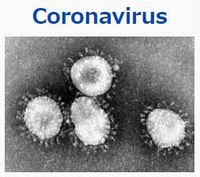

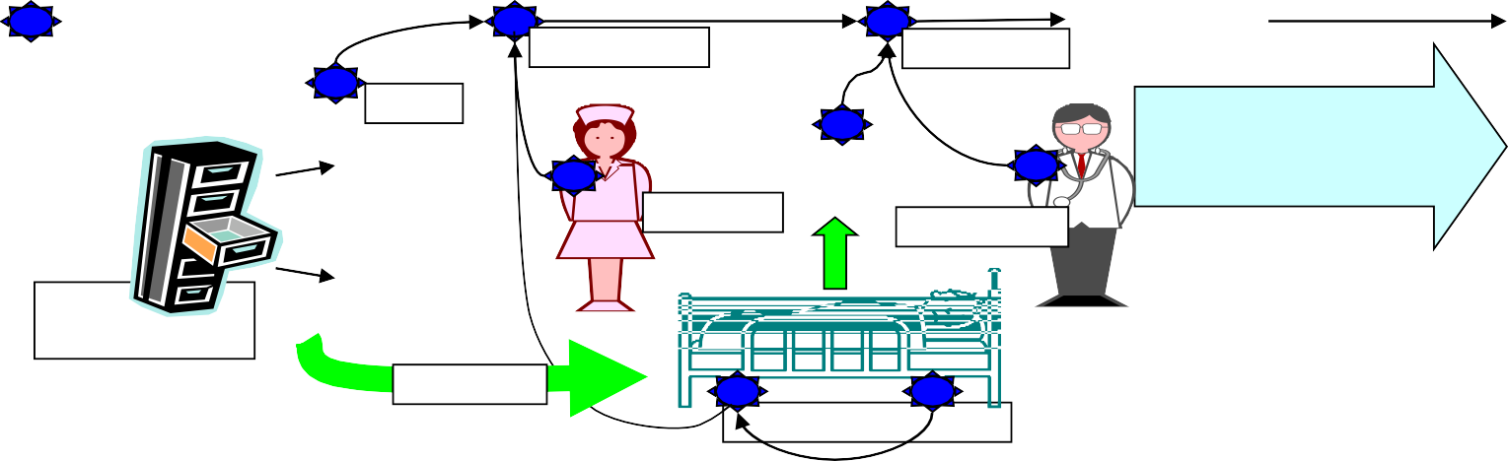
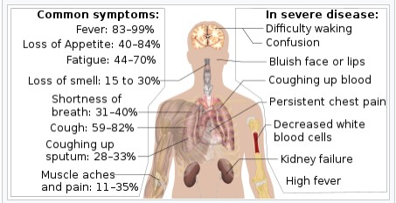
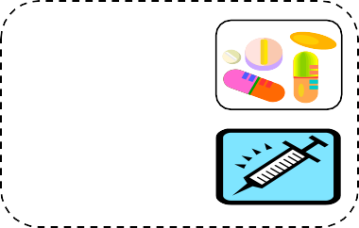

1.2 Medical Inspection and Treatment by BAN
Medical Healthcare Using BAN can perform remote real-time medical diagnosis and therapy
To prevent pandemic against COVID-19 and medical care incident etc. in daily life.
> Remote sensing vital sign and monitoring symptoms
> Evidence based medicine for clinical and nursing actions
•To support safe and efficient medical care for clinical staffs and patients etc.
> Online diagnosis, PCR and other inspection
> Protect clinical staffs and care givers with network
Server on Medical S
WBAN can apply for
ervices
Senso
^{⇒sensor} Recognition Recognition ^{Gate}
^{nodes} _{Details} Medical data _{Aut}
of
^{Nursing} Treatment
Stock information
Medication
Condition of patients
^{r node} Electronic medical card way
omatic recording medical treatments
and nursing
• Patients’ condition monitoring
•Warning information _{• Medical}
•Medical information
preventing pandemic and supporting daily care by remote sensing and therapy in digital healthcare.
information
Symptoms of COVID-19
6
Slide 6
Ryuji Kohno(YNU/YRP-IAI)

Slide 7

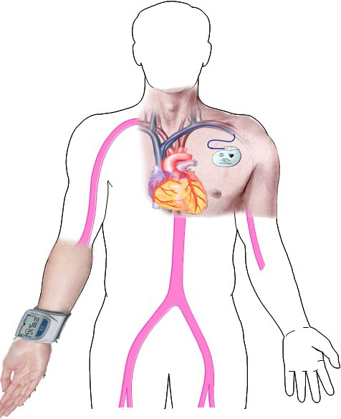
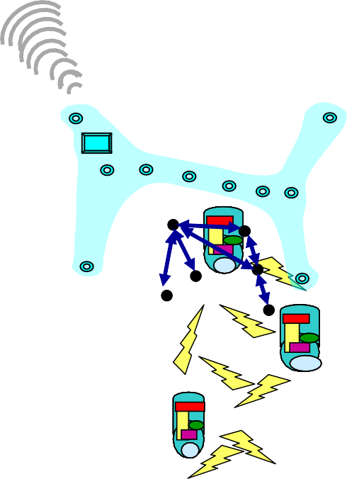



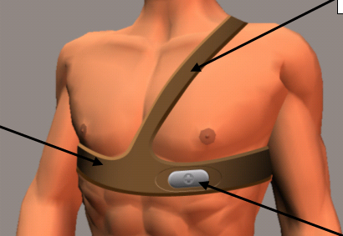


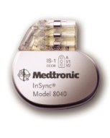

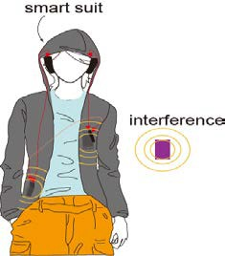

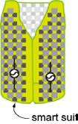


1.3 Wireless BAN: Body Area Network
Wearable BAN
Tele-metering or sensing
vital signs with various sensors
ECG EEG SPO2
Blood Pressure Heartbeat
Body temperature Glocuse level
Medical images(X-ray, MRI) and video
Implant BAN
Tele-control of Medical Equipment and Devices
Brain-Machin-Interface(BMI)
etc.
Novel Concept Intelligent Network of Vital
Sensors, eHR, Medical Robots etc.
Slide 7
Ryuji Kohno(YNU/YRP-IAI)

Slide 8

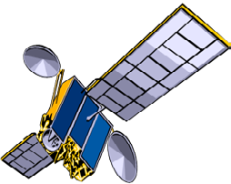
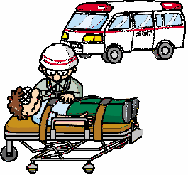
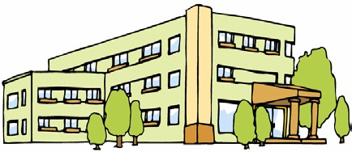






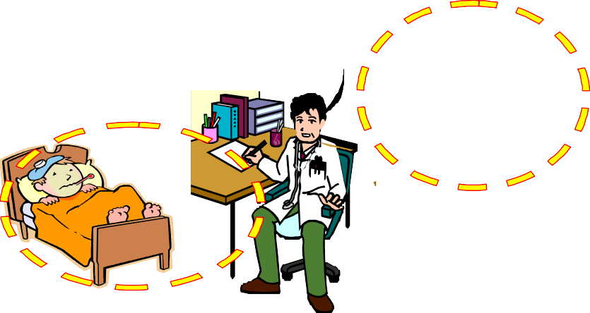








1.4 BAN- Use Cases for Remote Medical Services
doc.: IEEE 802.15-25-0033-02-06ma
Medical support
for developing countries
Satellite Link
Medical Data Server for Data Mining with Machine Learning
Satellite Networks
BAN
Moble
Big Data
Station
Network Cloud
Internet
Data mining
BAN
VSAT
Cellular Network
Medical Center and General Hospitals
8
BAN
切替
BAN
Submission
Slide 8
Ryuji Kohno(YNU/YRP-IAI)

Slide 9
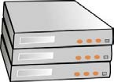










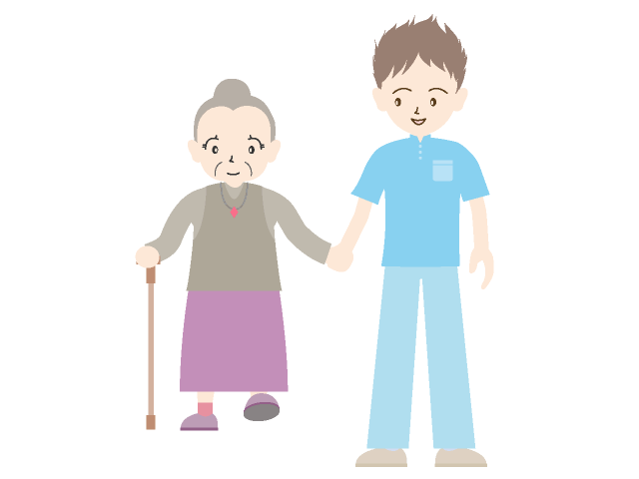
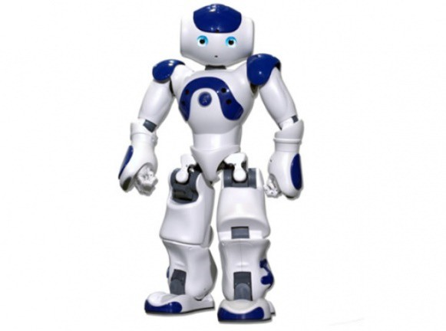
1.5 BAN-base Universal Platform with Network Cloud, Data Mining Server for Medical Healthcare
doc.: IEEE 802.15-25-0033-02-06ma
Data mining or Analysis
like Watson
Data storage server; DBMS
Network cloud (5G. 6G)
Hospital, Rehabilitation center, or Clinicians
Gateway
Body Area Network (BAN)
Coordinator
Node
Node
Node
physical assistant and surgery robots
Therapist, Nurses, Care givers
Elderly people
Submission
Slide 9
Ryuji Kohno(YNU/YRP-IAI)

Slide 10


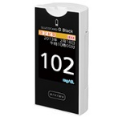
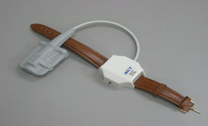
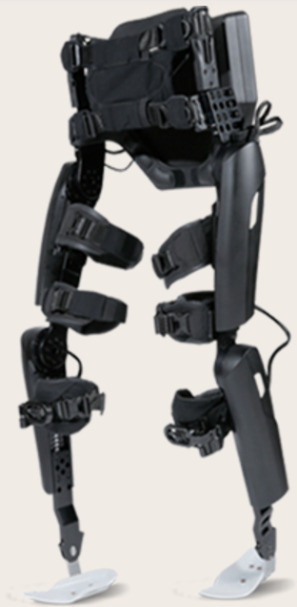
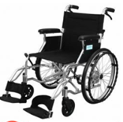

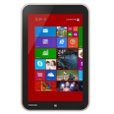

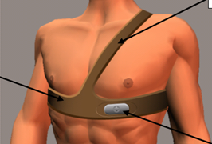
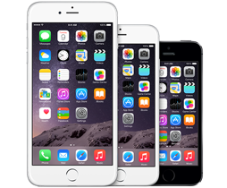

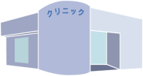
Integrated Platform among Wireless BAN, 5G/6G Cloud Network and AI Data Servers
BAN for User 1
Data
Mining
Bluetooth
Network Operator
(NTT DoCoMo,etc.)
ECG Sensor
Individual Wireless Connection for each a sensor
Cloud Server/Data Center System Operation
BLE
Glucose Sensor
Coordinator
Windows
UWB
Cloud
Network
USB
University Hospitals
Rehabilitation Robot
& Wheel Chair
4G, 5G, 6G
Cellular
Wi-Fi
WiMAX etc.
(Yokohama City Univ.
and others
….
Android
BAN for User 60
Remote Clinical Treatment & Testing
ECG Sensor
BT, BLE
BLE, BT, USB
Multiple Sensor
(SPo2 EEG, etc.)
Coordinator
YNU Kanagawa Medical Device Regulatory Science Center
UWB
iOS
Regulatory Compliance Test, R&D, Standardization of Healthcare ICT
※Coordinator in figure is just an image.
Surgery Robot
Slide 10
Ryuji Kohno(YNU/YRP-IAI)

Slide 11
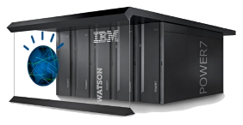
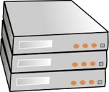






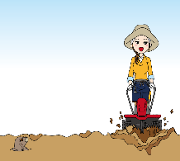
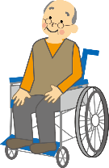

1.6 Universal Platform Based on BAN, Cloud Network, and AI Data Server for General Social Infrastructure in Medical Healthcare Services
Analysis Layer
Elderly People Living
Big Data Safety and
Ambient Analysis and
Regulatory Compliance
For Safety & Security
AI Data mining of Medical Big Data with Deep Learning Ex. Watson
Healthcare Medical Personal Database, Repository
Deep Learning and Analysis
For Feedback Sensing and Control
Smart Environment for Elderly People
WP4, 6 ,& 7: FST, YNU, MEDEA, INOV, UEDIN
Security Protection
against DOS Attach
Private network
(closed, secure)
e.g. 4G,5G,WiFi,
Edge Computing
Clinician, Nurse, Care Giver
Network Cloud
Cloud Layer
University Hospital,
Daycare Center
Deep Learning and Analysis
For Feedback Sensing and Control
Smart Environment for Elderly People
WP2, 5 & 8 ; MTC, FST, YNU
INOV, UOULU
gateway
gateway
WP3, 4, 9, 10 & 11; YCU, MTC, HSC, LMC, LUZ,
BAN Layer
Private network
BAN Coordinator
Embedded Processor for Deep Learning
(closed, secure)
BAN Coordinator
BAN Coordinator
IEEE 802.15.6 Wireless Body Area Network (BAN) for Human & Car Bodies
Vital Sensor
Environmental Sensor
Car Body Care
Rehabilitation Advise
Vital Sensor
Remote Control
Environmental Sensing & Controlling Equipes
Driver Vital Sensor
Smart Communication Tool
Car Drive Controlling
Vital Sensing
Vital Sensing & Remote Therapy
Elderly Driver Care
Rehabilitation patient
Home Farming
Cyber Physical Home Care
Elderly Hiker Care
Cyber Physical Elderly Community
Disable Elderly Support
WP2, 5, 6, 8 & 10; YNU, MTC, FST, HSC, LMA, YCU, HCU
UOUU, UNIFI, IMT, LUZ, UEDIN
BAN-base Universal Platform to Guarantee Valuable QoL for individual Elderly People
by Sensing their Vital, Living Environment Information and Feedback Controlling Systems
Submission
Ryuji Kohno(YNU/YRP-IAI)
Slide 11

Slide 12
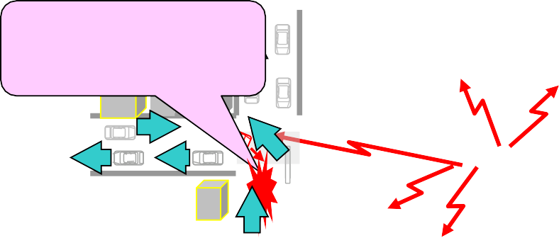
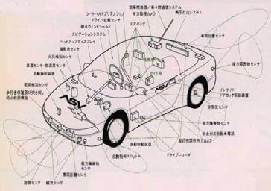
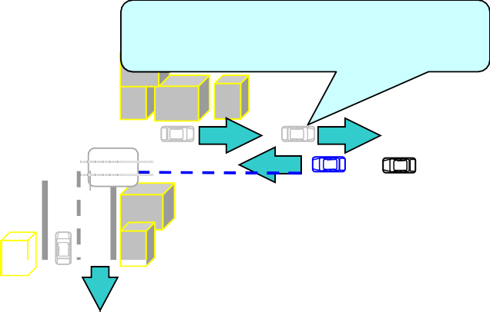
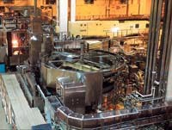


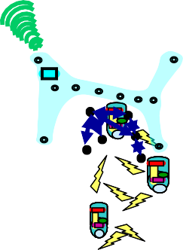

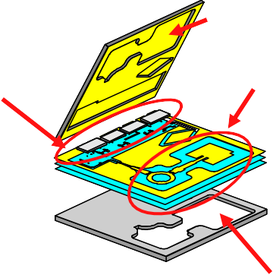






doc.: IEEE 802.15-25-0033-02-06ma
1.7 Extension of Use Cases of BAN beyond Medical Healthcare
Collision Avoidance
Collision Avoidance and safe driving by inter-vehicle networks
Using inter-vehicle and
roadside networks
Inter-module wireless Networks
A車
Road to car networks
Inter-vehicle networks
Car LAN & Wireless Harness
Car Navigation & Collision Avoidance Radar
Factory Automation (FA)
Dependable Wireless Networks for Transportation
Dependable Wireless Sensing & Controlling for Manufacturing (CIM)
Silicon Bsee
Wearable BAN
Tele-metering vital data
EEG. ECG,
Blad Pressure Temperatute MRI images
Implant BAN
Tele-controlling implant devices
UWB can solve
MMIC
(Flip Chip)
On Chip Antenna and Wireless Network in chio
such a problem
Etc.
Pacemaker with IAD
that radio interferes
a human body and
medical equipments
Silicon Base
Multi-layer BCB
Dependable Network among vital sensors, actuators, robots
Capsule Endoscope
Micor Machine Fablication
Dependable Wireless System Clock in Micro Circuit & Network in Devices
Dependable BAN for Medical Healthcare
Submission Slide 11
Ryuji Kohno(YNU/YRP-IAI)

Slide 13
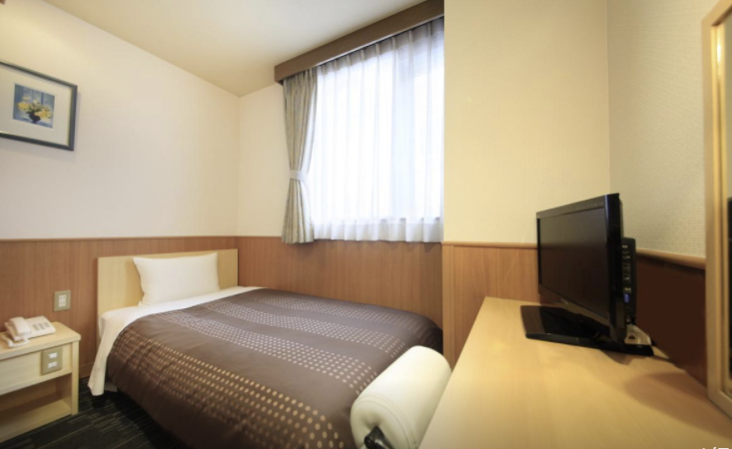
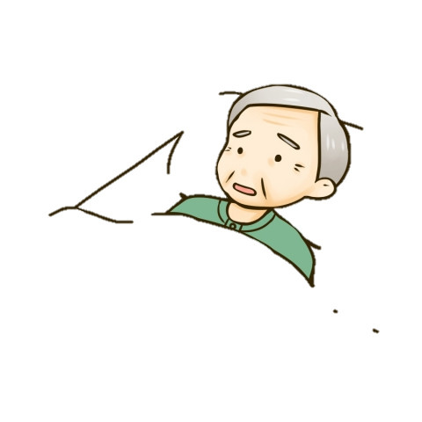
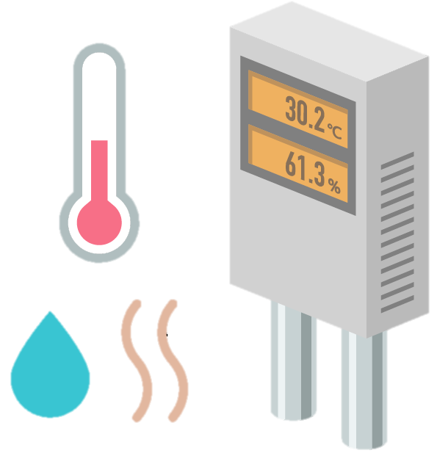
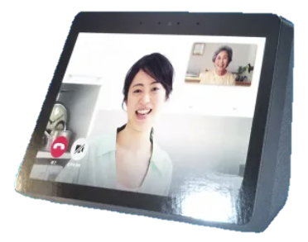

(2) BAN Platform Use Cases in Remote Treatment for COVID-19 Patients under Quarantine at Home
Family
Data Collection and Analysis
Analyzed results for health condition
Cloud Remote Monitoring Service
Environmental Data
BAN Coordinator
Without Clinical Staffs, health condition of COVID-19 patents can be monitoring and rescue them immediately.
Integrated Data
Data Input
Remote Therapy and mental care keeping distance
Vital Sensors for SpO2, ECG, Temperature etc.
Display
Smart Phone, Tablet,
Camera, Display. Microphone,
Speaker
Command for care of patients
Analyzed results
Real-time remote monitoring and care
Remote Maintenance of COVID-19 Patients at Home Using Platform of Integrated Vital Sensors/Wireless BAN/5G Cloud/AI Analysis
Dialog
Medical Care Center and
Government Control Center
Slide 13
Ryuji Kohno(YNU/YRP-IAI)
Notes:
ｲﾗｽﾄ
https://illust8.com/contents/6134
http://tech-pic.com/materials/13/24/307
http://mangatop.info/sozai/senior/3822/
https://illustimage.com/?id=2001
https://free-designer.net/archive/entry30752.html

Slide 14
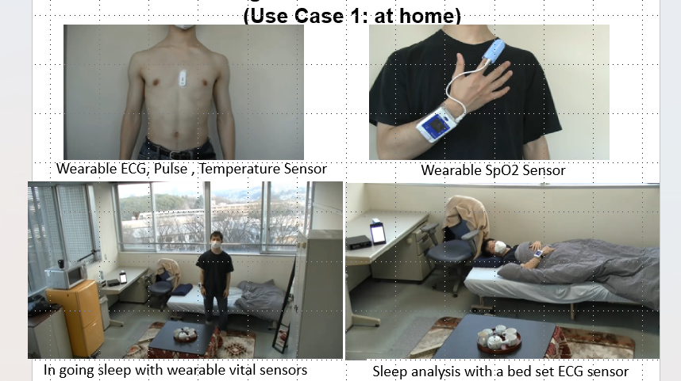
(2) Remote Monitoring and Analyzing Vital Signs and Feedback Using the BAN/Cloud/AI Server Platform
(Use Case 1: at home)
Slide 14
Ryuji Kohno(YNU/YRP-IAI)

Slide 15
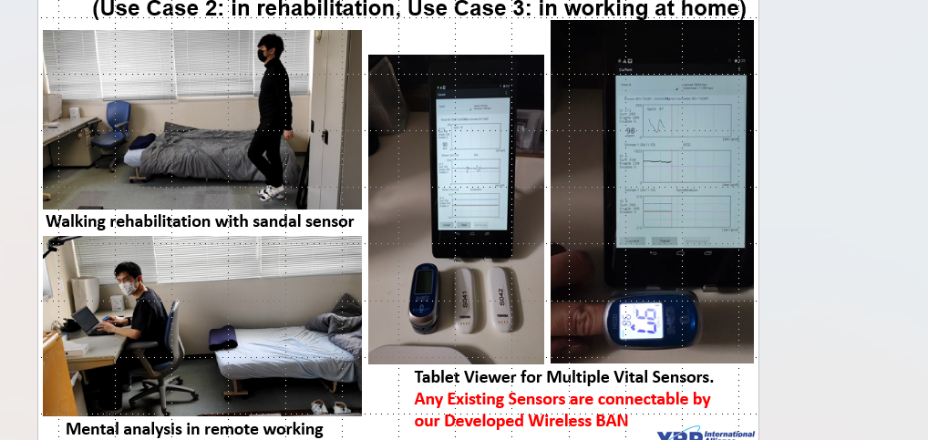
Slide 15
Ryuji Kohno(YNU/YRP-IAI)

Slide 16
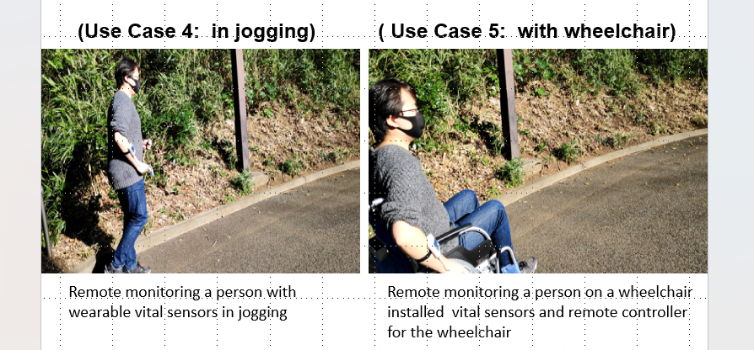
16
Slide 16
Ryuji Kohno(YNU/YRP-IAI)

Slide 17
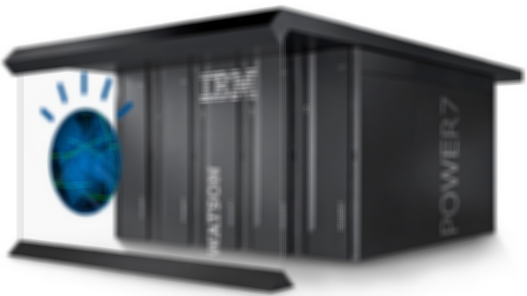
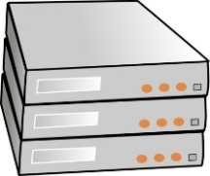

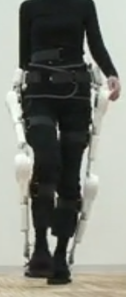




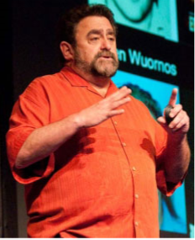
(3) Universal Platform with Integrated ICT, Robotics and AI by Remote Sensing and Mining of Vital Data for High Quality of Life with Medicine, Wellness, and Sport
AI Data mining of Medical Big Data with Deep Learning
Medical Database, Repository
METI, FCC; Supervise of Medical Big Data Processing and Application
PMDA, FDA; Clinical Study and Validation of Medicine and Medical Devices
University and Collaborating Universities in a world
Official Network
5G/6G, Internet for Cloud Network, Edge Computing
Efficient and Professional Diagnosis and Therapy
Gateway
Hospital,
Day Care Center
International Standard of Medical Body Area Network (BAN) IEEE802.15.6
Vital Data
Telecom Carrier Operator
Professional
Clinician
Command
Official Network
University Hospitals
Coordinator
Body Area Network (BAN)
Detect and Prevent Pandemic of COVID-19
Node
Node
Walking Assist Robots (HAL, ReWalk)
Remote Sensing Glucose level & controlling wearable insulin pump by BAN
Node
Node
Node
Node
Node
Sensing Physical and Mental Condition
Sensing Mental & Physical Condition for Training
Wheelchair
Node
Diabetes & Metabolic High Society People
Rehabilitation Robots
Elderly Patient, Sport Athlete
Clinician, Nurse, Therapist
Rehabilitation Center
Slide 17
Ryuji Kohno(YNU/YRP-IAI)
Notes:
Chronical Disease, Diabetes, etc.

Slide 18
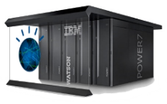


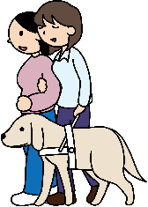

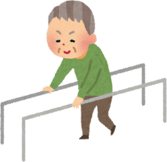

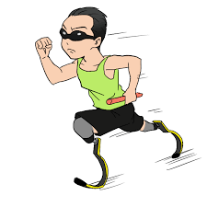

(4) General Platform for Elderly and Disability Care
High QoL of Disabled People by Remote Humanitarian and Health Case Using BAN-base Platform with Cloud Network and AI Server
AI Analysis Layer
Elderly People Living
Big Data Safety and
Ambient Analysis and
Regulatory Compliance
For Safety & Security
AI Data mining of Medical Big Data with Deep Learning Ex. Watson
Healthcare Medical Personal Database, Repository
Deep Learning and Analysis
For Feedback Sensing and Control
Smart Environment for Elderly People
Security Protection
against DOS Attach
Private network
(closed, secure)
e.g. 4G,5G,WiFi,
Edge Computing
Clinician, Nurse, Care Giver
Network Cloud Layer
Network Cloud
University Hospital,
Daycare Center
Deep Learning and Analysis
For Feedback Sensing and Control
Smart Environment for Elderly People
gateway
gateway
BAN Layer
BAN Coordinator
Embedded Processor for Deep Learning
Private network
(closed, secure)
BAN Coordinator
BAN Coordinator
IEEE 802.15.6 Wireless Body Area Network (BAN) for Human & Car Bodies
Vital Sensor
Environmental Sensor
Car Body Care
Driver Vital Sensor
Rehabilitation Advise
Vital Sensing，Sensing and controlling Equipment
Smart Communication Tool
Remote Control
Environmental Sensing & Controlling Equips
Car Drive Controlling
Vital Sensing & Remote Therapy
Disabled Driver Care
Rehabilitation Support
Cyber Physical Home Care
Guide and Service Dog Care
Para-sport Athlete Support
Cyber Physical Community
BAN-base Universal Platform to Guarantee Valuable QoL for individual Disabled People
by Sensing their Vital, Living Environment Information and Feedback Controlling Systems
Slide 18
Ryuji Kohno(YNU/YRP-IAI)

Slide 19


(5) Brain-Machine-Interface(BMI): Wireless Body Area Network (BAN) with AI Machine-Learning and User-Interface
Brain-Computer-Interface(BCI) and Brain-Machine-Interface(BMI) for Clinical Support to Disability and More General Use Cases Including for Entertainment, e-Game, and Heavy Industries.
Brain-Computer-Interface(BCI) for Understanding Human Contention and Machine Control.
Slide 19
Ryuji Kohno(YNU/YRP-IAI)

Slide 20










(5) Electrode Array
(Safety, High density, Stability)
3D-shape
Individutl MRI Data
1st Generation
Flexible electrode array
・Parylene-C、 High Density: IED 50μm
・Relationship between intracortical and
ECOG signal
2nd Generation
Up: High Density (IED: 2.5mm)
Down:Clinical
3D-double surface
for intra-sulcus
(Hirata M, IEICE Trans Commun, 2011)
Slide 20
Ryuji Kohno(YNU/YRP-IAI)

Slide 21


















(5)Super multi-channel system using UWB (4096ch～)
July 2025
doc.: IEEE 802.15-25-0033-03-06ma
1st Generation (128ch)
-ISM band (2.4GHz) [1.9Mbps] 12bit x 1kHz x 128ch
= 1.5 Mbps
2nd Generation (>4000ch) 12bit x 1kHz x 4096ch
= 49Mbps → UWB (Ultra Wide Band)
+ Distributed system
Electrode array+ LSI (64ch x 64units)
Large-scale Recording
Wireless transmitting (UWB)
Real-time Decoding
BMI
Robotic hand control
Feedback
Submission
Slide 21
Ryuji Kohno(YNU/YRP-IAI)

Slide 22




doc.: IEEE 802.15-25-0033-02-06ma
1.8 Demand of BAN for Automotive Uses
Increasing Demands in a world：
  New business promotion by applying wireless ICT to vehicle by huge alliance between automotive and telecom industries such as smart key, wireless harness
  Autonomous car driving and safety controlling of elderly drivers by ICT and data science
Smart Vehiles EV and HV
Challenging but Feasible Solutions:
  Provide Remote Sensing and Controlling Using ICT and AI
➔ Prevent Traffic Accidents , Jam and Co2 Emission
Promote a New Global Business of Automotive , ICT, and Electronics
C. Approach:
R&D of Enable Technologies for Smart Vehicle and City
Promote International Standard of Wireless Body Network（BAN) and Integrated Platform of BAN/5G/AI for Global Marketing for both Medical and Automotive uses
Regulatory Compliance of Devices & Services to Ensure Safety, Reliability, Security,
i.e. Dependability by Regulatory Science
Submission
Slide 22
Ryuji Kohno(YNU/YRP-IAI)

Slide 23






(1)Dependable BAN of Things for Autonomous Driving Cars
•
•
•
•
•
•
4-6 Mono Cameras
1-2 Stereo Cameras
2-4 Mid-Range Radar 2 Long Range Radar
8-16 Ultrasonic Sensors, 4 Wheel Speed Sensors Redundant Data Center
Number Crunchers for Data Fusion
ABS, ESP, …
Some ECUs we can’t tell you details today ☺
•
Interaction with Powertrain, Body Domain, Navigation, Airbag, CAR2CAR, CAR2Infrastructure
Automated Driving is leaving the Research Labs. Soon it will be in mass production.
Does this look familiar to data centers?
For automotive, Inter-vehicle communications(IVC) and Machine-to-Machine(M2M) inside a car like brake-axcel control must be core applications of Dependable BAN of Things.
Surround vision with redundant sensors
Slide 23
Ryuji Kohno(YNU/YRP-IAI)

Slide 24

















doc.: IEEE 802.15-25-0033-02-06ma
1.9 Use of BAN for Autonomous Car Driving
Driver or AI
For Autonomous Driving
Own Car
controller
Axel/Brake
Wireless channel
Car Running Ahead
Radar
For Collision Avoidance and Inter- Vehicle Communication
Wireless Feedback Sensing and Controlling Loop for Autonomous Driving
Controller
u[k]
u^ [k]
Car Axel/Brake Model and Radar System
r[k]
+
Bd 1/S
y[k]
K
+
-
+
Wireless channel
Ad
^
x[k]
x[k]
Feedback Delay Loop Model with Motion Equation
Submission
Slide 24
Ryuji Kohno(YNU/YRP-IAI)

Slide 25




(2) Demands for Dependable Wireless Network in Factory Automation(FA)
Demands for Internet of Things increase but Machine-to-Machine (M2M) should be reliable and secure, so Dependable BAN for Medicine can be applied for Dependable BAN of Things.
Slide 25
Ryuji Kohno(YNU/YRP-IAI)

Slide 26




1.10 Remote Localization and Rescue of Missing Victims Using Wireless Dependable BAN of Things/M2M
For Remote Controlling UAVs
UAVs/Drones
Rescue Team
controller
Navigation
Wireless channel
Missing Victims
Localization
By Using GNSS and Localization
of UAVs/Drones
Wireless Feedback Sensing and Controlling Loop for Rescue of Victims
UAVs/Drones Model and Localizing
Controller
u[k]
u^ [k]
System
r[k]
+
Bd 1/S
y[k]
K
+
-
+
Wireless channel
Ad
^
x[k]
x[k]
Feedback Delay Loop Model with Motion Equation
Slide 26
Ryuji Kohno(YNU/YRP-IAI)

Slide 27















(1) NZ(UC)-Japan(YNU) Joint Project；
Dependable Wireless Body Area Networks to Support Search and Rescue and Medical Treatment in Disaster Scenarios Using Multiple UAVs
GNSS: GPS, GLONAS,
BeiDou, QZS（Quasi-Zenith
Satellite System）
Step3; Localization of victim by TDOA ranging with UWB-BAN
Step2; Expanding UWB ranging area by recursive process
Victim
Unexplored area episode bldgs.
Step1; Positioning for anchor node UAVs using GNSS
Step4; Triage using sensed vital signs from UWB-BAN
Anchor nodes
Base station
Step5; Wireless power transmission to recharge battery of UAVs
mobile’s base station
Slide 27
Ryuji Kohno(YNU/YRP-IAI)

Slide 28

doc.: IEEE 802.15-25-0033-02-06ma
1.11 Body Area Network(BAN) of Vehicle Body
Motivation to extend human BAN(HBAN) to VBAN is to promote much dependable services by interaction between HBAN and VBAN.
Use case of Vehicle Body Area Network(VBAN) for Engine Room
Engine diagnostic sensor and controller
Air pressure sensor, wheel health sensor and controller
Transmission monitoring sensor and controller
Use case of Vehicle Body Area Network(VBAN) for Cabin Room
Cabin environment sensor (temperature, brightness, humidity etc.)
Sheet sensor, health care sensors for driver
Sheet sensor, health care sensors for passenger
4
2
5
1
3
6
https://media.istockphoto.com/photos/transparent-car-design-wire-model3d-illustration-my-own-car- design-picture-id594040008?k=6&m=594040008&s=612x612&w=0&h=XE8LiBjpM51aB4pH2CFt6- MT6IvALRPnlxPcac0RXhg=
Submission
Slide 28
Ryuji Kohno(YNU/YRP-IAI)

Slide 29



doc.: IEEE 802.15-25-0033-02-06ma
1.12 Use case in Factory Manufacturing Line; Detection of Twist and Cut of Cables
In order to improve QoS of controlling robots in factory lines, real-time sensing and controlling with permissible feedback control loop must be important requirement
Prediction and Real-time Detection of twist and cut in signal and power cables
Submission
Slide 29
Ryuji Kohno(YNU/YRP-IAI)

Slide 30











1.13 BAN/5G/AI Platform for Safe Aviation of Flying Vehicles as Air-MaaS(Mobility as a Service)
100km
Function with Software
ICT for self & remote maintenance
Beyond 5G
(6G)Platform
3D Ranging & Positioning
Satellite
Function with Hardware
2D Ranging & Communication
10km
Airplane
Self body maintenance and surround surveillance
1000m
BAN１
HAPS
Self Control
Inter AV/UAV remote sensing & controlling
Self Navigation
flight altitude
BAN/Ad-Hoc Network（BAN Layer)
CEL 1
BAN2
CEL 2
Device ranging & positioning in milli meter wave and tera Hz bands
Air Signpost
3D Ranging & positioning system,
3D Cellular Infrastructure Network
（Cloud Layer）
Aviation Control Support
Traffic Management of AV/UAV
UAV
（Doron)
Self Navigation & Traffic Management
150m
3D Cellular Network
10m
3D/2D Cellular Bas Station 1
3D/2D Cellular Bas Station 2
3D Array Sensing
AI/Machine Learning & Analysis
（Data Science Layer）
AI Deep Learning and Analysis for 3D/2D Traffic Management
0m
AI/Data Science Center

Slide 31








1.14 High Quality of Life by Parasports Supported by Wireless BAN, Network Cloud, Assisting Robots, AI Data Science
Guarantee Safe and Enjoyable Training and Games for Parasports ex. Chair Basketball & Ski
Fair Judgement of Sport Games with Wireless Sensing
Slide 31
Ryuji Kohno(YNU/YRP-IAI)

Slide 32











1.15 Applications of BAN Platform for Entertainment and Sports beyond Medicine, Wellness and Wellbeing
Jogging with BAN-chip installed MP3 Player
Wearable BAN-chip for wireless vital sensing & controlling, audio, video source sharing for sport
Bicycle with BAN-chip
Slide 32
Ryuji Kohno(YNU/YRP-IAI)
Notes:
1
32

Slide 33


1.16 Universal Platform to Achieve All SDGs
Slide 33
Ryuji Kohno(YNU/YRP-IAI)

Slide 34

1.17 Approach: Advanced ICT and Data Science to Achieve All of SDGs
Communication between Humans and Things
Solving Social Problems
Expansion of Communication Environment
Sophistication of Cyber-Physical Fusion
Slide 34
Ryuji Kohno(YNU/YRP-IAI)

Slide 35
1.18 Future Vision of Dependable Social Infrastructures Based on ICT& Data Science
Major 5 Infrastructures of Communications, Transportation, Energy, Commerce and Medicine
A. Information Traffic（Telecommunications）
B. Vehicular Traffic（Transportation）
C. Energy Traffic(Power & Energy Supply）
D. Money Traffic（Commerce）
E. Patient, Drag Traffic(Medicine)
should be integrated to control all flows in future infrastructure
A+B ➔ ITS & Autonomous Driving (Intelligent Transport System)
A+C ➔ Smart Grid & WPT (Wireless Power Transmission)
A+D ➔ E-Commerce (Borderless Secure Trade)
A+E ➔ Medicine ICT & Digital Health(Ubiquitous Medicine)
Aiming Development and Sustainable Operation of Dependable Social Services
Medical Service
Medical ICT
Ubiquitous Medical Care
Medicine
Human being
Human
Medical ICT
Ubiquitous Medical Care
Commerce
Energy Supply
Telecommunications
Disaster Prevention
Environment
Money
Information
Energy
ICT
Region
Information
Earth
E-commerce
E-Money
Disaster Pretension ICT
Sensor Network, Prediction
Vehicle
Smart Grid & WPT
Common Network for Electricity and Information
Nation
ITS
Telecommunications and Transportation
Environment ICT
Green and Eco Network,
Smart City
Public Safety ICT
Strategic Information Control
Transportation
Politics
Slide 35
Ryuji Kohno(YNU/YRP-IAI)

Slide 36

1.19 Demands of Dependable BAN of Things in IoT/M2M for Sustainable Social Services
36
Population Ageing & Medical crisis
Healthcare Service(Medical ICT)
Energy Network(Smart Grid)
Dependable BAN of Things for SDGs
CO₂ Reduction, Green Innovation
Public Safety, National Defense
Integrated BAN/Cloud/AI
Platform of Beyond 5G
Global Borderless Economics
Slide 36
Ryuji Kohno(YNU/YRP-IAI)

Slide 37








1.19 Common Secure and Dependable Social Infrastructure Platform Based on integrated BAN/Cloud/AI Server
BAN of Things
AI Big Data Mining Server with Deep Learning ex.：Watson
Data Base Registry Centre
In daily life, for safety condition of social infrastructure such as bridge, bldgs. In disaster, for rescue of victims big data can be mined with AI.
Private Network
4G, 5G, WiFi
Network Cloud
City Government, Maintenance Company,
Gateway
Body Area Network;
(BAN)
Gateway
Coordinator
Private Network
Coordinator
Location
Vital Sign
Vibration
Location
AE
Vibration
AE
Speed
Temperature
Vibration
Victim
Bridge
Road
Bldg.
Car
Emergency Rescue of Victims in Disaster
In daily life, BAN can monitor resilient level of social infrastructure while in disaster environment, BAN can be instantaneous ad-hoc networks for emergency rescue.
Slide 37
Ryuji Kohno(YNU/YRP-IAI)

Slide 38
2. Short Review of WBAN Standard IEEE802.15.6-2012
Slide 38
Ryuji Kohno(YNU/YRP-IAI)

Slide 39
2.1 Standard of Medical Wireless Body Area
Network (BAN);IEEE802.15.6
IEEE802
IEEE802.11
Wireless LAN
IEEE802.15
Wireless PAN
IEEE802.16
Wireless MAN
802.15.1
Bluetooth
802.15.2
Coexistence between WPAN and WLAN
802.15.3
PHY for High Rate WPAN
802.15.4
PHY for Low Rate WPAN
802.15.5
WPAN
Mesh Network
802.15.6
Wireless Medical BAN
2012.2 Standard was Completed
802.15.3a
Alternative PHY of 15.3
802.15.3b
Maintenance of 15.3
802.15.3c
PHY in Millimeter wave band
802.15.4a
Low rate UWB PAN Alternative PHY of 15.4
802.15.4b
Revision & Modification of 15.4 MAC
802.15.4c
Chinese WPAN
802.15.4d
Japanese WPAN
2007.3
Standard Completed
Slide 39
Ryuji Kohno(YNU/YRP-IAI)

Slide 40



2.2 Top View of IEEE Std 802.15.6
IEEE 802.15.6
Narrow band PHY on-body & in-body
UWB PHY
on-body
HBC PHY
on-body
Common MAC
（for all PHY）
Modulation: GMSK
•& DPSK
TX range: ~3m
Modulation:IR-UWB & FM-UWB
Frequency Selective
• 10-50MHz
125kbps- 2Mbps
Beacon-base- TDMA
Group Superframe
Priority support
Non-beacon mode
TX range: ~3m
Bands: MICS,WMTS,ISM • Band: UWB band
Data rate: ~ some Mbps
Data rate: ~10Mbps
UWB: Ultra-wideband
HBC: Human body communication
Slide 40
Ryuji Kohno(YNU/YRP-IAI)

Slide 41
2.3 User Priority Mapping
Priority level | Traffic designation | Data type
7 | Emergency or medical event report | Data
6 | High priority medical data or network control | Data or management
5 | Medical data or network control | Data or management
4 | Voice | Data
3 | Video | Data
2 | Excellent effort | Data
1 | Best effort | Data
0 | Background | Data
Slide 41
Ryuji Kohno(YNU/YRP-IAI)

Slide 42
2.4 Three Channel Access Modes
Channel access mode | Time reference-based (superframe structure) | Beacon | Notes
I | Yes | Yes | Coordinator sends beacon in each superframe except for inactive superframes.
II | Yes | No | Coordinator establishes time reference but doesn’t send beacon.
III | No | No | There is not time reference.
Slide 42
Ryuji Kohno(YNU/YRP-IAI)

Slide 43
2.5 Time-referenced Superframe w/ Beacon
Clock and position of each access phase
May obtain contended allocation for highest priority
B
B2
EAP1
RAP1
MAP
EAP2 RAP2
MAP
CAP
One superframe
EAP: exclusive access phase RAP: random access phase MAP: managed access phase CAP: contention access phase
Slide 43
Ryuji Kohno(YNU/YRP-IAI)

Slide 44
2.6 Dependable MAC for IEEE802.15.6ma
To enhance dependability in MAC layer, IEEE802.15.6 has applied a hybrid contention free and contention access MAC protocol in which high QoS level of packets have transmit without delay in contention free period (CFP) while low QoS level of packets with permissible delay in contention access period (CAP).
May obtain contended allocation for highest priority
B
B2
EAP1
RAP1
MAP
EAP2 RAP2
MAP
CAP
One superframe
EAP: exclusive access phase
RAP: random access phase
MAP: managed access phase
CAP: contention access phase e,g. CSMA/CD, ALOHA
Contention Free Period (CFP), e.g. TDMA)
Slide 44
Ryuji Kohno (YNU/YRP-IAI)

Slide 45
3.2 Technical Challenges for Enhanced Dependability
First of all, we should recognize that any technology in PHY and MAC cannot guarantee full dependability in every use case.
However, we can design a new standard which can guarantee a certain level of enhanced dependability in a specific defined use case.
As an analogy of informed consent in medical doctor to a patient, a manufacturer of a dependable wireless network can describe such a specific defined use case that the manufacture can guarantee a defined level of dependability showing necessary cost and remained uncertainty. This is an honest manner and much better than no guarantee for any use case.
Therefore, an expecting standard describes a specific use case in which worst performance can be guaranteed enough high while most of exiting standards have been designed with average performance base.
Technical requirement for the specific use case can be guaranteed.
Submission
Submission
Slide 45
Ryuji Kohno(YNU/YRP-IAI)

Slide 46
3.3 Uniqueness different from existing standards (1/2)
MAC protocol for around packets and recursive access for feedback loop in remote sensing and controlling;
Level of dependability can be defined with showing necessary cost and remained uncertainty. This is an honest manner and much better than no guarantee for any use case.
Worst performance can be guaranteed enough high while most of exiting standards have been designed with average performance base.
Others
Submission
Slide 46
Ryuji Kohno(YNU/YRP-IAI)

Slide 47
3.3 Uniqueness different from existing standards (2/2)
Physical(PHY) layer Technologies to satisfy technical requirement for enhanced dependability in the focused use cases
  In feedback loop for remote monitoring sensors or radars and feedback controlling actuators, real-time cognition of varying condition on site and adaptive reconfiguration in relatively messy, small, and dense areas are requested to guarantee worst performance with permissible delay and errors.
  Within a permissible limited feedback delay, propagation paths connecting between nodes and coordinator should be found to keep connectivity by diversity, channel switching etc. .
  For such a dynamic environment and QoS requirement changing situation, sophisticated PHY technologies are requested to guarantee minimum requirement of performance.
Submission
Slide 47
Ryuji Kohno(YNU/YRP-IAI)

Slide 48
3.4 Focused Issues in Amendment of std 15.6 BAN with Enhanced Dependability
MAC Protocol in case of coexistence of multiple BANs
  Amendment of MAC for resolving these problems in coexistence of BANs is necessary.
  Specified MAC protocol for feedback sensing and control loop between coordinator and nodes.
PHY Interference Mitigation In case of coexistence with other radios
  For enhanced dependability, UWB PHY of BAN should be updated to avoid performance degradation due to interference with coexisting other narrow band and UWB networks in overlapped frequency band.
Usability and Implementation Complexity
  Interoperability with narrow band and UWB PHY
  more flexible network topology,
  Transparency with other standards such as ETSI SmartBAN
Ranging and Positioning Capability of UWB-BAN
  Mobile nodes and coordinator of BAN need ranging and positioning of UWB-BAN
Submission
Slide 48
Ryuji Kohno(YNU/YRP-IAI)

Slide 49
doc.: IEEE 802.15-5-0033-02-06ma
4. Channel and Environment Models for Focused Use Cases for Revision of std 15.6-2012 for Human and Vehicle BANs with Enhanced Dependability TG16.6ma
Submission
Slide 49
Ryuji Kohno(YNU/YRP-IAI)

Slide 50

4.1 Channel models and scenarios in IEEE802.15.6ma
Scenario | Description | Frequency Band | Channel Model
S2 | Implant to Body Surface | 402-405 MHz, | CM2
S2.1 | Implant (upper body) to Body Surface | 3.1-10.6 GHz UWB | CM2.1
S2.2 | Implant (head) to Body Surface | 3.1-10.6 GHz UWB | CM2.2
S3 | Implant to External | 402-405 MHz, 3.1-10.6 GHz UWB | CM2
S4 | Body Surface to Body Surface (LOS) | 400, 600, 900 MHz 2.4, 3.1-10.6 GHz | CM3
S4.1 | Body Surface to Body Surface (LOS) | 3.1-10.6 GHz CM4.1 | CM4.1
S5 | Body Surface to Body Surface (NLOS) | 400, 600, 900 MHz 2.4, 3.1-10.6 GHz | CM3
S6 | Body Surface to External (LOS) | 900 MHz 2.4, 3.1-10.6 GHz | CM4
S6.1 | Body Surface (head) to External (LOS) | 3.1-10.6 GHz | CM6.1
S7 | Body Surface to External (NLOS) | 900 MHz 2.4, 3.1-10.6 GHz | CM4
Path loss (Mandatory)
Optional;
  Fading ( Small scale/ large scale)
  Shadowing
  Power delay profile
Specific use cases
Implant to Body Surface for BCI
Implant to External for BCI
Body surface to body surface for BCI
Body Surface to External for BCI
Implant to body surface for capsule endoscopy
Slide 50
Ryuji Kohno(YNU/YRP-IAI)

Slide 51





4.2 BMI with Wireless BAN with AI Machine-Learning and User-Interface
Brain-Machine-Interface(BMI) systems for Clinical Support to Disability such as autonomous robot hand control and communication assistance.
ECoG（Electrocorticogram) detected with implanted thousands of electrodes is transmitted in wireless by BAN with high capacity and dependability.
Slide 51
Ryuji Kohno(YNU/YRP-IAI)

Slide 52


4.2 Channel models and scenarios in use case of
BMI and BCI(Brain-Computer-Interface)
Specific use cases
Implant to Body Surface for BCI
Implant to External for BCI
Body surface to body surface for BCI
Body Surface to External for BCI
Implant to body surface for capsule endoscopy
We will define what is BCI and BMI.
・Implant to Body Surface for BCI
・Body Surface to External on-body surface for BCI
・Implant to External for BCI
Simulation and measured models of implant transmitters
Slide 52
Ryuji Kohno(YNU/YRP-IAI)

Slide 53
4.3 Channel models and scenarios for capsule endoscopy
Specific use cases
Implant(head) to on-body for BCI
Implant to External for BCI
Body surface to body surface for BCI
Body Surface to External for BCI
Implant to body surface for capsule endoscopy
Transceiver on body surface
Gastrointestinal tract
capsule endoscopy
Implant to Body Surface for Capsule Endoscopy
Slide 53
Ryuji Kohno(YNU/YRP-IAI)

Slide 54

4.4 Channel and Environmental models of VBAN
S11: On-vehicle to on-vehicle (LOS)
S13: On-vehicle to external (LOS)
S12: On-vehicle to on-vehicle (NLOS)
S9: In-vehicle to On-vehicle
S10: In vehicle to External
S8: In-vehicle to In-vehicle (sedan)
S14: On-vehicle to external (NLOS)
Common Standard of Dependable BAN IEEE802.15.6ma for human and car bodies makes a new market for both medical devices and automotive industries.
For instance, autonomous car safety control for elderly divers’ driving failure to avoid accidents.
Slide 54
Ryuji Kohno(YNU/YRP-IAI)

Slide 55



4.4 Use Case of Coexisting Multiple HBAN and VBAN
Geometrical configuration
Nodes and coordinator are in cabin room
Original channel models, common channel model to IEEE 802.15.4a and IEEE802.15.6-2012
VBAN Coordinator
HBAN Coordinator
Noise source
coordinator
Use case
Entertainment for passengers
  Nodes are in cabin room / coordinator is in cabin room.
scenario |  | Sedan/RV / SUV with engine | Sedan/RV / SUV without engine | Bus | Cargo / pickup | Special purpose
8.1vv | VBAN coordinator and VBAN coordinator | Case 3.1a |  | Case 3.1a | Same as 3.1a | ---
8.1vh | VBAN coordinator and HBAN coordinator | Case 3.1b |  |  |  | ---
Slide 55
Ryuji Kohno(YNU/YRP-IAI)

Slide 56

4.4 Channel models and scenarios in IEEE802.15.6ma
S11: On-vehicle to on-vehicle (LOS)
S13: On-vehicle to external (LOS)
S12: On-vehicle to on-vehicle (NLOS)
S9: In-vehicle to On-vehicle
S10: In vehicle to External
S8: In-vehicle to In-vehicle (sedan)
S14: On-vehicle to external (NLOS)
Slide 56
Ryuji Kohno(YNU/YRP-IAI)

Slide 57
4.5 Classification of Channel and Environment Models for Human and Vehicle Body Area Networks (HBAN&VBAN)
Channel model
※Covered by
IEEE 802.15.6-2012
HBAN model
In-body (Implant)
※
On-body
※
Channel model
With environment
Around body
Outdoor
※Around means;
Desk, WiFi AP in the room etc.
Indoor
※
Home
Implanted BCI model
Office
※
On skull BCI model
Medical (e.g. Hospital)
※
capsule endoscopy
※not covered in 2012
VBAN model
In-vehicle
Engine compartment
Note:
HBAN-model:
-Environment with co-existing systems is not considered.
VBAN model:
Key-less entry system
Localization in-body, on-body
Most dominant model should be defined and separatory defined as Mandatory and Optional.
Cabin
Through Engine compartment and cabin
On-vehicle
Roof
Around vehicle
Side Right/Left/Front/back
Bottom
Static vehicle
Moving vehicle
Slide 57
Ryuji Kohno(YNU/YRP-IAI)

Slide 58
Agenda
Demand for WBAN for Emergent Medical Healthcare Use and Huge Market of Automotive Use and Expecting New Use Cases
Short Review of WBAN Standard IEEE802.15.6-2012
Necessity and Uniqueness for Revision of BAN with Enhanced Dependability
Channel and Environment Models for Focused Use Cases in Human and Vehicle BANs with Enhanced Dependability
Requirement for Revision of 15.6 MAC for Human and Vehicle BANs with Enhanced Dependability TG16.6ma
Core Technologies in PHY Layer for Enhanced Dependability TG16.6ma
Core Technologies in MAC Layer for Enhanced Dependability TG16.6ma
Letter Ballot210 and Timeline of TG6ma
Slide 58
Ryuji Kohno(YNU/YRP-IAI)

Slide 59
doc.: IEEE 802.15-25-0033-02-06ma
5. Requirement for Revision of 15.6 MAC for Human and Vehicle BANs with Enhanced Dependability TG15.6ma
Submission
Slide 59
Ryuji Kohno(YNU/YRP-IAI)

Slide 60


5.1 Coexisting Models;
Interference among BANs and other Networks
There would be cases where BANs or BAN and other networks are spatially collapsed.
  Case 1: BANs, using same frequency bands
Case 2: BAN and PAN, using same frequency bands
Slide 60
Ryuji Kohno(YNU/YRP-IAI)

Slide 61


5.2 Coexisting Models;
Interference among BANs and other Radio Systems
Space Exploration Ship, Earth Exploration Satellite（EESS)
Radio Astronomy(RAS)
Case 3: BAN and other piconets such as cellular network or Wi-Fi, some part of their frequency bands are overlapped.
Case 4: Coexisting Passive Radio Receiver Systems such as RAS, EESS etc.
・When introducing a new radio system, R&D of technologies to avoid interference among coexisting systems is mandatory by regulation and necessary in standard.
・Particularly, cognitive sensing, measuring, modelling, and interference mitigation technologies must be a common subject among URSI commissions.
Slide 61
Ryuji Kohno(YNU/YRP-IAI)

Slide 62
5.3 Definition of Coexistence Environment Classes
Coexistence Class | Coexisting system(s) |  |  |  |  | Category
Level | 802.15.6ma | 802.15.6-2012 | Non-UWB (ex. Wi-Fi / Unlicensed / 3GPP) | 802.15 UWB (ex. 802.15.4) | Non-802.15 UWB (ex. ETSI SmartBAN) | Category
0 | - | - | - | - | - | Single BAN
1 (1a) | ✓ | - | - | - | - | Multiple 15.6 BANs
2 (1b) | ✓ | ✓ | - | - | -
3 | ✓ | - | ✓ | - | - | Non-UWB
4 (2a) | ✓ | - | - | ✓ | - | Multiple UWB systems
5 (2b) | ✓ | - | - | - | ✓
6 (2c) | ✓ | - | - | ✓ | ✓
7 | ✓ | ✓ | ✓ | ✓ | ✓ | Final Boss
The coexistence class has been redefied to 8 levels, which can be represented by 3 bits and would be suitable to include in PHY or MAC headers.
Slide 62
Ryuji Kohno(YNU/YRP-IAI)

Slide 63

    5.3.1 Coexistence Class States Transition(1/2)
The standard's revision supports BANs operating with high reliability (coexistence class 0) and coexisting in dense environments with intra-interference and inter-interference (coexistence class 1 to 7). Figure 6 shows the state transition between several classes of coexistence environments defined in above –mentioned table.
Class 0: 6ma BAN alone
Class 1: Multiple 6ms BANs
Class 2: 6ma BAN with old 6 BAN
Class 4: 6ma BAN with other
802.15 UWB WSNs e.x. 4z, 4ab
Class 3: 6ma BAN with other
narrowband Nets WSNs
Class 5: 6ma BAN with other
UWB Nets e.x. ESTI SmartBAN
Class 6: 6ma with 802.15 other WSN
Class 7: 6ma with any frequency
shared networks
Figure 6 Diagram of state transitions for coexistence class environments.
Slide 63
Ryuji Kohno(YNU/YRP-IAI)

Slide 64
    5.3.2 Coexistence Class States Transition(2/2)
The standard's revision focuses on the dependability mechanisms for a single HBAN or VBAN (Class 0) and the scenario with multiple HBANs or VBANS (Class 1).
Class 2 supports compatibility with legacy BANs (IEEE 802.15.6-2012 Std).
Class 4 supports coexistence with other IEEE 802.15 UWB Stds, and amendments such as 15.4, 15.8, 15.4z, and 4ab, via the PHY and MAC specification.
Classes 3, 5, 6, and 7 support coexistence with other wireless systems can result in Class 0, 1, and 2 by mitigation technology to cancel interference from other radios except regacy 15.6 at the receiver side (see clause 4.7.2 of draft#1.11.
During CCA, a BAN coordinator may analyze the type of synchronization preamble detected from a 15.6ma, 15.6, or 15.4 system.
In Figure 6, the state transition probabilities are approximated in consecutive superframes. Furthermore, the duration of the CAP and CFP are determined by statistics of various QoS level of packets in previous consecutive superframes for every coming superframe.
The draft revision #1.11 supports BANs operating with high reliability in dense environments coexisting with intra-interference and inter-interference due to other wireless systems in the same frequency band. Figure 6 shows state transition among several classes of coexistence environment defined in Table 1.
Slide 64
Ryuji Kohno(YNU/YRP-IAI)

Slide 65
doc.: IEEE 802.15-25-0033-03-06ma
6. Core Technologies in PHY Layer for Revision of std 15.6-2012 for Human and Vehicle BANs with Enhanced Dependability TG16.6ma
Submission
Slide 65
Ryuji Kohno(YNU/YRP-IAI)

Slide 66
doc.: IEEE 802.15-25-0033-02-06ma
6.1 Interference Mitigation Technologies
(1) Intra and Inter System Interference among BAN and Other PANs
Inter-user interference
Inter-system interference
Interference from the other wreless system using overlapped frequency band. ⇒ Unknown
IR-UWB uses the same pulse as all users signal in the same standard.
Other users signal and/or the other network signal would be interference.
＊ 802.11a (wi-fi) （5GHz） overlaps
UWB-WBAN
IEEE 802.15.6
user B
Other UWB system.
e.g. IEEE 802.15.4a
user ？
user C
interference
user ？
interference
User A wants to connect to“B”.
user ？
Submission
Slide 66
Ryuji Kohno(YNU/YRP-IAI)

Slide 67
(2) Approach for Intra and Inter System Interference among BAN and Other PANs
Sparate and Recognize each interference from different source.
* Apply suitable interference mitigation method according to source of interference.
Using both of Spatial and Temporal signal processing.
Inter-user interference
“IUI” in this presentation
Recognize and demodulate
Pulse shape multiple access Multi-user detection
known
Interference from a system using the same pulse
Inter-system interference
“ISI” in this presentation
unknown
Remove
Interference canceller
Interference from a system using overlapped frequency
Submission
Slide 67
Ryuji Kohno(YNU/YRP-IAI)

Slide 68

doc.: IEEE 802.15-25-0033-02-06ma
(3) Time Domain Interference Mitigation
OMF； orthogonal matched filter
consists a matched filter （MF₁） and MF Group（MFG）
Tap coefficients of MF₁ are the same as sequence of desired signal.
Coefficients of MF₁ and each MF_{k} that constituting MFG are orthogonal.
Desired signal does not through MF_{2～K-1} because orthogonality.
→only interference can through.
MFG makes replica of interference signal by lenear combination with weight vector w of linear combiner; LC.
Subtract interference replica from the output of MF₁ .
Principle of OMF
OMF can remove interference without any pre-knowledge of interference.
Submission
Slide 68
Ryuji Kohno(YNU/YRP-IAI)

Slide 69




(4) Space Domain Interference Mitigation
TDL-AA；Tapped delay line array antenna
Array antenna by using multiple antenna elements and tapped delay line.
Each antenna branch has coefficients.
Transfer function of this antenna has parameters of signal incoming angle;θ and frequency; ω.
⇒has characteristics of both of spatial and time domain.
（Tapped delay line array antenna）
Principle of TDL-AA
TDL-AA can work as interference canceller on both of time and space domains
Slide 69
Ryuji Kohno(YNU/YRP-IAI)

Slide 70





doc.: IEEE 802.15-25-0033-02-06ma
(5) Interference Mitigation among Other Radios
2.4GHz
5.2GHz
Frequency（Hz) Time（sec）
(a) Time Waveform of Pulse (right figure) and its Frequency Spectrum with notches in 2.4 and 5.2GHz for WLAN (left figure)
∝ 1
τ _{m}
ω₀
Frequency（Hz)
Time（sec）
(b) Time Waveform of Pulse (right figure) and its Frequency Spectrum satisfying spectrum mask (left figure)
Ref. R.Kohno, H.Zhang, H.Nagasaka, "Ultra Wideband impulse radio using free-verse pulse waveform shaping , Soft-Spectrum adaptation, and local sine template receiving," doc.: IEEE
802.15-03/097r1, March 3, 2003.
Submission
Slide 70
Ryuji Kohno(YNU/YRP-IAI)

Slide 71
(6) Integrated Terminal to Avoid Mutual Interference in case of overlaid coexisting BAN and other Radios such as UWB-BAN and 4G/5G
Cellular Base Station
(Primary BS)
BAN Node (Secondary User)
Cellular Terminal (Primary User)
Integrated Terminal
= (Cellular Terminal + BAN Coordinator)
= (Primary User + Secondary BS)
M. Kim, T. Kobayashi, C.Sugimoto, R Kohno, ”Transmission Power Control of UWB -WBAN for Avoidance of Interference to Cellular Networks Using Integrated Terminal for Both Networks,” International Journal of Computer Science and Telecommunications, ISSN
2047-3338 (Online) , Vol. 11, Issue 02, pp.8-15, March 2020
Submission
Slide 71
Ryuji Kohno(YNU/YRP-IAI)

Slide 72
6.2 Channel Coding
(1) QoS Levels of Packets corresponding to User Priority in IEEE802.15.6
In Std.15.6 WBAN systems, a various data such as vital signs, skin temperature, blood pressure, ECG, EEG, ECoG, and vehicle controlling commons have different QoS levels corresponding to user priority.
In 15.6ma for dependable WBAN for human and vehicles, data packet transmission should be dependable according to QoS levels even in various classes of coexistence environment.
Therefore, appropriate sets of error controlling scheme with FEC and hybrid ARQ corresponding to QoS levels have been standardized in 15.6ma,
User priority | Traffic designation | Frame type
0 | Background (BK) | Data
1 | Best effort (BE) | Data
2 | Excellent effort (EE) | Data
3 | Video (VI) | Data
4 | Voice (VO) | Data
5 | Medical data or network control | Data or management
6 | High-priority medical data or network control | Data or management
7 | Emergency or medical implant event report | Data
Slide 72
Ryuji Kohno(YNU/YRP-IAI)

Slide 73
(2) Channel Coding Table #1 for Class 0 and 1
Common with IEEE802.15.4ab
Error-correcting codes corresponding to QoS levels
User priority | Inner code | Outer code | HARQ
0 | 15.4ab LDPC or BCC (R=1/2) |  | -
1 | 15.4ab LDPC or BCC (R=1/2) |  | -
2 | 15.4ab LDPC or BCC (R=1/2) |  | -
3 | 15.4ab LDPC or BCC (R=1/2) |  | -
4 | 15.4ab LDPC or BCC (R=1/2) | (200,168) shortened RS code | -
5 | 15.4ab LDPC or BCC (R=1/2) | (200,168) shortened RS code | -
6 | 15.4ab LDPC or BCC (R=1/2) | (200,168) shortened RS code | -
7 | 15.4ab LDPC or BCC (R=1/2) | (200,168) shortened RS code | -
As an outer code, shortened Reed-Solomon (RS) codes with N=200 (original code length N=255) will be selected to correct burst errors due to interference from other WBANs and the coding rates are changed according to each QoS and channel condition
As an inner code, 15.4ab LDPC (K=324, 648, 972, R=1/2) or BCC will be selected for the coexistence of 15.6ma and 15.4ab
This updated concept table is considered as the first priority
Slide 73
Ryuji Kohno(YNU/YRP-IAI)

Slide 74
(3) Channel Coding Table #2 for Class 2
Common with IEEE802.15.4ab
User priority | Inner code | Outer code | HARQ
0 | 15.4ab LDPC or BCC (R=1/2) |  | -
1 | 15.4ab LDPC or BCC (R=1/2) |  | -
2 | 15.4ab LDPC or BCC (R=1/2) |  | -
3 | 15.4ab LDPC or BCC (R=1/2) |  | -
4 |  |  | ○
5 |  |  | ○
6 |  |  | ○
7 |  |  | ○
Hybrid ARQ (HARQ) for High QoS packets
As an outer code, shortened Reed-Solomon (RS) codes with N=200 (original code length N=255) will be selected to correct burst errors due to interference from other WBANs and the coding rates are changed according to each QoS and channel condition
As an inner code, 15.4ab LDPC (K=324, 648, 972, R=1/2) or BCC will be selected for the coexistence of 15.6ma and 15.4ab
This updated concept table is considered as the first priority
Slide 74
Ryuji Kohno(YNU/YRP-IAI)

Slide 75
(4) Channel Coding Table #3 for Class 5
Common with IEEE802.15.4ab
Error-correcting codes corresponding to QoS levels
User priority | Inner code | Outer code | HARQ
0 | 15.4ab LDPC or BCC (R=1/2) |  | -
1 | 15.4ab LDPC or BCC (R=1/2) |  | -
2 | 15.4ab LDPC or BCC (R=1/2) |  | -
3 | 15.4ab LDPC or BCC (R=1/2) |  | -
4 | 15.4ab LDPC or BCC (R=1/2)
5 | 15.4ab LDPC or BCC (R=1/2) | (200,168) shortened RS code | -
6 | 15.4ab LDPC or BCC (R=1/2) | (200,168) shortened RS code | -
7 | 15.4ab LDPC or BCC (R=1/2) | (200,168) shortened RS code | -
As an outer code, shortened Reed-Solomon (RS) codes with N=200 (original code length N=255) will be selected to correct burst errors due to interference from other WBANs and the coding rates are changed according to each QoS and channel condition
As an inner code, 15.4ab LDPC (K=324, 648, 972, R=1/2) or BCC will be selected for the coexistence of 15.6ma and 15.4ab
This updated concept table is considered as the first priority
Slide 75
Ryuji Kohno(YNU/YRP-IAI)

Slide 76
(5) Channel Coding Table #4 for Class 3, 4, 6 and 7
doc.: IEEE 802.15-25-0033-03-06ma
The same FEC for QoS levels 4,5,6 and 7 in Classes 0, 1, and 2
User priority | Inner code | Outer code | HARQ
0 | 15.4ab LDPC or BCC (R=1/2) | (200,168) shortened RS code | -
1 | 15.4ab LDPC or BCC (R=1/2) | (200,168) shortened RS code | -
2 | 15.4ab LDPC or BCC (R=1/2) | (200,168) shortened RS code | -
3 | 15.4ab LDPC or BCC (R=1/2) | (200,168) shortened RS code | -
4 | 15.4ab LDPC or BCC (R=1/2) | (200,168) shortened RS code | -
5 |  |  | ○
6 |  |  | ○
7 |  |  | ○
Hybrid ARQ (HARQ) for High QoS packets
As an outer code, 15.4ab LDPC (K=324, 648, 972, R=1/2) codes will be selected for the coexistence of 15.6ma and 15.4ab
As an inner code, 15.4a/z based convolutional codes (which are almost the same of our proposed decomposable codes) will be selected, and the coding rates are changed according to each QoS and channel condition, which can be applied to hybrid ARQ
This table is considered as the second choice
Submission
Slide 76
Ryuji Kohno (YNU/YRP-IAI)
Notes:
Coexistence class 8
Hybrid ARQ is utilized
Table #1 and #2 are shared by One drive

Slide 77
(6) Specification of Error-Control Defined Corresponding Combination of 8 QoS Levels and 8 Coexistence Classes
Coexistence Class | 0 | 1 | 2 | 3 | 4 | 5 | 6 | 7
QoS Level
0 | LDPC/BCC | LDPC/BCC | LDPC/BCC | LDPC/RS | LDPC/RS | LDPC/BCC | LDPC/RS | LDPC/RS
1 | LDPC/BCC | LDPC/BCC | LDPC/BCC | LDPC/RS | LDPC/RS | LDPC/BCC | LDPC/RS | LDPC/RS
2 | LDPC/BCC | LDPC/BCC | LDPC/BCC | LDPS/RS | LDPS/RS | LDPC/BCC | LDPS/RS | LDPS/RS
3 | LDPS/BCC | LDPS/BCC | LDPS/BCC | LDPS/RS | LDPS/RS | LDPS/BCC | LDPS/RS | LDPS/RS
4 | LDPC/RS | LDPC/RS | CFP/HARQ | LDPC/RS | LDPC/RS | LDPS/BCC | LDPC/RS | LDPC/RS
5 | LDPC/RS | LDPC/RS | CFP/HARQ | CFP/HARQ | CFP/HARQ | LDPC/RS | CFP/HARQ | CFP/HARQ
6 | LDPS/RS | LDPS/RS | CFP/HARQ | CFP/HARQ | CFP/HARQ | LDPS/RS | CFP/HARQ | CFP/HARQ
7 | LDPS/RS | LDPS/RS | CFP/HARQ | CFP/HARQ | CFP/HARQ | LDPS/RS | CFP/HARQ | CFP/HARQ
Slide 77
Ryuji Kohno(YNU/YRP-IAI)

Slide 78
(7) Evaluation of Channel Codes Assigned Corresponding to Different QoS Priority Levels
doc.: IEEE 802.15-25-0033-02-06ma
Bit error ratio of (54,46), (54,38), (54,28), (54,14) shortened RS codes and no encoding were evaluated under an
AWGN channel and BPSK modulation
Performances were improved as the coding rate decreased
LDPC simulator is currently checked and will be combined with the RS simulator
Submission
Slide 78
Ryuji Kohno (YNU/YRP-IAI)

Slide 79
(8) Performance Evaluation of Channel Coding with Interleaver
Slide 79
Ryuji Kohno(YNU/YRP-IAI)

Slide 80
(9) Effect of interleaving on BER performance
w/o Interleaving
w/ Interleaving
Modulation: BPSK
Interleaver type: Random
Channel: AWGN + burst erasure channel
Slide 80
Ryuji Kohno(YNU/YRP-IAI)

Slide 81
(10) Effect of interleaving on BER performance
Burst erasure: 65 bits, 30%
Burst erasure: 289 bits, 30%
Modulation: BPSK
Interleaver type: Random
Channel: AWGN + burst erasure channel
Slide 81
Ryuji Kohno(YNU/YRP-IAI)

Slide 82
(11) Effect of interleaving on BER performance
w/o Interleaving
w/ Interleaving
Modulation: BPSK
RS(54, 28) + LDPC(R=1/2)
Channel: AWGN + burst erasure channel
Slide 82
Ryuji Kohno(YNU/YRP-IAI)

Slide 83
7. Core Technologies in MAC Layer of IEEE802.15.6ma for Revision of std 15.6-2012 for Human and Vehicle BANs with Enhanced Dependability TG16.6ma
Submission
Slide 83
Ryuji Kohno(YNU/YRP-IAI)

Slide 84
7.1 MAC Basic Consensus
Two channels using two UWB band channels are applied for control channel to control frames of coexisting networks and data transmission channel. Its alternative mode is two channels or time slots for control and data transmission using a single UWB band channel.
IEEE802.15.6ma; revision of IEEE802.15.6-2012 focuses on enhanced dependability in data transmission and ranging according to the class 0-7 of coexistence.
  Class 0&1: New 15.6ma MAC is defined primarily to support enhanced dependability of a new 15.6ma BAN (Class 0) and multiple 15.6ma BANs (Class 1).
  Class 2: 15,6ma MAC is defined secondarily to support backward compatibility with a legacy 15.6-2012 BAN as long as enhanced dependability of a new 15.6ma BAN can be performed in Class 2.
  Class 4: 15.6ma MAC is defined to support interoperability with coexisting 15.4ab WSN/PAN in secondary as long as enhanced dependability of 15.6ma BAN can be performed in primary in Class 4.
  Class 3,5,6,7: 15.6ma MAC is defined to support enhanced dependability of 15.6ma BAN while mitigating interference from coexisting other radios.
Hence, new 15.6ma MAC documentation must be good enough by describing mostly in Class 1 including Class 0, and Class 4 while describing a way to recognize class of coexistence and to mitigate interference in other classes.
Slide 84
Ryuji Kohno(YNU/YRP-IAI)

Slide 85
7.2.1. MSDU format in 15.6-2012
7.2 MAC Frame Structure
The usual: MAC header + MAC payload + MAC footer
Slide 85
Ryuji Kohno(YNU/YRP-IAI)

Slide 86
7.2.2 15.6ma MAC
Due to the historic background of 15.6, the MSDU format supports several MAC mechanisms (polling, CSMA, slotted Aloha, LBT), and it is up to vendors what specifically to implement.
  However, the result was that the MAC spec is difficult to understand
The revision 15.6ma plans to simplify the MAC mechanism under a UWB PHY:
  LBT & slotted Aloha (CAP) and TDMA (CFP)
  (maybe the support of an Ethertype field)
  Hence, the MSDU Header will change.
Slide 86
Ryuji Kohno(YNU/YRP-IAI)

Slide 87
7.2.3 MAC Protocol for Multiple BAN Environment (Class 1) # 15-22-0639 & 15-22-651-01
Utilizes Control Channel.
    Limits transmission privilege on Control Channel only to coordinators.
    Allows more efficient and accurate clear channel assessment by separating control frames and data frames.
    Two mandatory channels for control and data frames are required.
Introduces 3 Periods in Data Channel
    Network Management Period (NMP) for Data Beacons,
    Contention Free Period (CFP) for scheduled data frames,
    And Contention Access Period (CAP) for unscheduled data frames and node connection/disconnection.
Each BAN has its own contention free period while sharing superframes.
    To avoid frame collision between coexisting BANs.
Operating procedures of some MAC functions such as BAN Creation and Superframe Transition are explained.
The newly required fields for performing this procedure have been explained.
Slide 87
Ryuji Kohno(YNU/YRP-IAI)

Slide 88
7.2.4 MAC in Class 1 for coexisting dependable BANs # 15-22-0594 & 15-22-651-01(January 2023)
Dependable BAN Service Classes
    Specifies three classes. Coexisting BANs will coordinates based on the BAN class.
Beacon Period Extension
    Allows flexible configuration of the beacon period.
    Supports large number of nodes while guaranteeing short cycle time.
    Guarantees that nodes can access the channel every cycle time.
Coordinator Hub and Beacon Access Phase
    Defines Beacon Access Phase (BAP) in the beacon period.
    Defines a coordinator hub and a leaf hub and let coordinator hub assigns beacon slots for leaf hubs.
Scheduled Access Extension
    Allows nodes have periodic access multiple ties in a beacon period
Adaptative Superframe Interleaving with Adjustment and Regulation
    Negotiates the structure of beacon period among coexisting dependable BANs and regulates transmissions.
Slide 88
Ryuji Kohno(YNU/YRP-IAI)

Slide 89
7.3 MAC Function
7.3.1 MAC Mode 1
Two UWB Bands Use for Control and Data Transmission Channels for Enhanced Dependability
According to functionality of used RF devices and modules, the following two modes of MAC function can be chosen. Primarily mode 1 is recommended for highly enhanced dependability if RF devices and modules can use two UWB bands channels while mode 2 is alternative choice if only a single UWB band channel is available.
  MAC Mode 1: Two channels using two UWB band channels are applied for control channel to manage frames of coexisting networks and data transmission channel.
  MAC Mode 2: Another alternative mode is two channels in time slots for control and data transmission using a single UWB band channel.
Slide 89
Ryuji Kohno(YNU/YRP-IAI)

Slide 90
(1) Channel configuration
Band group | Channel number | Central frequency (MHz) | Bandwidth (MHz) | Channel attribute in 802.15.6-2012 | Channel attribute for the revision
Low band | 0 | 3494.4 | 499.2 | Optional | Control | Optional
 | 1 | 3993.6 | 499.2 | Mandatory | Control/Data | Mandatory
 | 2 | 4492.8 | 499.2 | Optional |  | Optional
High band | 3 | 6489.6 | 499.2 | Optional | Control/Data | Optional
 | 4 | 6988.8 | 499.2 | Optional |  | Optional
 | 5 | 7488.0 | 499.2 | Optional | Control | Optional
 | 6 | 7987.2 | 499.2 | Mandatory | Control/Data | Mandatory
 | 7 | 8486.4 | 499.2 | Optional |  | Optional
 | 8 | 8985.6 | 499.2 | Optional |  | Optional
 | 9 | 9484.8 | 499.2 | Optional |  | Optional
 | 10 | 9984.0 | 499.2 | Optional |  | Optional
In the original IEEE Std 802.15.6-2012, one specific channel is designated as mandatory for each band group.
To maintain backward compatibility with the original standard, the mandatory channel configuration remains unchanged in the proposed revision.
Additionally, in the proposed revision, one channel is designated as the control channel, which can be utilized as a common channel shared by multiple systems.
Slide 90
Ryuji Kohno(YNU/YRP-IAI)

Slide 91
(2) Frame assignments for Control/Data Channels
Channels | Periods | Frames (draft)
 |  | From coordinators | From nodes
Control | n/a | Control Beacon Coordinator-to-coordinator | Not allowed
Data | Network Management | Data Beacon
 | Contention Free | Scheduled Data | Scheduled Data
 | Contention Access | Connection Assignment Disconnection Response Unscheduled Data | Connection Request Disconnection Notification Unscheduled Data
The frame assignments have been developed to account for hardware limitations between the coordinator and the nodes, including processing power, transmitting power, memory capacity, and energy efficiency.
Slide 91
Ryuji Kohno(YNU/YRP-IAI)

Slide 92
(3) Control Channel
Only coordinators are allowed to transmit on the control channel (C-Channel).
The control channel does not follow a time slot structure.
  Due to the mobility of BANs, there is a possibility that BANs or groups of BANs with different synchronization timings may come across each other.
  Therefore, it is reasonable to design MAC protocol with the assumption that reliable synchronization between multiple BANS is not possible.
  This is particularly important when considering the interoperability of BANs with other UWB systems.
Slide 92
Ryuji Kohno(YNU/YRP-IAI)

Slide 93
(3) Control Channel (cont.)
A coordinator is required to transmit a control beacon frame (C-Beacon) on the control channel (C-Channel) at regular intervals of T_{C} seconds.
  Prior to emitting the first C-Beacon, the coordinator must perform Clear Channel Assessment (CCA) to ensure the channel is clear.
  The C-Beacon Period, T_{C}, is randomly selected by the coordinator within the range of T_{C,min} to T_{C,max}.
Slide 93
Ryuji Kohno(YNU/YRP-IAI)

Slide 94

(4) Why is the C-Beacon Period Random?
When all coordinators transmit their C-Beacons at the same interval, a collision between C-Beacons will persist indefinitely, causing ongoing interference.
However, by assigning each coordinator a different interval, collisions can be minimized or eliminated.
It is desirable to choose intervals that are relatively prime or have a large greatest common multiple, as this reduces the likelihood of future collisions and enhances overall network performance.
Slide 94
Ryuji Kohno(YNU/YRP-IAI)

Slide 95
(5) Data Channel
Both coordinators and nodes have the capability to transmit on the data channel (D-Channel).
The time axis in a D-Channel is divided into superframes, each with a fixed duration of T_{D} seconds.
Within each superframe, the time axis is further divided into time slots, each with a fixed duration of T_{S} seconds.
The superframe consist of four distinct periods:
  Network Management Period (NMP): This period consist of N_{NMP} time slots, which are dedicated to transmitting network management frames, such as data beacons.
  Contention Free Period (CFP): This period consist of N_{CFP} time slots, which are reserved for transmitting scheduled frames.
  Contention Access Period (CAP): This period consist of N_{CAP} time slots, which are used for transmitting unscheduled frames.
  Inactive Period: During this period, no frames are transmitted.
Slide 95
Ryuji Kohno(YNU/YRP-IAI)

Slide 96

(5) Data Channel (cont.)
Each coordinator is required to select one D-Channel.
To achieve higher dependability, a coordinator may support the use of multiple D-Channels simultaneously.
Within each superframe of the selected D-Channel, a coordinator transmits a data beacon frame (D-Beacon) on a single time slot from the Network Management Period (NMP).
Slide 96
Ryuji Kohno(YNU/YRP-IAI)

Slide 97
(6) MAC Functions
BAN Creation
Superframe transition due to proximity of BAN piconets
Node Connection/Disconnection
Channel access
  Contention Free Period – TDMA
  Contention Access Period – Slotted aloha
Slide 97
Ryuji Kohno(YNU/YRP-IAI)

Slide 98

(7) BAN Creation
Neighbor BAN Detection: The coordinator monitors the C-Channel to identify neighboring BANs and determine their presence.
BAN ID Selection: The coordinator selects an available BAN ID that is not currently in use by neighboring BANs to ensure uniqueness within the network.
Data Channel (D-Channel) Selection: The coordinator chooses a suitable D-Channel for communication. D-Channel Occupancy Indexes obtained from neighboring BAN’s C-Beacons can be used to determine which D-Channel to use.
D-Channel Synchronization: If other BANs are using the same D-Channel, the coordinator synchronizes to the superframe of the BAN(s) already using that D-Channel.
Slide 98
Ryuji Kohno(YNU/YRP-IAI)

Slide 99
(7) BAN Creation (cont.)
D-Beacon Position Selection: The coordinator selects a specific position for the D-Beacon transmission within the Network Management Period (NMP) of the superframe. It ensures that the chosen position does not overlap with neighboring BANs using the same D-Channel.
Periodic Control Beacon (C-Beacon) Transmission: The coordinator transmits Control Beacons periodically on the C-Channel. The C-Beacon includes essential information such as the BAN ID, D-Channel number, and D-Beacon Position in NMP.
Periodic Data Beacon (D-Beacon) Transmission: The coordinator transmits Data Beacons periodically on the D-Channel. The D-Beacon provides slot numbers indicating the start of the Contention Free Period (CFP) and the Contention Access Period (CAP) within each superframe.
Slide 99
Ryuji Kohno(YNU/YRP-IAI)

Slide 100
(8) List of Frame Type
Channels | Periods | Frames | Sender | Receiver
Control | n/a | Control Beacon | Coordinator | Other Coordinators and Nodes
 |  | Coordinator-to-Coordinator |  | Other Coordinators
Data | Network Management | Data Beacon | Coordinator | Other Coordinators and Nodes
 | Contention Free | Scheduled Downlink Data | Coordinator | Specific Node
 |  |  | Coordinator | Relay Node
 |  |  | Relay Node | Relay Node
 |  |  | Relay Node | Specific Node
 |  | Scheduled Uplink Data | Node | Own Coordinator
 |  |  | Node | Relay Node
 |  |  | Relay Node | Relay Node
 |  |  | Relay Node | Own Coordinator
 | Contention Access | Connection Request | Node | Own Coordinator
 |  | Connection Assignment | Coordinator | Specific Node
 |  | Disconnection Notification | Node | Own Coordinator
 |  | Unscheduled Uplink Data | Specific Node | Own Coordinator
Slide 100
Ryuji Kohno(YNU/YRP-IAI)

Slide 101
7.3 MAC Function
7.3.2 MAC Mode 2
Two Channels in Time Slots for Control and Data Transmission Using a Single UWB Band Channel.
MAC Mode 1: Two channels in frequency bands using two UWB band channels are applied for control channel to manage frames of coexisting networks and data transmission channel.
MAC Mode 2: Another alternative mode is two channels in time slots for control and data transmission using a single UWB band channel.
Slide 101
Ryuji Kohno(YNU/YRP-IAI)

Slide 102
(1 )Unifying Control and Data Channels
Doc.#802.15-23-0387-00-06a (July 2023)
Control Channel
Data Channel
Frames for both Control Channel and Data Channels are accommodated into one single channel.
The time axis is divided into separate time periods for each frame types.
Time period
for C2C frames
Time period
for Coordinator-to-Nodes frames
Time axis
Superframe
Slide 102
Ryuji Kohno(YNU/YRP-IAI)

Slide 103
(2) Channel usage strategy
Case of low band, according to this proposal
Band group | Channel number | Central frequency (MHz) | Bandwidth (MHz) | Channel attribute in 802.15.6-2012 | Channel attribute for the revision
Low band | 0 | 3494.4 | 499.2 | Optional | Control | Optional
 | 1 | 3993.6 | 499.2 | Mandatory | Control/Data | Mandatory
 | 2 | 4492.8 | 499.2 | Optional | Control/Data | Optional
Band group | Channel number | Central frequency (MHz) | Bandwidth (MHz) | Channel attribute in 802.15.6-2012 | Channel attribute for the revision
Low band | 0 | 3494.4 | 499.2 | Optional | Control/Data | Optional
 | 1 | 3993.6 | 499.2 | Mandatory | Control/Data | Mandatory
 | 2 | 4492.8 | 499.2 | Optional | Control/Data | Optional
All channels carry both Coordinator-to-Coordinator Frames
and Coordinator-to-Node Frames.
Slide 103
Ryuji Kohno(YNU/YRP-IAI)

Slide 104
(3) Motivation
Low implementation difficulties
  Requires only one UWB RF.
Increase channel efficiency
  All channel can carry Coordinator-to-Node frames.
  Previously we had 1 control channel and n data channels.
  Now we have n+1 channels.
Slide 104
Ryuji Kohno(YNU/YRP-IAI)

Slide 105
MAC Protocol Proposal for Multiple BAN Environment (Class 1),
Proposal of control and data channels unification for 6ma MAC
# 15-22-0639, #15-23-0387
Doc.#802.15-23-0408-01-06a (July 2023)
Time period
for C2C frames
Time period
for Coordinator-to-Nodes frames
Time axis
Superframe
Unifying control and data channels into a single channel, instead of utilizing Control Channel, is proposed.
Frames for Coordinator to Coordinator link, previously carried by control channel, is carried by newly defined time period in the single channel.
For networks require higher dependability, feature of simultaneously utilizing multiple channel may still remain as optional.
Slide 105
Ryuji Kohno(YNU/YRP-IAI)

Slide 106
Proposed text for 6ma MAC – General framework elements, Beacon Access Phase, Frames and IEs for dependable BAN, and Interference Avoidance
# 15-23-0322, # 15-23-0367, # 15-23-0369, # 15-23-0324
New terms are defined.
  beacon access phase (BAP), coordinator hub, dependable BAN, dependable BAN group, leaf hub.
General explanation are modified according to new scope/features.
  The revised standard will specify access coordination at the MAC sublayer between BANs.
Classes (1-3) of dependable BANs are defined.
  In terms of bounded latency, probability of loss, update rate.
Length of superframe should be multiple times of fixed Basic Superframe Length.
Beacon Access Phase (BAP) is introduced.
  A coordinator hub (a.k.a. super-coordinator or coordinator of coordinators) manage beacon slot allocation for leaf hubs. The last slot of BAP is reserved for a BAN of the original std.
New features such as Access offset, Access Phase shifting are introduced.
  For mitigating the interference among coexisting dependable BANs, the start of access phase can be set differently.
Information Elements (IE) are added/defined according to the new features.
Slide 106
Ryuji Kohno(YNU/YRP-IAI)

Slide 107
Convergence
Proposal # 15-22-0639 is going to be modified. the MAC will be able to use single channel too.
  The fundamental difference of # 15-22-0639 and # 15-23-0322 series is already converged.
  The detailed differences need to be examined more deeply, but the convergence of such differences will be much easier.
The differences in terminology will be also converged.
  The two proposals have become very similar, but there are still many differences in terminology.
The convergence process will continue via teleconference prior to the September interim session, in order to complete the draft within the timeline.
Slide 107
Ryuji Kohno(YNU/YRP-IAI)

Slide 108
Doc.#802.15-22-0633-00-06a (November 2022)
7.4 MAC Protocol Using Negotiation among Coordinators in Coexistence of Multiple Wireless BANs
Slide 108
Ryuji Kohno(YNU/YRP-IAI)

Slide 109
7.4.1 Coordinator-to-coordinator communication
Coordinator-to-coordinator (C2C) communication is performed through a link between BAN Coordinators, separate from links between a BAN Coordinator and BAN Nodes.
To avoid complexity, it would be preferable to use the same PHY as the link between a BAN Coordinator and BAN Nodes.
BAN
Node
BAN
Node
BAN
Node
BAN
Coordinator
BAN
Coordinator
BAN
Node
Link between Coordinators
to talk to each other
BAN
Node
BAN
Node

Slide 110
7.4.2 Need for C2C communication
Interference and collisions in dense situations
  Links between coordinators can be utilized to control channel access between 2 or more BANs to reduce collisions and interference, especially in situations where BANs are densely located.
BAN
Node
BAN
Node
desired signal
BAN
Node
desired signal
BAN
Coordinator
BAN
Node
BAN
Coordinator
interference
collision
BAN
Node
BAN
Node

Slide 111

7.4.3 Possible Scenarios
Vehicle BAN and multiple Human BANs (n <= 5)
  As passengers are in the confined space, the probability of collision and the need for interference management increase.
  If a star topology is applied, Vehicle BAN can be a super-coordinator and perform central management.
  A Vehicle BAN coordinator may support up to 5 Human BAN coordinators for a passenger vehicle, such as sedan, pickup, SUV, utility vehicle.
Vehicle BAN
Coordinator
Human BAN
Coordinator
Human BAN
Coordinator

Slide 112
7.4.3 Possible Scenarios
Vehicle BAN and multiple Human BANs (n > 5)
  For a van or a bus that can accommodate more than 5 people, its Vehicle BAN should be able to accommodate more Human BANs. (for instance, up to 15 Human BAN coordinators)
  The communication range of the Vehicle BAN should also be considered along with the size of the vehicle.
Vehicle BAN Coordinator
HC
HC
HC
HC
HC
HC
HC
HC
HC: Human BAN Coordinator

Slide 113


7.4.3 Possible Scenarios
Vehicle BAN and multiple Human BANs (n > 5)
  Grouping Human BANs can also be considered.
Vehicle BAN Coordinator
HC
HC
HC
HC
HC
HC
HC
HC
HC: Human BAN Coordinator
Vehicle BAN Coordinator
Vehicle BAN Coordinator
HC
HC
HC
HC
HC
HC
HC
HC
HC: Human BAN Coordinator

Slide 114
7.4.3 Possible Scenarios
Multiple Human BANs
  A star topology may be undesirable.
    Unlike the case of Vehicle BAN, it is difficult to determine a super-coordinator, because there is no superiority or inferiority between Human BANs.
    Even if a super-coordinator is selected, it cannot cover the wider area of multiple Human BANs.
  If there is no Vehicle BAN, peer-to-peer (P2P) communication is the only option.
    However, distributed control increases complexity and communication overhead.

Slide 115
7.4.3 Possible Scenarios
Multiple Human BANs
  If peer-to-peer communication should be employed, it should be limited to BAN Coordinators, excluding links between BAN Coordinator and BAN Nodes, to reduce overheads.
  Careful considerations are required.
BAN
Coordinator
BAN
Coordinator
BAN
Coordinator
BAN
Coordinator
BAN
Coordinator

Slide 116
7.4.4 Detecting other BANs
Clear Channel Assessment (CCA) mechanisms that can also accommodate C2C communications should be considered.
  If the same PHY as that of the link within a single BAN is used, special time periods reserved for C2C communication may be required in a superframe.
It should be also noted that Vehicle BAN and Human BAN have different mobility characteristics.
  Vehicle BAN coordinators and nodes are fixed on the vehicle, while Human BAN coordinators and nodes are mobile.

Slide 117


doc.: IEEE 802.15-25-0033-02-06ma
7.4.5 Contention among Overlaid BANs
Interference problem in the case where multiple BANs overlap (specifically, situations where people with BAN approaching)
Issue
Because the schedule adjustment between the coordinators has not been done
Solution
Negotiation between coordinators, scheduling between different BANs, to prevent deterioration due to inter-BAN interference
Desired Packet
Interfering Packet
Desired Packet
Interfering Packet
What is interference at the MAC layer
Node 1
Node 1
Sensor nodes within the communication range try to transmit packets at the same timing, causing collisions, making it impossible to communicate correctly
Coordinator 1
Coordinator 2
Coordinator 1
Coordinator 2
Node 2
BAN1 BAN2
In case of no negotiation of Coordinators of overlapped BANs, contention happens among packets from nodes of f the BANs
Node
2
BAN1 BAN2
In case of negotiation of Coordinators of overlapped BANs, contention can be resolved
Ref. R.Kohno, S.Ogawa, “MAC Protocol with Interference Mitigation Using Negotiation among Coordinators in Multiple Wireless Body Area Networks (BANs),” IEEE802.15 doc.#15-19-0119-00- 0dep-ig-dep, Vancouver, Canada, March 12, 2019
Submission
Submission
Slide 117
Ryuji Kohno(YNU/YRP-IAI)

Slide 118



7.4.6 Outline of proposed method
Purpose
Increase the throughput of each BAN in case of interference
Communication should be guaranteed in descending order of User Priority
Proposal
Negotiate between coordinators, share the overlap situation of the sensor nodes, and identify the sensor nodes that will cause contention
Do not send them at the same time
1 and 4 'are not sent at the same time
コ1
C1
C1
C2
コC22
By detecting overlapped nodes, e.g. 1 and 4, coordinators e.g. C1 and C2 negotiate in order to minimize contentions
Fig3. Outline of proposed method
Slide 118
Ryuji Kohno(YNU/YRP-IAI)

Slide 119


7.4.7 procedure of how to identify overlap situations
Since BAN uses UWB communication, it uses physical layer information that indicates the distance (between coordinators and sensor nodes)
  By knowing the distance between a sensor node and the coordinator, it is possible to identify whether or not the node is within its communication range
Use the address of the sensor node given for each BAN
  By sharing this address among the coordinators, it is possible to identify whether a sensor node within the trust range is under its own control or under the control of another BAN
Fig4. how to identify overlap situations
Slide 119
Ryuji Kohno(YNU/YRP-IAI)

Slide 120


7.4.8 MAC protocol of MAP(Managed access period)
Proposal
(Adopt polling for MAP)
Divide Superframe's MAP structure into two parts, MAP 1 and MAP 2
In MAP 1, sensor nodes not related to interference are allocated
  Send at the same time
In MAP 2, sensor nodes related to interference are allocated
  When one BAN attempts to transmit at MAP 2, the other BAN is placed in a standby state
Non Overlapped Nodes
Overlapped Nodes
C1
C1
C2
C2
Fig4. MAC protocol of MAP
By separating by interference and non-interference, packet collision does not occur and efficient transmission can be done
Slide 120
Ryuji Kohno(YNU/YRP-IAI)

Slide 121


7.4.9 MAC protocol of RAP(Random Access Period)
Proposal
(Adopt CSMA / CA for RAP)
The Superframe's RAP protocol is as follows
If the interfering node is low UP (4 or less), do not conflict transmission rights (those with lower UP than competing nodes do not compete)
If the interference node is high UP (5 or more), compete transmission rights of normal CSMA/CA
Although contention will occur, it will guarantee in descending order of UP
C1
C2
C1
C2
Fig5. MAC protocol of RAP
It is possible to reduce the contention of packets while guaranteeing in descending order of UP
Slide 121
Ryuji Kohno(YNU/YRP-IAI)

Slide 122

7.4.10 Control to make the priority higher
We propose a MAC protocol not only giving average performance as a whole, but also differentiating between high UP and low UP
 | RAP
If it is low UP (4 or less) irrespective of interference or non-interference, do not compete transmission right If it is high UP (5 or more) irrespective of interference or non- interference, compete transmission right C1 C2 Fig8. RAP
MAP
How to assign transmission rights
The one with the largest UP value × elapsed time
as usual
We changed the weighting value called UP value
Weighting to make the priority more dominant
By changing parameters, we can cope with each design policy (giving average performance , differentiating between high UP and low UP)
Slide 122
Ryuji Kohno(YNU/YRP-IAI)

Slide 123
7.4.11 Summary
Coordinator-to-coordinator (C2C) communication is proposed to reduce collisions and interference, especially in situations where BANs are densely located.
Scenarios representing several cases in which multiple Human BANs and/or Vehicle BAN are densely located are presented.
A star topology was suggested for a scenario where a Vehicle BAN and Human BANs coexist, and a peer-to-peer topology where only Human BANs coexist.
We need careful consideration of the mentioned topologies, and how to detect other BANs.

Slide 124
8. TSN Possibility in WBAN 15.6ma
802.15.6 has BAN coordinator (hub) which can perform MAC bridge which connects two separate networks as 802.1 TSN(Time Sensitive Network).
A coordinator connects to nodes in its own network.
  Not only same nodes operate on the same PHY, but also different PHYs.
The revision may enable a coordinator to connect to other coordinators, to avoid interference and enhance dependability.
  Unlike wired network, wireless network shares same medium and collision occurs which plays significant role in dependability.
Slide 124
Ryuji Kohno(YNU/YRP-IAI)

Slide 125
8.1 Link between Coordinators
BAN
Node
BAN
Node
BAN
Node
BAN
Coordinator
BAN
Coordinator
BAN
Node
Link for Coordinators
to talk to each other
BAN
Node
BAN
Node
P2P connection seems appropriate.
  IEEE 802.15.8 Peer Aware Communication (PAC) can be adopted.
Star topology seems to be not plausible.
  Additional type of terminal (for say, coordinator of coordinators) should be defined.
  This new type of terminal should be able to cover a wide area in which multiple BANs are deployed.
By allowing P2P communication only for between coordinators, overhead due to P2P can be reduced.

Slide 126
8.2 C2C of Coexisting Multiple BANs as P2P
The target use case is one VBAN and 1,2,3 HBANs.
The idea of a link between coordinators is to control channel access between 2 or more BANs to reduce collisions, interference and to pass management and emergency messages.
The configuration with coordinators may be P2P, mesh, or star if one coordinator (VBAN) takes over as super-coordinator and the other coordinators (HBAN) as super-nodes.
In P2P, nodes talk to each other without the need for central control.
In our case, it means a multicast session between the VBAN coordinator and HBAN coordinators. It requires distributed control.
In the star case, it would be a superset of the star topology. The super-coordinator is the central control.
We need careful consideration due to the advantages and disadvantages of these topologies.

Slide 127
8.2 C2C of Coexisting Multiple BANs as P2P
Using 15.8 is an option, but it is not straightforward.
The PHY and MAC mechanisms for UWB are fixed.
If the novelty of 15.6a means to propose a novel PHY and simplified 15.6 MAC, 15.6a coordinators would need to have 2 PHYs and 2 MACs.
Also, using 15.8 implies that synchronization among coordinators must be distributed. It will increase the complexity of 15.6a implementations.
Mesh has an additional routing layer through which VBAN and HBAN coordinators talk to each other.
The mesh configuration would be an option if the objective is that all BAN coordinators ( VBAN and HBANs) talk to each other.
The use case we indicated in the PAR is VBAN to HBAN. Although, it is up to you.
Using a super-star topology, the VBAN coordinator (super-coordinator) would synchronize the other HBANs coordinators (super-nodes) and control the channel access.
Advantage: it is an extension of the BAN star topology.
Careful consideration of the mentioned topologies, and what option is better for 15.6a

Slide 128

8.3 IEEE 802.15.8 PAC Topology

Slide 129
8.4 Adoption of PAC in BAN
BAN
Node
BAN
Node
BAN
Coordinator
BAN
Node
BAN
Node
BAN
Coordinator
BAN
Node
BAN
Node
BAN
Node
BAN
Node
BAN
Coordinator
BAN
Node
BAN
Coordinator
BAN
Node
BAN
Node
BAN
Node

Slide 130
8.5 MAC Bridge of TSN in 802.15.6ma
BAN
Node
Data center
(ex. Medical Institute)
BAN
Node
BAN
Coordinator
Wi-Fi Access Point
/ Cellular Base Station
As a MAC Bridge,
BAN coordinator may relay frames to outer network.
BAN
Node

Slide 131
8.5.1 MAC Bridge of TSN in 802.15.6ma
BAN
Node
Data center
(ex. Medical Institute)
BAN
Node
BAN
Coordinator
Wi-Fi Access Point
/ Cellular Base Station
As a MAC Bridge,
BAN coordinator may relay frames to outer network.
Those frames can be from other BAN coordinator.
BAN
Node
BAN
Coordinator
BAN
Node
BAN
Node

Slide 132
8.5.2 Bridge operation
(From 802.1Q-2018 Bridges and Bridged Networks)
The principal elements of Bridge operation are
  Relay and filtering of frames
    Frame reception.
    Discard on received frame in error.
    ...
    Frame transmission.
  Maintenance of the information required to make frame filtering and relaying decisions.
  Management of the above.

Slide 133

8.5.3 How can we accomplish this?
If we assume the communication between coordinators uses
same PHY to the communication between coordinator and node,
Insert time period for communication between coordinators?
Expand to accommodate the beacons of multiple coordinators
within coverage?

Slide 134
8.5.4 15.6ma MAC Superframe
The 15.6ma MAC superframe is complex enough to accommodate more options.
The 15.6ma simplified MAC requires a new organization of the superframe. The same period, but with new organization.
  Contention access period + contention free access period
  Contention access and contention free access in the same period
Where is the UWB PHY used in the 15.6 MAC superframe?

Slide 135
8.6 MAC Bridging for Time-Sensitive Networking(TSN) of 802.15.6ma
March 2025
Major use cases of 802.15.6 Body Area Networks (BAN) include medical, automobile, and industrial applications.
Some of these applications such as vital signs monitoring are similar to the “audio/video (A/V) traffic” defined by IEEE Std 802.1Q-2018: Bridges and Bridged Networks, in that they are sensitive to transmission latency, latency variation, and packet loss.
Hence, goals of Time-Sensitive Networking (TSN) such as low latency and reliability are also important for BAN.
We present some potential ideas of using concepts of TSN in wireless networks, especially for Human-BAN and Vehicle-BAN.

Slide 136
8.6.1 Bridge operation
The principal elements of Bridge operation are
  Relay and filtering of frames
    Frame reception.
    Discard on received frame in error.
    ...
    Frame transmission.
  Maintenance of the information required to make frame filtering and relaying decisions.
  Management of the above.
(From 802.1Q-2018 Bridges and Bridged Networks)

Slide 137
8.6.2 Possible bridging in 802.15.6ma
BAN
(wireless)
WLAN
(wireless)
LAN
(wired)
Talker
Bridge
Bridge
Bridge
BAN
Node
BAN
Coordinator
Access Point
Switch / Router
BAN
Node
Server /
Nurse station
Talker
Vital sign monitor
Listener
Listener
BAN coordinator may relay frames to outer network as a MAC Bridge.
Slide 137
Ryuji Kohno(YNU/YRP-IAI)

Slide 138
8.6.3 BAN coordinator
Like 802.1 has MAC bridge which connects two separate networks, 802.15.6 has BAN coordinator (hub).
A coordinator connects to nodes in its own network.
  Not only same nodes operate on the same PHY, but also different PHYs.
The amendment may enable a coordinator to connect to other coordinators, to avoid interference and enhance dependability.
  Unlike wired network, wireless network shares same medium and collision occurs which plays significant role in dependability.

Slide 139

8.6.4 Two-hop star topology extension
Star topology + one hop (current std.)
  Since there is no Line-of-Sight link between back and front of a human body, as well as a vehicular body
Star topology + multiple hops (may be introduced in the amendment)
TSN concept may be applicable.
  Frame Replication and Elimination (802.1CB)
    When the amendment introduces using more than 2 relay nodes simultaneously.
  Link Control (802.1Qca)
Note: The relaying described in this slide operates on MAC layer, though corresponding 802.1 Stds define routing in the network layer.

Slide 140
8.6.5 Coordinator to Coordinator Bridging
Talker
BAN
WLAN
BAN
Node
LAN
Listener
Talker
Server,
Nurse station,
etc.
Wi-Fi Access Point
(or Cellular Base Station)
BAN
Node
BAN
Coordinator
As a MAC Bridge,
BAN coordinator may relay frames to outer network.
Those frames can be from other BAN coordinator.
BAN
Node
Talker
BAN
Coordinator
BAN
BAN
Node
BAN
Node
Talker
Talker
Slide 140
Ryuji Kohno(YNU/YRP-IAI)

Slide 141
8.6.6 TSN equipment to infrastructure
Slide 141
Ryuji Kohno(YNU/YRP-IAI)

Slide 142
8.6.7 TSN in the 15.6ma protocol stack
Slide 142
Ryuji Kohno(YNU/YRP-IAI)

Slide 143
8.6.8 TSN switch
15.6ma should focus on the MAC layer
Fortunately, there is no conflict with 802.1 MAC addresses.
Slide 143
Ryuji Kohno(YNU/YRP-IAI)

Slide 144
8.6.9 Summary
TSN concept of 802.1 Bridges may be useful for contention-avoidance among the multiple BANs and PANs to enhance the dependability as 802.15.6ma that is revision of the original 802.15.6-2012.
We may extend the star plus 1-hop topology to star plus 2-hops, to guarantee dependable connectivity.
We intend to simplify the contention-free/contention-based hybrid MAC of the original 15.6-2012 for feasible implementations with enhanced dependability.
Priority management in original 15.6-2012 could be re-defined in HBAN and newly defined in VBAN for enhanced dependability in IEEE802.15.6ma.

Slide 145
9. Letter Ballot 210 and Timeline of TG15.6ma
Submission
Slide 145
Ryuji Kohno(YNU/YRP-IAI)

Slide 146

9.1 Result of Letter Ballot LB210 for the Draft P802.15.6ma_D03
YES | 88
NO | 0
ABSTAIN | 8
total votes | 96
Voting members: 122
Nearly voting members: 3
Aspirant voting member: 25
Result of LB210 (Sept.20-Oct.20)
78.69% of Voters voted YES which is over 75%. Then LB210 was officially Approved.
Voted YES with and without Comments are 88 while No. of Comments is 113.
In Vancouver Interim Meeting November 2024, Comments Resolution was done.
In Kobe Interim Meeting January 2025, the Revised Draft P802.15.6ma_D04 will be approved in WG802.15. Then it will be recirculated in LB.
Slide 146
Ryuji Kohno(YNU/YRP-IAI)

Slide 147

9.2 Result of Letter Ballot LB212 for Recirculation of the Draft P802.15.6ma_D04 （Feb.18-March 5, 2025)
YES | 93
NO | 2
ABSTAIN | 7
total votes | 102
On Jan. 29, 2025
Voting members: 116
Nearly voting members: 17
Aspirant voting member: 23
Result of LB212 (Fe.18-March 5, 2025): 82.26% of Voters voted YES in aggregation which is over 75%. Then LB212 was officially Approved.
Voted YES with and without Comments are 93 while No. of Comments is 254.
In Atlanta Plenary Meeting March 2025, Comments Resolution was done.
In Worshow Interim Meeting May 2025, the Revised Draft P802.15.6ma_D05 will be approved in WG802.15. Then it will be recirculated in LB.
Slide 147
Ryuji Kohno(YNU/YRP-IAI)

Slide 148


Result of Letter Ballot LB217 for Recirculation of the Draft P802.15.6ma_D05 （April 25-May 10, 2025)
YES | 45
NO | 0
ABSTAIN | 4
total votes | 49
Result of LB217(Ap.25-May 10, 2025): 82.26% of Voters voted YES in aggregation which is over 75%. Then LB217 was officially Approved.
Voted YES with and without Comments are 45 while No. of Comments is 130.
In Atlanta Plenary Meeting March 2025, Comments Resolution was done.
In Worshow Interim Meeting May 2025, the Revised Draft P802.15.6ma_D05 will be approved in WG802.15. Then it will be recirculated in LB and may move to SA ballot
Slide 148
Ryuji Kohno(YNU/YRP-IAI)

Slide 149

Result of Letter Ballots LB210, 212, 217, 221 for the Draft P802.15.6ma_D03, 04, 05, and 06 （Sept. 2024- July 2025)
Result of LB221(June 20-July 05, 2025): 83.06% of Voters voted YES in aggregation which is over 75%. Then LB221 was officially Approved.
Voted YES with and without Comments are 103 while No. of Comments is 0.
In Madrid Plenary Meeting July 2025, Working Group will approve to submit to SA Ballot.
Slide 149
Ryuji Kohno(YNU/YRP-IAI)

Slide 150
9.2 CRG for draft document P802-15-6ma
For comments in Letter Ballot and Supponsor Ballot, CRG(Comment Resolution Group) must be coordinated. CRG consists of about 4-6 voters of whom members in the same affiliation should not be beyond 20%. TG Chair must be a member.
CRG Members
Ryuji Kohno (YNU/YRP-IAI)
Huan-Bang Li (NICT)
Takumi Kobayashi (Nitech)
Seong-Soon Joo (KPST)
Ryuji Kohno(YNU/YRP-IAI)

Slide 151
July 2025
3.3 Timeline for Starting Global Business with the New Standard IEEE802.15.6ma
Final SB recirculation, if required. Submission to RevCom
Jan 2026
Tech Req Doc July 2022
Presentation of proposals
May 2023
Comment Resolutionfor LB210
Nov. 2024
Comment Resolutionfor LB212
March 2025
Comment Resolutionfor LB217
May
2025
Comment Resolution for LB217
July
2025
SA Ballot
Sept
2025
WG PreBallot submission for Draft2.5 August 2024
Revcom Approve
March 2026
SA recirculation if required
Oct 2025
^{Draft V1,18 Com}
May. 2024
Recirculation (LB212)
Jan. 2025
RevcomSubmission
Feb. 2026
TRD,CMD
Call Proposals Sept 2022
Std. Draf V1.9 Proposals
Nov. 2023
Comment Resolution fo Draft v2.3 on WG for PreBallot July 2024
1st Letter Ballot(LB210)
Sept. 2024
2nd Recirculation (LB217)
April 2025
3rd Recirculation (LB)
June 2025
Unconditional approval for Standard Association Ballot (SA)
July 2025
Request EC approval for SA Ballot
Nov. 2026
Comment Resolution for SA Ballot
Oct. 2025
Notes: SASB/RevCom scheduled for 2024 a guess

Slide 152
9.4 Expecting Timeline detail
Topic item | Deadline | Action items | Notes
Std Draft D2_3 WG pre-ballot recirculation. | July/2024 |  | Editorial comments from 802.15 technical editor were addressed. Still missing cross-references.
Towards the July 2024 meeting | July/2024 | Adding MAC text. Revise PHY text. Editorial revisions.
Target WG letter ballot (LB) submission: submit draft to TEG | August/2024 | Disposition of comments. | 1. Based on pre-ballot resolutions, prepare Draft D2_4 2. Request LB submission before the September meeting. Consequently, the July meeting is used to resolve comments.
TG and WG Motion to letter ballot (LB) submission: submit draft to EC | Sep/2024 | TG and WG Motion to LB | Prepare all necessary documents: Project Task List, Progress Repor, Coexistence Assurance(CA) document, TG Motion to LB, WG Motion to LB
1st LB circulation | Sep/2024 |  | Comment-resolutions to LB recirculation.
Comment Resolution for LB | Nov/2024 |  | Comment-resolutions to LB recirculation.
2nd LB recirculation | Nov/2024 |  | Comment-resolutions to LB recirculation.
Conditional approval for Sponsor Ballot (SB) | Nov/2024 |  | Seek conditional approval for SB by the Executive Committee.
Final LB recirculation. | Jan/2025 |  | WG approval to request SB submission.
Request EC approval for SB | Jan/2025 |  | Request SB approval by the EC (conditional or not)
IEEE SA Sponsor Ballot submission | March/2025 |  | One month for IEEE SA editorial review.
1st SB recirculation | May/2025 |  | Comment-resolutions to SB and recirculation.
2nd SB recirculation | Jun/2025 |  | Comment-resolutions to SB and recirculation.
Request conditional/unconditional approval to RevCom | Jun/2025 |  | Submission to SASB agenda
Final SB recirculation, if required. Submission to RevCom | July/2025 |  | Submission to SASB
RevCom submission | July/2025 |  | RevCom approval
Note: the deadlines are subject to change.
Reference: doc.#15-23-0369-09-06ma
Ryuji Kohno(YNU/YRP-IAI)

Slide 153
10. Concluding Remark
Corresponding request from ETSI smart BAN and smart M2M, IG-DEP and its successive SG15.6a have discussed to focus on internal car network for IoT/M2M connections that is focused on BAN for human and car bodies.
As a revision of IEEE802.15.6, MAC for multiple BANs can be guaranteed to
satisfy permissible delay or back-off time and throughput of high QoS packets for human and vehicle BANs while maintaining average performance.
As a revision of IEEE802.15.6, PHY for UWB radios should be revised for updated UWB regulation. In particular, coexistence among different UWB
radios of IEEE802.15 such as 15.4a, 4f, 4z, 4ab can be supported.
To include new use cases with enhanced dependability such as ECoG for Brain-Machine-Interface, technical requirement was updated to cover higher data rate.
Core technologies such as multiple channel coding including HARQ corresponding to classes of cooesistences and QoS levels of packets and imterference mitigation in PHY layer have been involved in the revision.
Core technologies in MAC layer have been involved in the revision such as control/data channels, C2C communication and ranging,
First Letter Ballot210 for draft Std,802.15.6ma_D03 was approved in October. Then Comments Resolution have been proceeded in November Meeting.
After confirm revised draft 802,15,6ma_D04 by WG Technical Editor and CRG, it will be recirculated after January Meeting,
Slide 153
Ryuji Kohno(YNU/YRP-IAI)

Slide 154
Contacts and Conference call
Chair; Ryuji Kohno, YNU/YRP-IAI
kohno@ynu.ac.jp, kohno@yrp-iai.jp
1st Vice-Chair; Marco Hernandez, YRP-IAI/CWC
marco.hernandez@ieee.org
2nd Vice-Chair; Daisuke Anzai, Osaka Metropolitan Univ.
d.anzai@omu.ac.jp
Secretary; Takumi Kobayashi, Osaka Metropolitan Univ./YRP-IAI
kobayashi-takumi@yrp-iai.jp, Kobayashi.takumi@omu.ac.jp
Technical Editors;
Minsoo Kim, YRP-IAI minsoo@minsookim.com
Seong-Soon Joo, KPST ssjoo@etri.sci.kr
Kento Takabayashi, Toyo U. takabayashi@toyo.jp
Marco Hernandez, YRP-IAI/CWC marco.hernandez@ieee.org

Slide 155
Thank You !
Any Questions ?
Slide 155
Ryuji Kohno(YNU/YRP-IAI)

