Slide 1
Project: IEEE P802.15 Working Group for Wireless Specialty Networks (WSN)
Submission Title: TG4ab Meeting Slides January 2025
Date Submitted: 11 January 2025
Source: Benjamin A. Rolfe (Blind Creek Associates)
Contact:
Voice: [deprecated],
E-Mail: ben.rolfe @ ieee.org
Re: Task Group 4ab: 802.15.4 UWB Next Generation
Abstract: Meeting Slides for the 802 Wireless Interim January 2025
Purpose: Continue project progress and continue the illusion of organization
Notice: This document has been prepared to assist the IEEE P802.15. It is offered as a basis for discussion and is not binding on the contributing individual(s) or organization(s). The material in this document is subject to change in form and content after further study. The contributor(s) reserve(s) the right to add, amend or withdraw material contained herein.
Release: The contributor acknowledges and accepts that this contribution becomes the property of IEEE and may be made publicly available by P802.15.

Slide 2
Task Group 15.4ab Next Generation UWB Amendment
January 2025 802
\Wireless Interim Session
Mixed Mode
Live from
Kobe, Japan

Slide 3
Registration for 802 LMSC Plenaries and 802 Wireless Interims
This 802.15 meeting is part of the IEEE 802 Wireless Interim session
You must pay the registration fee in order to attend virtually or in person
If you have not already done so please register:
Session Information & Registration Website:
https://touchpoint.eventsair.com/2025-jan-ieee-802-wireless-interim-session/registration
If you do not intend to register for this session you must leave this meeting and, if you have logged attendance on IMAT, email the appropriate WG chair or vice chairs to have your attendance cancelled

Slide 4
Critically Important Notice!
The Kobe Convention Center DOES NOT PROVIDE HOUSEKEEPING!!!!!
You must clean up after yourself!
Please pick up ALL your empty coffee cups, plates, dishes or other discards (trash) after EACH meeting and put in the proper bin
You TG chair and VCs are not housekeepers either!

Slide 5
Meeting Preamble
Stuff you need to know before we get to the meeting content

Slide 6
Mixed Mode Logistics
Head table will project (one computer all day)
Local: queue to speak a microphone; remember remote attendees will hear you only if you use the microphone!
Remote attendees please queue via chat window
Local attendees when joining WebEx connect without audio!
In-room Webex with audio enabled will disrupt the meeting!
Presenters, both local and remote, will present via WebEx
For those Remote Attendees connecting to Webex, Configure Webex Audio to use “Music Mode” (seems to work best).
Makes sure “mute on entry” is set in WebEx
Please do not turn on video.

Slide 7
Task Group Rules
Discussion: Everyone present is welcome
Straw polls: Everyone present may vote
Formal motions: WG voters
To make, second and vote
Patent policy for PAR activities applies
All the usual rules of conduct
Please identify yourself on first contact with name and affiliation

Slide 8
IEEE-SA Patent, Copyright, and Participation Policies
See: https://grouper.ieee.org/groups/802/sapolicies.shtml
IEEE-SA Patent Slides for Standards Development Meetings (.pdf)
https://development.standards.ieee.org/myproject/Public/mytools/mob/slideset.pdf
IEEE-SA Standards Board Patent Committee (PatCom) home page
https://standards.ieee.org/content/ieee-standards/en/about/sasb/patcom/index.html
IEEE-SA Participation Policy meeting slide set - individual method (.pdf)
https://standards.ieee.org/content/dam/ieee-standards/standards/web/documents/other/Participant-Behavior-Individual-Method.pdf
Working Group Copyright Materials
https://standards.ieee.org/ipr/copyright-materials.html
https://standards.ieee.org/content/dam/ieee-standards/standards/web/documents/other/ieee-sa-copyright-policy-2019.pdf

Slide 9
Participants have a duty to inform the IEEE
Participants shall inform the IEEE (or cause the IEEE to be informed) of the identity of each holder of any potential Essential Patent Claims of which they are personally aware if the claims are owned or controlled by the participant or the entity the participant is from, employed by, or otherwise represents
Participants should inform the IEEE (or cause the IEEE to be informed) of the identity of any other holders of potential Essential Patent Claims
Early identification of holders of potential Essential Patent Claims is encouraged

Slide 10
Participants have a duty to inform the IEEE
Ways to inform IEEE
Cause an LOA to be submitted to the IEEE SA (patcom@ieee.org); or
Provide the chair of this group with the identity of the holder(s) of any and all such claims as soon as possible; or
Speak up now and respond to this Call for Potentially Essential Patents
If anyone in this meeting is personally aware of the holder of any patent claims that are potentially essential to implementation of the proposed standard(s) under consideration by this group and that are not already the subject of an Accepted Letter of Assurance, please respond at this time by providing relevant information to the WG Chair
Participants shall inform the IEEE (or cause the IEEE to be informed) of the identity of each holder of any potential Essential Patent Claims of which they are personally aware if the claims are owned or controlled by the participant or the entity the participant is from, employed by, or otherwise represents
Participants should inform the IEEE (or cause the IEEE to be informed) of the identity of any other holders of potential Essential Patent Claims
Early identification of holders of potential Essential Patent Claims is encouraged

Slide 11
IEEE 802 Ground Rules
Respect … give it, get it
NO product pitches
NO corporate pitches
NO prices
NO restrictive notices – (no confidentially notices in email)
Presentations must be openly available

Slide 12
Agenda
https://mentor.ieee.org/802.15/dcn/24/15-24-0678-01-04ab-detailed-agenda-january-2025.xlsx

Slide 13
Project Information

Slide 14
5.2.b Scope of the project (As approved):
This amendment enhances the Ultra Wideband (UWB) physical layers (PHYs) medium access control (MAC), and associated ranging techniques while retaining backward compatibility with enhanced ranging capable devices (ERDEVs). Areas of enhancement include:
additional coding, additional coding, preamble and modulation schemes to support improved link budget and/or reduced air-time relative to IEEE Std 802.15.4 UWB;
additional channels and operating frequencies;
interference mitigation techniques to support greater device density and higher traffic use cases relative to the IEEE Std 802.15.4 UWB;
improvements to accuracy, precision and reliability and interoperability for high-integrity ranging; schemes to reduce complexity and power consumption;
definitions for tightly coupled hybrid operation with narrowband signaling to assist UWB;
enhanced native discovery and connection setup mechanisms;
sensing capabilities to support presence detection and environment mapping;
and mechanisms supporting low-power low-latency streaming as well as high data-rate streaming allowing at least 50 Mb/s of throughput.
Support for peer-to-peer, peer-to-multi-peer, and station-to-infrastructure protocols are in scope, as are infrastructure synchronization mechanisms. This amendment includes safeguards so that the high throughput data use cases do not cause significant disruption to low duty-cycle ranging use cases.
https://development.standards.ieee.org/myproject-web/app#viewpar/9081

Slide 15
Near Term Working Milestones
 | Current Schedule
First letter ballot | June 2024
Initial LB comment resolution | Start: July 2024
First recirculation | Feb 2025
Recirculation comment resolution | March 2025
Second recirculation | May 2025
Recirculation comment resolution | June-July 2025
First SA-Ballot | July 2025
SA-Ballot comment resolution | Sept 2025
We are here
Recirc start by 20-Feb can close before the March Plenary

Slide 16
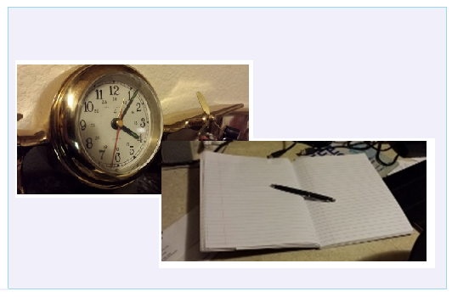
Editor’s Corner

Slide 17
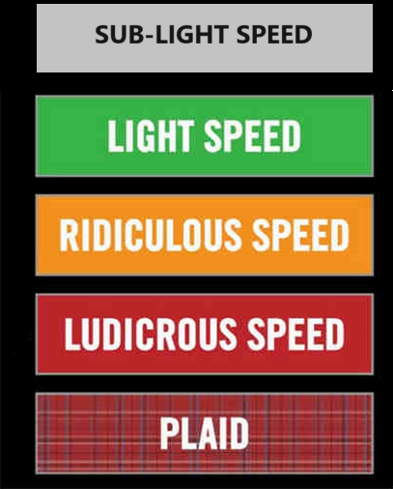
Comment resolution

Slide 18
Consolidated Comments
15-24-0371
https://mentor.ieee.org/802.15/dcn/24/15-24-0371-33-04ab-consolidated-comments-draft-1-0.xlsm

Slide 19
Comment Resolution Guidelines
Helpful things to know

Slide 20
Accepted and Revised
Accepted means the commenter provides a change resolution accepted by the group EXACTLY as proposed
There is NO RESOLUTION DETAIL when resolution is accepted.
Exception: MEC comment “draft meets all editorial requirements” (no change specified, we accept this comment)
Revised means we agree in principle that a change is required and we have provide an alternate change
Resolution detail contains EXACTLY what change we are asking the TE to make to the draft

Slide 21
General Guidelines
Copy dependent disposition details, don’t cross-reference
add “(same comment disposition detail as comment i-1234)”
Copy textual disposition details, don’t reference submissions, EXCEPT:
if the disposition detail contains something that cannot be easily and unambiguously represented in plain text, (e.g., graphics or extensive markup edits)
References to comment disposition details in external documents should be public URLs

Slide 22
Rejecting a comment correctly
Reasons to reject (only valid reasons): Rejected is used [only] when one or more of these applies:
The CRG disagrees with the technical change proposed
The proposed change in the comment does not contain sufficient detail
The comment is stale (no new information)
The commenter has indicated to the CRG chair that they wish to withdraw the comment
The comment is out of scope: Valid only for recirculation or when the comment is on material not part of the standard being balloted (explain which)
OK for SA ballot, to be avoided in 802.15 WG ballots
The comment includes an attachment that does not meet the criteria indicated by myProject ;
The CRG cannot address as a single issue;
Does not relate to a specific line, paragraph, figure, or equation in the balloted draft.
To be used only in dire, unresolvable deadlock
The CRG cannot come to a consensus to make changes necessary to address the comment.
CRG documenting that it failed at it’s primary responsibility to reach consensus

Slide 23
Rejecting a comment correctly: Detail
The disposition detail field should explain why the comment is being rejected using one or more of these reasons:
An (technical) explanation of why the CRG disagrees with the comment;
a statement that the comment is out of scope, and the rationale;
a statement that the proposed change in the comment does not contain sufficient detail so that the CRG can understand the specific changes that are being proposed;
a statement that the proposed change is already included in another part of the standard and not needed here.
a statement that the proposed wording change does not improve the technical clarity or accuracy of the text in the consideration of theCRG, e.g., "change happy to glad";
a statement that the CRG could not reach consensus on the changes necessary to address the comment;
a statement that the CRG has previously considered the comment (or a substantively similar comment), along with identification (by reference or copy) of the original comment and its disposition detail and status;
A statement that the commenter has withdrawn the comment.
For editorial comments: "The CRG refers this change to IEEE SA Editorial staff for consideration during preparation for publication.”

Slide 24
Why it matters
REVCOM may NOT approve the draft if comment resolution is not documented properly
At best it delays completion of the amendment
REVCOM is more likely to approve when we have followed the published guidelines from REVCOM

Slide 25
Recess
November 2024 802 Wireless Plenary

Slide 26
Resume from Recess
Task Group 15.4ab Next Generation UWB Amendment
November 2024 802 Wireless Plenary

Slide 27
Participants have a duty to inform the IEEE
Ways to inform IEEE
Cause an LOA to be submitted to the IEEE SA (patcom@ieee.org); or
Provide the chair of this group with the identity of the holder(s) of any and all such claims as soon as possible; or
Speak up now and respond to this Call for Potentially Essential Patents
If anyone in this meeting is personally aware of the holder of any patent claims that are potentially essential to implementation of the proposed standard(s) under consideration by this group and that are not already the subject of an Accepted Letter of Assurance, please respond at this time by providing relevant information to the WG Chair
Participants shall inform the IEEE (or cause the IEEE to be informed) of the identity of each holder of any potential Essential Patent Claims of which they are personally aware if the claims are owned or controlled by the participant or the entity the participant is from, employed by, or otherwise represents
Participants should inform the IEEE (or cause the IEEE to be informed) of the identity of any other holders of potential Essential Patent Claims
Early identification of holders of potential Essential Patent Claims is encouraged

Slide 28
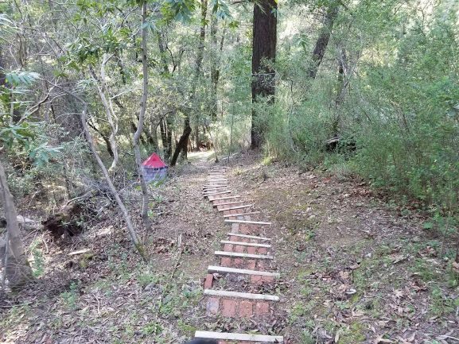
Next Steps

Slide 29
Forming a CRG
Comment Resolution Group (CRG)
Created by motion in the WG and authorized to initiate recirculation ballot(s) without WG motion.
During an interim or plenary session, the task group is the CRG
Why form an CRG now?
So we can initiate a recirculation before the January 2025 interim commences
Who should be the CRG
It must represent a diversity of affiliations: no single affiliation shared by 25% or more of the CRG.
Must be a voting member of WG15
Must be able to attend interim virtual meetings between close of November session ands start of January session (CRG action requires quorum)

Slide 30
Forming a CRG
Difference between TG and CRG between sessions
Everyone in the TG who attends meetings can contribute to comment resolutions
Approval of comment resolutions will be done by motion of all WG voters present just as we do in session
Motion to initiate recirculation is of CRG members
Volunteers to be on the CRG
Primary responsibility is to show up!
Meet the affiliation balance requirement
Need at least 4 people (to meet affiliation diversity)
No defined limit but…largest in WG15 history was about 17 people
6 to 12 is a good number

Slide 31
Propose: Same CRG makeup as in November
Name | Affiliation
Ben Rolfe (Chair) | BCA
Billy Verso | Qorvo
Clint Chaplin | Samsung
Riku Pirhonen | NXP
Mickael Maman | ST Microelectronics
Rojan Chitrakar | Huawei
Alex Krebs | Apple
Pooria Pakrooh | Qualcomm
Carlos Aldana | Meta
Li-Hsiang Sun | MediaTek
CRG Motion: move to request the working group form a comment resolution group with the following members:
Moved by: Second:
Result:

Slide 32
Any Other Business

Slide 33
Adjourned

