Slide 1
IEEE 802 Wireless Interim
802.15 WNG Tech Focus Info Package
Jan 15, 2025
Held in Kobe & Hybrid via Webex

Slide 2
General Administrative
The following WG15 Leadership will be heavily involved in running the event onsite Tues./Wed.:
Phil Beecher (802.15 WG 1st Vice Chair) pbeecher@ieee.org
Ann Krieger (802.15 WG 2nd Vice Chair) annkrieger.dod@gmail.com
Thomas Kuerner (Chair WG15 SC on Terahertz Comms.) t.kuerner@tu-braunschweig.de
Iwao Hosako (WG15 SC Terahertz Vice Chair and local industry contact) hosako@nict.go.jp
Ben Rolfe (WNG Chair) ben@blindcreek.com
Clint Powell (802.15 WG Chair - remote) cpowell@ieee.org
and will be coordinating closely with:
Jon Rosdahl (802 WCSC Treasurer and Events Planning) ben@blindcreek.com
Sara Archer (Mtg. Events) sara@mtgevents.com.au
Daniel Branik (Mtg. Events) daniel@mtgevents.com.au

Slide 3
Guest Fee Waivers & Demo Associated Costs
Guest Registration Fees for Wed. 1/15
Fees for AM & PM Breaks, and Lunch are expected to be waived by the 802 WCSC on it’s 12/18 call.
Demo Associated Costs
Cost for space and electricity for demo/display booths are expected to be waived by the 802 WCSC on it’s 12/18 call.
A budget limit of $2500 USD is being set

Slide 4
Tues./Wed. Timeline w.r.t. WNG & Demos
Tues.
Afternoon Demo packages arrive and are stored in provided area
Wed.
8-8:30am WG15 midweek CAC (No Guests Permitted)
8:30-9am Guests Meet & Greet w/802 Leadership (All Guests Permitted) All presenter/demo assistants meet and greet with WG15 and Terahertz SC leadership, available WCSC leadership and 802 Chair James Gilb
9-10am WG15 Midweek plenary (No Guests Permitted)
9am-12pm Demo Set Up (All Guests Permitted)
10-10:30am Normal AM break (All Guests Permitted)
10:30am-12:30pm WG15 WNG Tech Focus Presentations (Guest Presenters Only)
Wed. - From below onwards both presenters and demo assistant guests may participate:
~12-4pm Demos (All Guests Permitted) Tech Demos on 4th floor immediately starting a conclusion of WNG
12-1:30pm Lunch (All Guests Permitted) Regular lunch (with reserved tables for the invited guests and WG15 leadership if possible)
3:30-4pm Normal PM break (All Guests Permitted)
4-5pm Demo Tear Down and Pack (All Guests Permitted)

Slide 5
Invited Guests
802.15 WNG THz Presentations
THz Presentation 1 – “Current Status of 3e Device”
Mr. Keitarou Kondou (NICT)
THz Presentation 2 – “Progress of 3d; Results of the ThoR Project”
Dr. Tetsuya Kawanishi (Waseda Univ.)
THz Presentation 3 – “Progress of 3d; New Use Case”
Dr. Yozo Shoji (NICT)

Slide 6
Invited Guests
802.15 WNG THz Demo Assistants
THz Demo 1 – “THz wave (3d) + MMW (3e) hybrid …”
Dr. Shinsuke Hara (NICT)
Dr. Keizo Inagaki (NICT)
THz Demo 2 – “New Use Case…”
Dr. Nguyen Duc Phuc (NICT)
Mr. Aire Suzuki (NICT)
THz Demo 3 – “Uncompressed 4K transmission at 300GHz”
Dr. Isao Morohashi (NICT)
Dr. Tadashi Kishimoto (NICT)

Slide 7
IEEE Non-endorsement Disclaimer/Logo Policy
Presenters/demo assistants must conceal/prevent as much as possible any trademarks or brand names and have the non-endorsement disclaimer in their presentation and on display in their demo.
Presentations are due to the WG15 Leadership listed on Slide 2 by COB on Fri. 1/3, to allow ample time to review for any adjustments needed w.r.t. the above policy.

Slide 8
Non-endorsement Disclaimer Statement Instructions (see next slide for Disclaimer statement)
To be inserted after introduction slide(s) -
&
- To be included on the demo display board -

Slide 9
DISCLAIMER
The use of any particular/specific brands of components, equipment, or instruments as a part of the demonstration and presentation does not constitute an endorsement of those brands by IEEE, IEEE SA, or the IEEE LMSC.

Slide 10
Demo Storage Requirements
The three THz demos together would take up about 5 square meters if boxes are layed out flat, less if they are stacked.
THz Demo 1
- THz wave (3d) + MMW (3e) hybrid wireless communication system
Cardboard: 4 boxes
Box size W320 x D435 x H320 (size 120)
Total: 4 boxes
Storage space - 1 square meter
THz Demo 2
- New Use Case (3e, in future, it will be 3d)
Container (box): 1 (OD mm: 530 x 366 x 336)
Robot car (in hard case) (Outer diameter: about the same as above)
Approx. 40' display: (Approx. 1200 x 800 x 200 when packed)
Total: 3 pieces
Storage space - 2 square meters
THz Demo 3
- Uncompressed 4K transmission at 300GHz
Pelican case 1: W80cm x D60cm x H44cm
Pelican case 2: W80cm x D58cm x H49cm
Pelican case 3: W121cm x D43cm x H24cm
Cardboard: W63cm x D55cm x H28cm
Total: 4 pieces
Storage space - 2 square meters

Slide 11
Demo Display Booth

Slide 12
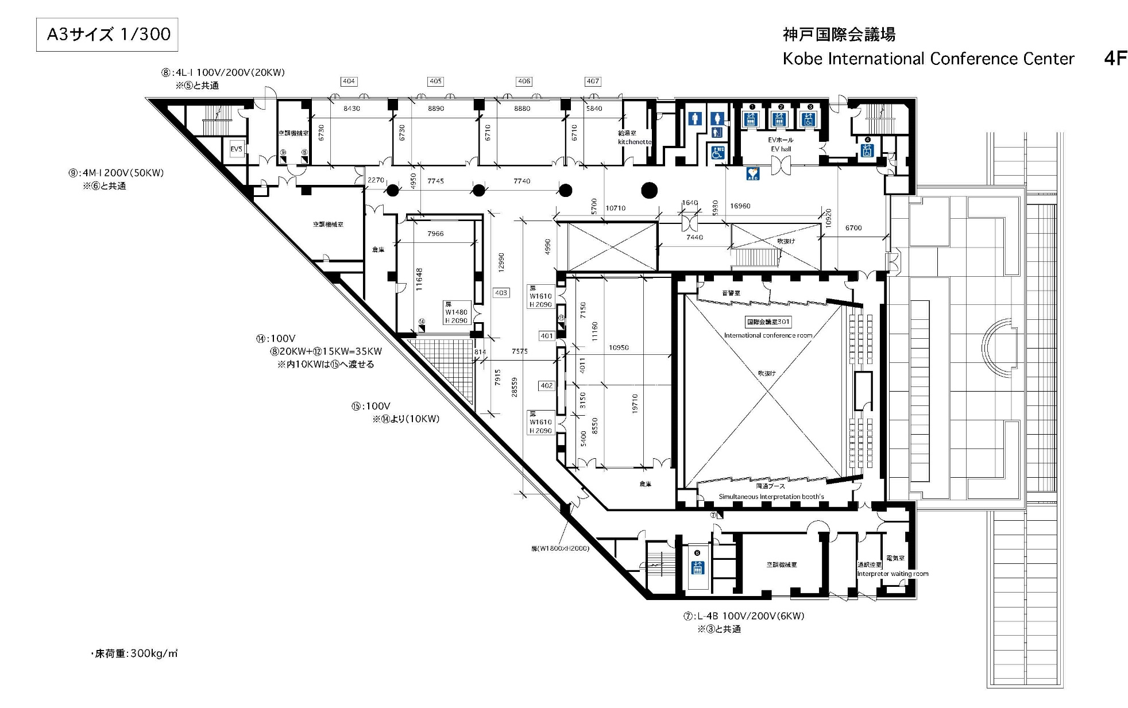
Floor Plan of Demos - on 4th Floor
Demo/Display Booths

Slide 13
802.15 WNG Tech Focus Agenda
WNG Open Ben Rolfe (BlindCreek Associates) 1min
802 Chair Welcome James Gilb (GA-ASI) 1min
WG15 Overview and Agenda Phil Beecher (Wi-SUN Alliance) 4min
THz Intro Thomas Kuerner (TUB) / Iwao Hosako (NICT) 10min
Current status of 3e device, Q&A Mr. Keitarou Kondou (NICT) 20min
Progress of 3d: Results of the ThoR Project, Q&A Prof./Dr. Tetsuya Kawanishi (Waseda Univ.) 20min
Progress of 3d: New Use Case, Q&A Dr. Yozo Shoji (NICT) 20min
THz Summary Thomas Kuerner (TUB) / Iwao Hosako (NICT) 5min
15.4 Intro Phil Beecher (Wi-SUN Alliance) 1min
Latest R&D Progress in Wireless Smart Utility Networks, Q&A Dr. Hiroshi Harada (Kyoto Univ.), Q&A 20min
15.4 Summary Phil Beecher (Wi-SUN Alliance) 5min
WNG Close Ben Rolfe (BlindCreek Associates) 1min
Demos immediately following WNG, until 4pm in common/break area on 4th floor

