Slide 1
IEEE 802.15 - Wireless Specialty Networks (WSNs)
A Continuously Evolving Family of Standards to Meet Future Wireless Specialty Network Needs
January 11th, 2025

Slide 2
Clint Powell
Chair - IEEE 802.15 Work Group on Wireless Specialty Networks (WSNs)
  cpowell@ieee.org
  Mobile/WhatsApp: 480 586-8457 Skype: clintonpowell
  Managing Director – Wireless IoT Standardization, PWC LLC
  IEEE 802.15 WG Chair & 802 LMSC Executive Committee
  IEEE 802.15 TG4ab (NG-UWB) - Vice Chair
  IEEE 802.15 TG14 (UWB-AHN) - Chair (acting)
  CSA IEEE 802.15.4 PHY/MAC Advisory Group - Chair
  CSA Aliro CSG Certification Policy & Procedure - Tiger Team Lead

Slide 3
Disclaimer
This presentation should be considered as the personal view of the presenter, not as a formal position, explanation, or interpretation of IEEE.
Per IEEE-SA Standards Board Bylaws
“At lectures, symposia, seminars, or educational courses, an individual presenting information on IEEE standards shall make it clear that his or her views should be considered the personal views of that individual rather than the formal position of IEEE.”

Slide 4
IEEE 802.15 WG on
Wireless Specialty Networks (WSNs)

Slide 5
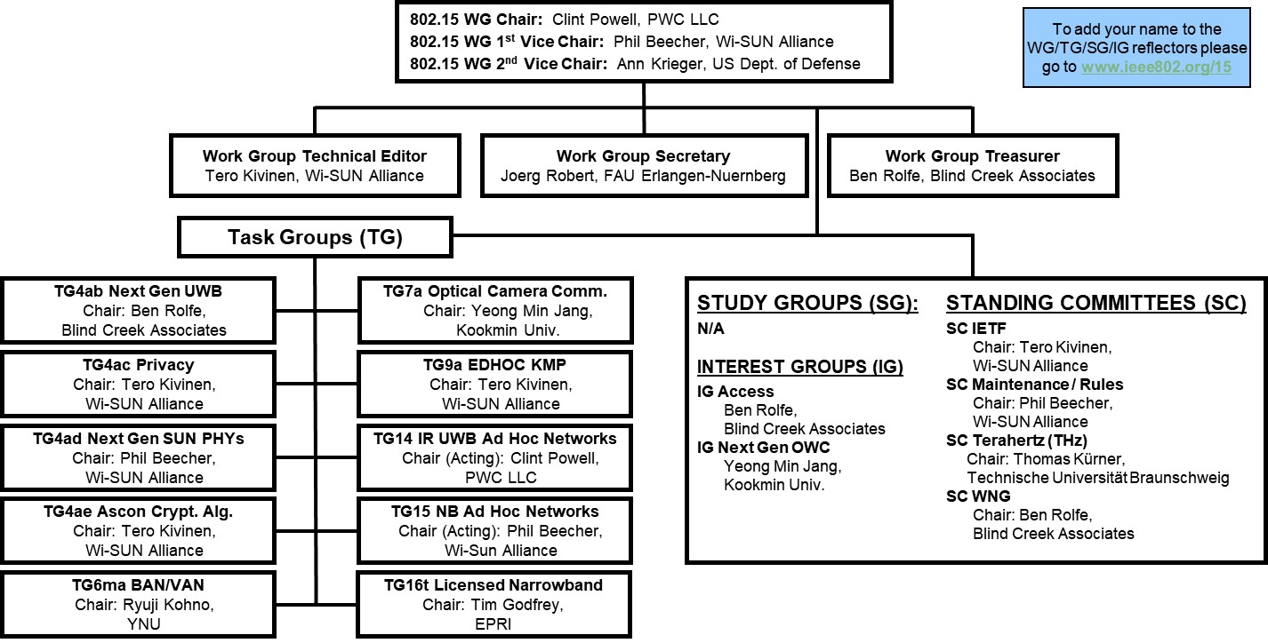
IEEE 802.15 WG Org Chart (of Active Projects) & Membership
802.15 WG Membership
Voting members: 115
Nearly voting members: 12
Aspirant voting members: 22

Slide 6
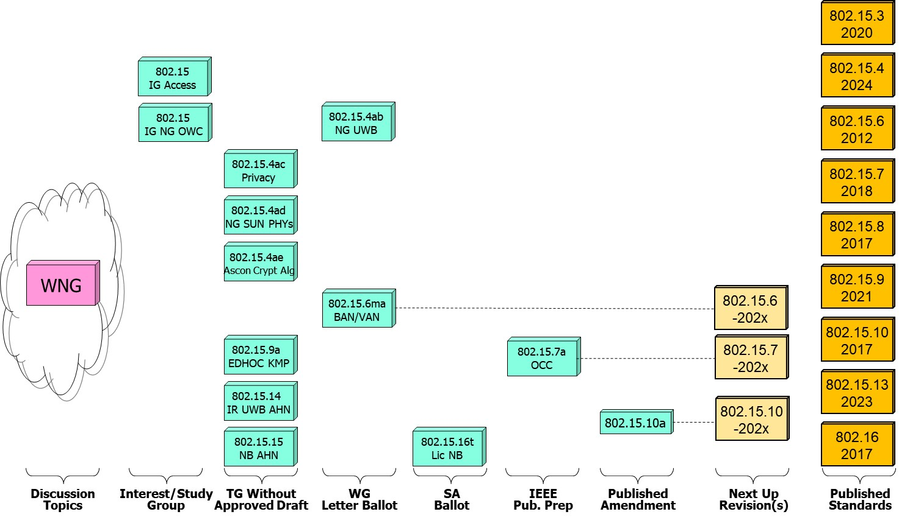
IEEE 802.15 Standards Projects Pipeline (a defined process)

Slide 7









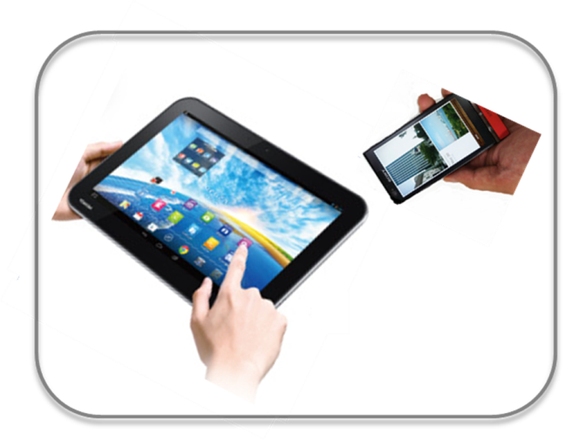
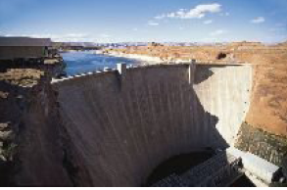





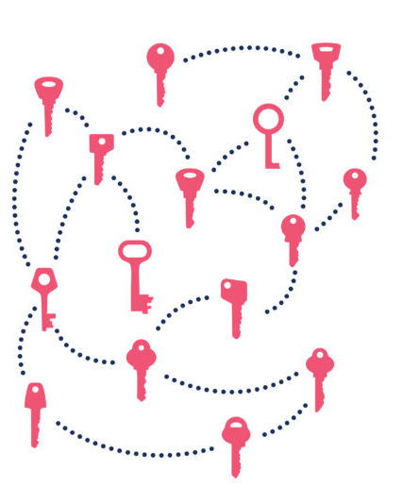
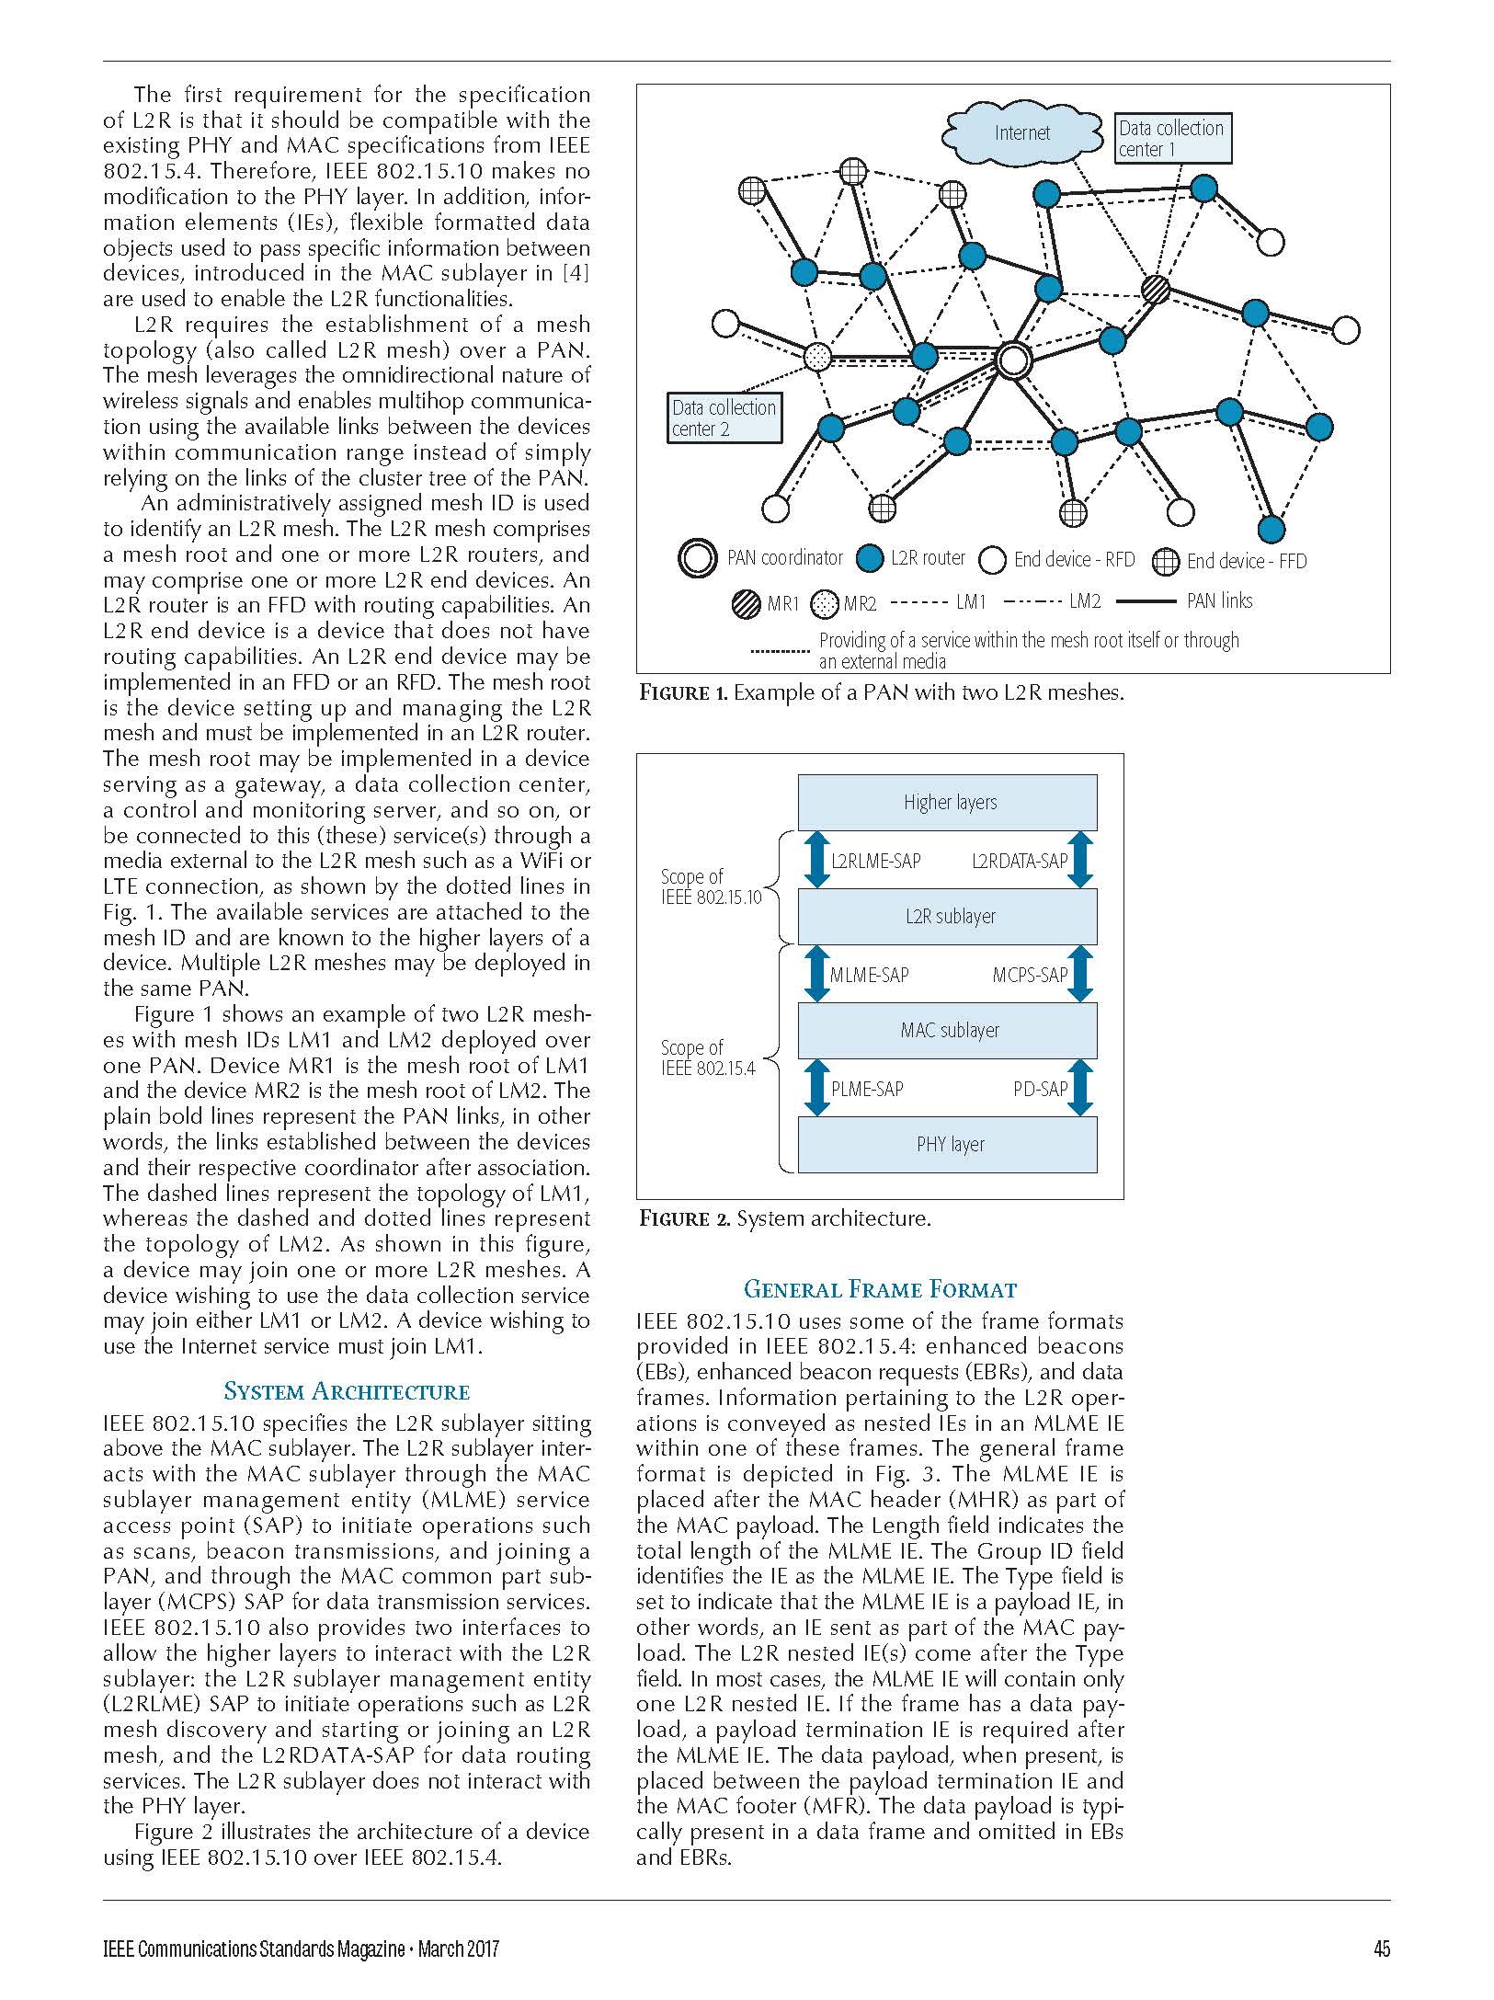

IEEE 802.15 Standards & their Applications
Locating and Tracking
Ultra-low Power Sensors
Automotive
802.15.16
802.15.4
FAN/MAN/RAN
Industrial Networks
Multi-media networks
&
High Speed
Interconnect
802.15.4
802.15.3
Structural Monitoring
802.15.7
802.15.13
802.15.6
Medical
802.15.9
802.15.10
Key
Management
Layer 2
Routing
Optical Communications
Agricultural Monitoring
Consumer Devices

Slide 8
802.15 Kobe Agenda

Slide 9
802.15 WNG Tech Focus Agenda (Wed., 1/15, 10:30am-12:30pm)
WNG Open Ben Rolfe (BlindCreek Associates) 1min
802 Chair Welcome James Gilb (GA-ASI) 1min
WG15 Overview and Agenda Phil Beecher (Wi-SUN Alliance) 4min
THz Intro Thomas Kuerner (TUB) / Iwao Hosako (NICT) 10min
  Current status of 3e device, Q&A
  Mr. Keitarou Kondou (NICT) 20min
  Progress of 3d: Results of the ThoR Project, Q&A
  Prof./Dr. Tetsuya Kawanishi (Waseda Univ.) 20min
  Progress of 3d: New Use Case, Q&A
  Dr. Yozo Shoji (NICT) 20min
  THz Summary Thomas Kuerner (TUB) / Iwao Hosako (NICT) 5min
15.4 Intro Phil Beecher (Wi-SUN Alliance) 1min
  Latest R&D Progress in Wireless Smart Utility Networks, Q&A
  Dr. Hiroshi Harada (Kyoto Univ.), Q&A 20min
  15.4 Summary Phil Beecher (Wi-SUN Alliance) 5min
WNG Close Ben Rolfe (BlindCreek Associates) 1min
Demos immediately following WNG, until 4pm in common/break area on 4th floor

Slide 10
IEEE 802.15 Standards

Slide 11
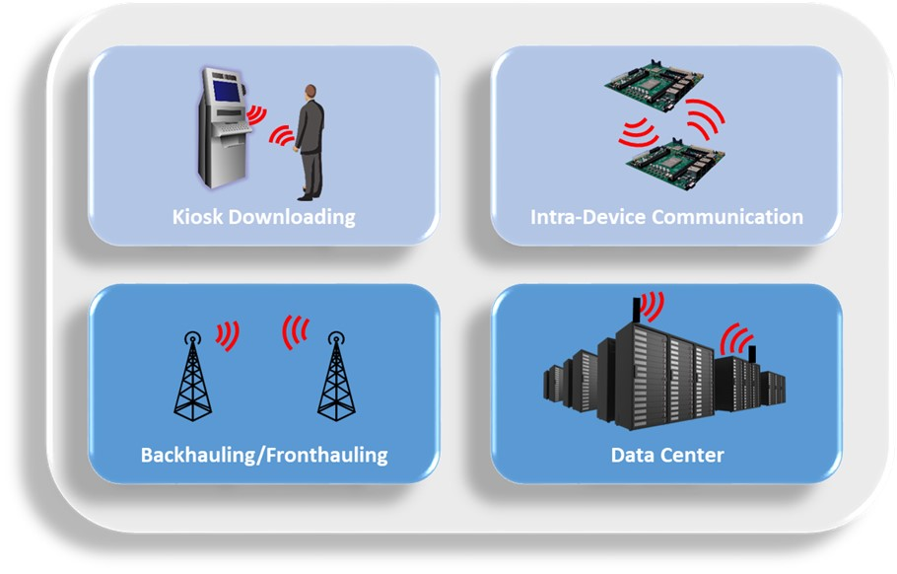
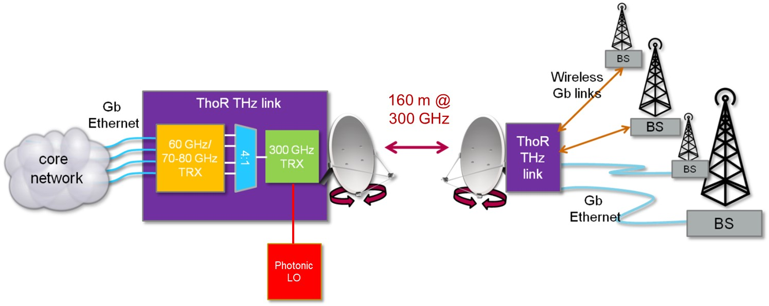
802.15.3 - Standard for high-speed interconnect and multi-media networks
Point-to-Point Applications
ThoR Project: Demonstrating the Capability of 300 GHz Backhaul/ Fronthaul links
Super High Speed/Massive Multimedia Download targeted for the 2020 Olympics in Japan
IEEE 802.15 TG3mb - Goals
  Rolling up the amendments to 802.15.3 published since IEEE Std 802.15.3‐2016
  Address errors, corrections, omissions
  Address both general and specific issues

Slide 12
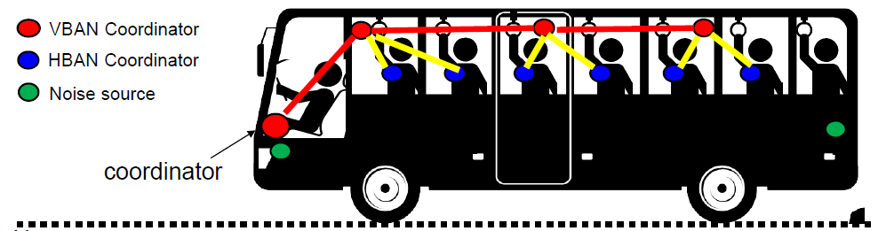
802.15.6 - Standard for body area networks
IEEE 802.15 TG6ma - Goals
Revision to 802.15.6 Standard adding following functionality
  Capabilities to cover overlapping body area networks (BANs) and vehicle area networks (VANs)

Slide 13
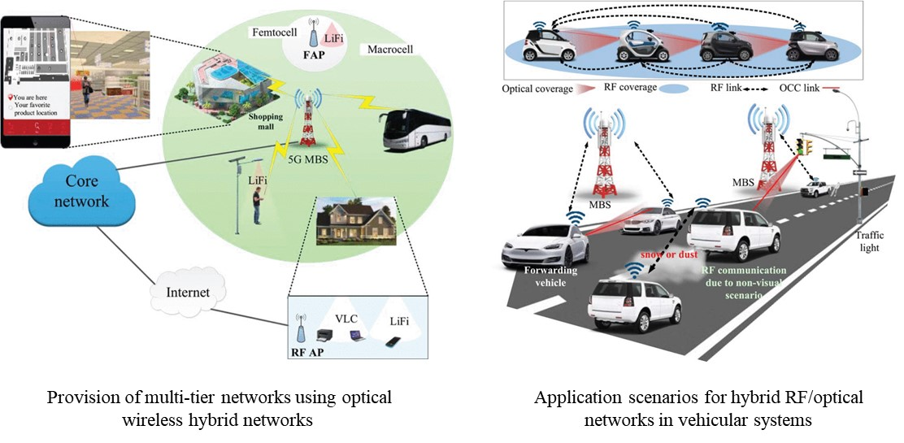
802.15.7 - Standard for optical camera communications
IEEE 802.15 TG7a - Goals
Amendment to 802.15.7 Standard adding following functionality
  AI based OCC
  Data rate: 100Mbit/s
  Mobility support: 350km/h
  Communication Distance: 200m

Slide 14
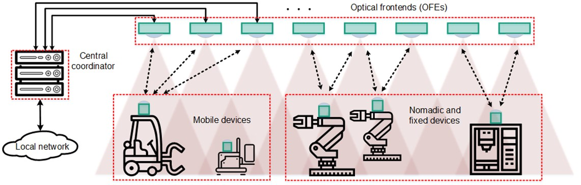
802.15.13 - Standard for multi-Gigabit optical communications
Example ceiling-mounted cellular light network application
  Small cells, high density, many parallel streams, improved security
  Offloading for radio networks
IEEE 802.15 TG13 - Goals
Define OWC specifications to enable high data rate transfer among end points with up to multi-Gigabit throughput and ranges up to 200 m unrestricted line of site targeting support for ceiling-mounted infrastructure serving stationary and mobile devices as well as point-to-point links

Slide 15
802.15.16 - Standard for licensed narrowband communications
IEEE 802.15 TG16t - Goals
Specify new PHY in licensed spectrum with channel bandwidths greater than or equal to 5 kHz and less than 100 kHz focusing on spectrum less than 2 GHz (this is an amendment to 802.16 (MAN), a.k.a. WiMAX)

Slide 16

802.15.4 Standard
A foundation for many diverse uses
Vast flexibility and adaptability for applications such as:
    Home Energy management
        Moderate data rates
        Low latency
        Small mesh networks
    Field area network support
        Need for low to moderate data rates (1kbit/sec to 2.4 Mbit/sec)
        Networks may be very large with mesh topologies scaling to thousands of nodes with multiple border routers
    UWB for precision location and communication
        Peer to peer ranging: one to a few with no infrastructure gateways or need for infrastructure (fixed) devices
        Infrastructure based (TDOA): Network of fixed anchors and mobile tags (phones or other devices)
        850 kbit/sec to ~50 Mbit/sec
        May combine ranging with data delivery

Slide 17
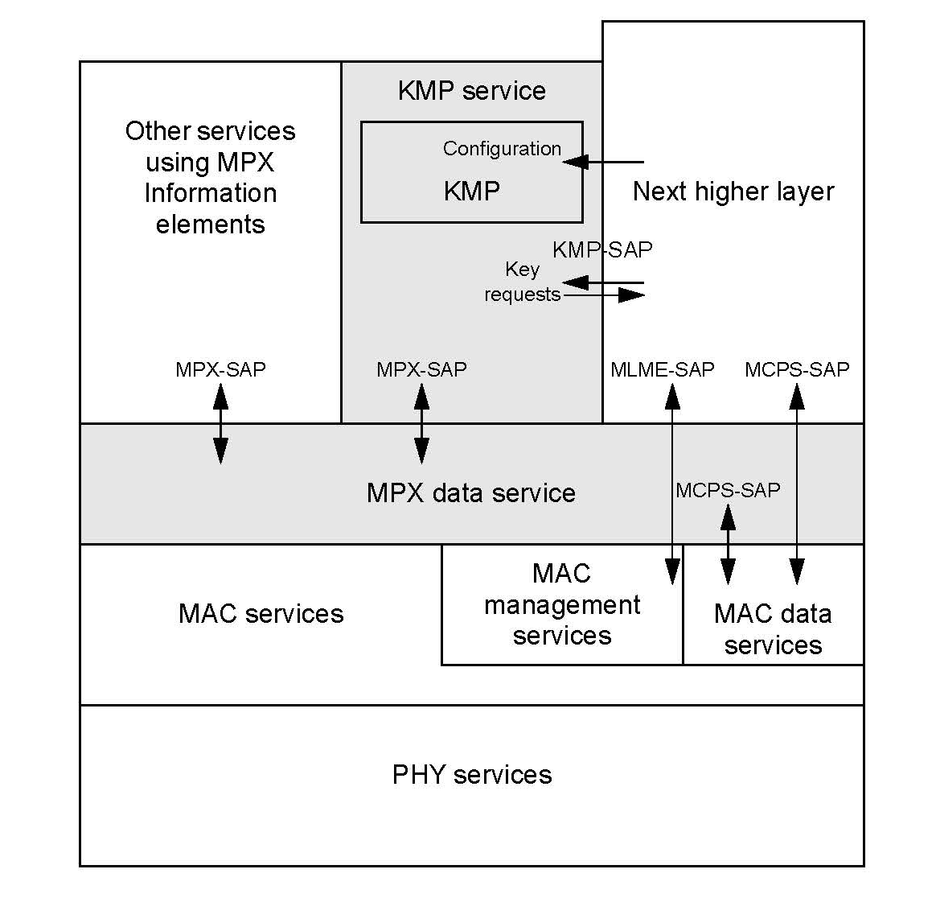
802.15.4 - Supporting Standards
802.15.9 - Standard for Transport of Key Management Protocol (KMP) Datagrams
The key transport mechanism sits between the MAC services and higher layers.
802.15.10 - Recommended Practice for Routing Packets in IEEE 802.15.4 Dynamically Changing Wireless Networks
L2R System Architecture
PAN with two L2R meshes

Slide 18
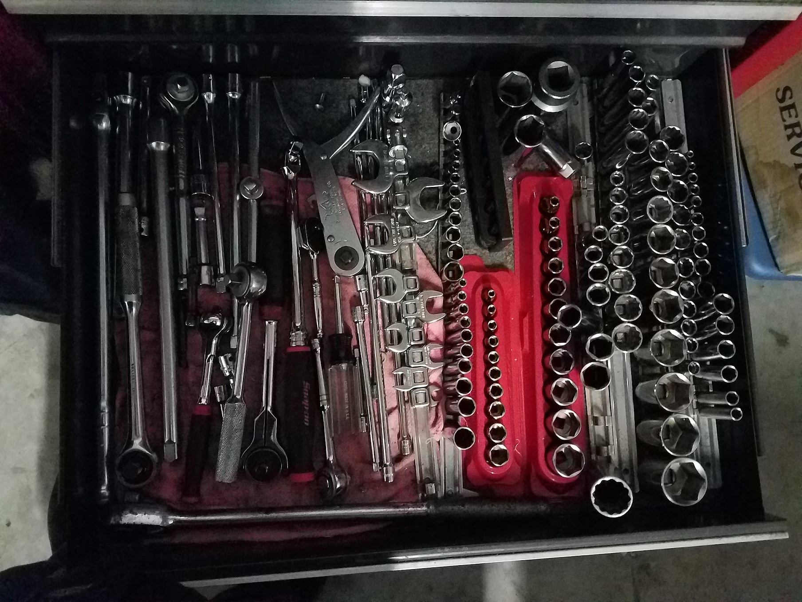
802.15.4 - Standard for Ad-Hoc networks
Is a well-equipped toolbox
A rich set of parts to assemble many different networks
  Multiple PHYs and a flexible, adaptable MAC
    Different option sets for with different application focuses
    Simple MAC features for directed and broadcast frame exchange
    Foundation for MAC layer security
    Flexible frame formats (containers)
    Multiple channel access schemes
        Random access with listen before talk (CSMA-CA)
        Random access via Aloha
        Time-based access (multiple schemes)
    Many options to support various needs
        Low power operation
        High precision ranging
        Control oriented communications

Slide 19
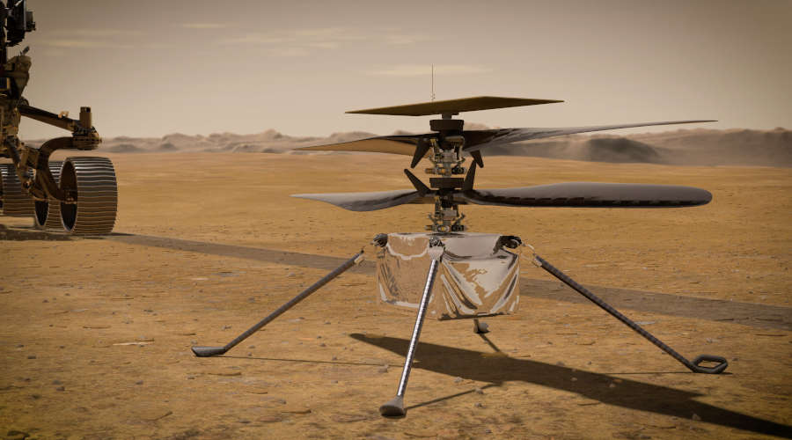
802.15.4 - Ad-Hoc Networks
Support many network topologies and applications
An Ad-Hoc network can be many things
    Network Scale - from a few devices to many thousands
    May not be infrastructure based
    May be formed without a single control point
    Supports peer-to-peer communication
        May support single hop peer-wise communication
        (e.g. Phone to Phone)
        May support multi-hop peer to one or more peers (mesh)
    May be formed dynamically and change rapidly
    May be relatively static once formed
  There are many different scales and types of
  Ad-Hoc network and many uses
        … including RC Helicopter control on Mars

Slide 20
802.15.4 Standard - NB & UWB at the Next Level
Large Consortium Adoption
802.15.4 PHY and MAC components are used as the underlying communications technology by many industry consortia including:
CCC
CSA
ETSI TG28
ETSI TG34
FiRa
IEEE 1901.1+2
IETF: 6lo
IETF: 6tisch
IETF: Roll
ISA100
ISO/IEC JTC1/ SC31/WG4
JUTA
Omlox
Thread Group
TIA TR-51
UWB Alliance
WIA
Wi-SUN Alliance

Slide 21

Growth of 802.15.4 NB Ad-Hoc Networks
Hundreds of Millions (to Billions) of Deployed 802.15.4 NB Devices
Field Area Networks for Smart Energy & Smart Cities
Home Energy Management
Industrial Controls
Consumer Entertainment
Smart Home Control
Wireless Gaming Controls
Smart Agriculture

Slide 22
802.15.4 UWB Ad-Hoc Networks
Industry Adoption
Support for multiple industries
    Manufacturing
        Locating and Tracking assets and people
    Automotive
        Secure entry
        Occupancy detection (“no child left behind”)
    Security, Public Safety, and Convenience
        Secure entry
        Presence detection
        Personnel location and tracking
    Healthcare
        Locating patients, personnel and equipment
        Contact tracing (infectious disease control)
    Consumer
        Locating and finding things
        Enhancing Virtual Reality and Augmented Reality
        Secure access to vehicles & buildings from your phone
Explosive Growth of 802.15.4 UWB continues

Slide 23
Future Projects
Endless Possibilities
  Applications of AI/LLM in Wireless Specialty Networks?
    Environment aware adaptive protocols (PHY and MAC)
  Integration of Security, Cryptography with PHY and MAC?
    Identification/Determination of Intent for Secure Access
  Other Ideas from Current and Future Participants like You

Slide 24
Final Remarks
IEEE 802.15 covers a wide breadth and depth of wireless technologies that are implemented in products that you may not even realize are using 802.15.
And remember,
      “… if it’s not Wi-Fi or Cellular it’s probably 802.15”

Slide 25
ADDITIONAL RESOURCES
IEEE 802.15 (WSN) WG - Homepage
https://ieee802.org/15

