Slide 1

IEEE 802.15 Work Group on
Wireless Specialty Networks (WSNs)
Kobe 802.15 WNG Technology Focus
Jan 15, 2025
Held in Kobe & Hybrid via Webex

Slide 2
802.15 WNG Tech Focus Agenda
WNG Open Ben Rolfe (BlindCreek Associates) 1min
802 Chair Welcome James Gilb (GA-ASI) 1min
WG15 Overview and Agenda Phil Beecher (Wi-SUN Alliance) 4min
THz Intro Thomas Kuerner (TUB) / Iwao Hosako (NICT) 10min
  Current status of 3e device, Q&A
  Mr. Keitarou Kondou (NICT) 20min
  Progress of 3d: Results of the ThoR Project, Q&A
  Prof./Dr. Tetsuya Kawanishi (Waseda Univ.) 20min
  Progress of 3d: New Use Case, Q&A
  Dr. Yozo Shoji (NICT) 20min
  THz Summary Thomas Kuerner (TUB) / Iwao Hosako (NICT) 5min
15.4 Intro Phil Beecher (Wi-SUN Alliance) 1min
  Latest R&D Progress in Wireless Smart Utility Networks, Q&A
  Dr. Hiroshi Harada (Kyoto Univ.), Q&A 20min
  15.4 Summary Phil Beecher (Wi-SUN Alliance) 5min
WNG Close Ben Rolfe (BlindCreek Associates) 1min
Demos immediately following WNG, until 4pm in common/break area on 4th floor

Slide 3
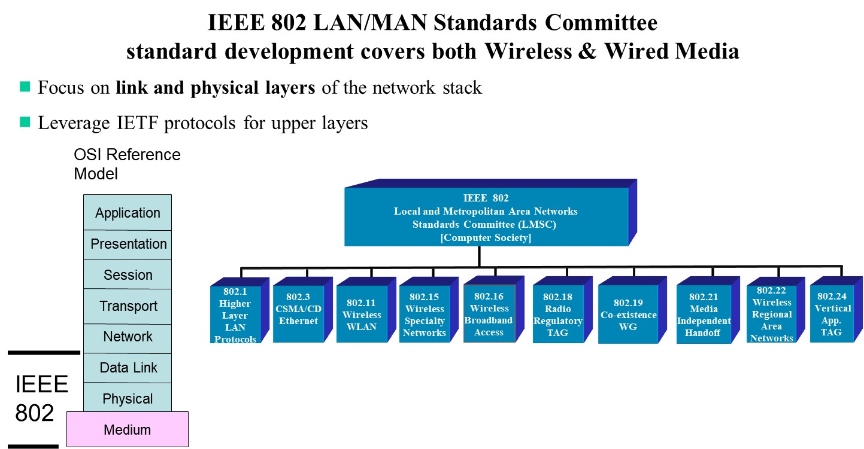
IEEE 802 LMSC

Slide 4
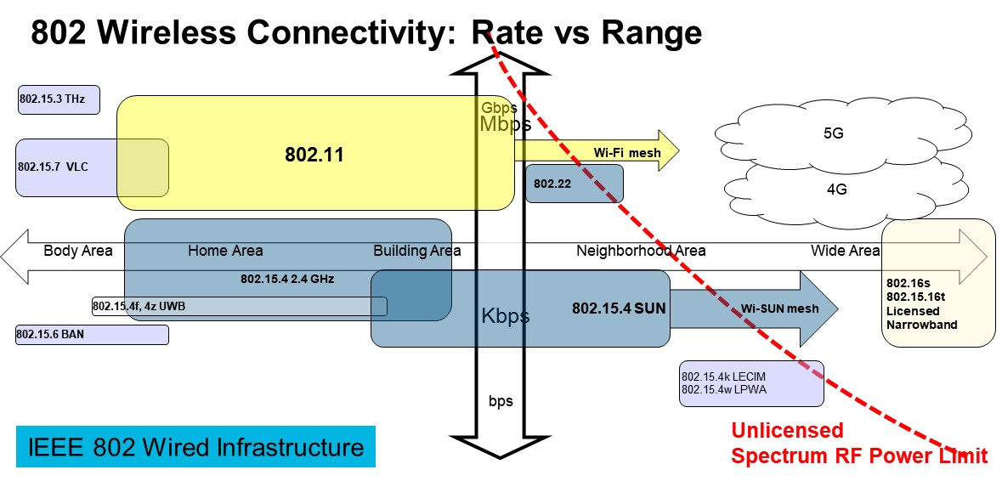
IEEE 802 Wireless Standards

Slide 5
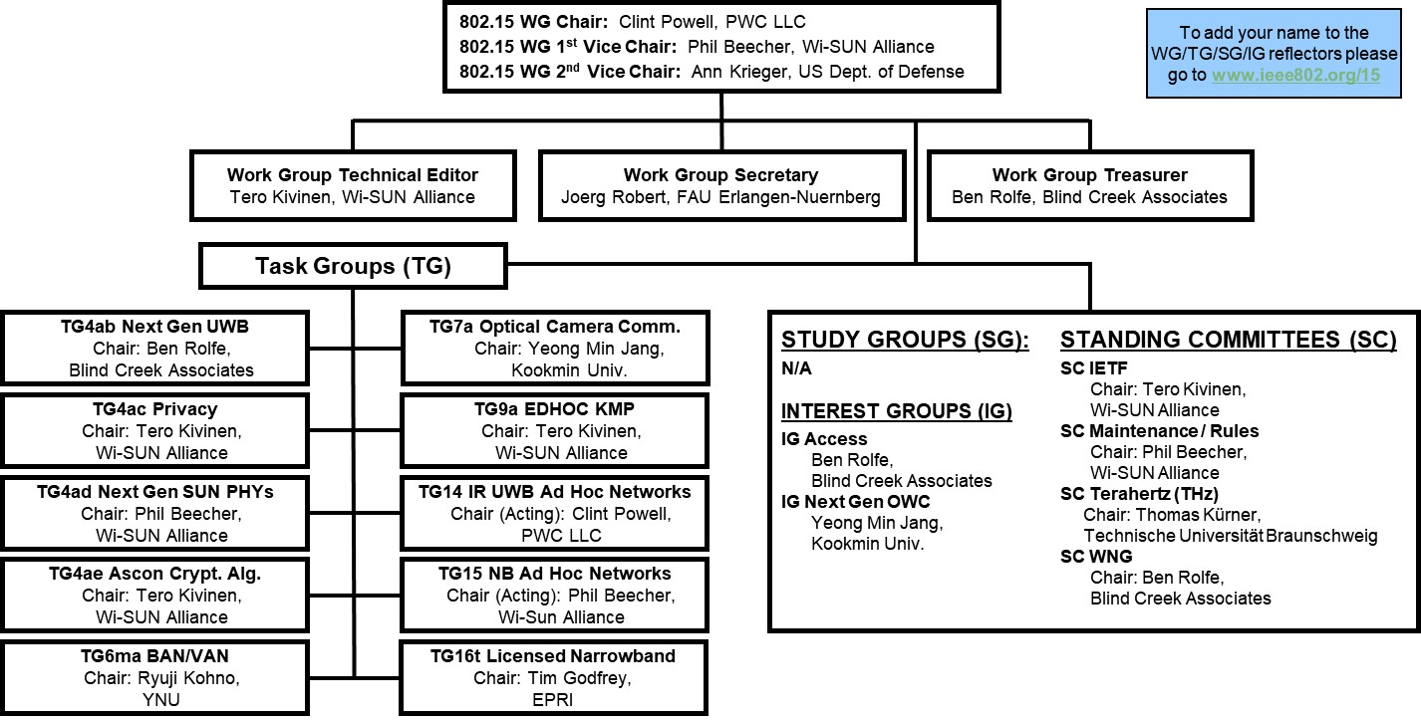
802.15 WG Org. Chart
802.15 WG Membership
Voting members: 115
Nearly voting members: 12
Aspirant voting members: 22

Slide 6
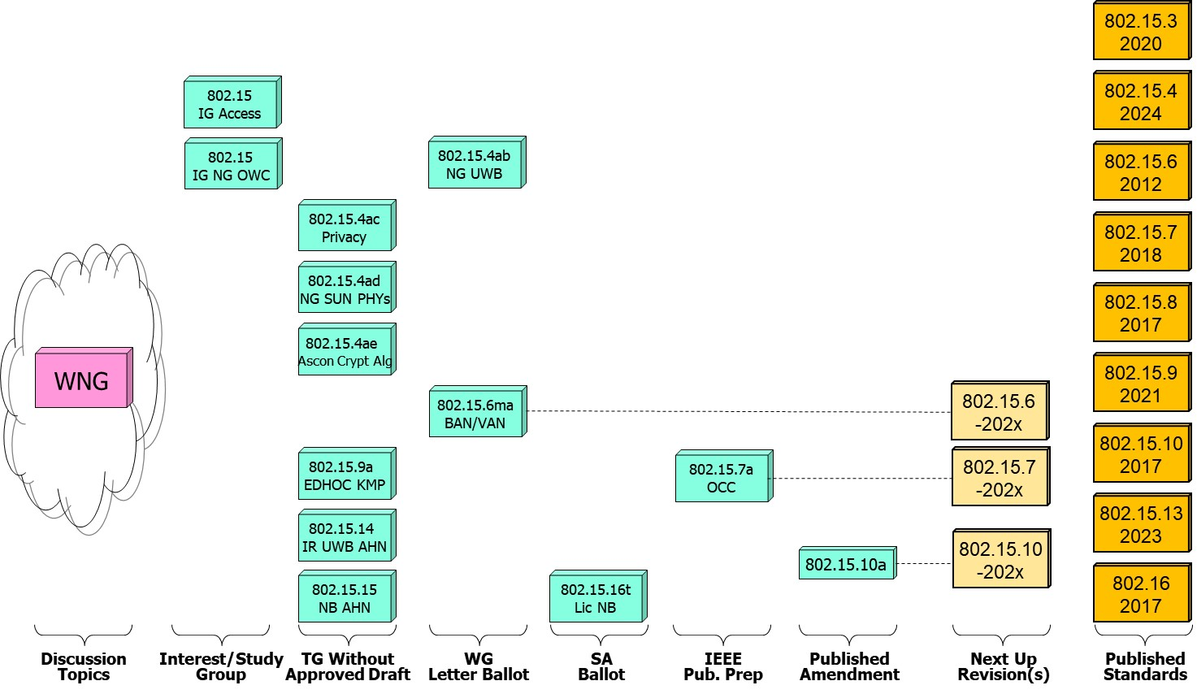
802.15 WG Standards Pipeline

Slide 7
802.15 Kobe Agenda

Slide 8
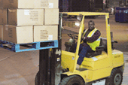
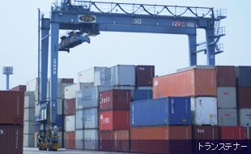

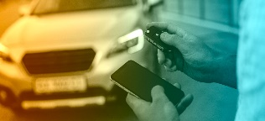





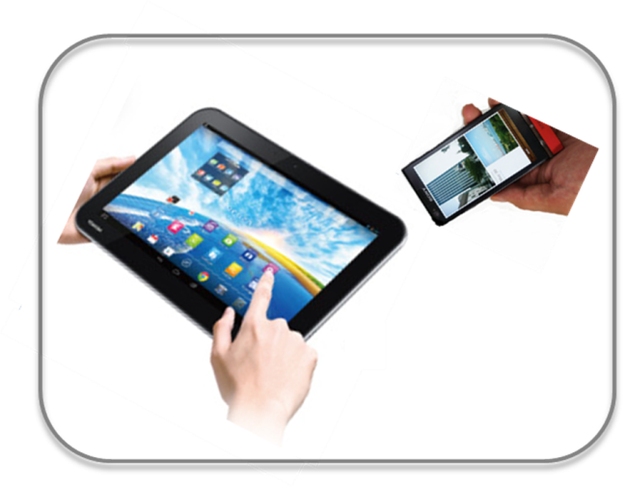






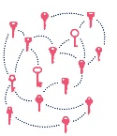
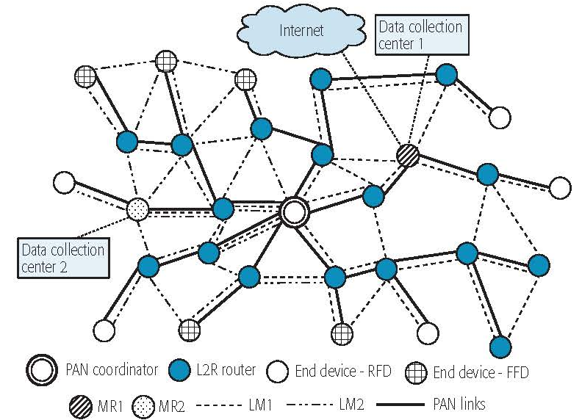

IEEE 802.15 Standards & their Applications
Locating and Tracking
Ultra-low Power Sensors
Automotive
802.15.16
802.15.4
FAN/MAN/RAN
Industrial Networks
Multi-media networks
&
High Speed
Interconnect
802.15.4
802.15.3
Structural Monitoring
802.15.7
802.15.13
802.15.6
Medical
802.15.9
802.15.10
Optical
Communications
Key
Management
Layer 2
Routing
Agricultural Monitoring
Consumer Devices
8

