Slide 1
Project: IEEE P802.15 Working Group for Wireless Specialty Networks (WSN)
Submission Title: TG4ab Closing Report
Submitted: 14 November 2024
Source: Benjamin A. Rolfe (Blind Creek Associates)
Contact:
Voice: [deprecated],
E-Mail: ben.rolfe @ ieee.org
Re: Task Group 4ab: 802.15.4 UWB Next Generation
Abstract: TG closing report for the 802 Plenary Session, November 2024
Purpose: Report on project progress and continue the illusion of organization
Notice: This document has been prepared to assist the IEEE P802.15. It is offered as a basis for discussion and is not binding on the contributing individual(s) or organization(s). The material in this document is subject to change in form and content after further study. The contributor(s) reserve(s) the right to add, amend or withdraw material contained herein.
Release: The contributor acknowledges and accepts that this contribution becomes the property of IEEE and may be made publicly available by P802.15.

Slide 2
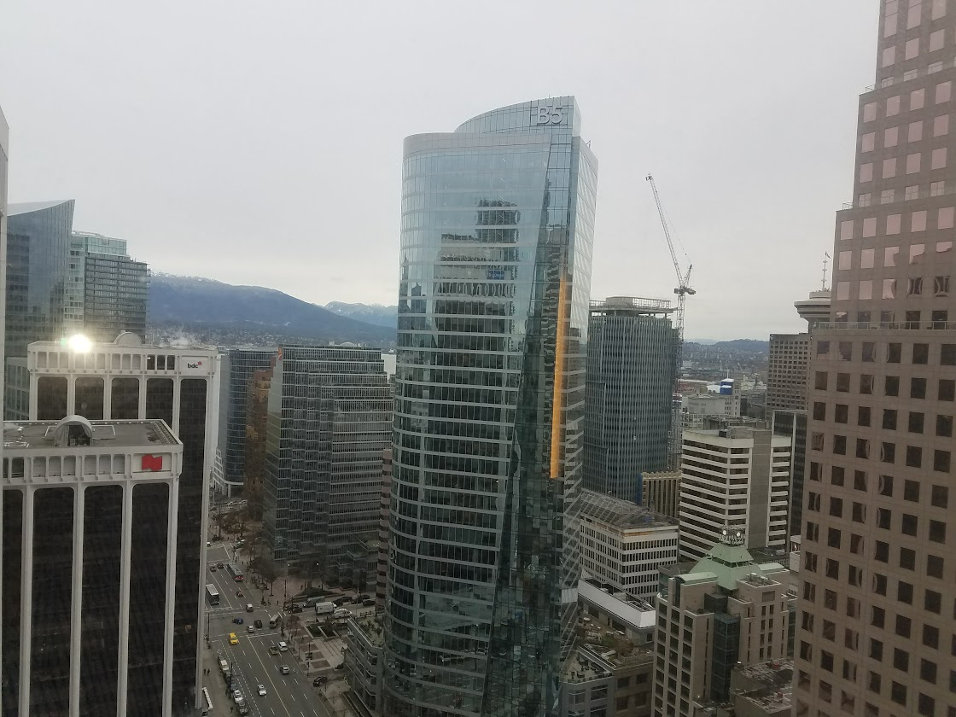
Task Group 15.4ab Next Generation UWB Amendment
November 2024 802 Plenary Session
Mixed Mode
Live from
Vancouver, BC, Canada

Slide 3
Session Objectives
Resolve comments
Resolve some more comments

Slide 4
Progres
864 technical comments total
Addressed 516 technical comments
140 technical during this session
348 technical comments left to address
89 we have proposed resolutions
259 awaiting proposed resolutions

Slide 5
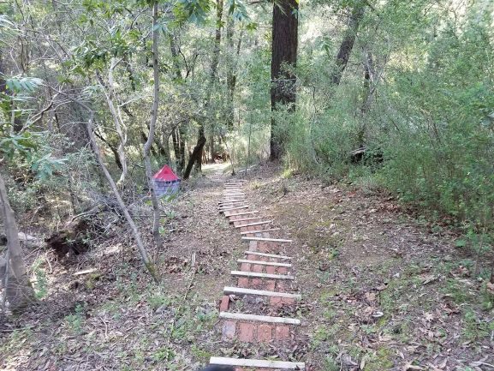
Next Steps

Slide 6
Near Term Working Milestones
 | Current Schedule
First letter ballot | June 2024
Initial LB comment resolution | Start: July 2024
First recirculation | Jan 2025
Recirculation comment resolution | Feb/March 2025
Second recirculation | March 2025
Recirculation comment resolution | March/April 2025
First SA-Ballot | May 2025
SA-Ballot comment resolution | Start July 2025
We are here

Slide 7
Forming a CRG: Volunteers
CRG Motion: move to request the working group form a comment resolution group with the following members:
Name | Affiliation
Ben Rolfe (Chair) | BCA
Billy Verso | Qorvo
Clint Chaplin | Samsung
Riku Pirhonen | NXP
Mickael Maman | ST Microelectronics
Rojan Chitrakar | Huawei
Alex Krebs | Apple
Pooria Pakrooh | Qualcomm
Carlos Aldana | Meta
Li-Hsiang Sun | MediaTek
Moved by: Clint Chaplin Second: Billy Verso
Passed by unanimous consent

Slide 8
Working Group Motion
See DVL

Slide 9
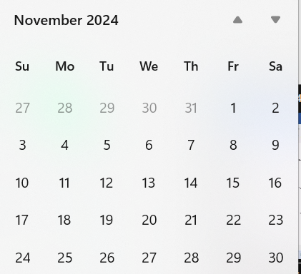
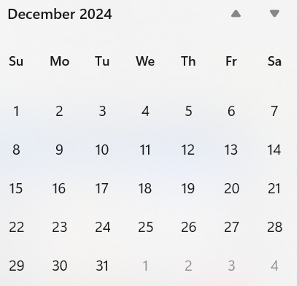
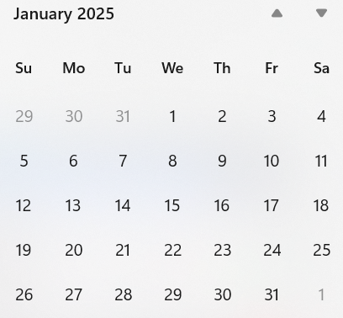
Call schedule, November thru January
Plenary
Interim
Commence on 26-November-2024 through January 7th
Weekly Tuesdays 06:00 PT (1 hour)
Thursdays 14:00 PT (1 hour)
Excludes November 28, December 24, 26, 31, January 2

Slide 10
Plan for January: Resolve comments!

Slide 11
Adjourned

