Slide 1
Project: IEEE P802.15 Working Group for Wireless Personal Area Networks (WPANs)
Submission Title : Long Range extension of the 802.15.4-2020 OFDM PHY
Date Submitted : March 10, 2025
Source : Thomas Almholt (Texas Instruments, Inc), Tomas Motos (Texas Instruments, Inc)
Re : TG4ad Next Generation SUN PHYs
Abstract : This contribution describes a new long range extension of the SUN 802.15.4 OFDM PHY with high degree of re-use of existing OFDM PHY.
Purpose: Long Range technology proposal
Notice: This document has been prepared to assist the IEEE P802.15.4ad It is offered as a basis for discussion and is not binding on the contributing individual(s) or organization(s). The material in this document is subject to change in form and content after further study. The contributor(s) reserve(s) the right to add, amend or withdraw material contained herein.
Release: The contributor acknowledges and accepts that this contribution becomes the property of IEEE and may be made publicly available by P802.15.
Slide 1
Notes:
Jul 12, 2010
Page 1

Slide 2
Submission Title : Long Range extension of the 802.15.4-2020 OFDM PHY
Date Submitted : Initial filing Feb 11, 2024, Revised March 10, 2025
Source : Thomas Almholt (Texas Instruments, Inc), Tomas Motos (Texas Instruments, Inc)
Re : TG4ad Next Generation SUN PHYs
Abstract : This contribution describes a new long range extension of the herein.
Release:
Slide 2
Notes:
Jul 12, 2010
Page 2

Slide 3
Agenda
SUN OFDM VLR as SC-FDMA extension from SUN OFDM
Packet Structure
Channel Access Mechanism (STF)
Interleaver
DBPSK Modulation Kernel
OFDM Windowing
LCG – Linear Congruential Generator
Channel Model Simulations
Network Capacity Simulations

Slide 4
SUN OFDM VLR as SC-FDMA
There are only three blocks that need to be modified in an OFDM modulator to account for a new scheme
  DSSS (Direct Sequence Spread Spreading) blocks takes information bits coming from the Interleaver and expands them into series of chips
  The Chips to Symbol is restricted to BPSK (Binary Phase Shift Keying), using a Differential Encoding
  Out of the N possible sub-carriers of OFDM only a single carrier is used

Slide 5
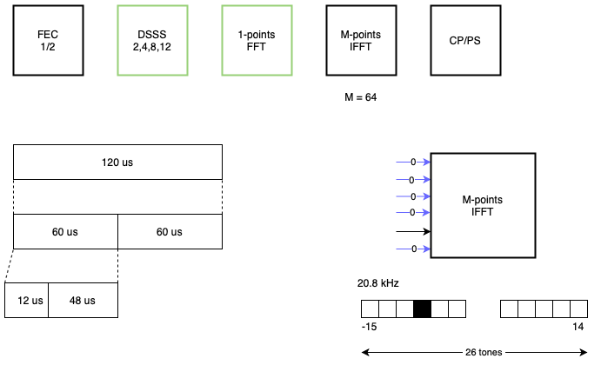
SUN OFDM VLR as SC-FDMA
  The use of DSSS creates additional redundancy to the transmitted information sequence to allow detection in lower SNR conditions (in the presence of more noise energy, or lower signal energy)
  The use of DBPSK (differential BPSK) to encode the binary information into symbols, on a pair-by-pair basis. Each of the OFDM symbols is sub divided into two sub-symbols transmitted on the same sub-carrier. This scheme allows a local view of the incoming symbols on the same sub-carrier. This scheme effectively removes the need for precise channel equalization.
  A single subcarrier is employed for each of the OFDM symbol. This effectively modifies OFDM into a system with N=1 and allows a Peak-to-Average-Power Ratio (PAPR) of around 1 dB
  Additional linear filtering across OFDM symbols reduces the Adjacent Channel Power (ACP) and simplifies upsampling of the baseband signal.
Notes:
Make good use of the ‘notes’ pane to complete the slide with comments and additional textual content. 3 – 4 sentences should be enough to describe any one slide.

Slide 6
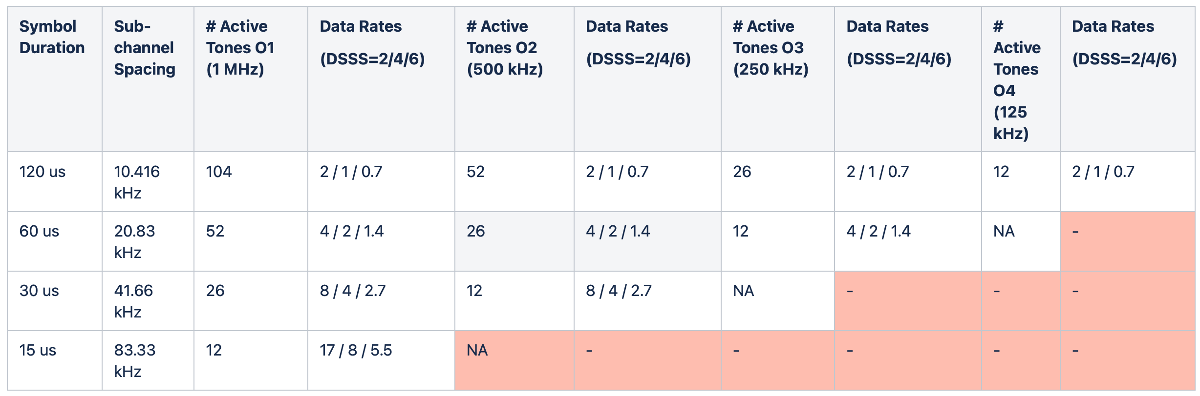
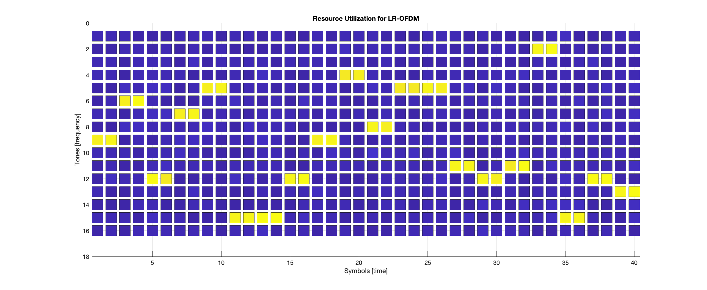
SUN OFDM VLR as SC-FDMA

Slide 7
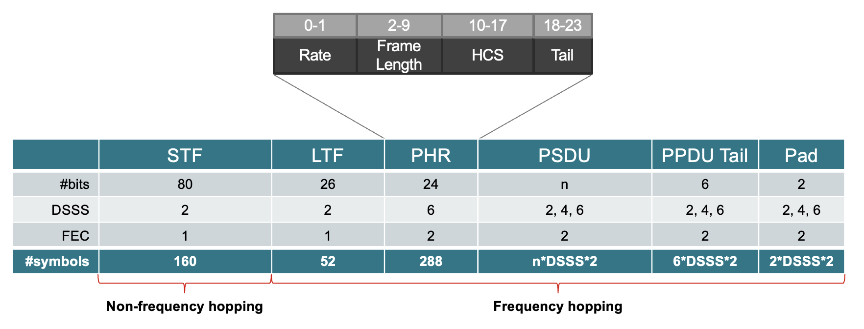
SUN OFDM VLR Packet Structure
The STF is 80 bits encoded to 160 chips, on a single sub-carrier
The LTF is 26 bits encoded to 52 chips, using the same hopping sequence as the rest of the packet
The PHR contains 24 information bits, 48 coded bits, interleaved and then spread to 288 chips, using the same hopping sequence as the rest of the packet
The PSDU contains n information bits, 2*n coded bits, interleaved and then spread to n*DSSS*2 chips

Slide 8
Channel Access Mechanism
Nodes synchronize on a specific sub-carrier that must be known in advance (the “meeting point”)
A subset of the sub-carriers is employed per network, so multiple networks can easily coexist by employing different subsets
Transmitting devices can randomly select between the N valid synchronization sub-carriers for each of their transmissions
Receiving nodes shall be able to listen to any of these sub-carriers. Typically, this is achieved by an N-node receiver configuration (but N can be 1 for simpler network topographies).
This scheme allows flexibility and scalability to network configurations and enables SUN OFDM VLR to be deployed with different network parameters
  1-to-many : single collector node, many end-nods
  N-to-many : N-collector node, many end-nodes
The general concept is that there is a subset of sub-carriers per network (out of the total active subcarriers) that can be used for STF. This is like the Advertising Channel concept (3 out of 40 channels) employed by Bluetooth LE devices

Slide 9
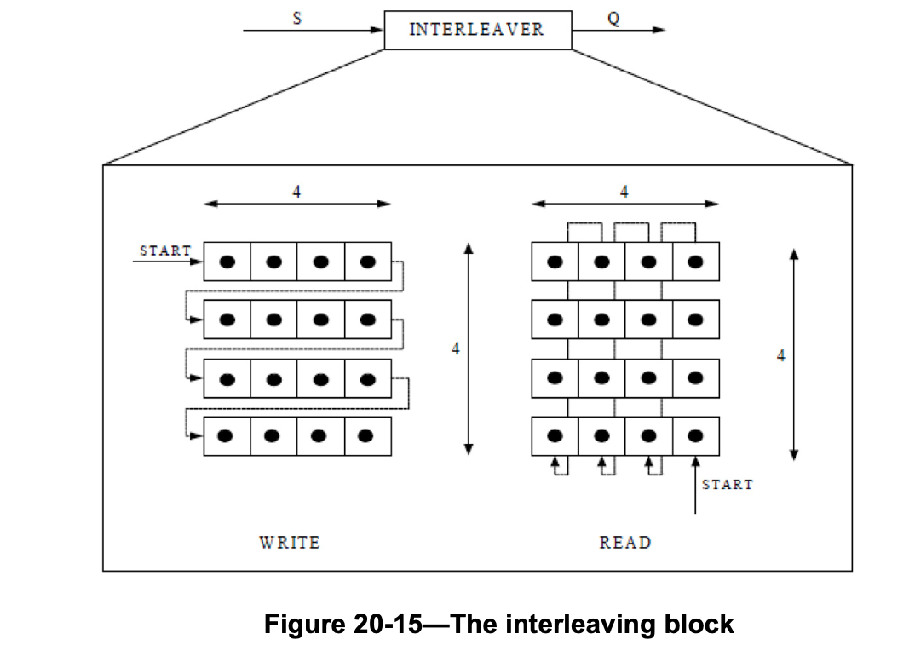
Interleaver
SUN OFDM VLR packets are byte oriented
In order to avoid additional padding requirements and reduce HW complexity, the interleaver size is adapted to this packet structure.
Every incoming 8 bits are transformed into 16 coded bits by the FEC convolutional encoder
Those 16 coded bits are then interleaved on a 4x4 interleaver engine, same as the existing configuration in SUN FSK

Slide 10
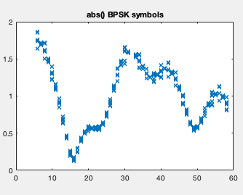
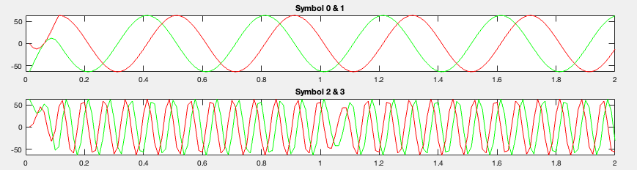
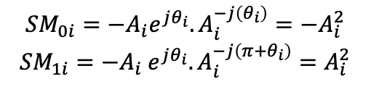
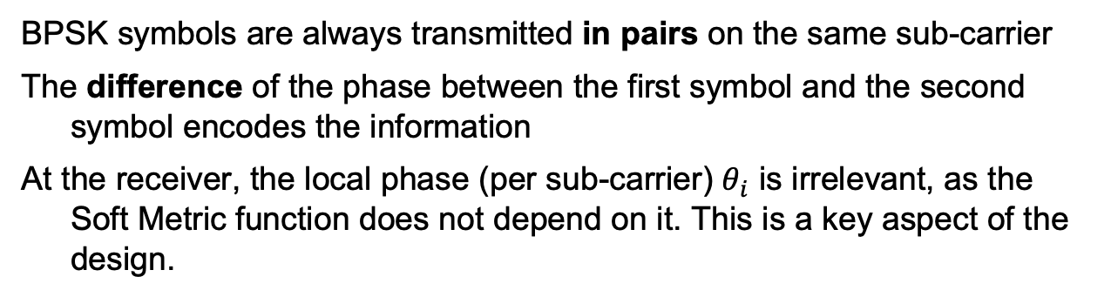
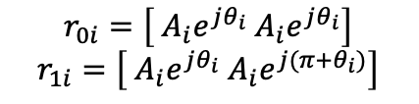
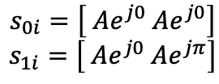
DBPSK Modulation Kernel
BPSK symbols are always transmitted in pairs on the same sub-carrier
The difference of the phase between the first symbol and the second symbol encodes the information
At the receiver, the local phase (per sub-carrier) $θ_{i}$ is irrelevant, as the Soft Metric function does not depend on it. This is a key aspect of the design.
$$s_{0i}=\left[ Ae^{j0} Ae^{j0}\right]$$
$$s_{1i}=\left[ Ae^{j0} Ae^{jπ}\right]$$
$$r_{0i}=\left[ A_{i}e^{jθ_{i}} A_{i}e^{jθ_{i}}\right]$$
$$r_{1i}=\left[ A_{i}e^{jθ_{i}} A_{i}e^{j(π+θ_{i})}\right]$$
$${SM}_{0i}=−A_{i}e^{jθ_{i}}.A_{i}^{−j\left(θ_{i}\right)}={−A}_{i}^{2}$$
$${SM}_{1i}=−A_{i}{ e}^{jθ_{i}}.A_{i}^{−j\left(π+θ_{i}\right)}=A_{i}^{2}$$
Transmitted pair i
Received pair i
Received soft metric i

Slide 11
DBPSK Properties
+ Unknown phase (per channel) is cancelled out
+ Frequency Offset Estimation Requirements are significantly reduced
+ Only inter-symbol frequency offset remnant is meaningful (<SymDur)
+ XTAL Drift Requirements significantly reduced
+ Timing Errors estimation requirements significantly reduced
+ No strict symbol synchronization nor tracking is required
+ Allows shorter STF and LTF sequences
+ Equalization and tracking over time requirements significantly reduced
+ Each sub-carrier can be considered as an independent narrow-band DBPSK channel
+ As every subchannel is demodulated independently (DBPSK) the amplitude/phase variations do not affect the overall demodulation across sub-channels
+ Effectively SUN OFDM VLR operates as demodulating independent subchannels of 10 kHz/20kHz/40kHz/80 KHz
The general message here is that due to the time-frequency sparsity of the transmitted signal, only differential encoding is feasible to allow low-complexity, low-overall-system-cost, battery powered operations

Slide 12



BPSK-with-pilot-tones issues (1/3)
9 12 2 11 14 4 13 3 6 5 7 10 9 12 2 11 14 4 13 3 6 5 7 10
Each of sub-carrier is visited evenly and only once every N_AT (number of active tones) (Example, N_AT = 12)
Corollary: the period between each of the sub-carriers is equal to the number of active sub-carrier
This also applies to the distances between the LTF, PHR and PSDU
If pilot tones are inserted on a 2 pilot tones per 6 data symbols (1 every 3), the distance between pilot tones on average is (3+1)*N_AT symbols (assuming that pilot tones are distributed so that they visit all sub-carriers over time)
For SymDur = 120 us and N_AT = 104, the distance between a pilot tone on the same sub-carrier is 49.2 ms!!
The maximum remnant frequency offset error for the phase rotation to be within 45 degrees from the previous symbol is:
Even if a receiver could obtain this resolution for the measurement, the XTAL stability requirements (Allan Variance) moves to the parts-per-billion
$$\frac{π}{4}=2πf_{err}T$$
$$\frac{1}{8T}=f_{err}$$
$f_{err}$ = 2.5 Hz

Slide 13
BPSK-with-pilot-tones issues (2/3)
9 12 2 11 14 4 13 3 6 5 7 10 9 12 2 11 14 4 13 3 6 5 7 10
Symbols per sub-channel are visited every N_AT. Timing error becomes a phase error.
Timing drift for 20 ppm XTALs: 40ppm*N_AT*SymDur = 0.5 us -> linear phase error for each of the sub-carriers
Example: for sub-carrier +52 (52 cyles per 96 us) -> 0.5 us corresponds to over pi/2 rotation, just due to timing offset errors
Supporting 20 ppm XTALs becomes very challenging due to the scarcity and the time separation between pilots

Slide 14
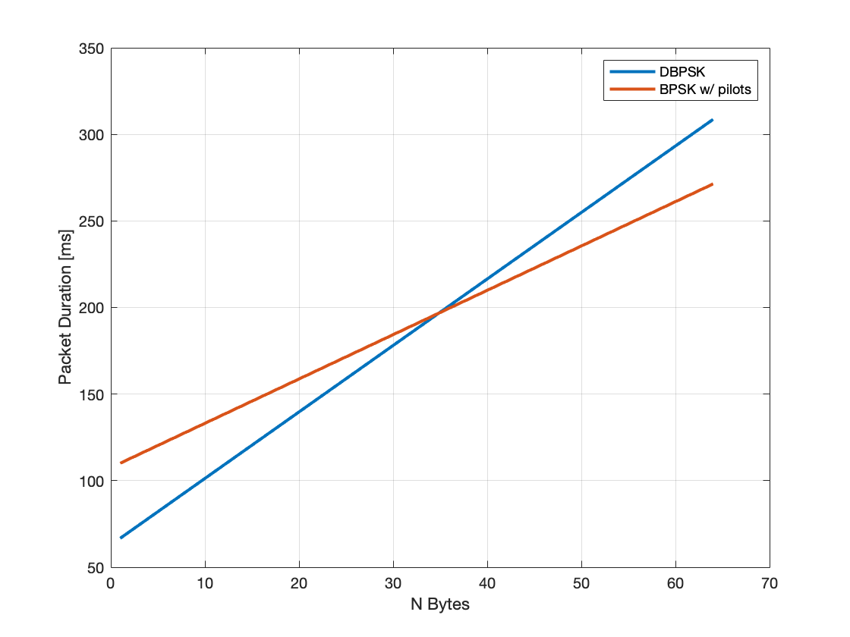
BPSK-with-pilot-tones issues (3/3)
A coherent modulation that requires to equalize each of the sub-channels and operates at ~5 dB lower SNR would require a substantially longer STF and LTF sequences.
Both STF and LTF shall be able to allow very strict frequency offset, symbol timing errors recovery. We are assuming at least x4 the duration for the STF and x8 the duration for the LTF (four visits to each sub-carrier)
For short duration packets, this investment is significant. DBPSK has shorter packet lengths than BPSK with pilots up to ~35 PDU sizes
Even for PDUs of 50 bytes, the difference between the two is only +10% of penalty for DBPSK
DSSS=2 SymDur=120 us

Slide 15
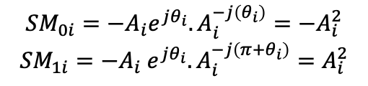
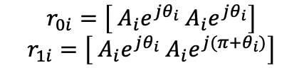
DBPSK summary
$$r_{0i}=\left[ A_{i}e^{jθ_{i}} A_{i}e^{jθ_{i}}\right]$$
$$r_{1i}=\left[ A_{i}e^{jθ_{i}} A_{i}e^{j(π+θ_{i})}\right]$$
$${SM}_{0i}=−A_{i}e^{jθ_{i}}.A_{i}^{−j\left(θ_{i}\right)}={−A}_{i}^{2}$$
$${SM}_{1i}=−A_{i}{ e}^{jθ_{i}}.A_{i}^{−j\left(π+θ_{i}\right)}=A_{i}^{2}$$
+ Differential BPSK is the only modulation kernel that can effectively be used on the sparse time/frequency resources of SUN OFDM VLR
+ BPSK modulations bring extreme requirements of frequency offset estimation, timing offset tracking, XTAL Allan Variance in the part-per-billion range
+ Other competing chirp-based technologies are also affected by these impairments and never achieve the “datasheet sensitivity” or “AWGN sensitivity” in the real world
+ When using a DBPSK kernel each sub-carrier can be demodulated independently without any need for channel equalization: frequency selective fading becomes flat-fading for each of the sub-carriers and phase and time drift are solved locally at the symbol level
+ DBPSK still meets the sensitivity requirements (< -120 dBm)

Slide 16
XTAL requirements
According to the Open Metering Standard Document Annex Q to
Volume 2 Primary Communication Issue 5.0.1 (release 2023-12)
Q.F.1 Common Causes and Techniques to Reduce Centre Frequency Drift
A common cause of centre frequency drift in the endpoint transmitter stems from impairments on the RF reference clock. Instability on the RF reference clock voltage supply, start-up characteristics of the RF reference clock and heat transfer from transceiver to RF reference clock are some of the most common impairments. […] Even small fluctuations of the voltage will cause noticeably frequency shifts which will translate into centre frequency drift on the transmitted signals. It is therefore important to use a hardware design which insures a stable voltage supply at all times.

Slide 17
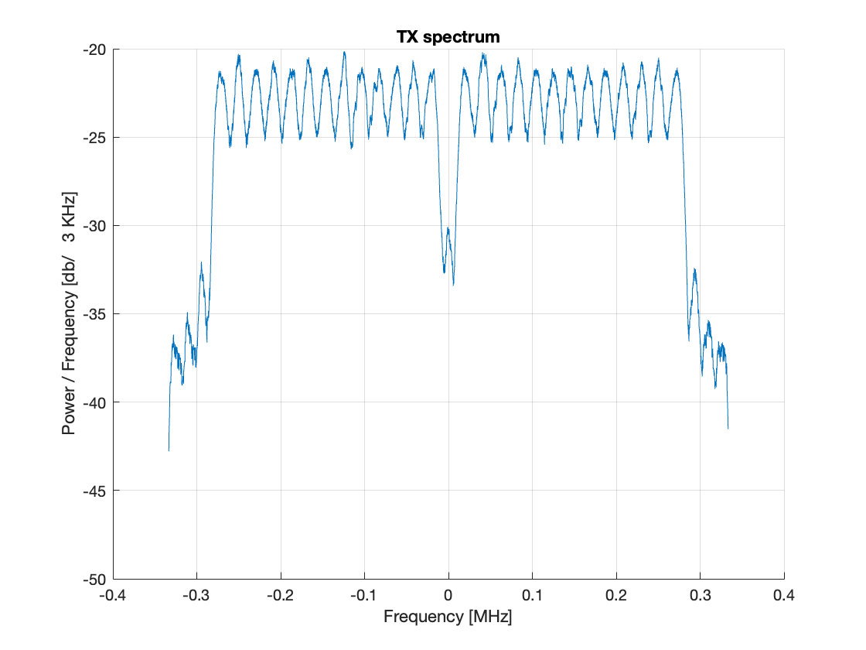
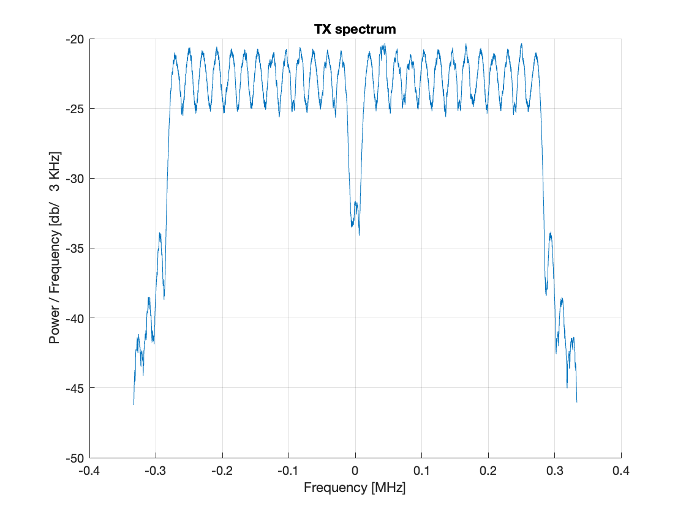
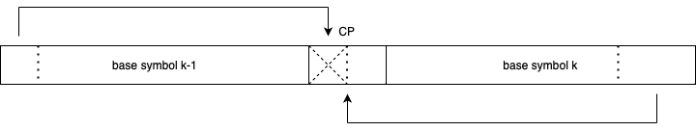
OFDM Windowing
SUN OFDM does not currently specify any windowing between symbols
We propose that this is changed for the next revision of the SUN OFDM specification. This change would also carry over to SUN OFDM VLR
A linear ramp for the first half of the CP is sufficient
Base Symbol Duration | CP Duration | Symbol Duration
96 us | 24 us | 120 us
48 us | 12 us | 60 us
24 us | 6 us | 30 us
12 us | 3 us | 15 us

Slide 18

Linear Congruential Generator
https://en.wikipedia.org/wiki/Linear_congruential_generator is an iterative algorithm that yields a sequence of pseudo-randomized numbers
General case:
$$X_{n+1}={((aX}_{n }+c) mod m)$$
Additionally, numbers are re-rolled if falling outside the number of active tones defined by each of the operating modes or if the number is the DC tone
For SUN OFDM VLR, we can select some specific values for a, c and m = 2*N_DFT
Index | a
0 | 17
1 | 29
2 | 37
3 | 41
4 | 53
5 | 61
6 | 73
7 | 89
Index | c | Index | c | Index | c
0 | 3 | 10 | 37 | 20 | 79
1 | 5 | 11 | 41 | 21 | 83
2 | 7 | 12 | 43 | 22 | 89
3 | 11 | 13 | 47 | 23 | 97
4 | 13 | 14 | 53 | 24 | 101
5 | 17 | 15 | 59 | 25 | 103
6 | 19 | 16 | 61 | 26 | 107
7 | 23 | 17 | 67 | 27 | 109
8 | 29 | 18 | 71 | 28 | 113
9 | 31 | 19 | 73 | 29 | 127

Slide 19
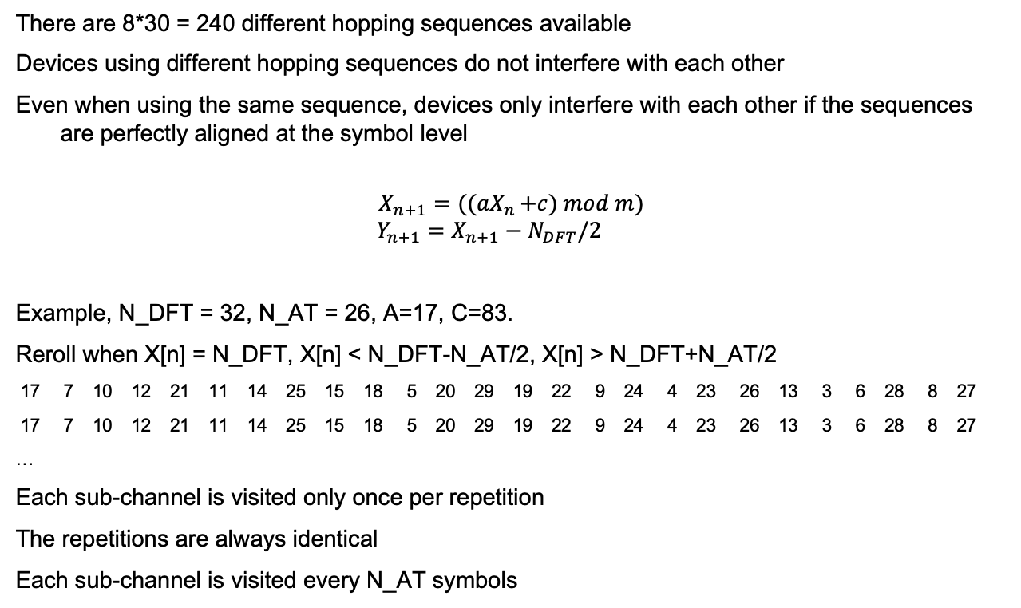
Linear Congruential Generator
There are 8*30 = 240 different hopping sequences available
Devices using different hopping sequences do not interfere with each other
Even when using the same sequence, devices only interfere with each other if the sequences are perfectly aligned at the symbol level
$$X_{n+1}={((aX}_{n }+c) mod m)$$
$$Y_{n+1}=X_{n+1}−N_{DFT}/2$$
Example, N_DFT = 32, N_AT = 26, A=17, C=83.
Reroll when X[n] = N_DFT, X[n] < N_DFT-N_AT/2, X[n] > N_DFT+N_AT/2
17 7 10 12 21 11 14 25 15 18 5 20 29 19 22 9 24 4 23 26 13 3 6 28 8 27
17 7 10 12 21 11 14 25 15 18 5 20 29 19 22 9 24 4 23 26 13 3 6 28 8 27
…
Each sub-channel is visited only once per repetition
The repetitions are always identical
Each sub-channel is visited every N_AT symbols

Slide 20
Channel Model Simulations

Slide 21
Selected Modes

Slide 22
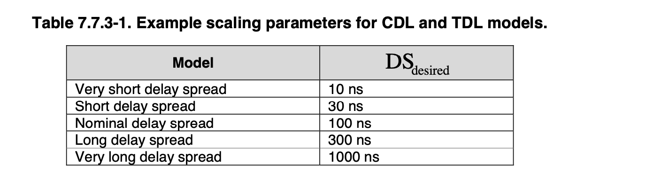
Channel Model for SUN OFDM VLR
Channel Models
  AWGN
  LOS (ETSI TR 138 901 TDL-D DS_{desired} = 1000 ns)
  NLOS (ETSI TR 138 901 TDL-B DS_{desired} = 1000 ns)
Matlab Models (nrTDLChannel) employed for channel generation
  Model randomized on a packet-per-packet basis
  200 packets per signal level, 20 bytes per packet
  Theoretical NF = 0 dB
    Different implementations can displace the provided curves by their own NF
Full model of the SUN OFDM VLR receiver
  Timing and Frequency Synchronization to the STF channel
  Hopping Patterns
  Interleaving
  DBPSK demodulation
  FEC

Slide 23
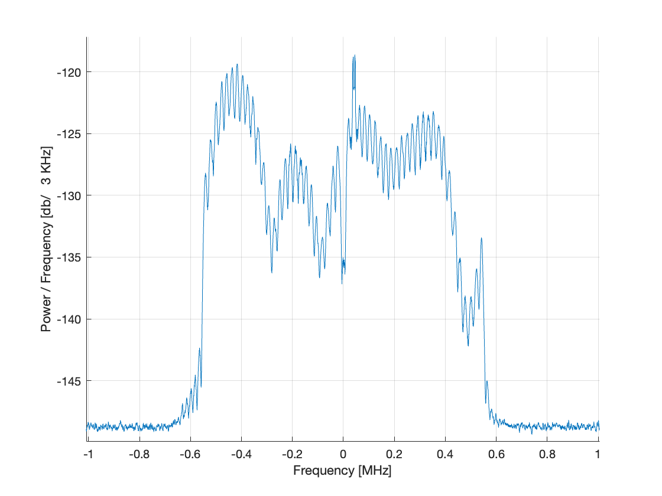
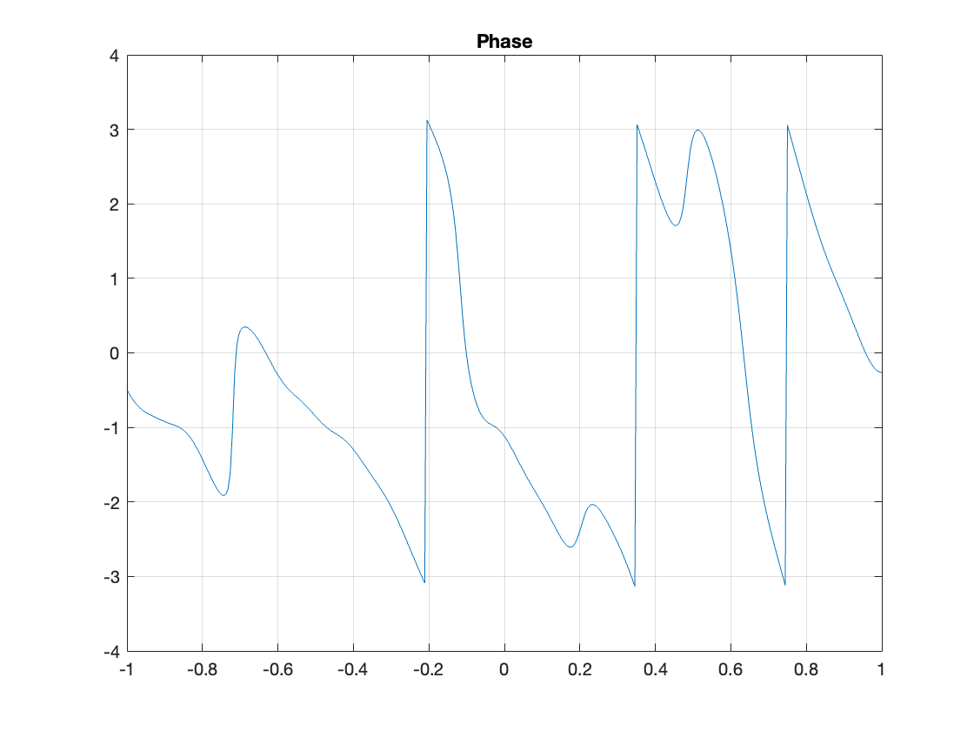
Example: O1, 1 MHz BW - 10kHz subcarriers
(104 tones) simulation
CRC OK
Amplitude and Phases varies quickly and significantly (20 dB in amplitude, non-linear phase variations) between faded sub-channels (TDL-B)

Slide 24
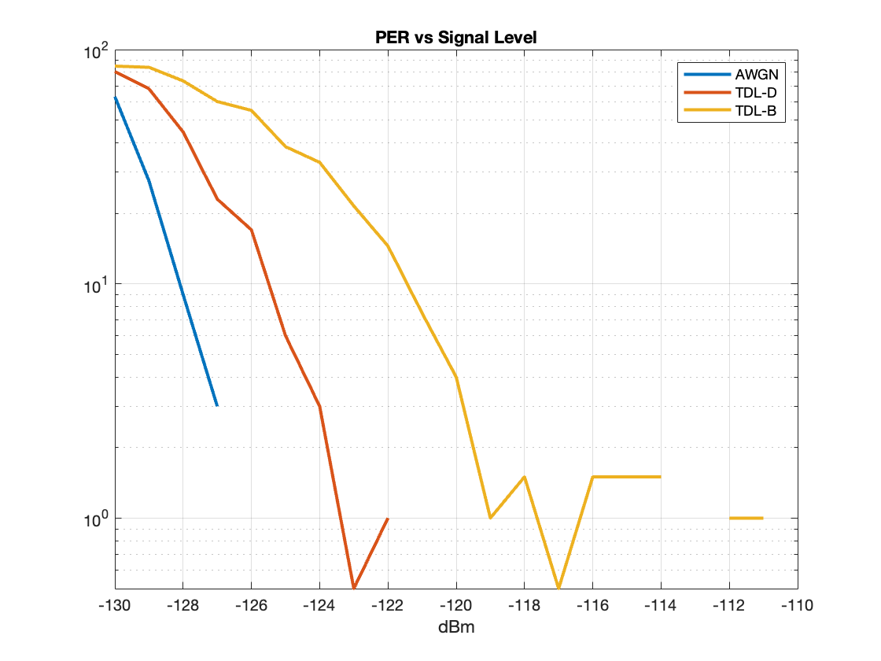
Option 1 – DSSS = 2 – 10 kHz subcarriers – 2kbps
AWGN (10 % PER)
  -128 dBm
TDL-D (10% PER)
  -125.5 dBm
TDL-B (10% PER)
  -122 dBm

Slide 25
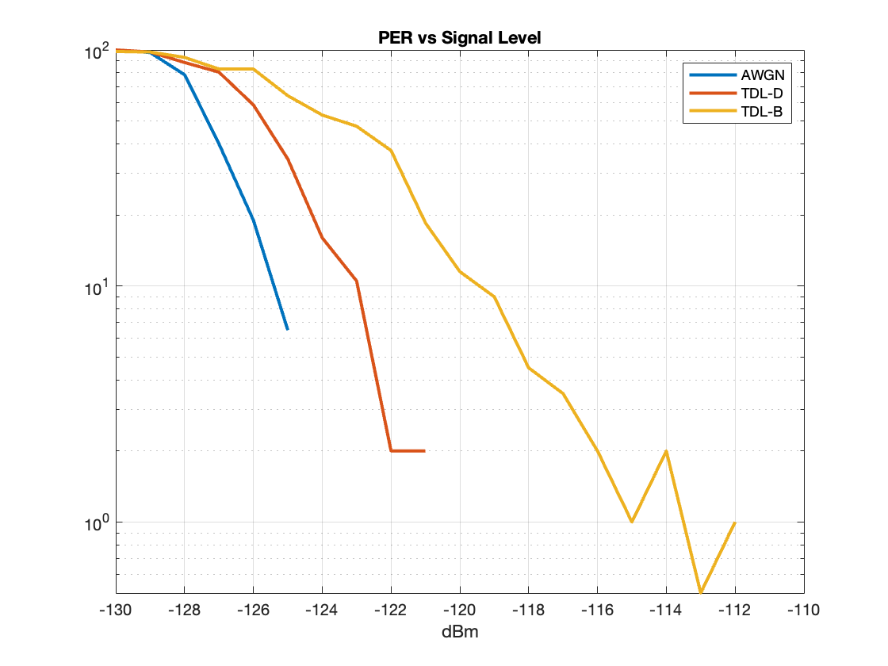
Option 1 – DSSS = 2 – 20 kHz subcarriers – 4kbps
AWGN (10 % PER)
  -125.5 dBm
TDL-D (10% PER)
  -123 dBm
TDL-B (10% PER)
  -119 dBm

Slide 26
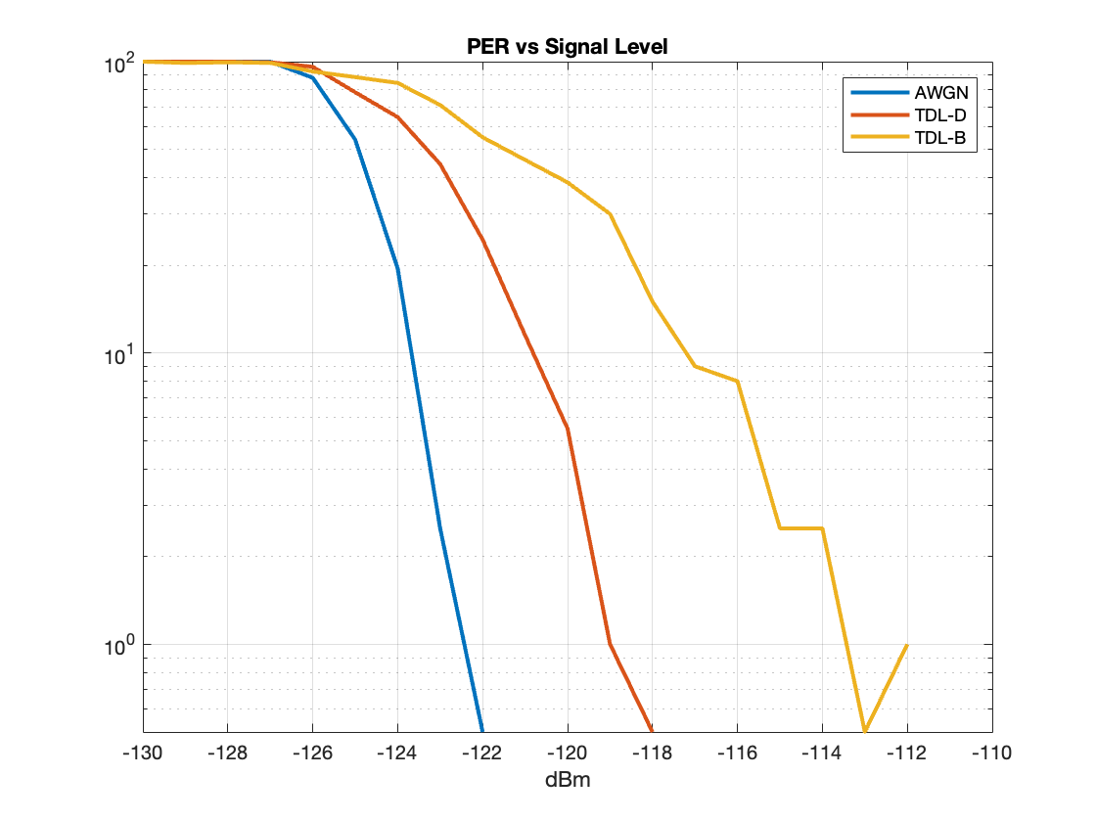
Option 1 – DSSS = 2 – 40 kHz subcarriers – 8kbps
AWGN (10 % PER)
  -124 dBm
TDL-D (10% PER)
  -121 dBm
TDL-B (10% PER)
  -117 dBm

Slide 27
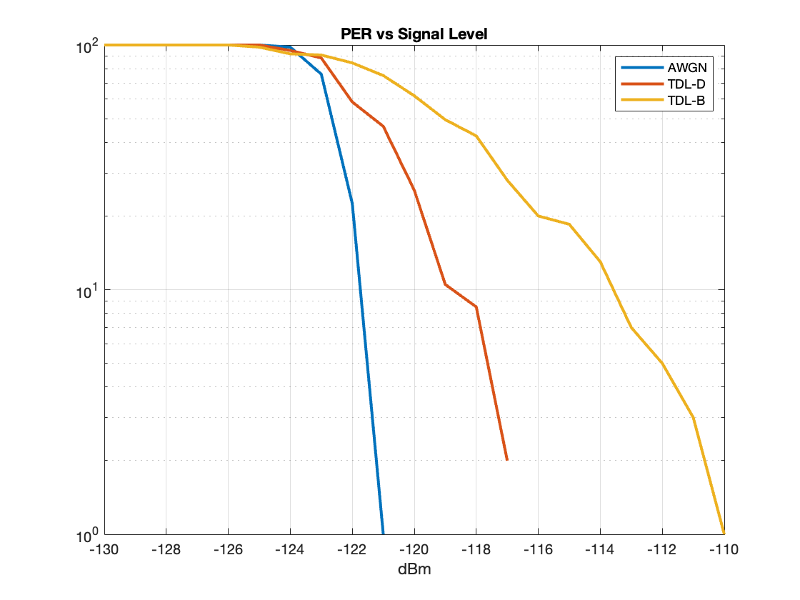
Option 1 – DSSS = 2 – 80 kHz subcarriers – 16kbps
AWGN (10 % PER)
  -122 dBm
TDL-D (10% PER)
  -119 dBm
TDL-B (10% PER)
  -114 dBm

Slide 28
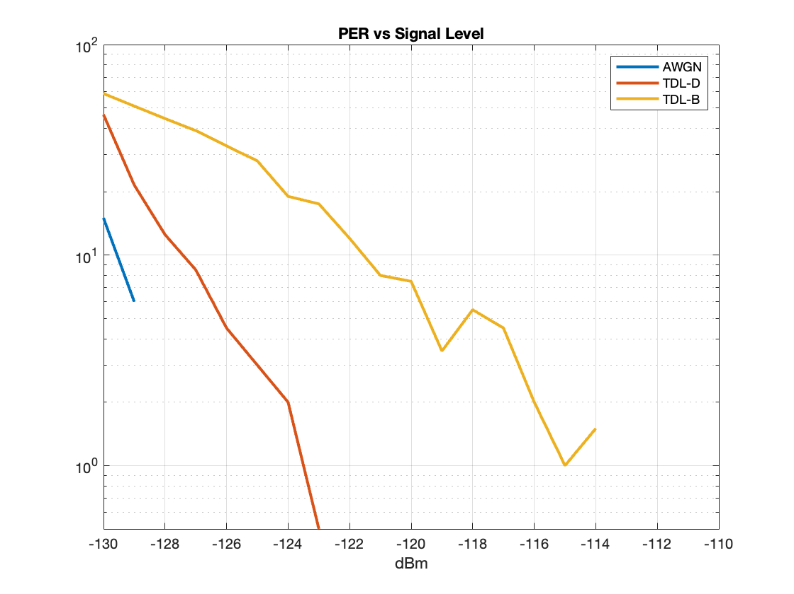
Option 4 – DSSS = 2 – 10 kHz subcarriers – 2kbps
AWGN (10 % PER)
  -129 dBm
TDL-D (10% PER)
  -126.5 dBm
TDL-B (10% PER)
  -122 dBm

Slide 29
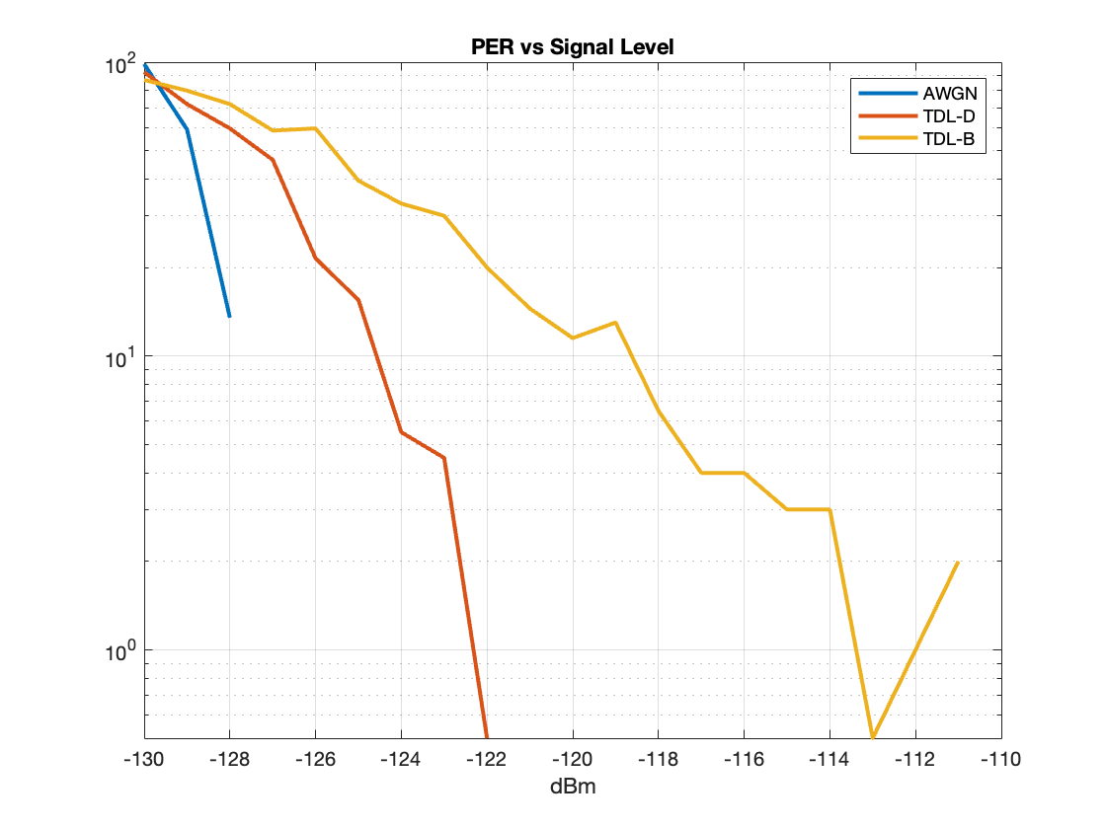
Option 3 – DSSS = 2 – 20 kHz subcarriers – 4kbps
AWGN (10 % PER)
  -127.5 dBm
TDL-D (10% PER)
  -124.5 dBm
TDL-B (10% PER)
  -119 dBm

Slide 30
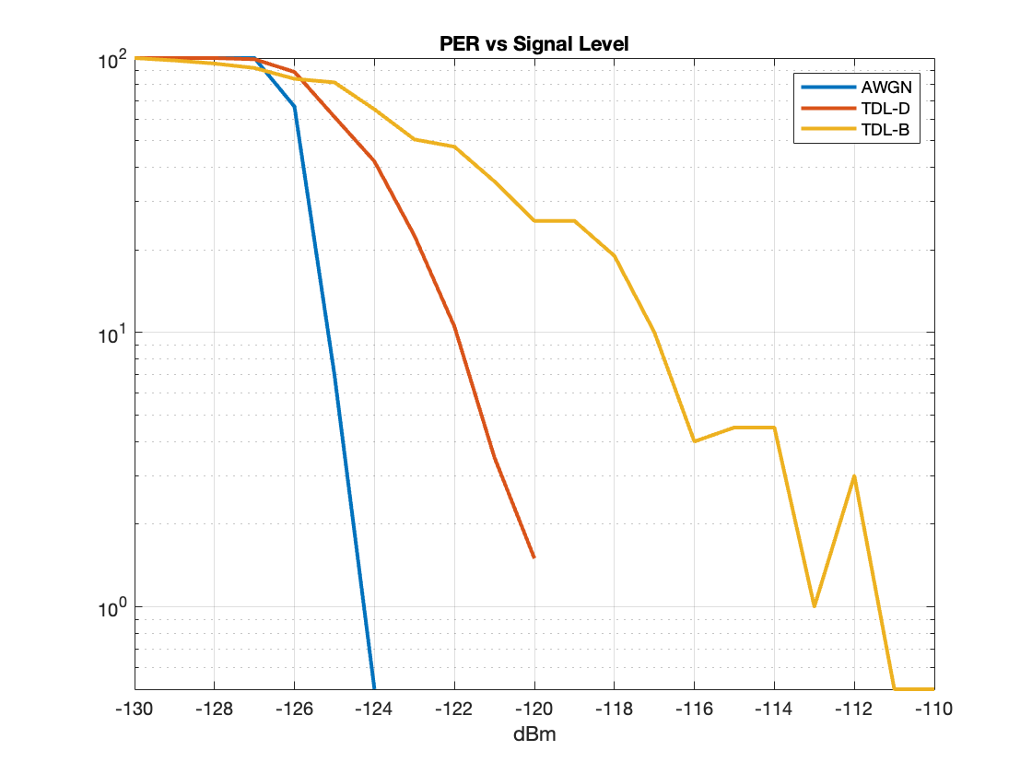
Option 2 – DSSS = 2 – 40 kHz subcarriers – 8kbps
AWGN (10 % PER)
  -125 dBm
TDL-D (10% PER)
  -122 dBm
TDL-B (10% PER)
  -117 dBm

Slide 31
Summary Table
 | AWGN | TDL-D (LOS) | TDL-B (NLOS)
O1 – DSSS2 – 10 kHz – 2 kbps | -128 dBm | -125.5 dBm | -122 dBm
O4 – DSSS2 – 10 kHz – 2 kbps | -129 dBm | -126.5 dBm | -122 dBm
O1 – DSSS2 – 20 kHz – 4 kbps | -125.5 dBm | -123 dBm | -119 dBm
O3 – DSSS2 – 10 kHz – 2 kbps | -127.7 dBm | -124.5 dBm | -119 dBm
O1 – DSSS2 – 40 kHz – 8 kbps | -124 dBm | -121 dBm | -117 dBm
O2 – DSSS2 – 10 kHz – 2 kbps | -125 dBm | -122 dBm | -117 dBm
O1 – DSSS2 – 80 kHz – 16 kbps | -122 dBm | -119 dBm | -114 dBm
TDL-D fading channel (LoS 1000 ns) results in ~3 dB of sensitivity impact compared to pure AWGN channel
TDL-B fading channel (nLoS 1000 ns) results in ~6-7 dB of sensitivity impact compared to pure AWGN channel
No PER floor observed in any of the simulations

Slide 32
Channel Model Simulation Conclusions
SUN OFDM VLR is inherently resistant to multipath due to the DBPSK modulation kernel and the distributed approach of time and frequency spreading
DBPSK is effectively the only feasible option for time/frequency sparse signals

Slide 33
Network Capacity Simulations

Slide 34
MAC Layers for SUN OFDM VLR
In LPWAN (Low Power Wide Area Network) the Medium Access Control methods need to be adapted to the needs and capabilities of the End Nodes
End Nodes:
  Low Power Nodes, battery powered. MAC layer shall not require them to stand on RX for unlimited periods of time
  MAC layer shall be optimized so that the traffic profile of the network does not require a significant number of retransmission of the information
  Low Power Nodes shall not be required to maintain strict timing windows based on active XTAL (few ppm)
  MAC layer shall not require devices to listen for ACKs for an extensive period of time
  MAC layer shall not require listening for Beacons at regular intervals
Given all these constrains the most popular configuration for these networks is a Pure ALOHA network
  ALOHA: every node transmits whenever they want, then listen for ACKs optionally
  https://en.wikipedia.org/wiki/ALOHAnet

Slide 35
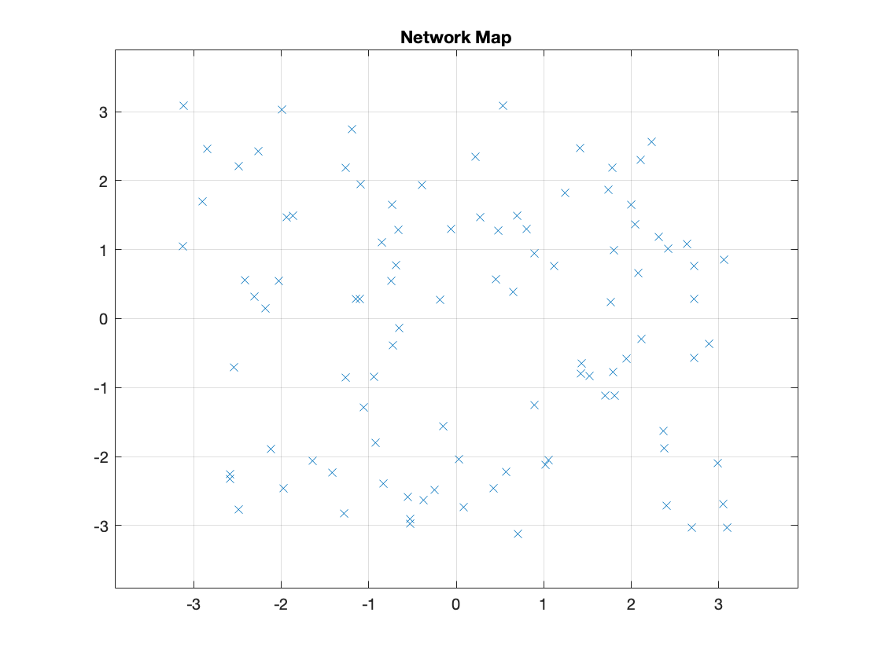
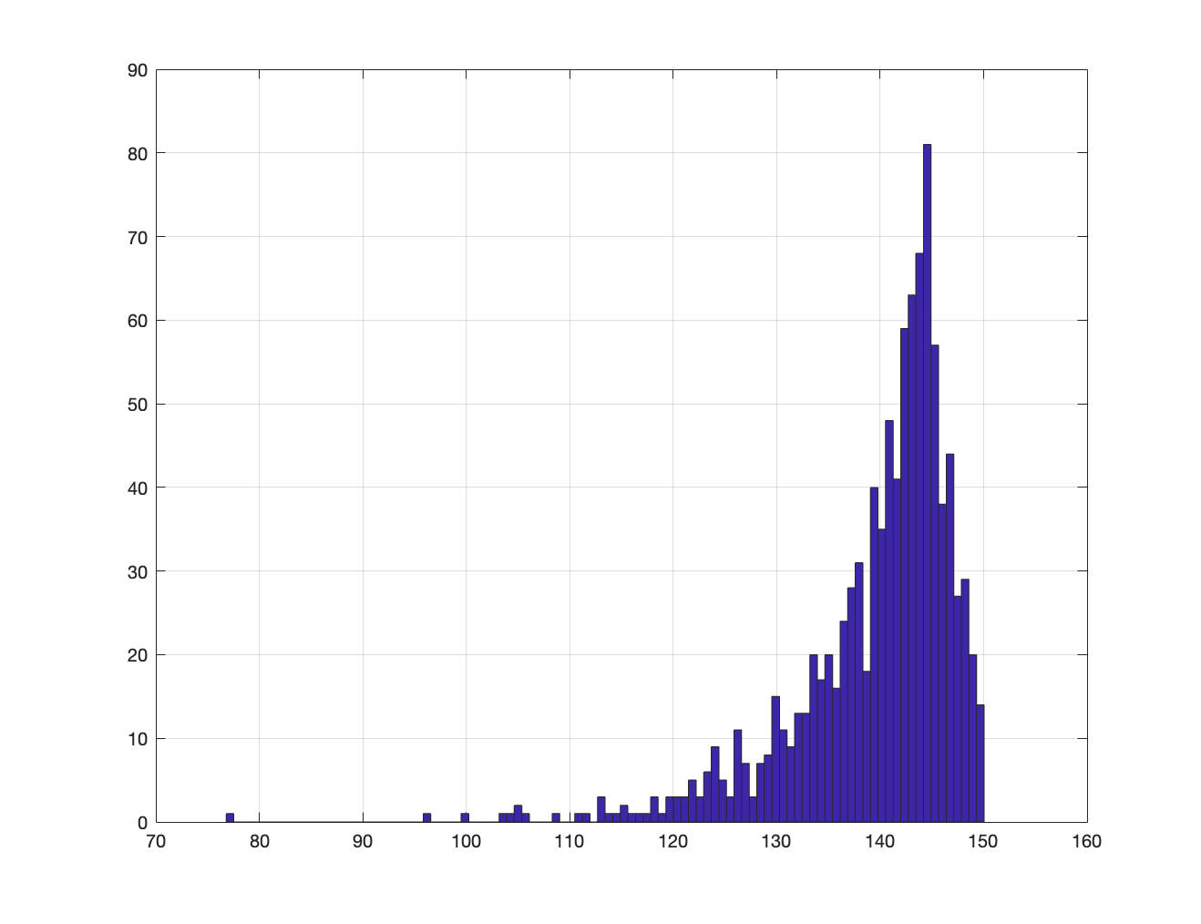
Randomly Generated Network
The Network is generated randomly for each group of simulations (but remains constant between multiple modes)
Using Hata model for Path Loss and urban areas (Rappaport page 153)
Link Budget for the network selected to be 151 dB, D_{max} = 3.2 km
Most of the nodes see a path loss in the [130,150] dB range
Additionally, nodes will see a randomized Fading applied to each transmission, with std dev of 6 dB
  This fading is flat fading, affecting the entire set of subcarriers equally
Path Loss [dB]

Slide 36
Measuring Network Throughput
Condition | Description
STF collision | Two STFs collide over the air, both packets are lost
PSDU collision | A second packet arrives while receiving a first packet. Both lost is CI_LIMIT is violated (CI_LIMIT is max difference between the packets)
Packet Faded | The packet is beyond Link Budget (due to random fading), thus lost
ACK blackout | TX ACK blocks incoming packets
Packet Lost | A packet is not seen (but does not cause a collision to other packet)
Metrics | Description
Packet TX | Total number of packets transmitted by network during simulation time
Packet RX | Total number of packets received by central node(s)
Packet ACKed | Total number of ACK’ed packets. PER = 1 – (ACK’ed / Packet TX)
PTXPM | Packet per min (TX)
POKPM | Packets per min (OK = ACK’ed)

Slide 37
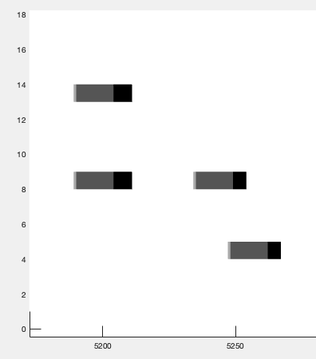
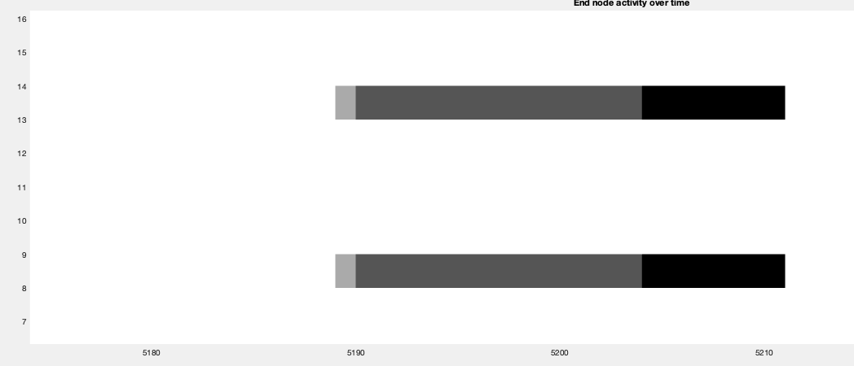
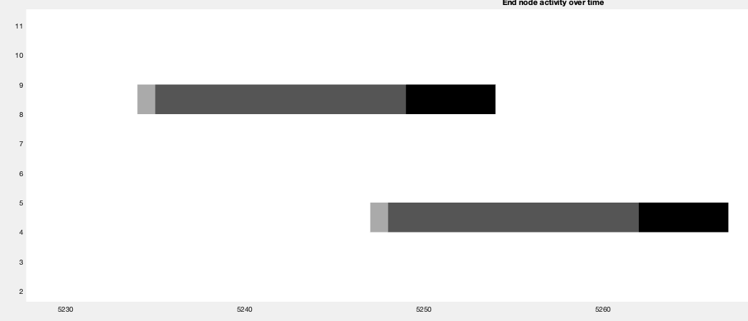
STF collision, PSDU collisions
STF collision
STF collision
PSDU collision?
PSDU collision or Packet Lost
STF RX
PSDU RX
ACKs TX
Packet lost

Slide 38
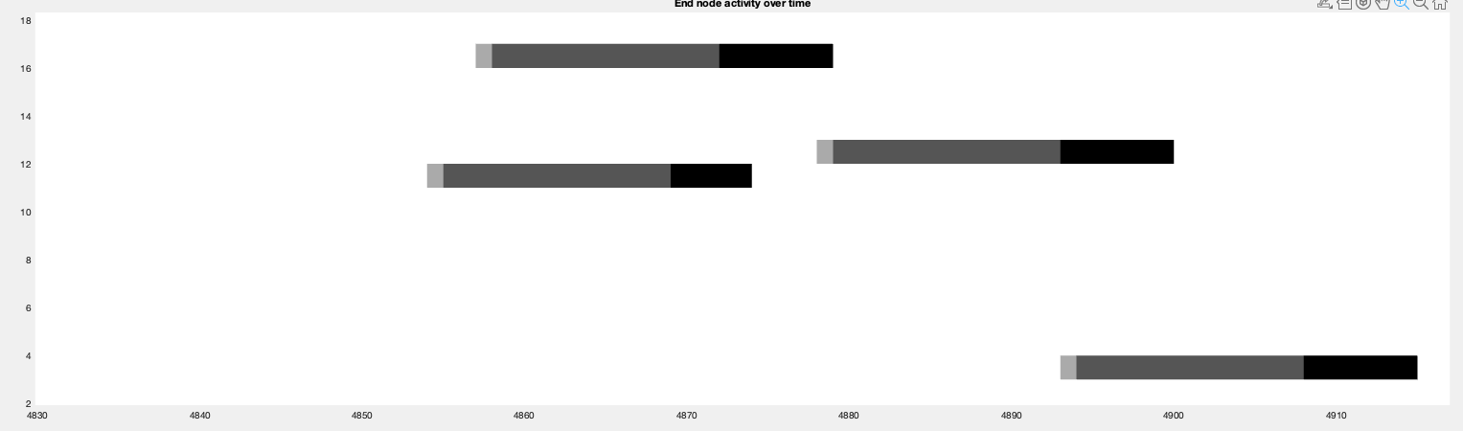
Condition: ACK blackout
PSDU collision or Packet Lost
ACK blackout
PSDU collision or Packet Lost
Short ACK
(DSSS=2)
Long ACK
(DSSS=6)

Slide 39
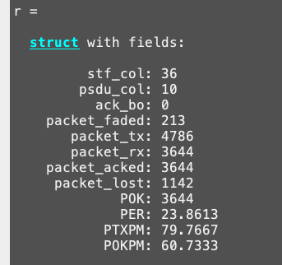
High Traffic (~23% PER, 80 PPM)
100 Nodes, 1 Central Node
CI_LIMIT = 25 dB (A packet can be received as long as the 2nd packet is not more than 25 dB over the original packet level)
STF Collisions are very low (<1 %)
PSDU Collisions are < 1% of the total source of packets lost when CI_LIMIT is 25 dB
Fading represents a similar ~3% of the packets (independent on the traffic)
Faded packets can be reduced by designing smaller networks with larger fading margins (6 dB is enough)
Most of the PER (~20 %) is due to packets that were ignored because the receiver node was busy receiving the first packet

Slide 40
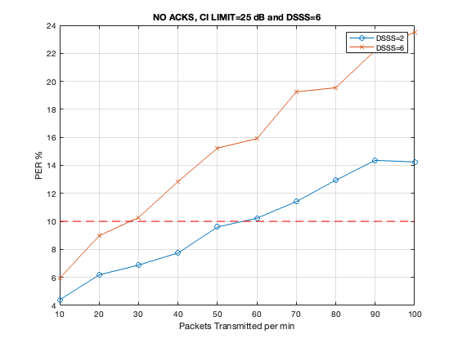
Baseline N:1 Network
Baseline | DSSS=2 | DSSS=6
10% | ~60 ppm | ~30 ppm

Slide 41
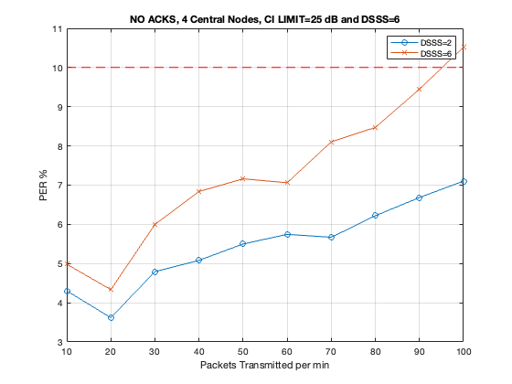
Multi-node RX N:M networks
Baseline | DSSS=2 | DSSS=6
 | ~60 | ~30
Multinode | DSSS=2 | DSSS=6
 | >>100 | > 100
SUN OFDM VLR can offer very significant network capacity improvements when using multiple RX nodes
Randomly select an STF sub-carrier, then there are N receivers in parallel always listening for their respective STF sub-carrier

Slide 42
Conclusions
Even for High PER situations, the STF collision rate stays below the 1% of the total collision sources
A multi-seed SUN OFDM VLR network can offer a very significant capacity increases compared to single-seed (or low CI_LIMIT) networks
SUN OFDM VLR PHY offers multiple configuration options for the upper layers to increase capacity

