Slide 1
Project: IEEE P802.15 Working Group for Wireless Personal Area Networks (WPANs)
Submission Title: [Channel Model for Evaluation of Transmission Characteristics of IEEE 802.15.4ad PHY]
Date Submitted: 11 November 2024
Source: Hiroshi Harada Shota Mori (Kyoto University)
Address Yoshidahonmachi. Sakyo, Kyoto, 606-8501, Japan
Voice: +81-75-753-5317 , E-Mail: hiroshi.harada@i.kyoto-u.ac.jp
Re: [Wireless Next Generation, Long Range extension enhancements to 802.15.4-2020]
Abstract: Channel Model for Evaluation of Transmission Characteristics of IEEE 802.15.4ad PHY. A part of this contribution supported from the commissioned research (No. JPJ012368C05101) by National Institute of Information and Communications Technology (NICT) , Japan is included.
Purpose: Propose channel models to evaluate proposed systems for IEEE 802.15.4ad.
Notice: This document has been prepared to assist the IEEE P802.15. It is offered as a basis for discussion and is not binding on the contributing individual(s) or organization(s). The material in this document is subject to change in form and content after further study. The contributor(s) reserve(s) the right to add, amend or withdraw material contained herein.
Release: The contributor acknowledges and accepts that this contribution becomes the property of IEEE and may be made publicly available by P802.15.

Slide 2
Channel Model for Evaluation of Transmission Characteristics of IEEE 802.15.4ad PHY
Nov. 11, 2024
Hiroshi Harada and Shota Mori

Slide 3
Background
In IEEE 802.15.4ad, the group are considering channel models in order to perform simulations for various propagation environments.
The following channel model is proposed for use in #290
For use cases that use frequencies below 500MHz band
Urban Area: Typical Urban Channel model as defined in COST 207 （Hereafter called TU model）
Rural Area: IEEE 802.22 Profile A model (Hereafter called 802.22 model）
For use cases that use frequencies of 500 MHz or higher
TR38.901 3GPP-based TDL channel model (Hereafter called 3GPP TDL model）
However, for the TU model and 802.22 model, the parameters for the simulation, such as the moving speed of the receiver, have not been determined.
For the 3GPP model, the scaling parameters has not been determined in 802.15.4ad group.
This contribution document determines these parameters.

Slide 4
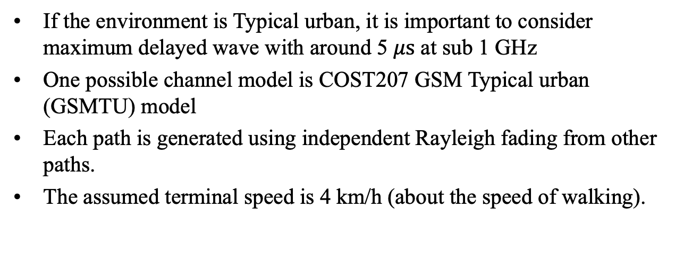
Channel Model in Urban Area
If the environment is Typical urban, it is important to consider maximum delayed wave with around 5 $μs$ at sub 1 GHz
One possible channel model is COST207 GSM Typical urban (GSMTU) model
Each path is generated using independent Rayleigh fading from other paths.
The assumed terminal speed is 4 km/h (about the speed of walking).
Ref.: COST207, “Digital land mobile communications,” Mar. 1989．

Slide 5
Channel Model in Rural Area
Based on Doc. 15-24-287, the delay spread could be 10 $μs$ if VHF band is used. In this case, a possible model for such a model is IEEE 802.22 Type A.
Each path is generated using independent Rayleigh fading from other paths.
The assumed terminal speed is 4 km/h (about the speed of walking).
Parameter | Path1 | Path2 | Path3 | Path4 | Path5 | Path6
Delay ($μs$) | 0 | 3.0 | 8.0 | 11 | 13 | 21
Relative power (dB) | 0 | -7 | -15 | -22 | -24 | -19
Ref. E. Sofer and G. Chouinard, “WRAN Channel Modeling,” IEEE802.22-05/0055r7, 2005.

Slide 6
3GPP channel model
Candidate
NLOS model
TDL-A/B/C
LoS model
TDL-D/E
TR38.901 TDL model has a normalized RMS delay spread to accommodate various desired RMS delay spreads and is used by applying a scaling parameter.
The assumed terminal speed is 4 km/h (about the speed of walking).

Slide 7
TR38.901 TDL-A/B/C/D/E
TDL-A
TDL-B
3GPP, “Study on channel model for frequencies from 0.5 to 100 GHz,” 3GPP Tech. Rep. 38.901 V17.0.0, Mar. 2022.

Slide 8
TR38.901 TDL-A/B/C/D/E
TDL-C
3GPP, “Study on channel model for frequencies from 0.5 to 100 GHz,” 3GPP Tech. Rep. 38.901 V17.0.0, Mar. 2022.

Slide 9
TR38.901 TDL-A/B/C/D/E
TDL-D
TDL-E
Path | Normalized Delay | Relative Power (dB) | Fading distribution
1 | 0.0000 | –0.2 | LOS path
 | 0.0000 | –13.5 | Rayleigh
2 | 0.035 | –18.8 | Rayleigh
3 | 0.612 | –21 | Rayleigh
4 | 1.363 | –22.8 | Rayleigh
5 | 1.405 | –17.9 | Rayleigh
6 | 1.804 | –20.1 | Rayleigh
7 | 2.596 | –21.9 | Rayleigh
8 | 1.775 | –22.9 | Rayleigh
9 | 4.042 | –27.8 | Rayleigh
10 | 7.937 | –23.6 | Rayleigh
11 | 9.424 | –24.8 | Rayleigh
12 | 9.708 | –30.0 | Rayleigh
13 | 12.525 | –27.7 | Rayleigh
NOTE: The first tap follows a Ricean distribution with a K-factor of 13.3 dB and a mean power of 0 dB.
NOTE: The first tap follows a Ricean distribution with a K-factor of 22 dB and a mean power of 0 dB.
3GPP, “Study on channel model for frequencies from 0.5 to 100 GHz,” 3GPP Tech. Rep. 38.901 V17.0.0, Mar. 2022.

Slide 10
Scaling parameter
Use the delay time scaled as shown in the formula below to match the desired RMS delay spread. $τ_{n,scaled}=τ_{n,model}∙{DS}_{desired}$
$τ_{n,model}$: The normalized delay value listed in the n-th path of the model
${DS}_{desired}$: Desired RMS delay spread
$τ_{n,scaled}$: $Delay time used for the \text{n}\text{−}\text{th} path$
Table 7.7.3-1 in 3GPP TR 38.901 gives an example of a scaling parameter for a very long delay spread of 1000 ns.
The RMS delay spread of the GSMTU is 1.0616 $μs$, so this value is reasonable.

Slide 11
Scaling parameters for the NLOS environment
Candidates are TDL-A/B/C
Assuming that the urban environment is similar to that of GSMTU
The RMS delay spread of the GSMTU is 1.0616 $μs$
When this spread is applied, the maximum delay time of the delayed wave becomes the following:
TDL-A：9.6586 * 1.0616 [$μs$] = 10.3 [$μs$]
TDL-B：4.7834 * 1.0616 [$μs$] = 5.1 [$μs$]
TDL-C：8.6523 * 1.0616 [$μs$] = 9.2 [$μs$]
When 1000 ns is applied, the maximum delay time of the delay wave is as follows.
TDL-A：9.6586 * 1 [$μs$] = 9.7 [$μs$]
TDL-B：4.7834 * 1 [$μs$] = 4.8 [$μs$]
TDL-C：8.6523 * 1 [$μs$] = 8.7 [$μs$]
Considering that the maximum delay time of the GSMTU is 4.8 $μs$, TDL-B is considered to be appropriate, and a scaling parameter of 1000 n$s$ is considered to be appropriate
Each path is generated using independent Rayleigh fading from other paths.

Slide 12
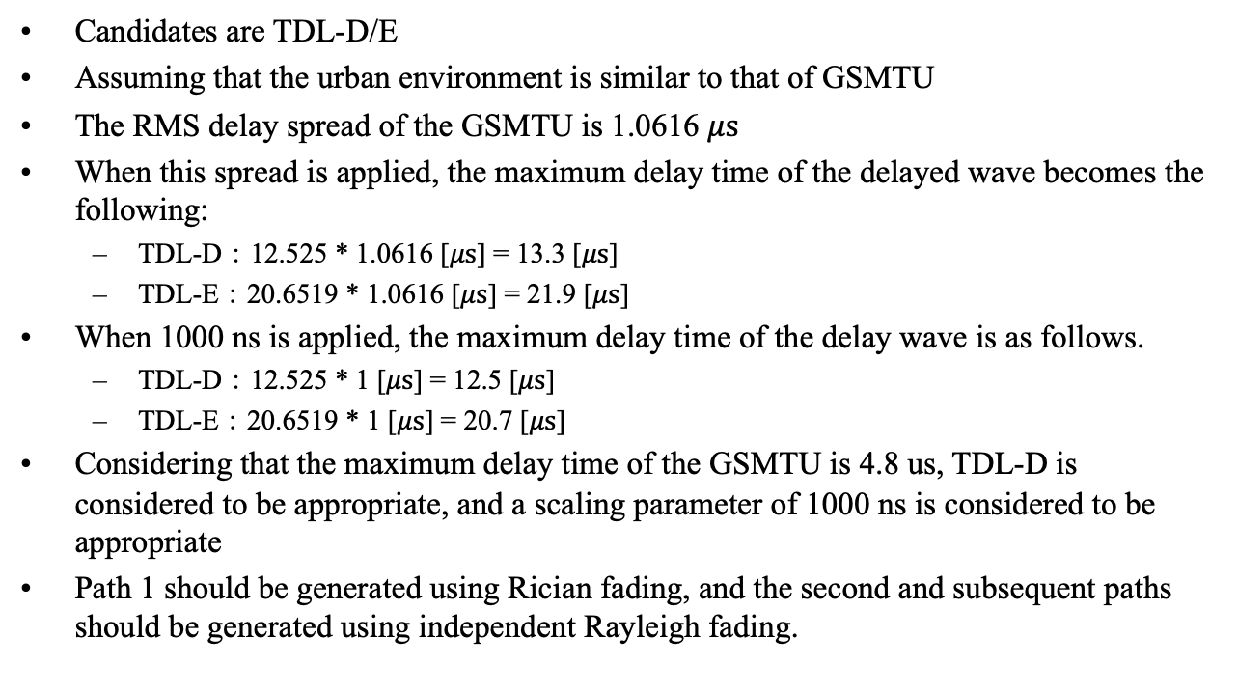
Scaling parameters for the LOS environment
Candidates are TDL-D/E
Assuming that the urban environment is similar to that of GSMTU
The RMS delay spread of the GSMTU is 1.0616 $μs$
When this spread is applied, the maximum delay time of the delayed wave becomes the following:
TDL-D：12.525 * 1.0616 [$μs$] = 13.3 [$μs$]
TDL-E：20.6519 * 1.0616 [$μs$] = 21.9 [$μs$]
When 1000 ns is applied, the maximum delay time of the delay wave is as follows.
TDL-D：12.525 * 1 [$μs$] = 12.5 [$μs$]
TDL-E：20.6519 * 1 [$μs$] = 20.7 [$μs$]
Considering that the maximum delay time of the GSMTU is 4.8 us, TDL-D is considered to be appropriate, and a scaling parameter of 1000 ns is considered to be appropriate
Path 1 should be generated using Rician fading, and the second and subsequent paths should be generated using independent Rayleigh fading.

