Slide 1
Project: IEEE P802.15 Working Group for Wireless Specialty Networks (WSN)
Submission Title: TG4ab Meeting Slides November 2025 Date
Submitted: 11 November 2024
Source: Benjamin A. Rolfe (Blind Creek Associates)
Contact:
Voice: [deprecated],
E-Mail: ben.rolfe @ ieee.org
Re: Task Group 4ab: 802.15.4 UWB Next Generation
Abstract: Meeting Slides for the 802 Plenary Session, November 2024
Purpose: Continue project progress and continue the illusion of organization
Notice: This document has been prepared to assist the IEEE P802.15. It is offered as a basis for discussion and is not binding on the contributing individual(s) or organization(s). The material in this document is subject to change in form and content after further study. The contributor(s) reserve(s) the right to add, amend or withdraw material contained herein.
Release: The contributor acknowledges and accepts that this contribution becomes the property of IEEE and may be made publicly available by P802.15.

Slide 2
Task Group 15.4ab Next Generation UWB Amendment
November 2024 802 Plenary Session
Mixed Mode
Live from
Vancouver, BC, Canada

Slide 3
Registration for 802 LMSC Plenaries and 802 Wireless Interims
This 802.15 meeting is part of the IEEE 802 plenary session
You must pay the registration fee in order to attend virtually or in person
If you have not already done so please register:
Session Information & Registration Website:
https://web.cvent.com/event/cfbda833-a1ae-4e62-b6c3-fa156738a349/summary
If you do not intend to register for this session you must leave this meeting and, if you have logged attendance on IMAT, email the appropriate WG chair or vice chairs to have your attendance cancelled

Slide 4
Meeting Preamble
Stuff you need to know before we get to the meeting content

Slide 5
Mixed Mode Logistics
Head table will project (one computer all day)
Local: queue to speak a microphone; remember remote attendees will hear you only if you use the microphone!
Remote attendees please queue via chat window
Local attendees when joining WebEx connect without audio!
In-room Webex with audio enabled will disrupt the meeting!
Presenters, both local and remote, will present via WebEx
For those Remote Attendees connecting to Webex, Configure Webex Audio to use “Music Mode” (seems to work best).
Makes sure “mute on entry” is set in WebEx
Please do not turn on video.

Slide 6
Rejecting a comment correctly
Reasons to reject (only valid reasons): Rejected is used [only] when one or more of these applies:
The CRG disagrees with the technical change proposed
The proposed change in the comment does not contain sufficient detail
The comment is stale (no new information)
The commenter has indicated to the CRG chair that they wish to withdraw the comment
The comment is out of scope: Valid only for recirculation or when the comment is on material not part of the standard being balloted (explain which)
OK for SA ballot, to be avoided in 802.15 WG ballots
The comment includes an attachment that does not meet the criteria indicated by myProject ;
The CRG cannot address as a single issue;
Does not relate to a specific line, paragraph, figure, or equation in the balloted draft.
To be used only in dire, unresolvable deadlock
The CRG cannot come to a consensus to make changes necessary to address the comment.
CRG documenting that it failed at it’s primary responsibility to reach consensus

Slide 7
Rejecting a comment correctly: Detail
The disposition detail field should explain why the comment is being rejected using one or more of these reasons:
An (technical) explanation of why the CRG disagrees with the comment;
a statement that the comment is out of scope, and the rationale;
a statement that the proposed change in the comment does not contain sufficient detail so that the CRG can understand the specific changes that are being proposed;
a statement that the proposed change is already included in another part of the standard and not needed here.
a statement that the proposed wording change does not improve the technical clarity or accuracy of the text in the consideration of theCRG, e.g., "change happy to glad";
a statement that the CRG could not reach consensus on the changes necessary to address the comment;
a statement that the CRG has previously considered the comment (or a substantively similar comment), along with identification (by reference or copy) of the original comment and its disposition detail and status;
A statement that the commenter has withdrawn the comment.
For editorial comments: "The CRG refers this change to IEEE SA Editorial staff for consideration during preparation for publication.”

Slide 8
General Guidelines
Copy dependent disposition details, don’t cross-reference
add “(same comment disposition detail as comment i-1234)”
Copy textual disposition details, don’t reference submissions, EXCEPT:
if the disposition detail contains something that cannot be easily and unambiguously represented in plain text, (e.g., graphics or extensive markup edits)
References to comment disposition details in external documents should be public URLs

Slide 9
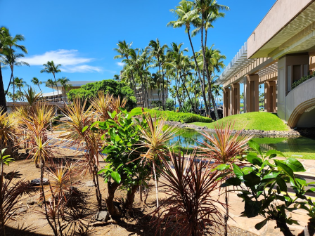
Recess
November 2024 802 Wireless Plenary

Slide 10
Resume from Recess
Task Group 15.4ab Next Generation UWB Amendment
November 2024 802 Wireless Plenary

Slide 11
Participants have a duty to inform the IEEE
Ways to inform IEEE
Cause an LOA to be submitted to the IEEE SA (patcom@ieee.org); or
Provide the chair of this group with the identity of the holder(s) of any and all such claims as soon as possible; or
Speak up now and respond to this Call for Potentially Essential Patents
If anyone in this meeting is personally aware of the holder of any patent claims that are potentially essential to implementation of the proposed standard(s) under consideration by this group and that are not already the subject of an Accepted Letter of Assurance, please respond at this time by providing relevant information to the WG Chair
Participants shall inform the IEEE (or cause the IEEE to be informed) of the identity of each holder of any potential Essential Patent Claims of which they are personally aware if the claims are owned or controlled by the participant or the entity the participant is from, employed by, or otherwise represents
Participants should inform the IEEE (or cause the IEEE to be informed) of the identity of any other holders of potential Essential Patent Claims
Early identification of holders of potential Essential Patent Claims is encouraged

Slide 12
Next Steps

Slide 13
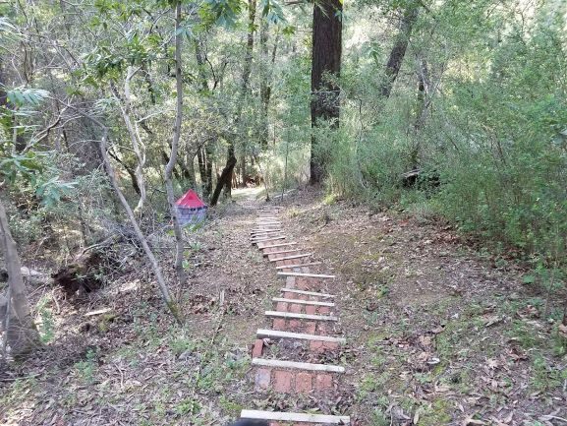
Next Steps

Slide 14
Near Term Working Milestones
 | Current Schedule
First letter ballot | June 2024
Initial LB comment resolution | Start: July 2024
First recirculation | Jan 2025
Recirculation comment resolution | Feb/March 2025
Second recirculation | March 2025
Recirculation comment resolution | March/April 2025
First SA-Ballot | May 2025
SA-Ballot comment resolution | Start July 2025
We are here

Slide 15
Forming a CRG
Comment Resolution Group (CRG)
Created by motion in the WG and authorized to initiate recirculation ballot(s) without WG motion.
During an interim or plenary session, the task group is the CRG
Why form an CRG now?
So we can initiate a recirculation before the January 2025 interim commences
Who should be the CRG
It must represent a diversity of affiliations: no single affiliation shared by 25% or more of the CRG.
Must be a voting member of WG15
Must be able to attend interim virtual meetings between close of November session ands start of January session (CRG action requires quorum)

Slide 16
Forming a CRG
Difference between TG and CRG between sessions
Everyone in the TG who attends meetings can contribute to comment resolutions
Approval of comment resolutions will be done by motion of all WG voters present just as we do in session
Motion to initiate recirculation is of CRG members
Volunteers to be on the CRG
Primary responsibility is to show up!
Meet the affiliation balance requirement
Need at least 4 people (to meet affiliation diversity)
No defined limit but…largest in WG15 history was about 17 people
6 to 12 is a good number

Slide 17
Forming a CRG: Volunteers
CRG Motion: move to request the working group form a comment resolution group with the following members:
Name | Affiliation
Ben Rolfe (Chair) | BCA
Billy Verso | Qorvo
Clint Chaplin | Samsung
Riku Pirhonen | NXP
Mickael Maman | ST Microelectronics
Rojan Chitrakar | Huawei
Alex Krebs | Apple
Pooria Pakrooh | Qualcomm
Carlos Aldana | Meta
Li-Hsiang Sun | MediaTek
Moved by: Clint Chaplin Second: Billy Verso
Passed by unanimous consent

Slide 18
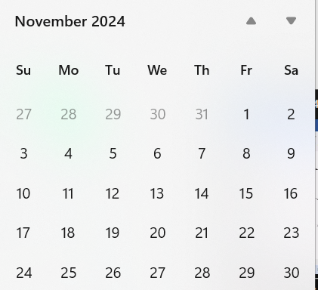
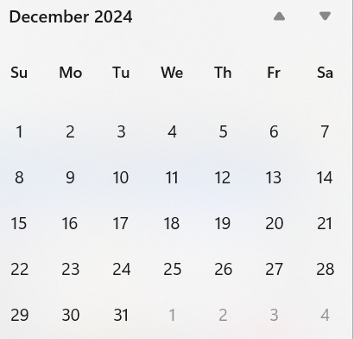
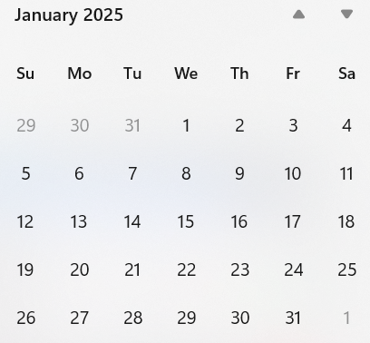
Call schedule, November thru January
Plenary
Commence on 26-November-2024 through January 7th
Weekly Tuesdays 06:00 PT (1 hour)
Thursdays 14:00 PT (1 hour)
Excludes November 28, December 24, 26, 31, January 2

Slide 19
Any Other Business

Slide 20
Adjourned

