Slide 1
Project: IEEE P802.15 Working Group for Wireless Specialty Networks (WSN)
Submission Title: Frequency Stitching Channel Usage Method
Source: Panpan Li, Bin Qian, Lei Huang, David Xun Yang (Huawei Technologies)
Address : [Huawei Bantian Base, Longgang District, Shenzhen, 518129 China]
E-Mail: [lipanpan25@huawei.com]
Re: Task Group 4ab: UWB Next Generation for 802.15.4
Abstract: [NB, UWB]
Purpose:
Notice: This document has been prepared to assist the IEEE P802.15. It is offered as a basis for discussion and is not binding on the contributing individual(s) or organization(s). The material in this document is subject to change in form and content after further study. The contributor(s) reserve(s) the right to add, amend or withdraw material contained herein.
Release: The contributor acknowledges and accepts that this contribution becomes the property of IEEE and may be made publicly available by P802.15.
Notes:
Jul 12, 2010
Page 1

Slide 2
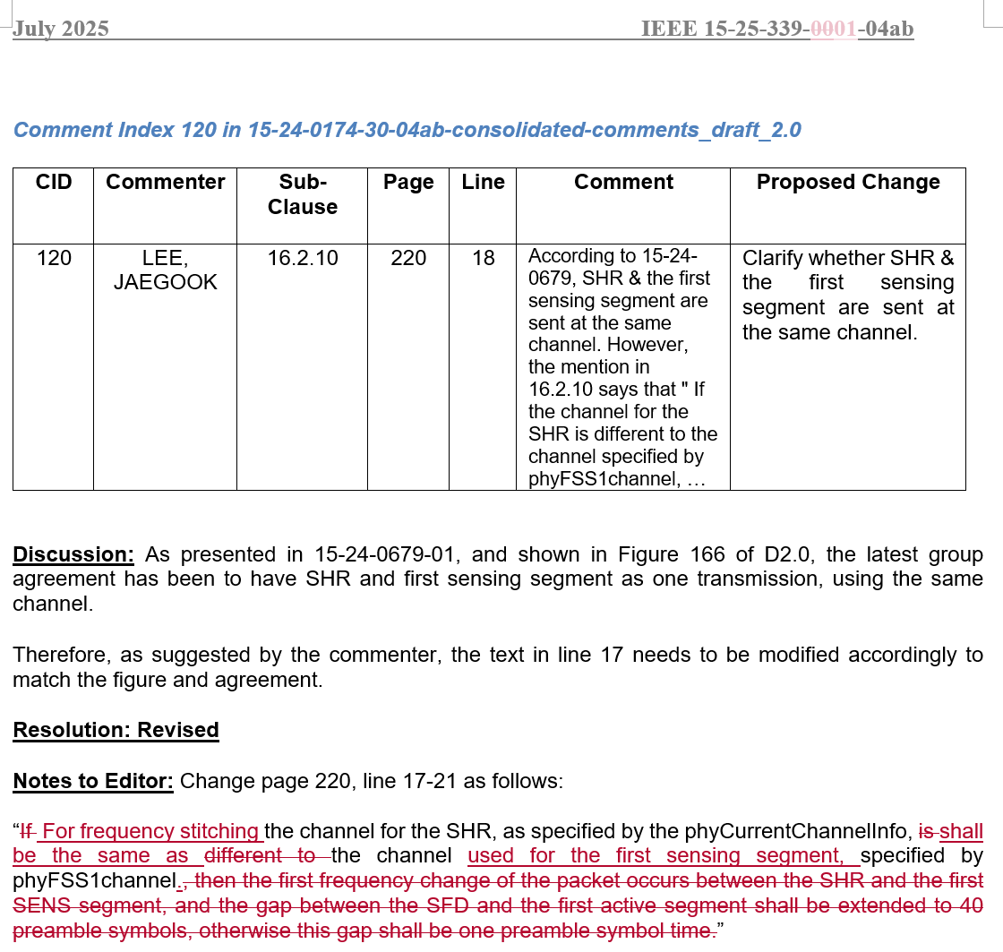
Introduction
Comment #120 pointed out the conflict text regarding frequency stitching.
DCN #15-25-339-01 proposed to stick to the consensus reached in DCN #15-24-679 and delete the conflict paragraph.
The contribution will present out views regarding this topic.

Slide 3
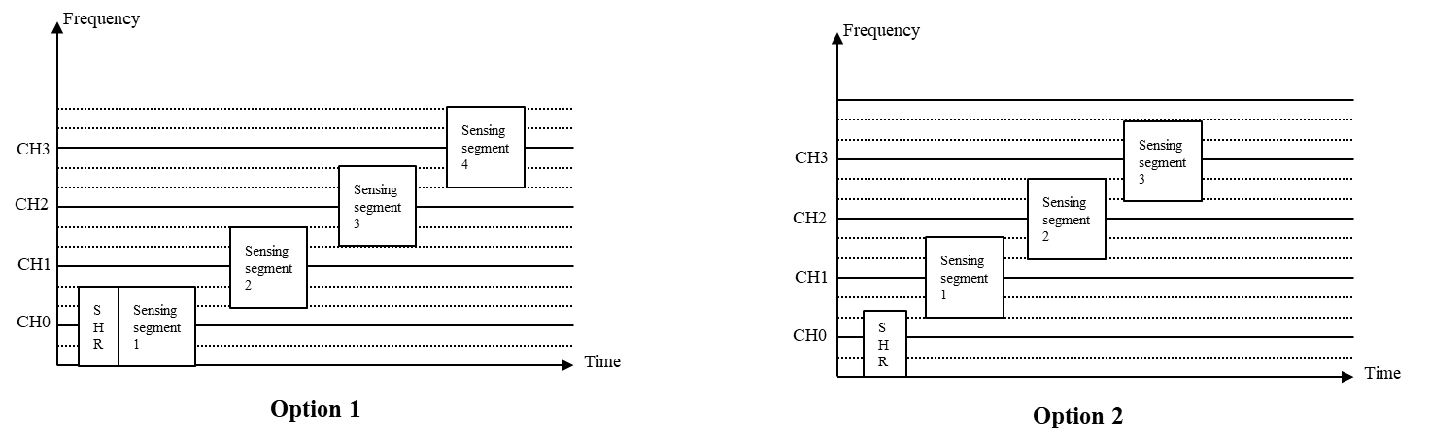
Recap of Timeline
CID #901, 1253, 264 for Draft 0.1 pointed out the problem that the transmission of SHR in each sensing packet is missing.
In September 2024, DCN #15-24-0462-00 proposed that SHR will be transmitted with first sensing segment and received the feedback that the length of SHR+segment is longer than length of segment, thus resulting power backoff. Group expected to transmit SHR separately.
In Nov-Dec 2024, DCN #15-24-0579 r0-r2 presented two options:
  Option 1: SHR will be transmitted with first sensing segment as one transmission
  Option 2: Just let all transmissions at different channels
  A straw poll was run and Option 1 was preferred.
In Dec 2024, DCN #15-24-0679-01 proposed the resolution aligning with the discussion result in DCN #15-24-0579 and was accepted.

Slide 4
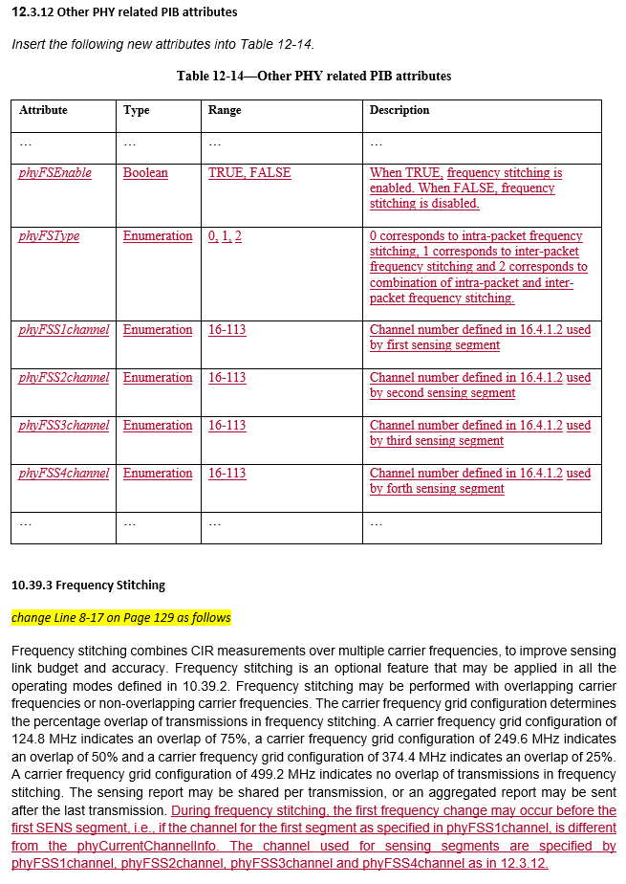
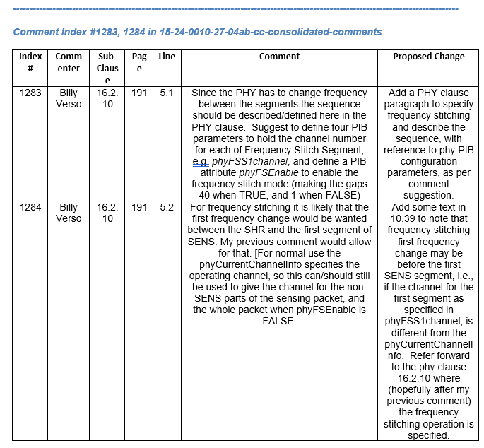
Recap of Timeline
In Nov 2024, DCN #15-24-0675-01 was accepted.
  To address CID 1283, 1284, some frequency stitching related primitives were defined and sentences describing the usage of defined primitives.
  The author didn’t realize the conflict of these added sentences with parallel discussions regarding DCN 579.
  No objection from group.

Slide 5
Next Step
Both schemes have pros and cons
  Option 1: SHR will be transmitted with first sensing segment as one transmission
    Pros: easier for implementation
    Cons: suffer power penalty
  Option 2: SHR and the first sensing segment are transmitted in different channels
    Pros: no power penalty
    Cons: sensing performance penalty because of not utilizing all bandwidth
  Option 3: configurable channel usage
    Pros: flexible
    Cons: increased implementation complexity
Suggest stick to the consensus reached in DCN #15-24-0579-02.
Support the proposed resolution in #15-25-0339-01.

Slide 6
SP
Which one do you like ?
  Option 1: SHR will be transmitted with first sensing segment as one transmission
  Option 2: SHR and the first sensing segment are transmitted in different channels
  Option 3: configurable channel usage
  Abstain

