Slide 1
Project: IEEE P802.15 Working Group for Wireless Specialty Networks (WSN)
Submission Title: July Plenary TG4ab Closing Report
Date Submitted: 12 May 2024
Source: Benjamin A. Rolfe (Blind Creek Associates)
Contact:
Voice: [deprecated],
E-Mail: ben.rolfe @ ieee.org
Re: Task Group 4ab: 802.15.4 UWB Next Generation
Abstract: Closing Report for the July 2024 Plenary Session
Purpose: Continue project progress and continue the illusion of organization
Notice: This document has been prepared to assist the IEEE P802.15. It is offered as a basis for discussion and is not binding on the contributing individual(s) or organization(s). The material in this document is subject to change in form and content after further study. The contributor(s) reserve(s) the right to add, amend or withdraw material contained herein.
Release: The contributor acknowledges and accepts that this contribution becomes the property of IEEE and may be made publicly available by P802.15.

Slide 2
Task Group 15.4ab Next Generation UWB Amendment
July 2024 802 Wireless Plenary Session
Mixed Mode
Live Montreal, Quebec, Canada
Closing Report

Slide 3
Agenda
(check mentor for latest version)
https://mentor.ieee.org/802.15/dcn/24/15-24-0344-02-04ab-tg4ab-agenda-july-2024.xlsx

Slide 4
Session Objectives
Review and Resolve ballot comments
Update the Coexistence Assessment Document

Slide 5
5.2.b Scope of the project (As approved):
This amendment enhances the Ultra Wideband (UWB) physical layers (PHYs) medium access control (MAC), and associated ranging techniques while retaining backward compatibility with enhanced ranging capable devices (ERDEVs). Areas of enhancement include:
additional coding, preamble and modulation schemes to additional coding, preamble and modulation schemes to support improved link budget and/or reduced air-time relative to IEEE Std 802.15.4 UWB;
additional channels and operating frequencies;
interference mitigation techniques to support greater device density and higher traffic use cases relative to the IEEE Std 802.15.4 UWB;
improvements to accuracy, precision and reliability and interoperability for high-integrity ranging; schemes to reduce complexity and power consumption;
definitions for tightly coupled hybrid operation with narrowband signaling to assist UWB;
enhanced native discovery and connection setup mechanisms;
sensing capabilities to support presence detection and environment mapping;
and mechanisms supporting low-power low-latency streaming as well as high data-rate streaming allowing at least 50 Mb/s of throughput.
Support for peer-to-peer, peer-to-multi-peer, and station-to-infrastructure protocols are in scope, as are infrastructure synchronization mechanisms. This amendment includes safeguards so that the high throughput data use cases do not cause significant disruption to low duty-cycle ranging use cases.
https://development.standards.ieee.org/myproject-web/app#viewpar/9081

Slide 6
Near Term Working Milestones
 | Original Schedule | Current Schedule
Call for proposals | November 2021
Cut-off for new features (high level feature set), PHY | May 2022
Cut-off for new features (high level feature set), MAC | July 2022
Draft 0 | Post-January 2023 | Post March July Sept 2023
TG draft review and revision complete | February - March 2023 | Mar-June 2023 Sept 2023 Oct 2023
Working group pre-ballot review commence | March – May 2023 (following March meeting) | July August Sept Start: Nov 2023 Close: 2 Jan 2024
Comment Resolution |  | Start: Jan 2024 Done: June 2024 (??)
First letter ballot | June 2023 (following meeting) | Oct Nov 2023 Jan 2024 June 2024
Initial LB comment resolution |  | Start: July 2024 Done: TBD
DONE
We are here
DONE

Slide 7
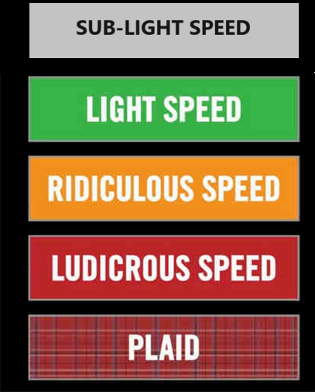
Comment Resolution

Slide 8
Overview of Comments
Total # Comments | # with Blank resolution
1470 | 1402
Technical | Editorial
854 | 611
General
5
Technical Category | Code | # CIDs
Ack changes | ACK | 2
Other channel access | CHA | 3
Dynamic Data Rate Mode | DDRN | 0
Device discovery | DISC | 36
Multi-node ranging / Hyper Block | HB | 66
LDPC | LCPC | 0
MAC General | MAC | 23
Not another category | MISC | 4
MMS general (both) | MMS | 246
MMS specific to Narrow Band | MMSNB | 4
MMS specific to UWN | MMSUWB | 9
Narrow Band specific function | NBF | 31
New frame format | NEWFR | 279
Technical Category | Code | # CIDs
UWB PHY HRP | PHYHRP | 13
UWB PHY LE | PHYLE | 8
Narrow Band PHY | PHYNB | 20
RSS | RSS | 5
Sensing | SENS | 86
SSBD | SSBD | 6
Assigned to the Technical Editor | TE | 617
UWB data offload | UWBDO | 10
Wake-up Radio | WUR | 1
Technical | Editorial
29 | 16
General | Total
2 | 47
Proposed Resolutions
47
Lots of fun to be had!

Slide 9
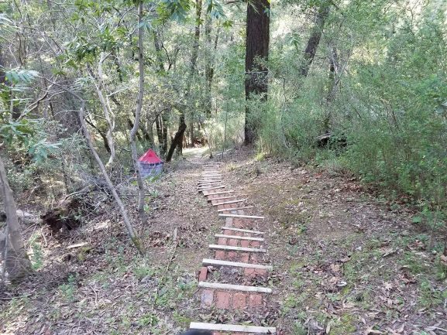
Next Steps

Slide 10
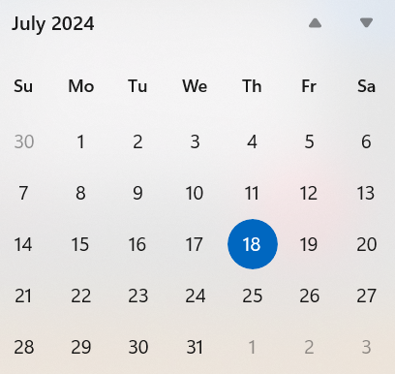
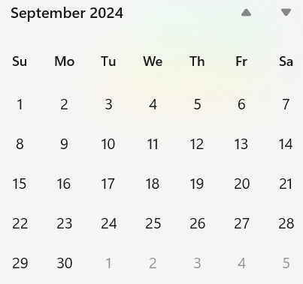
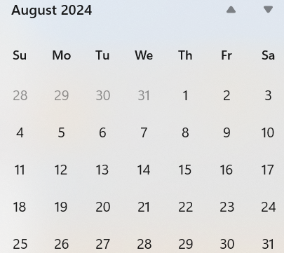
Call schedule, July thru Sept
Tuesdays, July 30, 06:00 PT (1 hour)
Weekly Tuesdays and Thursdays 06:00 (1 hour)
August 6 through September 5.

Slide 11
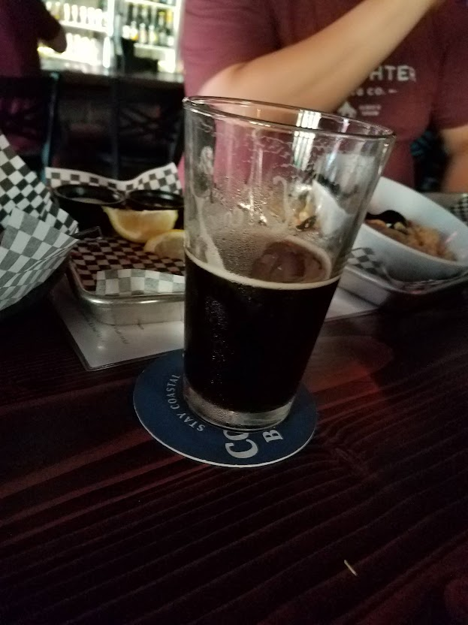
Thanks for listening

