Slide 1
Project: IEEE P802.15 Working Group for Wireless Personal Area Networks (WPANs)
Submission Title: IG Access July Meeting Slides
Date Submitted: 17 January 2024
Source: Benjamin A. Rolfe (Blind Creek Associates)
Contact:
Voice: +1 408 395 7207, E-Mail: ben.rolfe @ ieee.org
Re: Wireless Next Generation
Abstract: Agenda and Meeting Slides for the July 2024 Plenary Session. Interest group access
Purpose: Support the illusion of organization.
Notice: This document has been prepared to assist the IEEE P802.15. It is offered as a basis for discussion and is not binding on the contributing individual(s) or organization(s). The material in this document is subject to change in form and content after further study. The contributor(s) reserve(s) the right to add, amend or withdraw material contained herein.
Release: The contributor acknowledges and accepts that this contribution becomes the property of IEEE and may be made publicly available by P802.15.
Notes:
Jul 12, 2010
Page 1

Slide 2
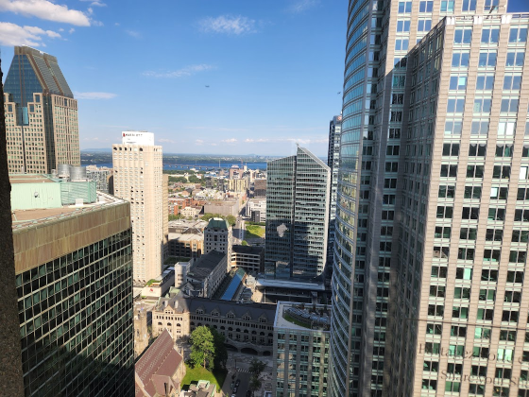
July 2024 802 Plenary Interest Group, Spectrum Channel Access

Slide 3
Hybrid Meeting
Registration is required
Please remember to enter your attendance in IMAT
Reminder:
This is a non-PAR activity
All the rules of conduct apply https://grouper.ieee.org/groups/802/sapolicies.shtml

Slide 4
Agenda
Opening and Meeting Reminders
Overview of Interest Group
Technical Discussion
Any other business
Adjourn

Slide 5
Opportunity Statement
Need to share spectrum
Need to share with uncoordinated, random access
Sharing through coexistence is essential
Need to accommodate reality
We need a systems view of coexistence to advance beyond avoidance
Greater than a single amendment to a single standard

Slide 6
Basis Realities for this IG (ground rules)
There are many 802 wireless technologies
All are important
None are more important (in the system view) than others
Diversity of uses is an important metric for spectrum efficiency
Diversity of technologies is a strength of 802
There are other technologies we have to expect
Won’t abide by our rules
Must abide by regulations
802 is not a regulatory body

Slide 7
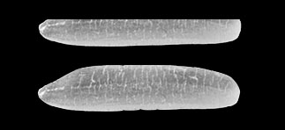
A tale of two methods of unlicensed access
+23 dBm/MHz
Mt Everest
8,849 meters
Standard Power U-NII
Power Represented as Height
Emitted Signal Power
-41 dBm/MHz
1.6 Rice Grains (2mm ea.)
UWB

Slide 8
Foundation: Sharing
Sharing means different things.
I told
you that spectrum is mine!
Toddler Rules of Sharing
1. If it’s mine, it’s mine!
Incumbents
2. If it’s yours, it’s mine!
New Entrants
3. If it’s broken, it’s yours!
Use the bands we don’t want

Slide 9
Foundation: Sharing
Or to put that another way…
Traditional non-sharing: It’s mine and you can’t play with it
Sharing by avoidance: in time, frequency, geography: you get a turn
Sharing by coexistence: We can play together
Traditional unlicensed (LBT): avoidance at a finer time scale
Co-use: ability for two radios to transmit and not annihilate each other

Slide 10
Foundation: Sharing
Sharing means different things
Avoidance is one tool (part) that is familiar
Separation in time, frequency or geography
Unsustainable
Avoidance isn’t enough nor sustainable
Sharing by enabling mutual successful operation is better
This is a working definition of sharing by coexistence
Coexistence is complicated – no one methods works always, everywhere, for everyone

Slide 11
A Systems View
There’s a lot of different things using the spectrum
Not all are “family”
There are a lot of different use cases RF environments, driving different (and often dynamic) requirements
There’s a lot of parts that are useful
Some commonality among our standards
Many, many choices (knobs to twiddle)
There are many trade-offs – what works best depends upon what you need to accomplish
A systems view: do what works best for what you are optimizing (optimal assembly of parts – this is dynamic)

Slide 12
Coexistence isn’t one thing
Channel sensing can be useful
Traditional LBT (listen, decide) can work sometimes
Traditional LBT doesn’t work sometimes
LBT is part of a solution, not a solution
Obvious examples of LBT:
802.11 CSMA-CA (multiple variations)
802.15.4 CSMA-CA (multiple variations)
Need to look at the whole problem

Slide 13
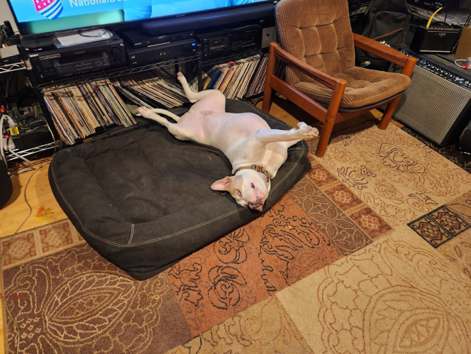
Discussion

Slide 14
IG Results (outputs)
[to be discussed]

Slide 15
Any Other Business

Slide 16
Adjourned

