Slide 1
IG NG-OWC
Submission Title: Integrating OCC with Few-shot Learning for NG-OWC
Date Submitted: July 16, 2024
Source: Muhammad Rangga Aziz Nasution, Nguyen Ngoc Huy, Yeong Min Jang (Kookmin University)
Address: Room #603 Mirae Building, Kookmin University, 77 Jeongneung-Ro, Seongbuk-Gu, Seoul, 136702, Republic of Korea
Voice: +82-2-910-5068 E-Mail: yjang@kookmin.ac.kr
Re:
Abstract: Present the Autoencoder with unsupervised deep learning for NG-OWC
Purpose: Presentation for contribution on IG NG-OWC
Notice: This document has been prepared to assist the IG NG-OWC. It is offered as a basis for discussion and is not binding on the contributing individual(s) or organization(s). The material in this document is subject to change in form and content after further study. The contributor(s) reserve(s) the right to add, amend or withdraw material contained herein.
Release: The contributor acknowledges and accepts that this contribution becomes the property of IEEE and may be made publicly available by IG NG-OWC.

Slide 2
Integrating OCC with Few-shot Learning for NG-OWC July 16, 2024

Slide 3
Contents
Background
How few-shot learning works
Integrating OCC with Few-shot learning
Conclusion

Slide 4
Background
Few-shot learning is a machine learning paradigm where models are designed to generalize and perform tasks effectively with only a few labeled examples. This approach contrasts with traditional methods that require large datasets for training.
Few-shot learning enables models to quickly adapt to new tasks or classes with minimal data. Techniques such as meta-learning, transfer learning, and similarity-based methods are commonly used to achieve this rapid adaptation.

Slide 5
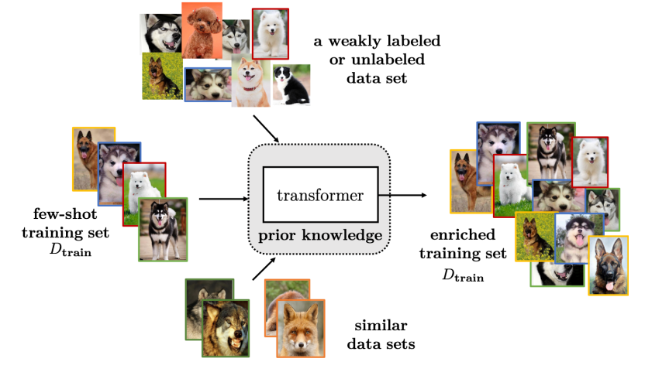
How Few-shot Learning Works
Few-shot learning functions to generalize knowledge from previously seen tasks to new tasks with minimal data. By learning how to learn, models can apply insights from a few examples to handle new, similar tasks effectively
Few-shot learning enables models to make accurate predictions and classifications based on a small number of training examples. This efficiency is particularly valuable in scenarios where collecting large datasets is impractical or impossible.

Slide 6
How Few-shot Learning Works
Few-shot learning allows models to quickly adapt to new and unseen classes or tasks with very few labeled examples. This rapid adaptation is crucial for applications where conditions or requirements change frequently, and there is a need for swift model updates.
Few-shot learning effectively leverages prior knowledge from related tasks or domains to enhance performance on new tasks. Techniques like transfer learning and meta-learning help the model use pre-existing knowledge to better understand and learn from the limited new data it encounters.

Slide 7
Integrating OCC with Few-shot Learning
Few-shot learning can enable OCC systems to generalize from a small number of examples to recognize and decode new signal patterns. This is particularly useful for adapting to new communication protocols or signal formats with minimal retraining.
In OCC applications, collecting extensive labeled data for every possible signal variation can be challenging. Few-shot learning allows the system to efficiently recognize and interpret signals from a few examples, making it practical to deploy in diverse environments.

Slide 8
Integrating OCC with Few-shot Learning
Few-shot learning allows OCC systems to quickly adapt to changing lighting conditions, backgrounds, and other environmental factors. This ensures reliable communication even when the physical environment or the characteristics of the light source change frequently.
By leveraging models pre-trained on large datasets, few-shot learning can fine-tune these models to the specific requirements of OCC. This enables the system to rapidly and effectively learn new signal patterns or adapt to new conditions with minimal additional data.

Slide 9
Conclusion
Few-shot learning significantly enhances the flexibility of OCC systems by enabling them to generalize and adapt to new signal patterns and communication protocols with minimal data, facilitating smoother integration into various applications.
By efficiently recognizing and decoding signals from a limited number of examples, few-shot learning reduces the need for extensive labeled datasets, making OCC systems more practical and cost-effective to implement.
The rapid adaptation capabilities of few-shot learning ensure that OCC systems remain reliable and effective even in dynamically changing environments, such as varying lighting conditions and backgrounds.
Few-shot learning allows OCC systems to leverage pre-trained models, enabling quick and effective learning of new signal patterns or environmental conditions. This results in faster deployment and improved performance with minimal additional training data.

Slide 10
Reference
Y. Wang, Q. Yao, J. T. Kwok, and L. M. Ni, “Generalizing from a few examples: A survey on few-shot learning,” ACM Comput. Surv., vol. 53, no. 3, pp. 1–34, 2021.
J. Raghuram et al., “Few-shot domain adaptation for end-to-end communication,” arXiv [cs.LG], 2021.
L. Zhu, M. Deng, B. Lu, X. Guo, and A. Wang, “Turbulence-resistant high-capacity free-space optical communications using OAM mode group multiplexing,” Opt. Express, vol. 31, no. 9, p. 14454, 2023.

