Slide 1
IG NG-OWC
Submission Title: Integrating Optical Camera Communication and Deep Learning into Intelligent Internet of Vehicles for NG-OWC
Date Submitted: July 16, 2024
Source: Herfandi Herfandi, Nguyen Ngoc Huy, Yeong Min Jang, Kookmin University
Address: Room #603 Mirae Building, Kookmin University, 77 Jeongneung-Ro, Seongbuk-Gu, Seoul, 136702, Republic of Korea
Voice: +82-2-910-5068 E-Mail: yjang@kookmin.ac.kr
Re:
Abstract: Present the integrating OCC and DL into IIoV for NG-OWC
Purpose: Presentation for contribution on IG NG-OWC
Notice: This document has been prepared to assist the IG NG-OWC. It is offered as a basis for discussion and is not binding on the contributing individual(s) or organization(s). The material in this document is subject to change in form and content after further study. The contributor(s) reserve(s) the right to add, amend or withdraw material contained herein.
Release: The contributor acknowledges and accepts that this contribution becomes the property of IEEE and may be made publicly available by IG NG-OWC.

Slide 2
Integrating Optical Camera Communication and Deep Learning into Intelligent Internet of Vehicles for NG-OWC July 16, 2024

Slide 3
Contents
Background
Overview of the IoV
Architecture Optical Vehicular Communication
OCC Transmitter & Receiver
Architecture Intelligent IoV
Results of Intelligent IoV
Conclusion

Slide 4
Background
Currently, the amount of technology devices equipped with sensors has significantly increased, including vehicles, smartphones, laptops, tablets, TVs, and music systems.
The Internet of Vehicles (IoV) is an evolution of Vehicular Ad Hoc Networks (VANETs) designed to provide "smart transportation" by enhancing traffic safety and efficiency via real-time communication.
Optical Camera Communication (OCC) uses LEDs and cameras for communication in autonomous vehicles. OCC provides MIMO capabilities, an unlicensed spectrum, large frequency bands, simultaneous distance measurement, independence from base stations, and the ability to broadcast information.
The integration of Deep Learning (DL) helps detect the position of LEDs and recognize signals from transmitted LED patterns.

Slide 5
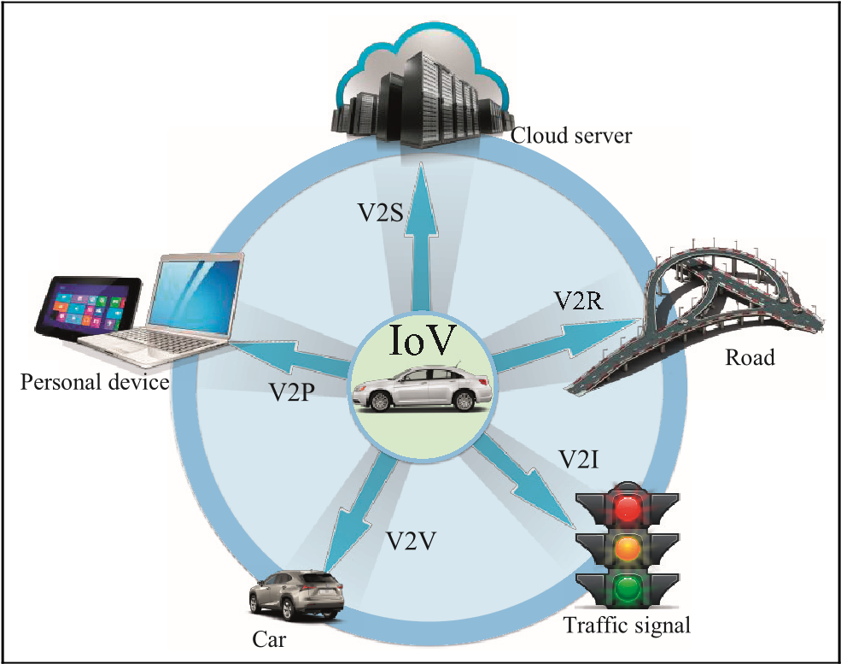
Overview of the IoV
The Internet of Vehicles (IoV) is an essential part of the Internet of Things (IoT) that connects various networks, including intra-vehicle networks and networks between vehicles and the Internet
Several countries have already started implementing or planning basic IoV services.
Additionally, Google and Apple are developing connected driving systems for smartphones, such as Apple CarPlay.
Intelligent Transport Systems (ITS) need to develop new solutions that can complement existing networks to better process data from vehicles.
Optical Camera Communication (OCC) could be a better option for vehicle-to-vehicle communication, improving driving safety, providing collision warnings, detecting pedestrians, and estimating the distance between vehicles.
<The five types of vehicular communications of IoV>

Slide 6
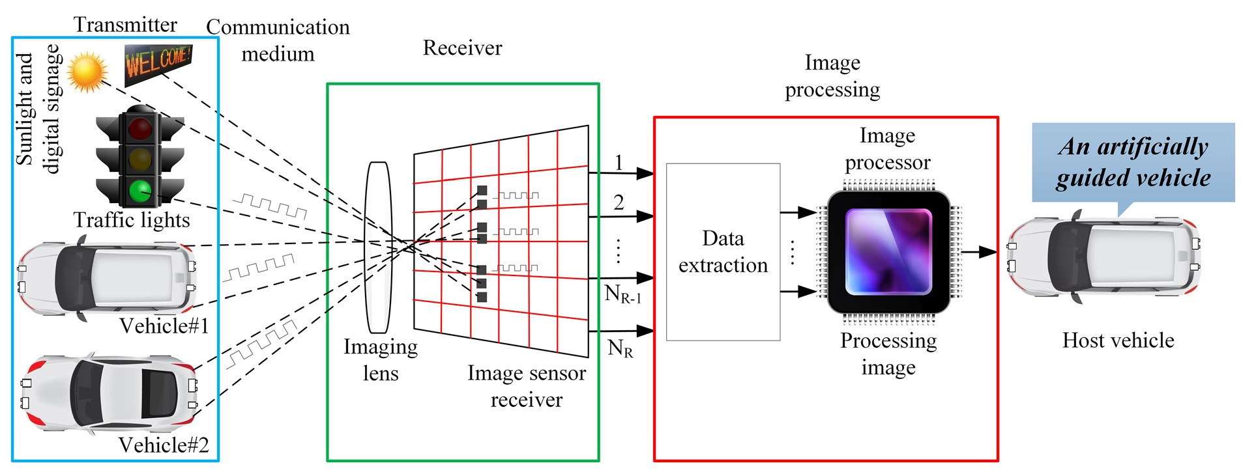
Architecture Optical Vehicular Communication
<Operation of image sensor–based optical vehicular communication>
Transmitter: Traffic lights and vehicles (Vehicle #1 and Vehicle #2) use LED arrays as signal transmitters. Sunlight and digital billboards are sources of interference.
Communication Medium: Light from the transmitter is transmitted via the air to the receiver. The imaging lens on the receiver captures light from various sources.
Receiver: The light captured by the lens is forwarded to the image sensor, which forms pixel images. The image sensor differentiates signals from various transmitters and eliminates background noise.
Image Processing: Data is extracted from the signals received by the image sensor, separating relevant signals from interference. Images are processed to decode information from the LED arrays, including vehicle safety data and position.
Host Vehicle: The vehicle receives and processes information from the transmitter.

Slide 7
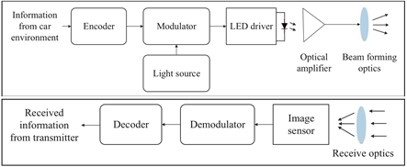
OCC Transmitter & Receiver
<Block diagram of the OCC transmitter & receiver>
Transmitter
Encoder: Collects data from the vehicle's environment, which is then encoded.
Modulator: Modulates the encoded data.
Light Source: High-power LEDs or laser diodes generate light signals.
LED Driver: Controls the operation of the LEDs.
Optical Amplifier: Amplifies the light signal if needed.
Beam Forming Optics: Directs the emitted light signal information from the transmitter.
Receiver:
Receive Optics: The imaging lens projects light onto the image sensor.
Image Sensor: Captures images of the road environment.
Demodulator: Demodulates the received signals.
Decoder: Uses algorithms to decode the signals from the transmitter captured by the camera. And Received information from the transmitter.

Slide 8
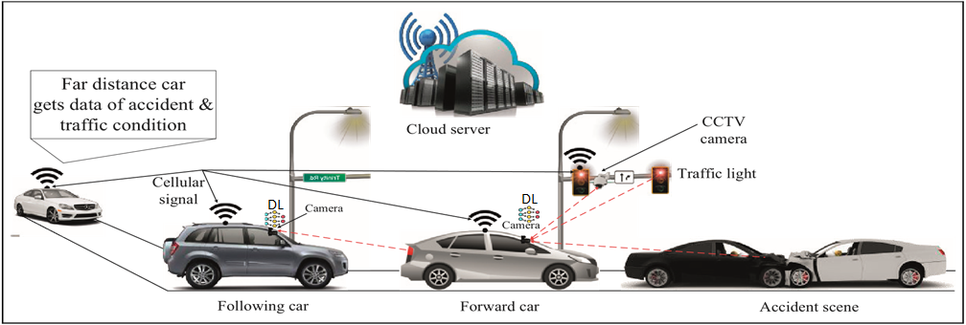
Architecture Intelligent IoV
< System architecture for an intelligent IoV>
There are three main forms of communication in the system architecture for intelligent IoV: V2V,V2I and V2C.
V2V: The front vehicle transmits information using modulated rear LED lights, and the rear vehicle receives this information.
V2I: Vehicles can receive traffic information from traffic lights, including emergency information, traffic conditions, safety information, and accident reports.
V2C: Both front and rear vehicles can share information with the cloud server using edge server technology via API.
By using cameras as receivers in OCC, we can perform multiple LED detections and recognize signal patterns from LED arrays using deep learning. Additionally, with the region of interest technique, we can remove interference from light sources.

Slide 9
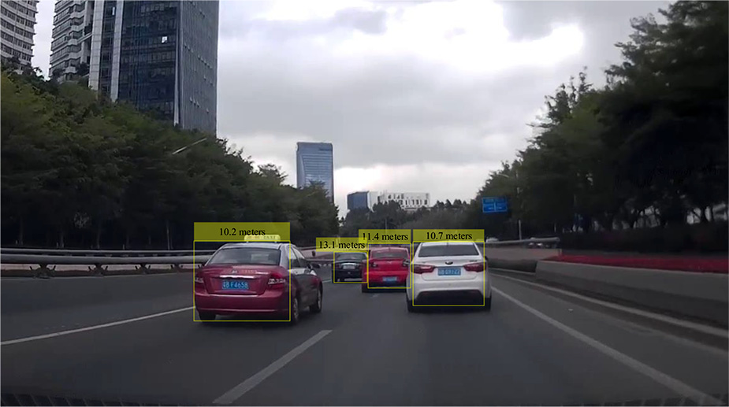
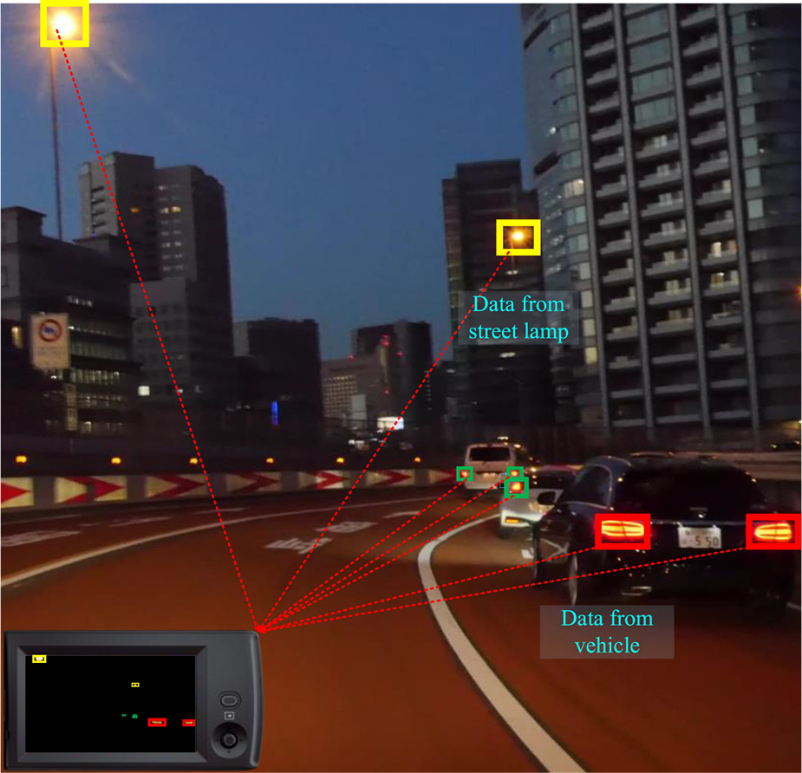
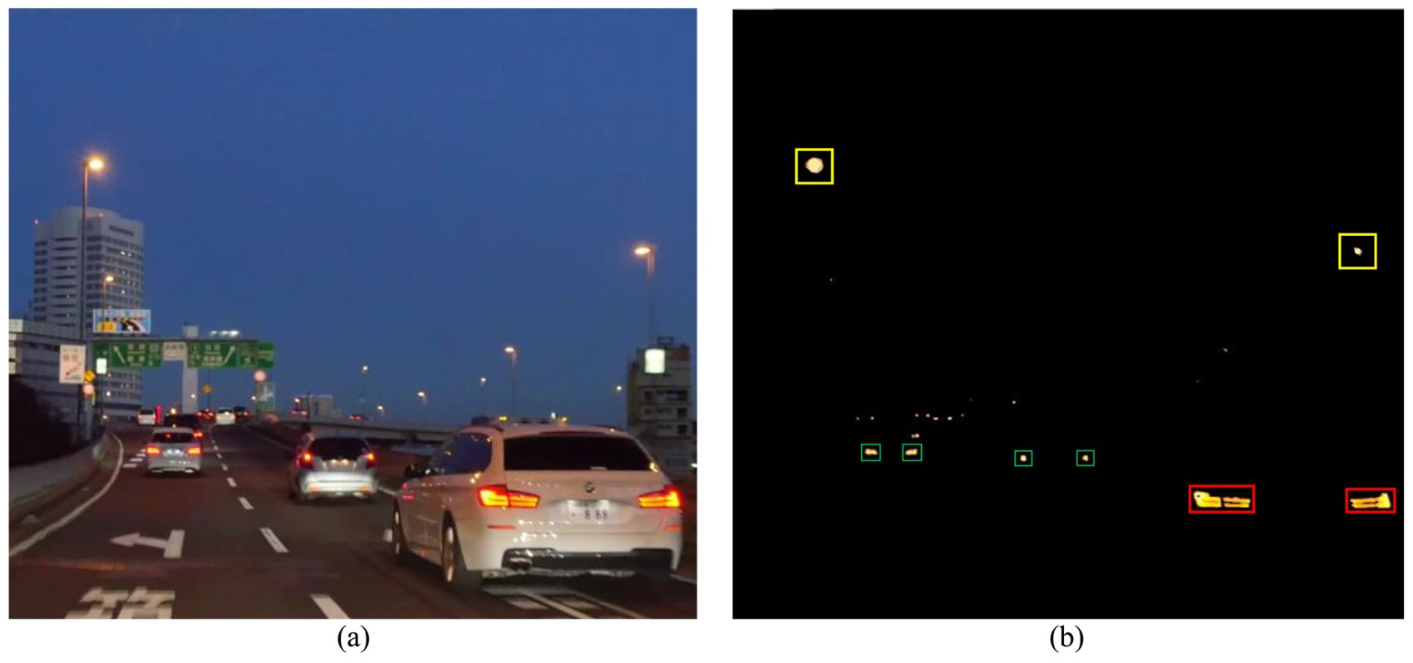
Results of Intelligent IoV
< Measurement of distance using stereo camera – based depth estimation>
< Multiple RoI detection to remove interference from light sources.>
< (a) Original image, (b) successful removal of interference from light sources>

Slide 10
Conclusion
Integrating Optical Camera Communication (OCC) and Deep Learning (DL) into Intelligent Internet of Vehicles (IoV) significantly improves real-time communication, enhancing traffic safety and efficiency through advanced vehicle-to-vehicle and vehicle-to-infrastructure interactions.
DL enables accurate detection of LED positions and recognition of signals, effectively mitigating interference from sunlight, bad weather, and other sources, ensuring reliable communication under various conditions.
The IoV system architecture includes V2V, V2I, and V2C communication, enabling seamless data exchange between vehicles, infrastructure, and the cloud.
In the context of NG-OWC, integrating OCC and DL into Intelligent IoV enhances real-time communication, safety, and efficiency.

Slide 11
Reference
A. Islam, N. Thomos and L. Musavian, "Multi-Agent Deep Reinforcement Learning for Spectral Efficiency Optimization in Vehicular Optical Camera Communications," in IEEE Transactions on Mobile Computing, vol. 23, no. 5, pp. 3666-3679, May 2024, doi: 10.1109/TMC.2023.3278277.
M. Eghbal, F. Tabataba, A. Gholami, J. Abouei, and M. Uysal, "Effect of a vehicle’s mobility on SNR and SINR in vehicular optical camera communication systems," in Opt. Express vol. 32, 12257-12275 (2024).
Huang, R.; Yamazato, T. A Review on Image Sensor Communication and Its Applications to Vehicles. Photonics 2023, 10, 617. https://doi.org/10.3390/photonics10060617
Islam A, Hossan MT, Jang YM. Convolutional neural networkscheme–based optical camera communication system for intelligent Internet of vehicles. International Journal of Distributed Sensor Networks. 2018;14(4). doi:10.1177/1550147718770153

