Slide 1
IG NG-OWC
Submission Title: Adaptive modulation and coding(AMC) technique for OCC/FSO link for NG-OWC
Date Submitted: July 16, 2024
Source: Ones Sanjerico Sitanggang, Nguyen Ngoc Huy, Yeong Min Jang (Kookmin University)
Address: Room #603 Mirae Building, Kookmin University, 77 Jeongneung-Ro, Seongbuk-Gu, Seoul, 136702, Republic of Korea
Voice: +82-2-910-5068 E-Mail: yjang@kookmin.ac.kr
Re:
Abstract: Present the adaptive modulation and coding(AMC) technique for OCC/FSO link for NG-OWC Purpose: Presentation for contribution on IG NG-OWC
Notice: This document has been prepared to assist the IG NG-OWC. It is offered as a basis for discussion and is not binding on the contributing individual(s) or organization(s). The material in this document is subject to change in form and content after further study. The contributor(s) reserve(s) the right to add, amend or withdraw material contained herein.
Release: The contributor acknowledges and accepts that this contribution becomes the property of IEEE and may be made publicly available by IG NG-OWC.

Slide 2
Adaptive modulation and coding(AMC) technique for OCC/FSO link for NG-OWC July 16, 2024

Slide 3
Contents
Background
Adaptive modulation and coding(AMC) technique for OCC/FSO link for NG-OWC
Conclusion

Slide 4
Background
OCC and FSO technologies face significant challenges, particularly atmospheric turbulence, which causes fading in communication systems.
Additionally, fading caused by atmospheric turbulence can lead to sudden and unpredictable fluctuations in signal intensity, especially in optical communication systems like Free-Space Optical (FSO).
In Optical Camera Communication (OCC), atmospheric turbulence can result in Mie and Rayleigh scattering, where changes in light intensity are irregular and can vary unpredictably with fluctuations in atmospheric turbulence conditions.
Transmitting data with fixed modulation under these conditions can lead to degraded system performance in terms of BER (Bit Error Rate) and system data rate.
Currently, AMC techniques have been used in RF communication systems. However, there is a need to apply these techniques to support channel systems in OCC and FSO communications.

Slide 5
Adaptive modulation and coding(AMC) technique for OCC/FSO link for NG-OWC
An adaptive scheme refers to a communication scheme that can adjust to certain conditions to ensure stable and efficient data transmission.
In OCC/FSO, adaptive threshold techniques are used to calculate optimal parameters such as modulation levels and error correction codes to maintain signal quality amidst atmospheric turbulence.
Additionally, implementing adaptive modulation and coding(AMC) in OCC/FSO systems allows real-time adjustment of modulation levels and coding schemes based on detected channel conditions, minimizing Bit Error Rate (BER) and optimizing system data rate.

Slide 6
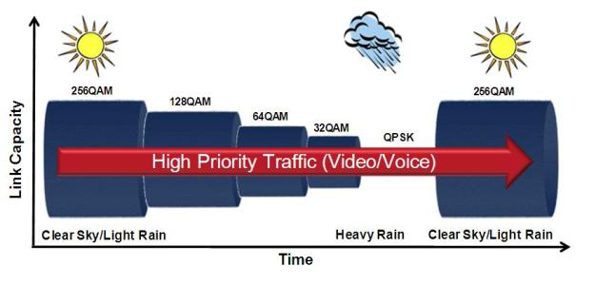
Adaptive modulation and coding(AMC) technique for OCC/FSO link for NG-OWC
By Continuously monitoring channel conditions, the proposed method optimizes data throughput in the communication system. When the channel quality is good (with minimal fading and interference), the algorithm selects high-level modulation to maximize throughput.
However, when channel conditions deteriorate (such as during rain or fog), causing high interference and fading in the communication system, the algorithm switches to low-level modulation schemes to minimize Bit Error Rate (BER).

Slide 7
Adaptive modulation and coding(AMC) technique for OCC/FSO link for NG-OWC
With this adaptive algorithm, it can mitigate the effects of atmospheric disturbances on communication, maintaining stability and efficiency in data transmission even under unstable environmental conditions.

Slide 8
Conclusion
In the proposed approach to address this, AMC techniques adjust modulation levels and coding schemes according to varying channel conditions, such as atmospheric turbulence in OCC/FSO systems.
Through continuous monitoring of channel conditions, the system selects high-level modulation to maximize throughput when the channel is in good condition, and switches to low-level modulation to minimize Bit Error Rate (BER) when channel conditions deteriorate.
This implementation of AMC ensures stability and efficiency of optical communication and FSO systems against atmospheric disturbances.

Slide 9
Reference
M. Elamassie and M. Uysal, "Feedback-Free Adaptive Modulation Selection Algorithm for FSO Systems," in IEEE Wireless Communications Letters, vol. 10, no. 9, pp. 1964-1968, Sept. 2021, doi: 10.1109/LWC.2021.3088871.
M. R. Bhatnagar, "A One Bit Feedback Based Beamforming Scheme for FSO MISO System Over Gamma-Gamma Fading," in IEEE Transactions on Communications, vol. 63, no. 4, pp. 1306-1318, April 2015, doi: 10.1109/TCOMM.2015.2391178.

