Slide 1
Project: IEEE P802.15 Working Group for Wireless Specialty Networks (WSN)
Submission Title: TG 15.4ab Interim Call Slides May-July
Date Submitted: 28 May 2024
Source: Benjamin A. Rolfe (Blind Creek Associates)
Contact:
Voice: +1 408 395 7207, E-Mail: ben.rolfe @ ieee.org
Re: Task Group 4ab: 802.15.4 UWB Next Generation
Abstract: Meeting Slides the Interim meeting, May 28 through July 11, 2024
Purpose: Continue project progress
Notice: This document has been prepared to assist the IEEE P802.15. It is offered as a basis for discussion and is not binding on the contributing individual(s) or organization(s). The material in this document is subject to change in form and content after further study. The contributor(s) reserve(s) the right to add, amend or withdraw material contained herein.
Release: The contributor acknowledges and accepts that this contribution becomes the property of IEEE and may be made publicly available by P802.15.

Slide 2
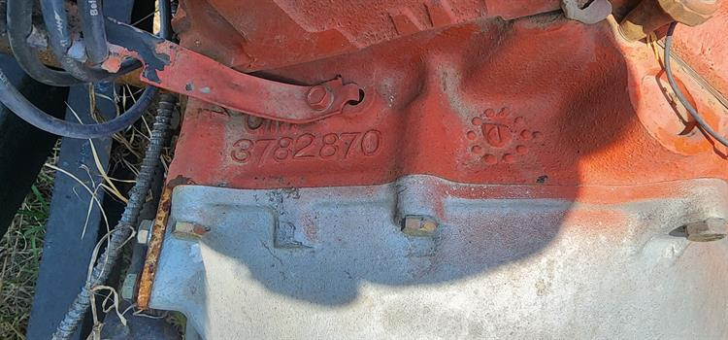
Task Group 15.4ab Next Generation UWB Amendment
Meeting Slides for the Interim meeting
May 28th through July 11th, 2024

Slide 3
Meeting Preamble
Stuff you need to know before we get to the meeting content

Slide 4
Task Group Rules
Discussion: Everyone present is welcome
Straw polls: Everyone present may vote
Formal motions: WG voters
To make, second and vote
Patent policy for PAR activities applies
All the usual rules of conduct
Please identify yourself on first contact with name and affiliation

Slide 5
IEEE-SA Patent, Copyright, and Participation Policies
See: https://grouper.ieee.org/groups/802/sapolicies.shtml
IEEE-SA Patent Slides for Standards Development Meetings (.pdf)
https://development.standards.ieee.org/myproject/Public/mytools/mob/slideset.pdf
IEEE-SA Standards Board Patent Committee (PatCom) home page
https://standards.ieee.org/content/ieee-standards/en/about/sasb/patcom/index.html
IEEE-SA Participation Policy meeting slide set - individual method (.pdf)
https://standards.ieee.org/content/dam/ieee-standards/standards/web/documents/other/Participant-Behavior-Individual-Method.pdf
Working Group Copyright Materials
https://standards.ieee.org/ipr/copyright-materials.html
https://standards.ieee.org/content/dam/ieee-standards/standards/web/documents/other/ieee-sa-copyright-policy-2019.pdf

Slide 6
Participants have a duty to inform the IEEE
Participants shall inform the IEEE (or cause the IEEE to be informed) of the identity of each holder of any potential Essential Patent Claims of which they are personally aware if the claims are owned or controlled by the participant or the entity the participant is from, employed by, or otherwise represents
Participants should inform the IEEE (or cause the IEEE to be informed) of the identity of any other holders of potential Essential Patent Claims
Early identification of holders of potential Essential Patent Claims is encouraged

Slide 7
Participants have a duty to inform the IEEE
Ways to inform IEEE
Cause an LOA to be submitted to the IEEE SA (patcom@ieee.org); or
Provide the chair of this group with the identity of the holder(s) of any and all such claims as soon as possible; or
Speak up now and respond to this Call for Potentially Essential Patents
If anyone in this meeting is personally aware of the holder of any patent claims that are potentially essential to implementation of the proposed standard(s) under consideration by this group and that are not already the subject of an Accepted Letter of Assurance, please respond at this time by providing relevant information to the WG Chair
Participants shall inform the IEEE (or cause the IEEE to be informed) of the identity of each holder of any potential Essential Patent Claims of which they are personally aware if the claims are owned or controlled by the participant or the entity the participant is from, employed by, or otherwise represents
Participants should inform the IEEE (or cause the IEEE to be informed) of the identity of any other holders of potential Essential Patent Claims
Early identification of holders of potential Essential Patent Claims is encouraged

Slide 8
IEEE 802 Ground Rules
Respect … give it, get it
NO product pitches
NO corporate pitches
NO prices
NO restrictive notices – (no confidentially notices in email)
Presentations must be openly available

Slide 9
Agenda
https://mentor.ieee.org/802.15/dcn/24/15-24-0328-01-04ab-tg4ab-agenda-may-july-2024.xlsx

Slide 10
5.2.b Scope of the project (As approved):
This amendment enhances the Ultra Wideband (UWB) physical layers (PHYs) medium access control (MAC), and associated ranging techniques while retaining backward compatibility with enhanced ranging capable devices (ERDEVs). Areas of enhancement include:
additional coding, preamble and modulation schemes to additional coding, preamble and modulation schemes to support improved link budget and/or reduced air-time relative to IEEE Std 802.15.4 UWB;
additional channels and operating frequencies;
interference mitigation techniques to support greater device density and higher traffic use cases relative to the IEEE Std 802.15.4 UWB;
improvements to accuracy, precision and reliability and interoperability for high-integrity ranging; schemes to reduce complexity and power consumption;
definitions for tightly coupled hybrid operation with narrowband signaling to assist UWB;
enhanced native discovery and connection setup mechanisms;
sensing capabilities to support presence detection and environment mapping;
and mechanisms supporting low-power low-latency streaming as well as high data-rate streaming allowing at least 50 Mb/s of throughput.
Support for peer-to-peer, peer-to-multi-peer, and station-to-infrastructure protocols are in scope, as are infrastructure synchronization mechanisms. This amendment includes safeguards so that the high throughput data use cases do not cause significant disruption to low duty-cycle ranging use cases.
https://development.standards.ieee.org/myproject-web/app#viewpar/9081

Slide 11
Near Term Working Milestones
 | Original Schedule | Current Schedule
Call for proposals | November 2021
Cut-off for new features (high level feature set), PHY | May 2022
Cut-off for new features (high level feature set), MAC | July 2022
Draft 0 | Post-January 2023 | Post March July Sept 2023
TG draft review and revision complete | February - March 2023 | Mar-June 2023 Sept 2023 Oct 2023
Working group pre-ballot review commence | March – May 2023 (following March meeting) | July August Sept Start: Nov 2023 Close: 2 Jan 2024
Comment Resolution |  | Start: Jan 2024 Done: June 2024 (??)
First letter ballot | June 2023 (following meeting) | Oct Nov 2023 Jan 2024 June 2024
Initial LB comment resolution |  | Start: July 2024 Done: TBD
DONE
We are here

Slide 12
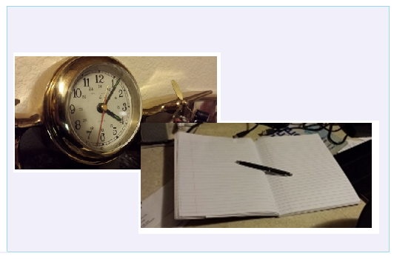
Editor’s Corner

Slide 13
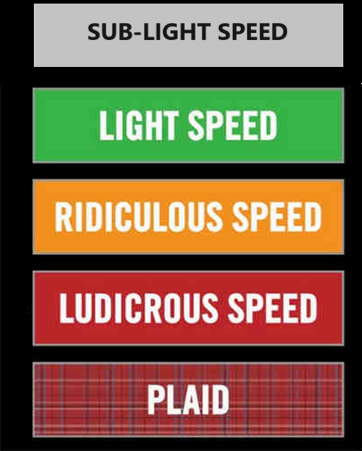
Comment resolution

Slide 14
To-Do
15-24-0221-03-04ab-draft-c-comment-resolution-for-mms-cids-7-29-52-80-81-90-91-212-269-318-683-729-859-862-879-894-and-901.docx | 15-24-0245-00-04ab-proposed-resolutions-for-sensing-primitives.docx | 15-24-0274-00-04ab-cr-for-hrp-uwb-phy-cid-274-and-275.docx | 15-24-0294-02-04ab-draftc-comment-resolution-assigned-to-me-part-1-cids-152-153-178-179-200-232-233-234-235-236-294-313-677-678.docx | 15-24-0318 | 15-24-0326-00-04ab-draft-c-comment-resolution-for-mms-fragments.docx
Carl | Rojan, Lei Huang | Vinod, Xiliang | Carlos | Pooria | Carl | Carlos | Pooria/Bin Q | Mickael
318 | 220 | 274 | 200 | 79 | 859 | 310 | 666 | 197
683 | 221 | 275 | 294 | 82 | 860 | 231 | 223
894 |  |  | 313 |  | 861 |  | 431
52 |  |  | 232 |  | 862
684 |  |  | 178
7 |  |  | 233
212 |  |  | 234
901 |  |  | 235
29 |  |  | 677
80 |  |  | 179
729 |  |  | 153
81 |  |  | 236
90 |  |  | 678
91
296
879

Slide 15
No Disposition Detail or Document #
Index # | Page | Sub-clause | Line # | Comment | Proposed Change | Disposition Status (Accepted, Rejected, Revised) | Category | Assignee
197 | 30 | 10.31.2 | 5 | To explain the notion of multiple devices sending RCM messages, it would be good to cross reference a description that explains how receipt of RCM is handled in a device potentially receiving different RCM from multiple sources. | If not already present, insert description text in an appropriate subclause. Cross reference the description from here. |  | HB | Carlos
310 | 33 | 10.31.9.10 | 23 | It seems the receiver address is redundant since it is already in the MAC header | Remove the Receiver Address Present field and Receiver Address field in the Scheduling List field |  | HB | Carlos
666 | 112 | 10.39.7.1 | 2 | PHY parameters e.g., channel, preamble code etc. used for sensing are missing. | Add PHY parameters e.g., channel, preamble code etc. used for sensing |  | SENS | Pooria/Bin Q
223 | 116 | 10.39.7.1 | 18 | This is breaking the MAC which should send an ACK when AR is set and nothing else. also IE's such as these are not typically directly ACTED ON BY the MAC layer. i.e. upper layer should receive the IE and decide what MAC configuration to change. It would be bad policy to change the ACK method, like this since the radio/MAC may be shared/used for multiple protocols. | DELETE THIS FUNCTIONITY. |  | SENS | Pooria/Bin Q
431 | 126 | 10.39.7.1 | 2 | It is not clear which channel is used to transmit the report, and the report should be associated to the channel number | As in the comment |  | SENS | Pooria/Bin Q
231 | 134 | 10.40.3 | 17 | Seem to me that we are missing the MLME primitives necessary to allow the upper layers to initiate transmission of the HRP UWB Association Request command, and indicate its reception etc. | Add them. |  | DISC | Carlos
652182

Slide 16
Timeline Notes: Update
Sequence: Complete Draft, Complete TEG, open ballot
Complete draft:
Apply contents of document 15-24-0010
Complete remaining comments (28-30 May)
Apply remaining comments
Motion to start LB on draft via 10-day email ballot (no later than 30-May to close 10 June)
Revise CAD (28-May)-
TEG review (Begin: ASAP, End no later than 10-June)
Need a consolidated draft
Need to run in parallel with 10 day email ballot on motion
Maybe using incremental draft
Open ballot:
Ballots draft and CAD
Must start by 11-June

Slide 17
TG motion: Approval of comment resolutions
TG4ab Approves comment resolutions in document 15-24-0010-35-04ab.
Moved by:
Seconded by:
Result:

Slide 18
TG motion: Draft needs to be edited before LB
Move that TG4ab formally request that the 802.15 WG start a WG Letter Ballot requesting approval of CA document 15-23-452-04-04ab and document P802.15.4ab-pre-ballot-C (as edited in accordance with the instructions in document 15-24-0010-35-04ab) and to forward document P802.15.4ab-pre-ballot-C, as edited in accordance with the instructions in document 15-24-0010-35-04ab, and CA document 15-23-452-04-04ab to Standards Association ballot pending the completion and inclusion of the edits in the draft.
Moved by:
Seconded by:
Result:

Slide 19
WG motion: Draft needs to be edited before LB
Move that 802.15 WG start a WG Letter Ballot requesting approval CA document 15-23-452-04-04ab and document P802.15.4ab-pre-ballot-C (as edited in accordance with the instructions in document 15-24-0010-35-04ab) and to forward document P802.15.4ab-pre-ballot-C (as edited in accordance with the instructions in document 15-24-0010-35-04ab), and CA document 15-23-452-04-04ab to Standards Association ballot pending the completion and inclusion of the edits in the draft.
Moved by: Ben Rolfe
Seconded by:
NOTE: To be conducted via electronic email ballot

Slide 20
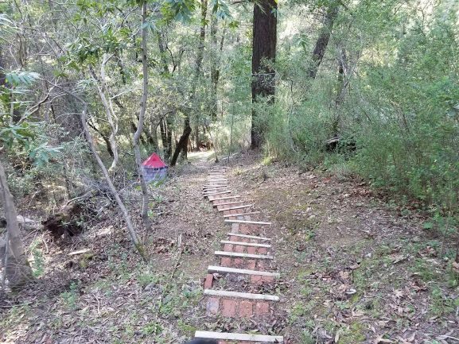
Next Steps

Slide 21
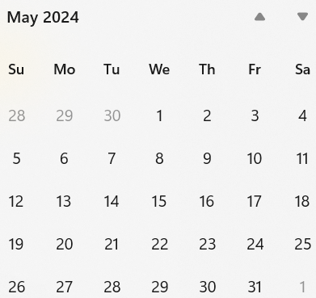
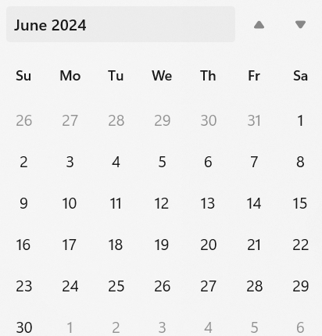
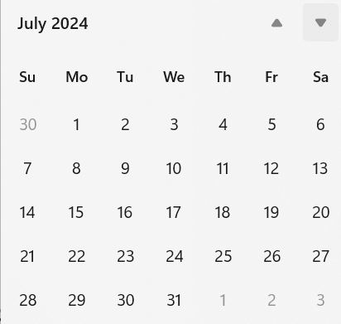
Call schedule, March thru May
NEXT
Weekly on Tuesdays and Thursdays 2 hours split:
6am PT (1 hour)
3pm PT (1 hour)
Commencing 28-May-2024
Will cancel when LB starts
NEXT

Slide 22
Recess

