Slide 1
Project: IEEE P802.15 Working Group for Wireless Specialty Networks (WSN)
Submission Title: May 2024 interim TG4ab Meeting Slides
Date Submitted: 12 May 2024
Source: Benjamin A. Rolfe (Blind Creek Associates)
Contact:
Voice: [deprecated],
E-Mail: ben.rolfe @ ieee.org
Re: Task Group 4ab: 802.15.4 UWB Next Generation
Abstract: Meeting Slides for the Wireless Interim Session, January 2024
Purpose: Continue project progress and continue the illusion of organization
Notice: This document has been prepared to assist the IEEE P802.15. It is offered as a basis for discussion and is not binding on the contributing individual(s) or organization(s). The material in this document is subject to change in form and content after further study. The contributor(s) reserve(s) the right to add, amend or withdraw material contained herein.
Release: The contributor acknowledges and accepts that this contribution becomes the property of IEEE and may be made publicly available by P802.15.

Slide 2
Task Group 15.4ab Next Generation UWB Amendment
May 2024 802 Wireless Interim Session
Mixed Mode
Live Warsaw, Poland

Slide 3
Meeting Preamble
Stuff you need to know before we get to the meeting content

Slide 4
Mixed Mode Logistics
Head table will project (one computer all day)
Local: queue to speak a microphone; remember remote attendees will hear you only if you use the microphone!
Remote attendees please queue via chat window
Local attendees when joining WebEx connect without audio!
In-room Webex with audio enabled will disrupt the meeting!
Presenters, both local and remote, will present via WebEx
For those Remote Attendees connecting to Webex, Configure Webex Audio to use “Music Mode”.
Makes sure “mute on entry” is set in WebEx
Please do not turn on video.

Slide 5
Hybrid Meeting Conduct: Other
In room breakouts:
We have the TG4ab Meeting rooms (physical and virtual) during our scheduled meeting times
We have a 2nd breakout room (physical and virtual) with coordination with WG chair
If leading a breakout – get with TC chair or VC for webex details
Keep in mind we have remote attendees in inconvenient time zones when able (use email reflector, etc)
We will do the best we can and keep learning as we go!

Slide 6
Time Management
We will need to stay within the allocated time to get through everything
If less than the allocated time is used in a time slot, we’ll start the next time slot (accumulate any unused time to the end of the meeting)
Accumulated time will be used to continue discussion where needed

Slide 7
Additional Reminders
No Photography or recording is allowed
Press (i.e., anyone reporting publicly on this meeting) are to announce their presence (Jan 2019 IEEE-SA Standards Board Ops Manual 5.3.3.2)
Wear badges at all times in meeting areas (face to face attendees)

Slide 8
Registration for 802 LMSC Plenaries and 802 Wireless Interims
This 802.15 meeting is part of the IEEE 802 wireless inerim session
You must pay the registration fee in order to attend virtually or in person
If you have not already done so please register:
Session Information & Registration Website:
https://touchpoint.eventsair.com/2024-jan-ieee-802-wireless-interim-session/registration
If you do not intend to register for this session you must leave this meeting and, if you have logged attendance on IMAT, email the appropriate WG chair or vice chairs to have your attendance cancelled

Slide 9
Task Group Rules
Discussion: Everyone present is welcome
Straw polls: Everyone present may vote
Formal motions: WG voters
To make, second and vote
Patent policy for PAR activities applies
All the usual rules of conduct
Please identify yourself on first contact with name and affiliation

Slide 10
IEEE-SA Patent, Copyright, and Participation Policies
Consolidated Slide Set: https://www.ieee802.org/3/WG_tools/templates/policies_slides_12012023.pptx
See: https://grouper.ieee.org/groups/802/sapolicies.shtml
IEEE-SA Patent Slides for Standards Development Meetings (.pdf)
https://development.standards.ieee.org/myproject/Public/mytools/mob/slideset.pdf
IEEE-SA Standards Board Patent Committee (PatCom) home page
https://standards.ieee.org/content/ieee-standards/en/about/sasb/patcom/index.html
IEEE-SA Participation Policy meeting slide set - individual method (.pdf)
https://standards.ieee.org/content/dam/ieee-standards/standards/web/documents/other/Participant-Behavior-Individual-Method.pdf
Working Group Copyright Materials
https://standards.ieee.org/ipr/copyright-materials.html
https://standards.ieee.org/content/dam/ieee-standards/standards/web/documents/other/ieee-sa-copyright-policy-2019.pdf

Slide 11
PARTICIPANTS HAVE A DUTY TO INFORM THE IEEE
Participants shall inform the IEEE (or cause the IEEE to be informed) of the identity of each holder of any potential Essential Patent Claims of which they are personally aware if the claims are owned or controlled by the participant or the entity the participant is from, employed by, or otherwise represents
Participants should inform the IEEE (or cause the IEEE to be informed) of the identity of any other holders of potential Essential Patent Claims
Early identification of holders of potential Essential Patent Claims is encouraged

Slide 12
Participants have a duty to inform the IEEE
Ways to inform IEEE
Cause an LOA to be submitted to the IEEE SA (patcom@ieee.org); or
Provide the chair of this group with the identity of the holder(s) of any and all such claims as soon as possible; or
Speak up now and respond to this Call for Potentially Essential Patents
If anyone in this meeting is personally aware of the holder of any patent claims that are potentially essential to implementation of the proposed standard(s) under consideration by this group and that are not already the subject of an Accepted Letter of Assurance, please respond at this time by providing relevant information to the WG Chair
Participants shall inform the IEEE (or cause the IEEE to be informed) of the identity of each holder of any potential Essential Patent Claims of which they are personally aware if the claims are owned or controlled by the participant or the entity the participant is from, employed by, or otherwise represents
Participants should inform the IEEE (or cause the IEEE to be informed) of the identity of any other holders of potential Essential Patent Claims
Early identification of holders of potential Essential Patent Claims is encouraged

Slide 13
OTHER GUIDELINES FOR IEEE WORKING GROUP MEETINGS
All IEEE SA standards meetings shall be conducted in compliance with all applicable laws, including antitrust and competition laws.
Don’t discuss the interpretation, validity, or essentiality of patents/patent claims.
Don’t discuss specific license rates, terms, or conditions.
Relative costs of different technical approaches that include relative costs of patent licensing terms may be discussed in standards development meetings.
Technical considerations remain the primary focus.
Don’t discuss or engage in the fixing of product prices, allocation of customers, or division of sales markets.
Don’t discuss the status or substance of ongoing or threatened litigation.
Don’t be silent if inappropriate topics are discussed. Formally object to the discussion immediately.
---------------------------------------------------------------
For more details, see IEEE SA Standards Board Operations Manual, clause 5.3.10 and Antitrust and Competition Policy: What You Need to Know at http://standards.ieee.org/develop/policies/antitrust.pdf

Slide 14
PATENT-RELATED INFORMATION
The patent policy and the procedures used to execute that policy are documented in the:
IEEE SA Standards Board Bylaws (http://standards.ieee.org/develop/policies/bylaws/sect6-7.html#6)
IEEE SA Standards Board Operations Manual (http://standards.ieee.org/develop/policies/opman/sect6.html#6.3)
Material about the patent policy is available at http://standards.ieee.org/about/sasb/patcom/materials.html
If you have questions, contact the IEEE SA Standards Board Patent Committee Administrator at patcom@ieee.org

Slide 15
Participant behavior in IEEE-SA activities is guided by the IEEE Codes of Ethics & Conduct
All participants in IEEE-SA activities are expected to adhere to the core principles underlying the:
IEEE Code of Ethics
IEEE Code of Conduct
The core principles of the IEEE Codes of Ethics & Conduct are to:
Uphold the highest standards of integrity, responsible behavior, and ethical and professional conduct
Treat people fairly and with respect, to not engage in harassment, discrimination, or retaliation, and to protect people's privacy.
Avoid injuring others, their property, reputation, or employment by false or malicious action
The most recent versions of these Codes are available at http://www.ieee.org/about/corporate/governance

Slide 16
Participants in the IEEE-SA “individual process” shall act independently of others, including employers
The IEEE-SA Standards Board Bylaws require that “participants in the IEEE standards development individual process shall act based on their qualifications and experience”
This means participants:
Shall act & vote based on their personal & independent opinions derived from their expertise, knowledge, and qualifications
Shall not act or vote based on any obligation to or any direction from any other person or organization, including an employer or client, regardless of any external commitments, agreements, contracts, or orders
Shall not direct the actions or votes of other participants or retaliate against other participants for fulfilling their responsibility to act & vote based on their personal & independently developed opinions
By participating in standards activities using the “individual process”, you are deemed to accept these requirements; if you are unable to satisfy these requirements then you shall immediately cease any participation

Slide 17
IEEE-SA standards activities shall allow the fair & equitable consideration of all viewpoints
The IEEE-SA Standards Board Bylaws (clause 5.2.1.3) specifies that “the standards development process shall not be dominated by any single interest category, individual, or organization”
This means no participant may exercise “authority, leadership, or influence by reason of superior leverage, strength, or representation to the exclusion of fair and equitable consideration of other viewpoints” or “to hinder the progress of the standards development activity”
This rule applies equally to those participating in a standards development project and to that project’s leadership group
Any person who reasonably suspects that dominance is occurring in a standards development project is encouraged to bring the issue to the attention of the Standards Committee or the project’s IEEE-SA Program Manager

Slide 18
IEEE SA Copyright Policy
By participating in this activity, you agree to comply with the IEEE Code of Ethics, all applicable laws, and all IEEE policies and procedures including, but not limited to, the IEEE SA Copyright Policy.
Previously Published material (copyright assertion indicated) shall not be presented/submitted to the Working Group nor incorporated into a Working Group draft unless permission is granted.
Prior to presentation or submission, you shall notify the Working Group Chair of previously Published material and should assist the Chair in obtaining copyright permission acceptable to IEEE SA.
For material that is not previously Published, IEEE is automatically granted a license to use any material that is presented or submitted.

Slide 19
IEEE SA Copyright Policy
The IEEE SA Copyright Policy is described in the IEEE SA Standards Board Bylaws and IEEE SA Standards Board Operations Manual
IEEE SA Copyright Policy, see Clause 7 of the IEEE SA Standards Board Bylaws https://standards.ieee.org/about/policies/bylaws/sect6-7.html#7 Clause 6.1 of the IEEE SA Standards Board Operations Manual https://standards.ieee.org/about/policies/opman/sect6.html
IEEE SA Copyright Permission
https://standards.ieee.org/content/dam/ieee-standards/standards/web/documents/other/permissionltrs.zip
IEEE SA Copyright FAQs
https://standards.ieee.org/faqs/copyrights/
IEEE SA Best Practices for IEEE Standards Development
http://standards.ieee.org/content/dam/ieee-standards/standards/web/documents/other/best_practices_for_ieee_standards_development_051215.pdf
Distribution of Draft Standards (see 6.1.3 of the SASB Operations Manual)
https://standards.ieee.org/about/policies/opman/sect6.html

Slide 20
Reminders
You are reminded NOW that all the 802 and IEEE rules you heard at the opening plenary apply to every meeting. This is your final reminder!
Meetings will start ON TIME as shown on the schedule – arrive early, finish nesting, get comfortable
Questions and discussions time may be limited: Use the email reflector to continue discussion!
Take advantage of coffee breaks and other ad hoc time as well as the reflector, and
Don’t forget about remote attendees!

Slide 21
Agenda
https://mentor.ieee.org/802.15/dcn/24/15-24-0128-02-04ab-tg4ab-agenda-march-2024.xlsx
(check mentor for latest version)

Slide 22
Participants have a duty to inform the IEEE
Ways to inform IEEE
Cause an LOA to be submitted to the IEEE SA (patcom@ieee.org); or
Provide the chair of this group with the identity of the holder(s) of any and all such claims as soon as possible; or
Speak up now and respond to this Call for Potentially Essential Patents
If anyone in this meeting is personally aware of the holder of any patent claims that are potentially essential to implementation of the proposed standard(s) under consideration by this group and that are not already the subject of an Accepted Letter of Assurance, please respond at this time by providing relevant information to the WG Chair
Participants shall inform the IEEE (or cause the IEEE to be informed) of the identity of each holder of any potential Essential Patent Claims of which they are personally aware if the claims are owned or controlled by the participant or the entity the participant is from, employed by, or otherwise represents
Participants should inform the IEEE (or cause the IEEE to be informed) of the identity of any other holders of potential Essential Patent Claims
Early identification of holders of potential Essential Patent Claims is encouraged

Slide 23
Agenda
Motion to approve agenda contained in document 15-24-0201-04.
Moved by David Xun Yang (Huawei)
Second by Clint Chaplin (SRA)
Discussion:

Slide 24
Approvals of Minutes
Motion to approve minutes contained in documents 15-24-0195-00 and 15-24-0252-01
Moved by: David Xun Yang (Huawei)
Second by: Clint Chaplin (SRA)
Discussion:
Minutes of March Plenary
https://mentor.ieee.org/802.15/dcn/24/15-24-0195-00-04ab-tg4ab-mar-plenary-mins.docx
Minutes of Conference Calls March through May
https://mentor.ieee.org/802.15/dcn/24/15-24-0252-01-04ab-tg4ab-conf-call-mins-mar-to-may-2024.docx

Slide 25
Session Objectives
Resolve collected comments
Complete the draft!
Commence WG Letter Ballot when:
We have a technically complete draft
We have a draft that is ready to ballot
We have completed WG pre-requirements

Slide 26
5.2.b Scope of the project (As approved):
This amendment enhances the Ultra Wideband (UWB) physical layers (PHYs) medium access control (MAC), and associated ranging techniques while retaining backward compatibility with enhanced ranging capable devices (ERDEVs). Areas of enhancement include:
additional coding, preamble and modulation schemes to additional coding, preamble and modulation schemes to support improved link budget and/or reduced air-time relative to IEEE Std 802.15.4 UWB;
additional channels and operating frequencies;
interference mitigation techniques to support greater device density and higher traffic use cases relative to the IEEE Std 802.15.4 UWB;
improvements to accuracy, precision and reliability and interoperability for high-integrity ranging; schemes to reduce complexity and power consumption;
definitions for tightly coupled hybrid operation with narrowband signaling to assist UWB;
enhanced native discovery and connection setup mechanisms;
sensing capabilities to support presence detection and environment mapping;
and mechanisms supporting low-power low-latency streaming as well as high data-rate streaming allowing at least 50 Mb/s of throughput.
Support for peer-to-peer, peer-to-multi-peer, and station-to-infrastructure protocols are in scope, as are infrastructure synchronization mechanisms. This amendment includes safeguards so that the high throughput data use cases do not cause significant disruption to low duty-cycle ranging use cases.
https://development.standards.ieee.org/myproject-web/app#viewpar/9081

Slide 27
Near Term Working Milestones
 | Original Schedule | Current Schedule
Call for proposals | November 2021
Cut-off for new features (high level feature set), PHY | May 2022
Cut-off for new features (high level feature set), MAC | July 2022
Draft 0 | Post-January 2023 | Post March July Sept 2023
TG draft review and revision complete | February - March 2023 | Mar-June 2023 Sept 2023 Oct 2023
Working group pre-ballot review commence | March – May 2023 (following March meeting) | July August Sept Start: Nov 2023 Close: 2 Jan 2024
Comment Resolution |  | Start: Jan 2024 Done: May 2024
First letter ballot | June 2023 (following meeting) | Oct Nov 2023 Jan 2024 Goal: March 2024
Initial LB comment resolution |  | Start: May 2024 June 2024 Done: TBD
DONE
We are here
?
Heading towards
Current pace -> Start LB in May or later

Slide 28
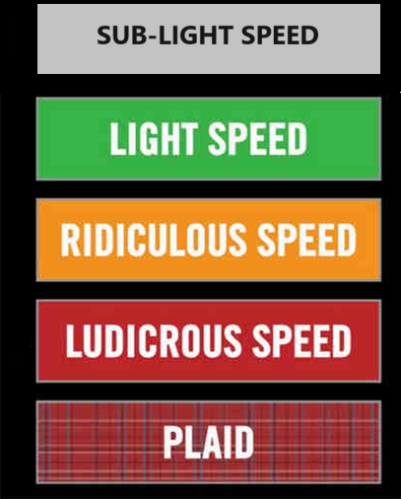
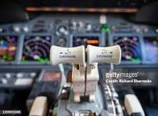
Comment resolution reports
2CV

Slide 29
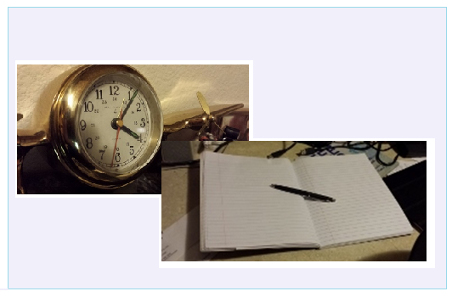
Editor’s Corner

Slide 30
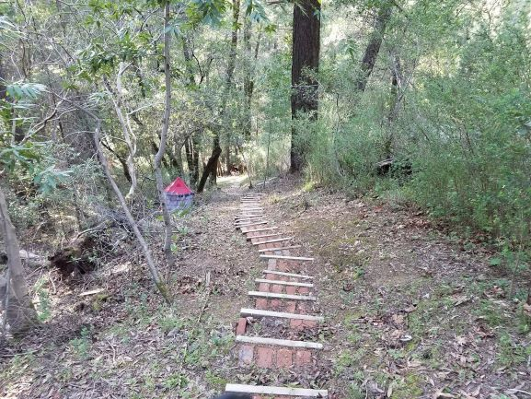
Next Steps

Slide 31
Completing the Draft
Goal: create a technically complete draft that is ready for balloting
Complete:
NO TBDs or implied TBDs (e.g. ??)
Sufficient detail to be understood and (maybe) implementable
Not perfect: that’s what balloting is for!
To get there: Identify and fill holes
Resolve comments with technically complete content and sufficient details for TE to execute
Approve changes to enable editor to create ballotable draft
Provide DRAFT READY text to TE
That means consistent with the base standard!

Slide 32
Steps up to Letter Ballot: Summary
Complete draft, posted to drafts area
Comment resolutions documented and approved (TG motion)
TG technical editor has applied all resolutions
TEG Review:
WG chair assigns Technical Expert Group
TEG reviews for technical consistency with base standard
WG Technical Editor review
WGTE reviews for editorial consistency with base standard
Reference: https://mentor.ieee.org/802.15/dcn/23/15-23-0083-05-0mag-project-task-list.xlsx for tasks and OM xref

Slide 33
Timeline Notes
Minimum duration of WG initial ballot: 30 days
40 is preferred for a complex draft
Editor’s review completed
Editor needs time to prepare draft
TEG review not completed – must be before ballot can begin
Ballot open latest is 09-June
July Meeting: 15-July
Ballot close latest is 10-July
Potentially 3 weeks after close of interim (two call days)

Slide 34
Interim Webex Meetings (May-July)
TBD

