Slide 1
Project: IEEE P802.15 Working Group for Wireless Personal Area Networks (WPANs)
Submission Title: MAC Performance Evaluation of Multiple BAN Coexistence Under TG6ma Channel Model
Date Submitted: May 14th, 2024
Source: Daisuke Anzai¹, Kosei Nagai¹, Takumi Kobayashi¹, Marco Hernandez², Ryuji Kohno²
Company: ¹Nagoya Institute of Technology (NIT), Japan; ²Yokosuka Research Park International Alliance Institute (YRP-IAI), Japan
Address: Gokiso-cho, Showa-ku, Nagoya, 466-8555, Japan
Voice: +81-52-735-5389, FAX: +81-52-735-5389, E-Mail: anzai@nitech.ac.jp
Re: In response to call for technical contributions
Abstract: This provides preliminary MAC performance evaluation results in a case of multiple BAN coexistence under the TG6ma channel model.
Purpose: Material for discussion in P802.15.6a TG corresponding to comments in EC Meeting
Notice: This document has been prepared to assist the IEEE P802.15. It is offered as a basis for discussion and is not binding on the contributing individual(s) or organization(s). The material in this document is subject to change in form and content after further study. The contributor(s) reserve(s) the right to add, amend or withdraw material contained herein.
Release: The contributor acknowledges and accepts that this contribution becomes the property of IEEE and may be made publicly available by P802.15.

Slide 2
MAC Performance Evaluation of Multiple BAN Coexistence Under TG6ma Channel Model
Daisuke Anzai, Kosei Nagai, Takumi Kobayashi, Marco Hernandez, Ryuji Kohno
Nagoya Institute of Technology (NIT), YRP International Alliance Institute (YRP-IAI)

Slide 3
Introduction
Coexistence of multiple BANs and other UWB applications (e.g. IEEE 802.15.4ab) is a key issue in providing high dependability
In multiple BAN coexistence, we propose a synchronous BAN coordination to avoid packet collisions even between different BANs, which is optimally managed under multiple BAN coexistence situations
We carry out fundamental MAC performance evaluation to demonstrate the importance of the proposed structure based on the TG6ma channel model with IR-UWB modulation

Slide 4
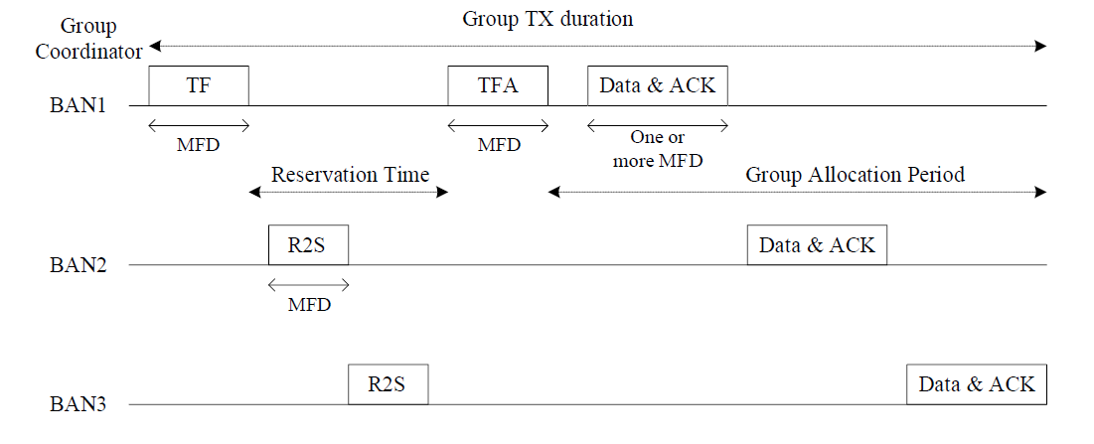
Synchronous BAN coordination

Slide 5
Simulation scenario with perfectly managed BANs

Slide 6
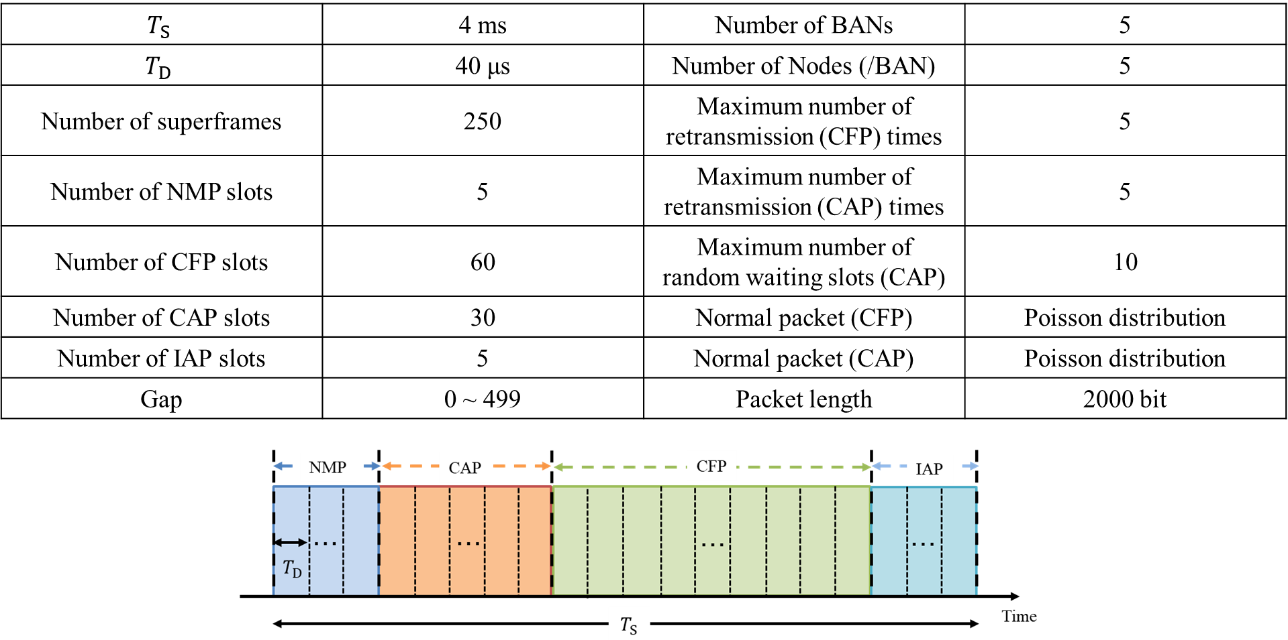
MAC simulation parameters

Slide 7
Evaluation results in CFP
Five managed BANs
Concatenated code (LDPC+RS)

Slide 8
Simulation scenario with one interference BAN

Slide 9
Evaluation results in CFP
Four managed BANs and one interference BAN
Concatenated code (LDPC+RS)

Slide 10
References
D. Anzai, R. Inuzuka, M. Kim, T. Kobayashi, M. Hernandez, R. Kohno, “Fundamental MAC Performance Evaluation under Multiple IEEE802.15.6ma BAN Co-Existence,” in Proc. IEEE ISMICT 2023, Lincoln, USA, Mach 2023.
D. Anzai, I. Balasingham, G. Fischer, J. Wang, “Reliable and High-Speed Implant Ultra-Wideband Communications with Transmit–Receive Diversity,” EAI/Springer Innovations in Communication and Computing, pp. 27-32, March 2020.
Y. Shimizu, D. Anzai, R. C-Santiago, P. A. Floor, I. Balasingham, and J. Wang, “Performance evaluation of an ultra-wideband transmit diversity in a living animal experiment” IEEE Trans. Microw. Theory Tech., vol. 65, no. 7, pp. 2596-2606, July 2017.
D. Anzai, K. Katsu, R. Chavez-Santiago, Q. Wang, D. Plettemeier, J. Wang, and I. Balasingham, “Experimental evaluation of implant UWB-IR transmission with living animal for body area networks,” IEEE Trans. Microw. Theory Tech., vol. 62, no. 1, pp. 183-192, Jan. 2014.
J. Shi, D. Anzai, and J. Wang, “Channel modeling and performance analysis of diversity reception for implant UWB wireless link,” IEICE Trans. Commun., no. E95-B, vol. 10, pp. 3197-3205, Oct. 2012.

