Slide 1
Project: IEEE P802.15 Working Group for Wireless Personal Area Networks (WPANs)
Submission Title: [Channel masks of radio channels for SUN PHYs in Japan]
Date Submitted: 13 March, 2024
Source: Hiroshi Harada (Kyoto University)
Address Yoshidahonmachi. Sakyo, Kyoto, 606-8501, Japan
Voice: +81-75-753-5317 , E-Mail: hiroshi.harada@i.kyoto-u.ac.jp
Re: [Wireless Next Generation, Long Range extension enhancements to 802.15.4-2020]
Abstract: Introduce channel mask of a radio channel standardized by ATIB STD-T108 for the discussion on interference control. A part of this contribution was supported from the commissioned research (No.05101) by National Institute of Information and Communications Technology (NICT) , Japan.
Purpose: Propose use for the new standardization of Next Generation SUN PHYs
Notice: This document has been prepared to assist the IEEE P802.15. It is offered as a basis for discussion and is not binding on the contributing individual(s) or organization(s). The material in this document is subject to change in form and content after further study. The contributor(s) reserve(s) the right to add, amend or withdraw material contained herein.
Release: The contributor acknowledges and accepts that this contribution becomes the property of IEEE and may be made publicly available by P802.15.

Slide 2
Channel mask of a radio channel in Japan
March 13, 2024
Hiroshi Harada, Ph.D.

Slide 3
Background
Next-generation SUN will require interference control with existing systems that use the same frequencies.
FSK and OFDM, standardized in IEEE 802.15.4, are candidates for next-generation SUN. In particular, OFDM spectrum is widely distributed in its own band.
In Japan, the ARIB, an SDO, defines the transmit power, operating frequency, and channel mask in ARIB STD-T108 for the SUN using Sub-1 GHz.
This contribution document reviews the channel masks specified in this ARIB STD-T108

Slide 4

Land Mobile Stations
Frequency band:
  920.5-922.3 MHz
Bandwidth
  $\left(200 × n\right) kHz$ (n=1,2,3,4,5)
Transmission power
  250 mW or less
Antenna gain
  3 dBi or less (absolute gain)
  However, in case EIRP is less than 27 dBm (the value of 3 dBi plus 250 mW of antenna power), it is allowed to fill in the gap by the antenna gain.
Reference: ARIB STD T-108 Version 1.5
fc: Center frequency

Slide 5

Land Mobile Stations
Frequency band:
  922.3-923.5 MHz
Bandwidth
  $\left(200 × n\right) kHz$ (n=1,2,3,4,5)
Transmission power
  250 mW or less
Antenna gain
  3 dBi or less (absolute gain)
  However, in case EIRP is less than 27 dBm (the value of 3 dBi plus 250 mW of antenna power), it is allowed to fill in the gap by the antenna gain.
fc: Center frequency
Reference: ARIB STD T-108 Version 1.5

Slide 6
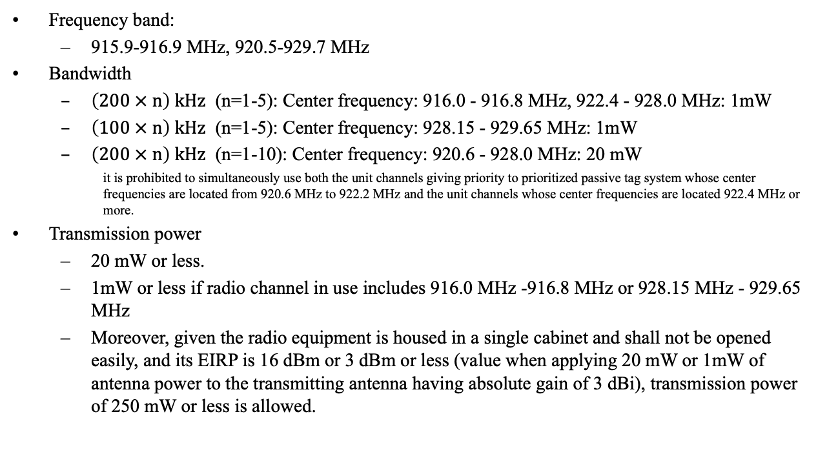
Specified low-power radio stations
Frequency band:
  915.9-916.9 MHz, 920.5-929.7 MHz
Bandwidth
  $\left(200 × n\right) kHz$ (n=1-5): Center frequency: 916.0 - 916.8 MHz, 922.4 - 928.0 MHz: 1mW
  $\left(100 × n\right) kHz$ (n=1-5): Center frequency: 928.15 - 929.65 MHz: 1mW
  $\left(200 × n\right) kHz$ (n=1-10): Center frequency: 920.6 - 928.0 MHz: 20 mW
    it is prohibited to simultaneously use both the unit channels giving priority to prioritized passive tag system whose center frequencies are located from 920.6 MHz to 922.2 MHz and the unit channels whose center frequencies are located 922.4 MHz or more.
Transmission power
  20 mW or less.
  1mW or less if radio channel in use includes 916.0 MHz -916.8 MHz or 928.15 MHz - 929.65 MHz
  Moreover, given the radio equipment is housed in a single cabinet and shall not be opened easily, and its EIRP is 16 dBm or 3 dBm or less (value when applying 20 mW or 1mW of antenna power to the transmitting antenna having absolute gain of 3 dBi), transmission power of 250 mW or less is allowed.
Reference: ARIB STD T-108 Version 1.5

Slide 7
Specified low-power radio stations
Antenna gain
  3 dBi or less (absolute gain)
  However, in case EIRP (Note) is more than 16 dBm or 3 dBm (value when applying 20 mW or 1 mW of antenna power to the transmitting antenna having absolute gain of 3 dBi), the excess amount should be reduced by the antenna gain and if it is 16 dBm or 3 dBm, and if it is 16 dBm or 3 dBm or less, it is allowed to fill in the gap by the antenna gain
Reference: ARIB STD T-108 Version 1.5

Slide 8
Specified low-power radio stations
(915.9 MHz to 916.9 MHz, 1mW or less)
Reference: ARIB STD T-108 Version 1.5

Slide 9
Specified low-power radio stations
(920.5 MHz to 922.3 MHz, 20 mW or less)
Reference: ARIB STD T-108 Version 1.5

Slide 10
Specified low-power radio stations
(922.3 MHz to 928.1 MHz, 1 mW or less)
Reference: ARIB STD T-108 Version 1.5

Slide 11
Specified low-power radio stations
(922.3 MHz to 928.1 MHz, 20 mW or less)
Reference: ARIB STD T-108 Version 1.5

Slide 12
Specified low-power radio stations
(922.3 MHz to 928.1 MHz, 1 mW or less)
Reference: ARIB STD T-108 Version 1.5

