Slide 1
Project: IEEE P802.15 Working Group for Wireless Specialty Networks (WSN)
Submission Title: TG 15.4ab Interim Call Slides Jan-March
Date Submitted: 29 January 2024
Source: Benjamin A. Rolfe (Blind Creek Associates)
Contact:
Voice: +1 408 395 7207, E-Mail: ben.rolfe @ ieee.org
Re: Task Group 4ab: 802.15.4 UWB Next Generation
Abstract: Meeting Slides the Interim meeting, January 30 through March 5, 2024
Purpose: Continue project progress and continue the illusion of organization
Notice: This document has been prepared to assist the IEEE P802.15. It is offered as a basis for discussion and is not binding on the contributing individual(s) or organization(s). The material in this document is subject to change in form and content after further study. The contributor(s) reserve(s) the right to add, amend or withdraw material contained herein.
Release: The contributor acknowledges and accepts that this contribution becomes the property of IEEE and may be made publicly available by P802.15.

Slide 2
Task Group 15.4ab Next Generation UWB Amendment
Meeting Slides for the Interim meeting
January 30 through March 5, 2024

Slide 3
Meeting Preamble
Stuff you need to know before we get to the meeting content

Slide 4
Task Group Rules
Discussion: Everyone present is welcome
Straw polls: Everyone present may vote
Formal motions: WG voters
To make, second and vote
Patent policy for PAR activities applies
All the usual rules of conduct
Please identify yourself on first contact with name and affiliation

Slide 5
IEEE-SA Patent, Copyright, and Participation Policies
See: https://grouper.ieee.org/groups/802/sapolicies.shtml
IEEE-SA Patent Slides for Standards Development Meetings (.pdf)
https://development.standards.ieee.org/myproject/Public/mytools/mob/slideset.pdf
IEEE-SA Standards Board Patent Committee (PatCom) home page
https://standards.ieee.org/content/ieee-standards/en/about/sasb/patcom/index.html
IEEE-SA Participation Policy meeting slide set - individual method (.pdf)
https://standards.ieee.org/content/dam/ieee-standards/standards/web/documents/other/Participant-Behavior-Individual-Method.pdf
Working Group Copyright Materials
https://standards.ieee.org/ipr/copyright-materials.html
https://standards.ieee.org/content/dam/ieee-standards/standards/web/documents/other/ieee-sa-copyright-policy-2019.pdf

Slide 6
Participants have a duty to inform the IEEE
Participants shall inform the IEEE (or cause the IEEE to be informed) of the identity of each holder of any potential Essential Patent Claims of which they are personally aware if the claims are owned or controlled by the participant or the entity the participant is from, employed by, or otherwise represents
Participants should inform the IEEE (or cause the IEEE to be informed) of the identity of any other holders of potential Essential Patent Claims
Early identification of holders of potential Essential Patent Claims is encouraged

Slide 7
Participants have a duty to inform the IEEE
Ways to inform IEEE
Cause an LOA to be submitted to the IEEE SA (patcom@ieee.org); or
Provide the chair of this group with the identity of the holder(s) of any and all such claims as soon as possible; or
Speak up now and respond to this Call for Potentially Essential Patents
If anyone in this meeting is personally aware of the holder of any patent claims that are potentially essential to implementation of the proposed standard(s) under consideration by this group and that are not already the subject of an Accepted Letter of Assurance, please respond at this time by providing relevant information to the WG Chair
Participants shall inform the IEEE (or cause the IEEE to be informed) of the identity of each holder of any potential Essential Patent Claims of which they are personally aware if the claims are owned or controlled by the participant or the entity the participant is from, employed by, or otherwise represents
Participants should inform the IEEE (or cause the IEEE to be informed) of the identity of any other holders of potential Essential Patent Claims
Early identification of holders of potential Essential Patent Claims is encouraged

Slide 8
IEEE 802 Ground Rules
Respect … give it, get it
NO product pitches
NO corporate pitches
NO prices
NO restrictive notices – (no confidentially notices in email)
Presentations must be openly available

Slide 9
Agenda
https://mentor.ieee.org/802.15/dcn/24/15-24-0102-13-04ab-tg4ab-agenda-jan-march-2024.xlsx

Slide 10
5.2.b Scope of the project (As approved):
This amendment enhances the Ultra Wideband (UWB) physical layers (PHYs) medium access control (MAC), and associated ranging techniques while retaining backward compatibility with enhanced ranging capable devices (ERDEVs). Areas of enhancement include:
additional coding, preamble and modulation schemes to additional coding, preamble and modulation schemes to support improved link budget and/or reduced air-time relative to IEEE Std 802.15.4 UWB;
additional channels and operating frequencies;
interference mitigation techniques to support greater device density and higher traffic use cases relative to the IEEE Std 802.15.4 UWB;
improvements to accuracy, precision and reliability and interoperability for high-integrity ranging; schemes to reduce complexity and power consumption;
definitions for tightly coupled hybrid operation with narrowband signaling to assist UWB;
enhanced native discovery and connection setup mechanisms;
sensing capabilities to support presence detection and environment mapping;
and mechanisms supporting low-power low-latency streaming as well as high data-rate streaming allowing at least 50 Mb/s of throughput.
Support for peer-to-peer, peer-to-multi-peer, and station-to-infrastructure protocols are in scope, as are infrastructure synchronization mechanisms. This amendment includes safeguards so that the high throughput data use cases do not cause significant disruption to low duty-cycle ranging use cases.
https://development.standards.ieee.org/myproject-web/app#viewpar/9081

Slide 11
Project Schedule (working baseline)
Proposed project schedule | Nov -22 | Dec-22 | Jan-23 | Feb-23 | Mar-23 | Apr-23 | May-23 | Jun-23 | Jul-23 | Aug-23 | Sep-23 | Oct-23 | Nov-23 | Dec-23 | Jan-24 | Feb-24 | Mar-24 | Apr-24 | May-24 | Jun-24 | Jul-24 | Aug-24 | Sep-24 | Oct-24 | Nov24 | Dec 24 | Jan 25 | Feb 25 | Mar 25 | Apr 25 | May 25 | June 25 | July 25
Integrate poposals/contributions into TFD
Develop draft from TFD
Draft 0
TG draft review and revision
Working group pre-ballot review
Pre-ballot review and comment resolution
First letter ballot
LB Comment Resolution
WG Recirculatoin
Comment resolution, 1st recirc
Conditional approval for SA ballot
WG Recirculatoin
Comment resolution, 2nd recirc and final recirc
First SA ballot
Comment resolution, first SA ballot
SA Resirculation
Comment resolution, SA recirculation
SA Resirculation
Comment resolution, 2nd SA recirc
Conditional or unconditional approval to RevCom
Optional 3rd SA recirc if needed
 |  |  |  |  |  |  |  |  |  |  |  |  |  |  |  |  |  |  |  |  |  |  |  |  |  |  |  |  |  |  |  |  |  |  |  |  |  | `
You are Here

Slide 12
Near Term Working Milestones
 | Original Schedule | Current Schedule
Call for proposals | November 2021
Cut-off for new features (high level feature set), PHY | May 2022
Cut-off for new features (high level feature set), MAC | July 2022
Draft 0 | Post-January 2023 | Post March July Sept 2023
TG draft review and revision complete | February - March 2023 | Mar-June 2023 Sept 2023 Oct 2023
Working group pre-ballot review commence | March – May 2023 (following March meeting) | July August Sept Start: Nov 2023 Close: 2 Jan 2024
Comment Resolution |  | Start: Jan 2024 Done: March 2024
First letter ballot | June 2023 (following meeting) | Oct Nov 2023 Jan 2024 March 2024
Initial LB comment resolution |  | Start: May 2024 Done: TBD
DONE
We are here
Heading towards

Slide 13
Editor’s Corner

Slide 14
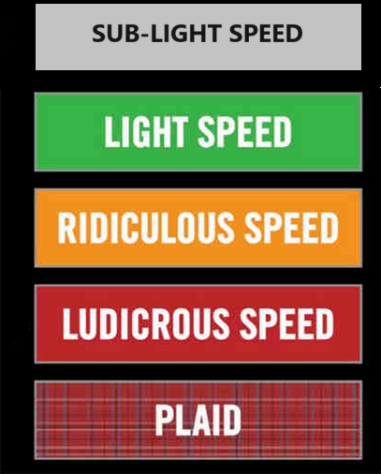
Comment resolution reports

Slide 15
Progress Summary and Extrapolation
Total # Comments | # with Blank resolution | # with non-blank resolution
926 | 526 | 400
Timeline
CC Close | 2-Jan
Now | 5-Mar
Elapsed | 63
Res/day | 6.35
Remaining days | 83
Extrapolated done | 26-May
based on 15-24-0010-15 (March 5th)

Slide 16
Next Steps

Slide 17
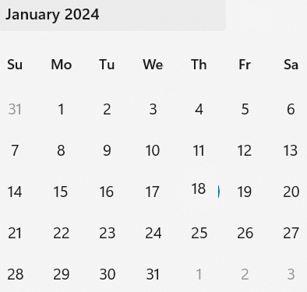
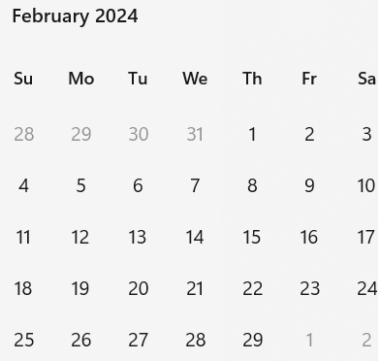
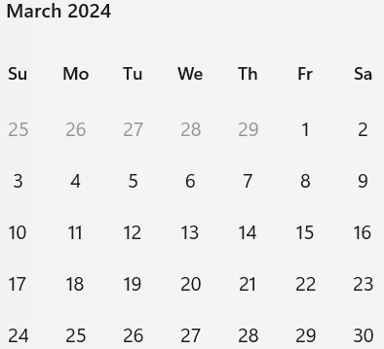
Call schedule, January thru March
Now
Next
Weekly on Tuesdays 2 hours split:
6am PT (1 hour)
3pm PT (1 hour)
Commencing January 30th 2024
Note: due to the major new year holiday in China, we will skip February 13th.

Slide 18
Spherical Earth Model
First Hour
Second Hour
Location | Local Time | Time Zone | UTC Offset
San Diego (USA – California) | Tuesday, 30 January 2024, 06:00:00 | PST | UTC-8 hours
Boston (USA – Massachusetts) | Tuesday, 30 January 2024, 09:00:00 | EST | UTC-5 hours
Dublin (Ireland) | Tuesday, 30 January 2024, 14:00:00 | GMT | UTC
Berlin (Germany) | Tuesday, 30 January 2024, 15:00:00 | CET | UTC+1 hour
Beijing (China) | Tuesday, 30 January 2024, 22:00:00 | CST | UTC+8 hours
Seoul (South Korea) | Tuesday, 30 January 2024, 23:00:00 | KST | UTC+9 hours
Corresponding UTC (GMT) | Tuesday, 30 January 2024, 14:00:00
Location | Local Time | Time Zone | UTC Offset
San Diego (USA – California) | Tuesday, 30 January 2024, 15:00:00 | PST | UTC-8 hours
Boston (USA – Massachusetts) | Tuesday, 30 January 2024, 18:00:00 | EST | UTC-5 hours
Dublin (Ireland) | Tuesday, 30 January 2024, 23:00:00 | GMT | UTC
Berlin (Germany) | Wednesday, 31 January 2024, 00:00:00 | CET | UTC+1 hour
Beijing (China) | Wednesday, 31 January 2024, 07:00:00 | CST | UTC+8 hours
Seoul (South Korea) | Wednesday, 31 January 2024, 08:00:00 | KST | UTC+9 hours
Corresponding UTC (GMT) | Tuesday, 30 January 2024, 23:00:00

