Slide 1

148th Session of meetings of the
IEEE 802.15 Working Group for Wireless Specialty Networks (WSN)
Opening Report
January 14-19, 2024
Held in Panama City & Hybrid via Webex

Slide 2
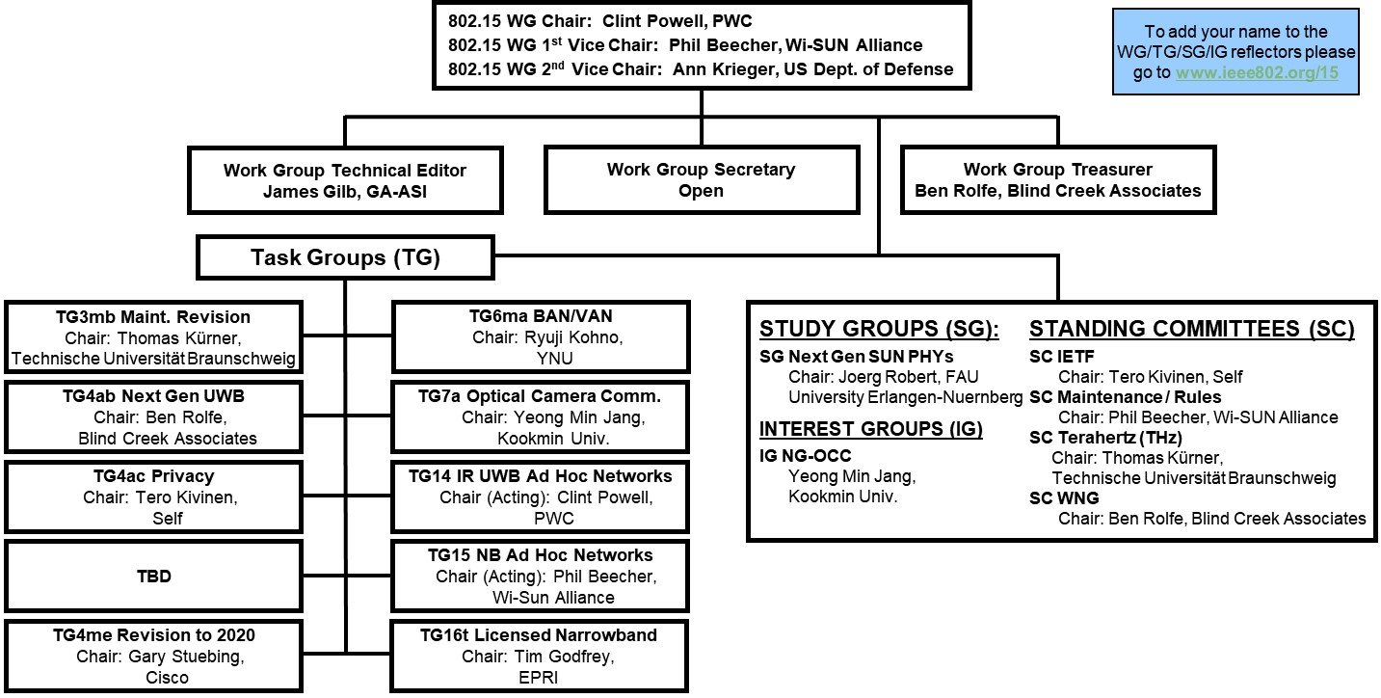
802.15 WG Org. Chart

Slide 3
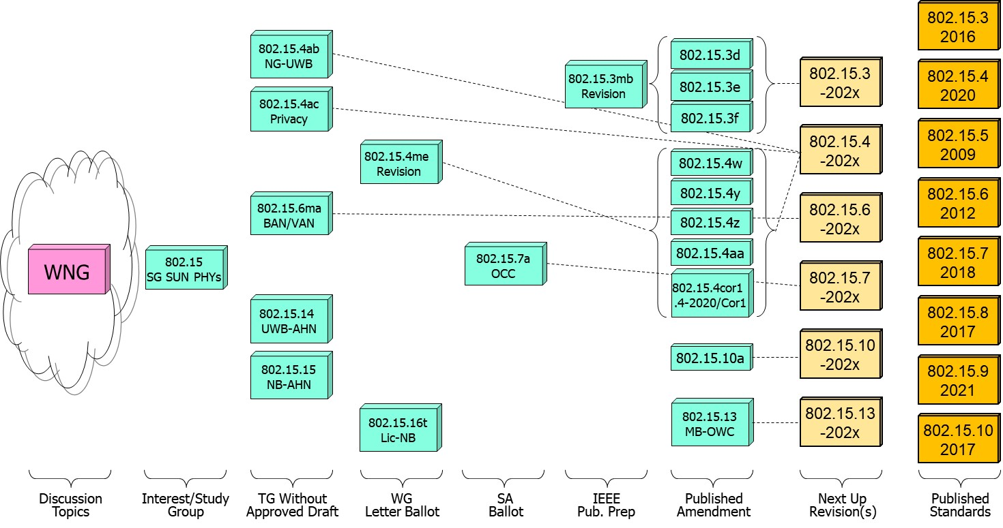
802.15 WG Standards Pipeline

Slide 4
802.15 WG Administrative
Voting members: 138
Nearly voting members: 5
Aspirant voting member: 20
802.15 WG Officer Elections
Clint Powell - Chair (elected March 2022)
Phil Beecher - 1st Vice-Chair (elected March 2022)
Ann Krieger - 2nd Vice-Chair (elected Nov. 2022)
WG Secretary needed
James Gilb - Tech. Editor (appointed March 2023)
Ben Rolfe - Treasurer (appointed March 2023)

Slide 5
Meeting Slots for 802.15 WG Jan. Interim

Slide 6
2.6a: 2024 January Designation of Individual experts
Individual experts who attend electronically for a specific purpose/presentation can be designated as such by the WG Chair and receive a registration fee waiver and limited attendance rights.
See section 5 in https://mentor.ieee.org/802-ec/dcn/17/ec-17-0090-25-0PNP-ieee-802-lmsc-operations-manual.pdf ,
  The Working Group Chair may designate specific individual experts who are allowed to participate in Working Group discussions via electronic means during an in-person meeting for the benefit of the group. These individuals are not considered to be attending the meeting and so they are not required to pay meeting fees and they do not get participation credit. The participation of these individuals should be limited to specific technical topics. Such participation shall be documented in the minutes of the Working Group meeting.
The individuals listed below are hereby designated as specific individual experts on their respective topics and subject to the restrictions and benefits described in the 802 OM.
  Example: Name, Affiliation, Specific mtg.
  n/a
  n/a
  n/a
  n/a
For WNG, attendance for each is limited to the WNG timeslot in which the respective presentation is scheduled.

Slide 7
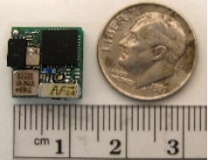

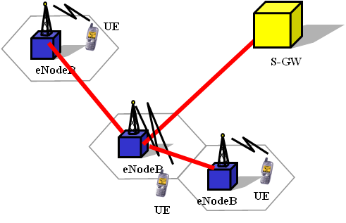

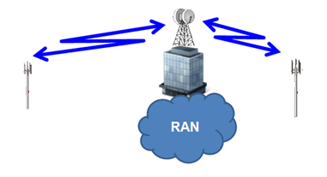







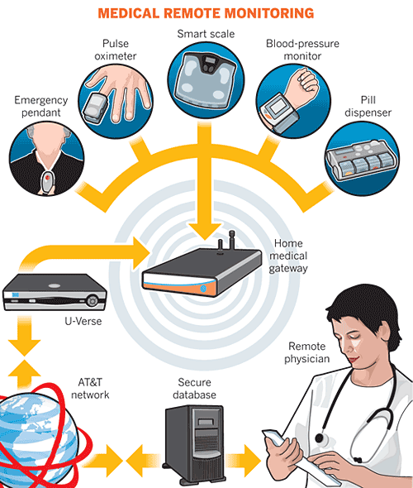
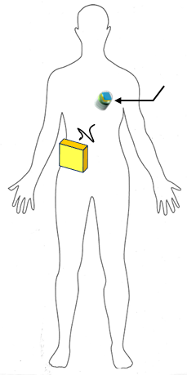

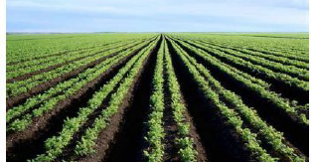

IEEE 802.15 Standards & their Applications
802.15.16
802.15.4
Locating and Tracking
Ultra-low Power Sensors
Automotive
FAN/MAN/RAN
802.15.4
Multi-media networks
&
High Speed
Interconnect
802.15.3
Industrial Networks
802.15.7
802.15.13
Medical
802.15.6
Critical Infrastructure Networks
Consumer Devices
Optical
Communications
Agricultural Sensing
Structural Monitoring
Slide 7

Slide 8
802.15 WG Subgroups/Objectives
TG 3mb – Revision b, Maintenance (mb)
Objective: revision for 802.15.3, extension of the frequency range to 300 GHz and review the 802.1D references and replace them with 802.1Q as appropriate
TG 4ab – Next Generation Ultra WideBand (NG-UWB) Amendment
Objective: enhancements to 802.15.4 Ultra Wideband (UWB) physical layers (PHYs) media access control (MAC), and associated ranging techniques while retaining backward compatibility with enhanced ranging capable devices (ERDEVs)
TG 4ac – Privacy Amendment
Objective: modifications to the IEEE Std 802.15.4 medium access control (MAC) specification to specify mechanisms that address and improve user privacy

Slide 9
802.15 WG Subgroups/Objectives
TG 4me – Revision e, Maintenance (me)
Objective: revision to 802.15.4-2020, rolling up amendments 802.15.4w, 802.15.4y, 802.15.4z, and 802.15.4aa and work on errors, omissions, updates, etc.
TG 6ma – Revision a, Maintenance (ma)
Objective: enhancements to the BAN Ultra Wideband (UWB) physical layer (PHY) and media access control (MAC) to support enhanced dependability to a human BAN (HBAN) and adds support for vehicle body area networks (VBAN), a coordinator in a vehicle with devices around the vehicular cabin
TG 7a – Optical Camera Communication (OCC) Amendment
Objective: high-rate OCC Physical Layer (PHY) using light wavelengths from 10,000 nm to 190 nm delivering data rates up to 100 Mb/s for point-to-point and point-to-multipoint communication

Slide 10
802.15 WG Subgroups/Objectives
TG 14 – Impulse Radio Ultra Wideband Wireless Ad Hoc Networks (UWB-AHN) ---IN HIBERNATION---
Objective: focused on impulse radio (IR) Ultra Wideband (UWB) PHY and MAC providing precision ranging capability that is accurate to the centimeter level by including (via. referencing) the 802.15.4 IR UWB functionality into a simple focused specification
TG 15 – Narrow Band Wireless Ad Hoc Networks (NB-AHN)
---IN HIBERNATION---
Objective: focused on narrow band ad hoc network PHY and MAC by including (via referencing) functionality and features of 802.15.4 into a simple focused specification
TG 16t – Licensed Narrowband (Lic-NB)
Objective: specify new PHY in licensed spectrum with channel bandwidths greater than or equal to 5 kHz and less than 100 kHz focusing on spectrum less than 2 GHz.

Slide 11
802.15 WG Subgroups/Objectives
SG Next Generation SUN PHYs
Objective: Develop a PAR & CSD for extending the SUN PHYs

Slide 12
802.15 WG Subgroups/Objectives
SC Maintenance/Rules
Objective: review errors noted in published standards providing a response/proposal to the 802.15 WG; review the 802.15 WG operations manual and general P&P and suggest changes to 802.15 WG; review PARs submitted by other WGs
SC IETF – Internet Engineering Task Force standing committee
Objective: provides an 802.15 liaison to IETF for projects associated with 802.15 standards
SC THz – Terahertz (THz)
Objective: communicate THz communications developments, providing input to the regulatory framework for THz comms. in close cooperation IEEE 802.18 TAG; trigger the start of projects to amend existing and develop new standards for THz comms.
SC WNG – Wireless Next Generation (WNG)
Objective: provides an opportunity to individuals to make technical presentations to the 802.15 WG on new technologies and/or proposals for new projects

Slide 13
Session Objectives Jan. 14-19, 2024
TG 3mb (Revision)
  Not meeting – at IEEE Editors
TG 4ab (NG-UWB)
  Identify draft missing pieces and determine work assignments
  Resolve comments and address feedback on pre draft
  Assess readiness to start Initial Letter Ballot
TG 4ac (Privacy)
  Continue preparing draft
TG 4me (Revision)
  Conduct comment resolution from 2nd Letter Ballot Recirc
  Assess readiness to start 3rd Letter Ballot Recirc
TG 6ma (Revision + BAN/VAN)
  Resolve comments from pre ballot review
  Assess readiness to start Initial Letter Ballot

Slide 14
Session Objectives Sept. 11-14, 2023
TG 7a (OCC)
  Conduct comment resolution for Initial Sponsor Ballot
  Assess readiness to start 1st Sponsor Ballot Recirc
TG 14 (UWB-AHN) – in hibernation, no meetings
TG 15 (NB-AHN) – in hibernation, no meetings
TG 16t (Lic-NB)
  Conduct comment resolution from Initial Letter Ballot
  Assess readiness to start 1st Letter Ballot Recirc
Joint 802.1/802.15
  Not meeting

Slide 15
Session Objectives Sept. 11-14, 2023
SG NG-SUN PHYs
  Hear more presentations
  Assess readiness to start Task Group
SC MAINTENANCE
  Review draft of detailed development process steps checklist
  Identify list of all templates for WG15 Subpage
SC IETF
  Discuss IETF activities related to 802/802.15 at WG15 mid-week
SC THz
  Hearing presentations on THz related topics
SC WNG
  Hearing presentations on WSN related topics

