Slide 1
Project: IEEE P802.15 Working Group for Wireless Specialty Networks (WSN)
Submission Title: TG 15.4ab November 2023 Closing Report
Source: Benjamin A. Rolfe (Blind Creek Associates)
Contact:
Voice: +1 408 395 7207, E-Mail: ben.rolfe @ ieee.org
Re: Task Group 4ab: 802.15.4 UWB Next Generation
Abstract: Closing Report summarizing TG accomplishments
Purpose: Continue project progress
Notice: This document has been prepared to assist the IEEE P802.15. It is offered as a basis for discussion and is not binding on the contributing individual(s) or organization(s). The material in this document is subject to change in form and content after further study. The contributor(s) reserve(s) the right to add, amend or withdraw material contained herein.
Release: The contributor acknowledges and accepts that this contribution becomes the property of IEEE and may be made publicly available by P802.15.
Notes:
Jul 12, 2010
Page 1

Slide 2
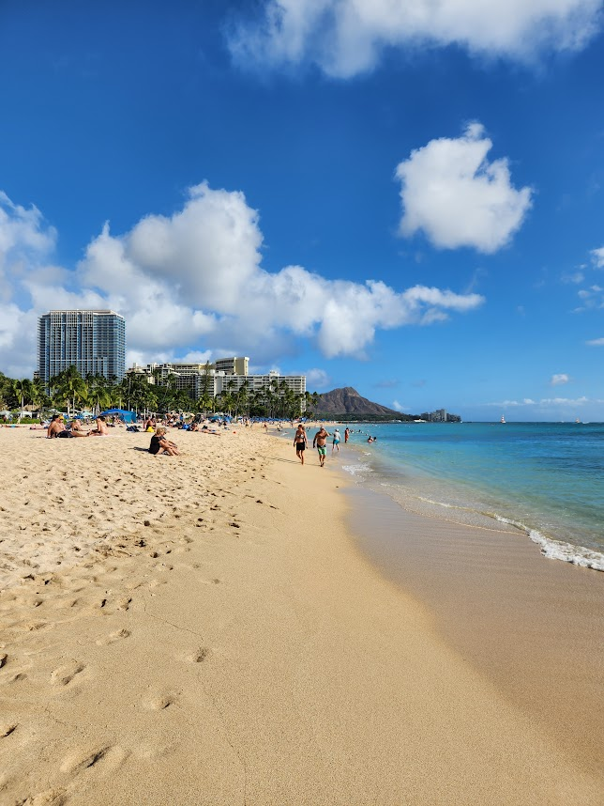
Task Group 15.4ab Next Generation UWB Amendment
November 2023 802 Plenary Session
Mixed Mode
Live from Honolulu, Hi, USA

Slide 3
Agenda
Document:
https://mentor.ieee.org/802.15/dcn/23/15-23-0546-10-04ab-tg4ab-agenda-november-2023.xlsx

Slide 4
Overview
Pre-draft draft
Current draft: P802.15.4ab™/D (pre-ballot) B
Received some comments from TG comment collection
Resolved comments
Comments in doc 15-23-0475
Ready for TE to produce next draft
Next: Produce Pre-ballot draft C and complete working group comment collection cycle
To commence 1-2 week following plenary session

Slide 5
Session Objectives
Complete comment resolution
Provide TE with details to update
Commence working group comment collection

Slide 6
Presentations during plenary
Doc | Ver | Link
502 | 3 | https://mentor.ieee.org/802.15/dcn/23/15-23-0502-03-04ab-group-consensus-on-operating-parameter-sets.docx
505 | 6 | https://mentor.ieee.org/802.15/dcn/23/15-23-0505-06-04ab-text-for-ptf-report-ie.docx
539 | 2 | https://mentor.ieee.org/802.15/dcn/23/15-23-0539-01-04ab-proposed-resolution-for-10-146-147-148.docx
549 | 1 | https://mentor.ieee.org/802.15/dcn/23/15-23-0549-01-04ab-proposed-resolutions-for-draft-b-comments-140-225-226.docx
552 | 4 | https://mentor.ieee.org/802.15/dcn/23/15-23-0552-04-04ab-proposed-updates-on-ac-ie-and-cir-report-ie.docx
561 | 0 | https://mentor.ieee.org/802.15/dcn/23/15-23-0561-00-04ab-proposed-resolution-for-nb-channel-map.docx
562 | 0 | https://mentor.ieee.org/802.15/dcn/23/15-23-0562-00-04ab-cir-report-ie-format.pptx
563 | 0 | https://mentor.ieee.org/802.15/dcn/23/15-23-0563-00-04ab-proposed-text-for-cir-report-format.docx
573 | 0 | https://mentor.ieee.org/802.15/dcn/23/15-23-0573-00-04ab-balanced-wireless-in-device-coexistence.pptx
575 | 2 | https://mentor.ieee.org/802.15/dcn/23/15-23-0575-01-04ab-resolution-proposals-for-comments-21-22-25-26-28-99-155-164-166.docx
579 | 0 | https://mentor.ieee.org/802.15/dcn/23/15-23-0579-00-04ab-privacy-addressing-requirements-in-4ab.pptx
581 | 0 | https://mentor.ieee.org/802.15/dcn/23/15-23-0581-00-04ab-proposed-resolution-on-ac-ie-comments-part-three.docx
591 | 0 | https://mentor.ieee.org/802.15/dcn/23/15-23-0591-00-04ab-proposed-resolutions-ci-53-235-236.pptx
604 | 0 | https://mentor.ieee.org/802.15/dcn/23/15-23-0604-00-04ab-resolutions-to-cids-183-230-234-240.xlsx
285 | 1 | https://mentor.ieee.org/802.15/dcn/23/15-23-0285-01-04ab-effect-of-no-lbt-nb-on-802-11-devices.pdf

Slide 7
Motion
Adopt the comment resolutions in 15-23-0475-31 and instruct the technical editor to apply to produce pre-ballot draft C. Direct the TG chair to request WG chair initiate working group comment collection on pre-ballot draft C as soon as possible.
Moved by: Clint Chaplin (SRA)
Second by: Billy Verso (Qorvo)

Slide 8
Next Steps

Slide 9
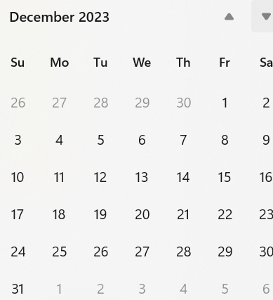
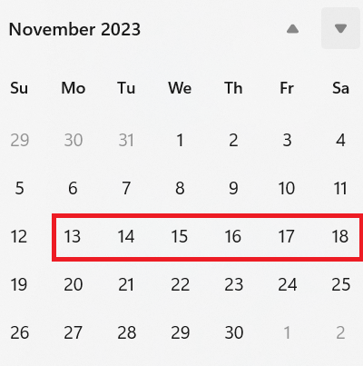
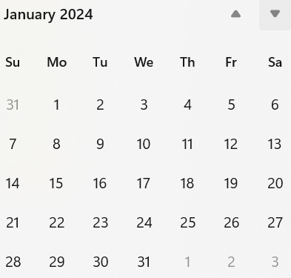
Interim telecon/Webex schedule
Weekly on Tuesday commencing 4-December 06:00 PT
If no agenda items by COB Friday before, call will be cancelled

Slide 10
Thanks

