Slide 1
Project: IEEE P802.15 Working Group for Wireless Specialty Networks
Submission Title: Hybrid ARQ Scheme for High QoS Packets in High Class of Coexistence of IEEE 802.15.6ma
Date Submitted: 16 September 2025
Source: Kento Takabayashi¹, Daisuke Anzai², Ryuji Kohno^{3,4}
Company: (1) Toyo University (2) Osaka Metropolitan University (3)Yokohama National University (4) YRP International Alliance Institute
Address: (1) 2100 Kujirai, Kawagoe, Saitama, Japan 351-8585, (3)79-5 Tokiwadai, Hodogaya-ku, Yokohama, 240-8501 Japan,
(4) YRP1 Blg., 3-4 Hikarinooka, Yokosuka-City, Kanagawa, 239-0847 Japan
Voice:[(1) +81-866-94-2104 , (3) +81-90-5408-0611] E-Mail:[takabayashi.kento.xp@gmail.com, kohno@ynu.ac.jp, kohno@yrp-iai.jp]
Re: In response to call for technical contributions
Abstract: The HARQ mechanism for IEEE 802.15.6ma is provided. IEEE 802.15.6ma will deal with various QoS level data. Hence, it is required to consider an error control scheme corresponding to these QoS. We introduce the HARQ for the highest coexistence environment class and the high QoS level data.
Purpose: Material for discussion in P802.15.6ma TG corresponding to comments in EC Meeting
Notice: This document has been prepared to assist the IEEE P802.15. It is offered as a basis for discussion and is not binding on the contributing individual(s) or organization(s). The material in this document is subject to change in form and content after further study. The contributor(s) reserve(s) the right to add, amend or withdraw material contained herein.
Release: The contributor acknowledges and accepts that this contribution becomes the property of IEEE and may be made publicly available by P802.15.

Slide 2
Hybrid ARQ Scheme for High QoS Packets in High Class of Coexistence of IEEE 802.15.6ma
September 2025,
Hybrid Session,
Hilton Waikoloa Village, US
Kento Takabayashi ⁽¹⁾, Daisuke Anzai⁽²⁾, Ryuji Kohno^{(3,4)}
(1) Toyo University (2) Osaka Metropolitan University (3)Yokohama National University (4) YRP International Alliance Institute

Slide 3
Coexistence environment level
Coexistence environment class | Environment
0 | 6ma BAN only
1 [1a] | Multiple 6ma BANs 1a
2 [1b] | Multiple 15.6 & 6ma BANs
3 | Multiple 6ma BANs & non-UWB systems (Wi-Fi & Unlicensed 3GPP)
4 [2a] | Multiple 6ma BANs & 802.15 UWB systems
5 [2b] | Multiple 6ma BANs, non-802.15 UWB systems (ETSI UWB systems)
6 [2c] | Multiple 6ma BANs & 802.15 UWB & non-802.15 UWB systems (ETSI UWB)
7 | Multiple 6ma BANs & non-UWB systems (Wi-Fi & Unlicensed 3GPP) & 802.15 UWB & non-802.15 UWB systems (ETSI UWB)
  A hybrid ARQ (HARQ) shall be utilized at the highest class “7”
  15.6ma considers the half-rate BCC and LDPC as an error correcting code
    A HARQ scheme using those FEC is introduced

Slide 4
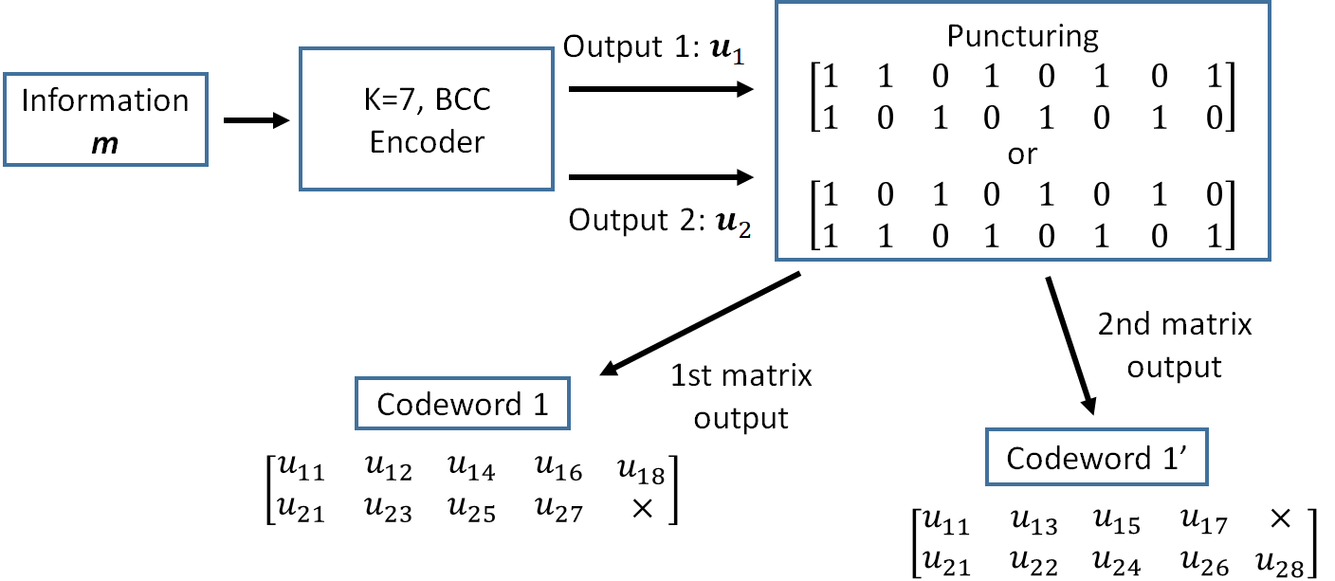
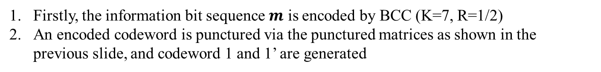
Hybrid ARQ mechanism (BCC case)
Firstly, the information bit sequence $m$ is encoded by BCC (K=7, R=1/2)
An encoded codeword is punctured via the punctured matrices as shown in the previous slide, and codeword 1 and 1’ are generated

Slide 5
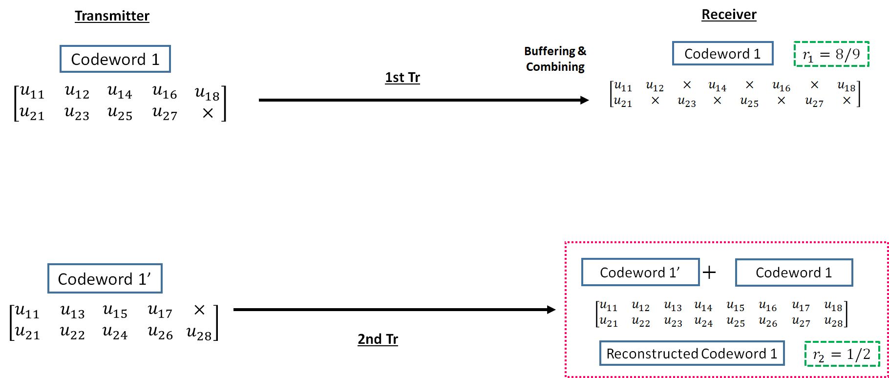
Hybrid ARQ mechanism (BCC case)
3. The codeword 1 is transmitted to a receiver
4. If bit errors are detected after decoding the codeword 1, a receiver buffers the transmitted codeword 1, and a transmitter re-sends the codeword 1’ to a receiver
5. At the receiver, transmitted codeword 1’ is combined with a buffered codeword 1, and a reconstructed codeword 1 (R=1/2) is generated

Slide 6
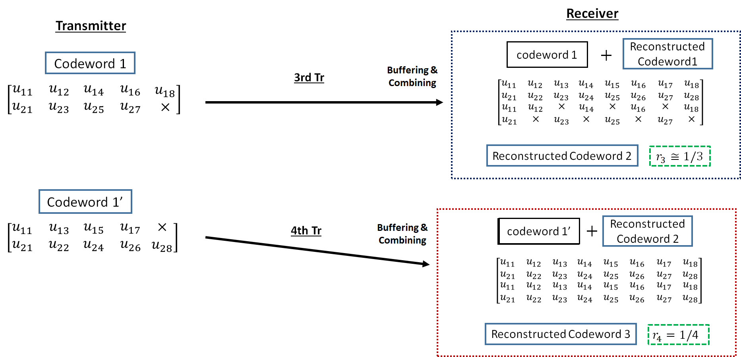
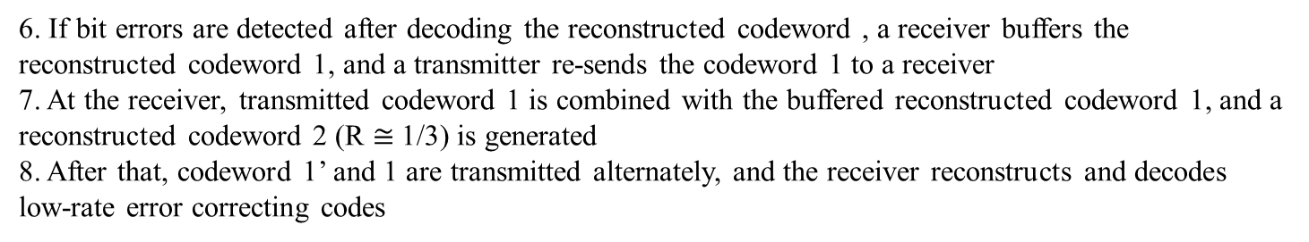
Hybrid ARQ mechanism (BCC case)
6. If bit errors are detected after decoding the reconstructed codeword , a receiver buffers the reconstructed codeword 1, and a transmitter re-sends the codeword 1 to a receiver
7. At the receiver, transmitted codeword 1 is combined with the buffered reconstructed codeword 1, and a reconstructed codeword 2 (R $≅$1/3) is generated
8. After that, codeword 1’ and 1 are transmitted alternately, and the receiver reconstructs and decodes low-rate error correcting codes

Slide 7
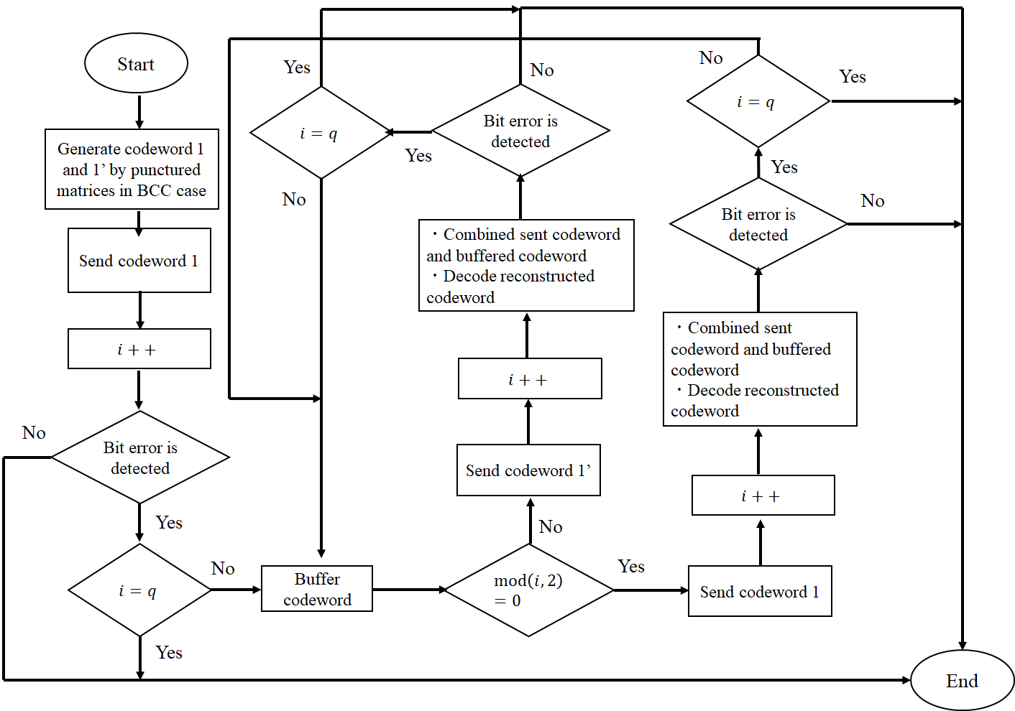
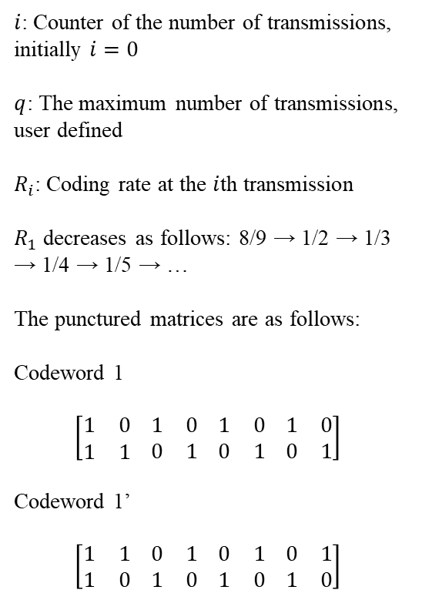
Hybrid ARQ mechanism (BCC case)
$i$: Counter of the number of transmissions, initially $i=0$
$q$: The maximum number of transmissions, user defined
$R_{i}$: Coding rate at the $i$th transmission
$R_{1}$ decreases as follows: 8/9 → 1/2 → 1/3 → 1/4 → 1/5 → …
The punctured matrices are as follows:
Codeword 1
$$\left[\begin{matrix}1 & 0 \\ 1 & 1\end{matrix} \begin{matrix}1 & 0 \\ 0 & 1\end{matrix} \begin{matrix}1 & 0 \\ 0 & 1\end{matrix} \begin{matrix}1 & 0 \\ 0 & 1\end{matrix}\right]$$
Codeword 1’
$$\left[\begin{matrix}1 & 1 \\ 1 & 0\end{matrix} \begin{matrix}0 & 1 \\ 1 & 0\end{matrix} \begin{matrix}0 & 1 \\ 1 & 0\end{matrix} \begin{matrix}0 & 1 \\ 1 & 0\end{matrix}\right]$$

Slide 8
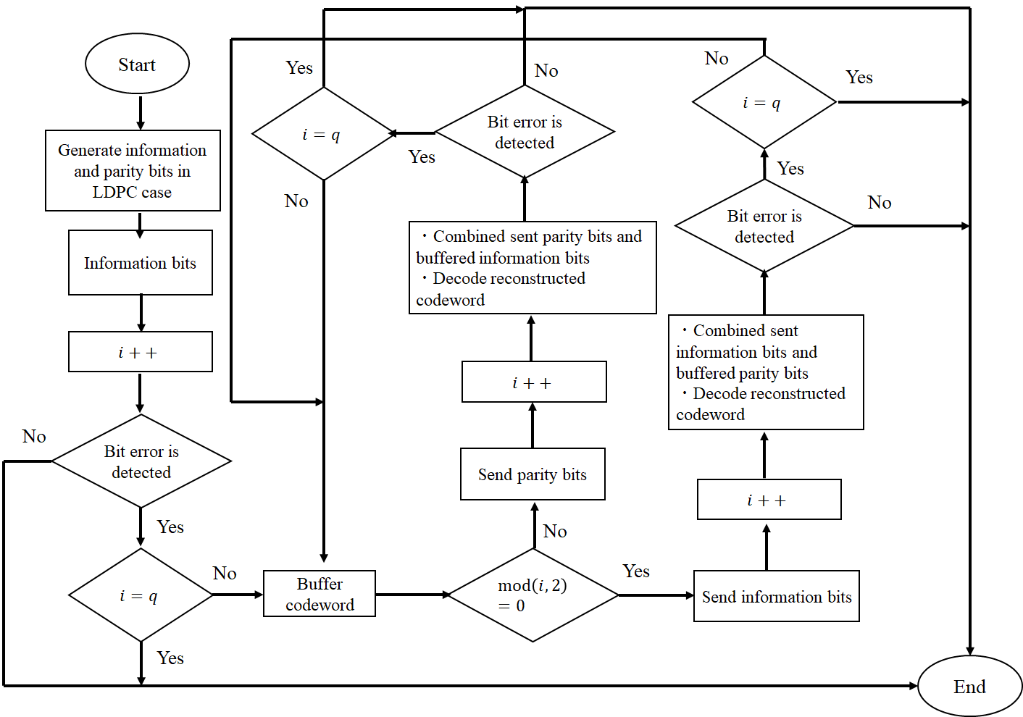
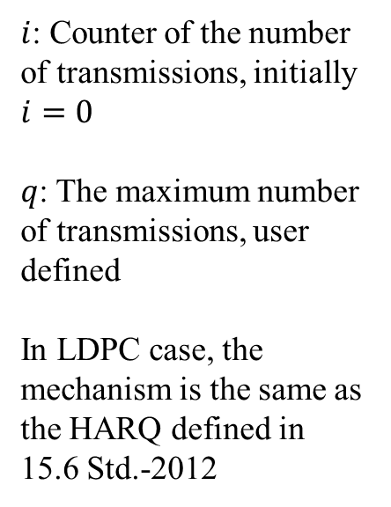
Hybrid ARQ mechanism (LDPC case)
$i$: Counter of the number of transmissions, initially $i=0$
$q$: The maximum number of transmissions, user defined
In LDPC case, the mechanism is the same as the HARQ defined in 15.6 Std.-2012

Slide 9
Classification of Channel and Environment Models for Human and Vehicle Body Area Networks (HBAN&VBAN)
Channel model
※Covered by
IEEE 802.15.6-2012
HBAN model
In-body (Implant)
※
On-body
※
Channel model
With environment
Around body
Outdoor
※Around means;
Desk, WiFi AP in the room etc.
Indoor
※
Home
Implanted BCI model
Office
※
On skull BCI model
Medical (e.g. Hospital)
※
capsule endoscopy
※not covered in 2012
VBAN model
In-vehicle
Engine compartment
Note:
HBAN-model:
-Environment with co-existing systems is not considered.
VBAN model:
Key-less entry system
Localization in-body, on-body
Most dominant model should be defined and separatory defined as Mandatory and Optional.
Cabin
Through Engine compartment and cabin
On-vehicle
Roof
Around vehicle
Side Right/Left/Front/back
Bottom
Static vehicle
Notes:
IEEE802.15.6ma assumes various scenarios for HBAN and VBAN, and the channel model applied varies depending on the scenario
In this presentation, we consider an environment in which on-body to external device communication in HBAN and interference from other systems exist

Slide 10
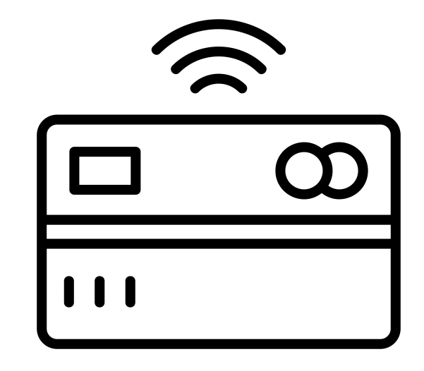
Radio environment
15.6ma
15.6ma
EMI source
15.4z
15.6ma
15.6ma
15.6
15.4ab
15.6ma
On body to an external device channel: IEEE model CM4
Interference from other WBANs and systems: Bit erasure channel
15.4
Notes:
In this presentation, we will assume the area surrounded by the red dotted circle in this figure
The IEEE model CM4 is applied to the on-body to external device channel model, and the bit erasure channel is applied to the interference from other systems

Slide 11
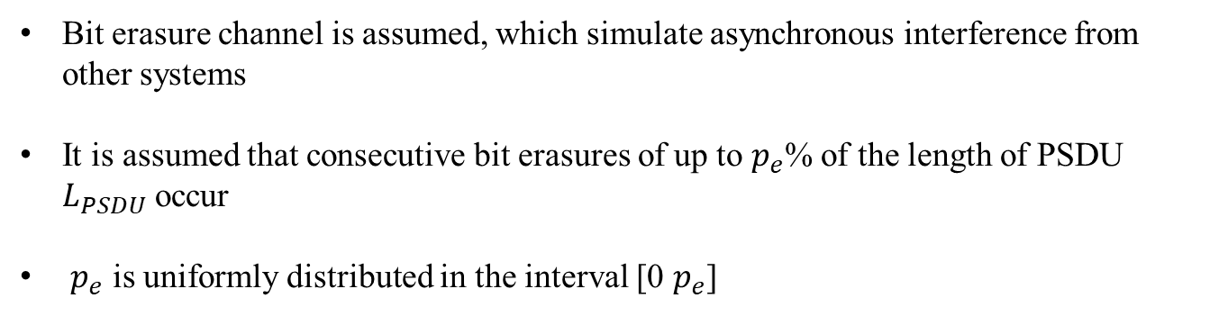
Bit erasure channel
0 1 1 0 0 1 0 0 1・・・0 1 1 1 ✕ ✕ ✕ ✕ ✕ ✕ ・・・0 1 1 0 0 0 1 1
Consecutive bit erasures
Bit erasure channel is assumed, which simulate asynchronous interference from other systems
It is assumed that consecutive bit erasures of up to $p_{e}$% of the length of PSDU $L_{PSDU}$ occur
$p_{e}$ is uniformly distributed in the interval [0 $p_{e}$]
Notes:
For bit erasure channels, the assumptions explained in this slide apply

Slide 12
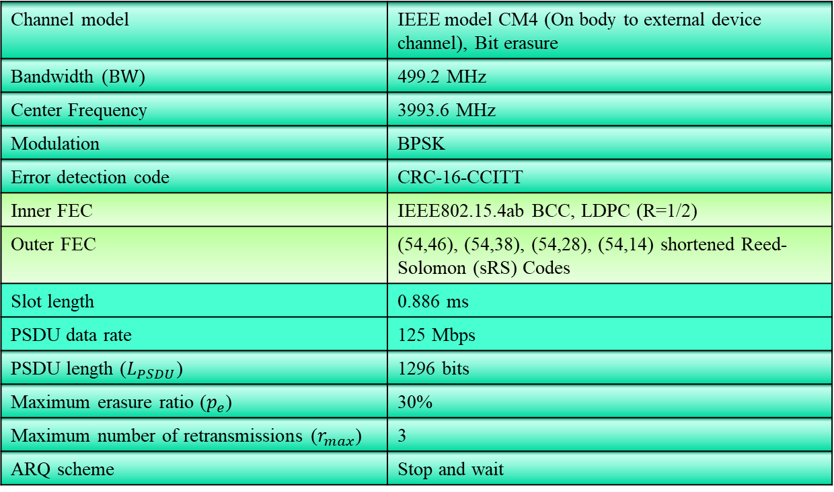
Evaluation
Channel model | IEEE model CM4 (On body to external device channel), Bit erasure
Bandwidth ($BW$) | 499.2 MHz
Center Frequency | 3993.6 MHz
Modulation | BPSK
Error detection code | CRC-16-CCITT
Inner FEC | IEEE802.15.4ab BCC, LDPC (R=1/2)
Outer FEC | (54,46), (54,38), (54,28), (54,14) shortened Reed-Solomon (sRS) Codes
Slot length | 0.886 ms
PSDU data rate | 125 Mbps
PSDU length ($L_{PSDU}$) | 1296 bits
Maximum erasure ratio ($p_{e}$) | 30%
Maximum number of retransmissions ($r_{max}$) | 3
ARQ scheme | Stop and wait
Notes:
This presentation evaluated several metrices under on body to on body channel model (including multipath fading)

Slide 13
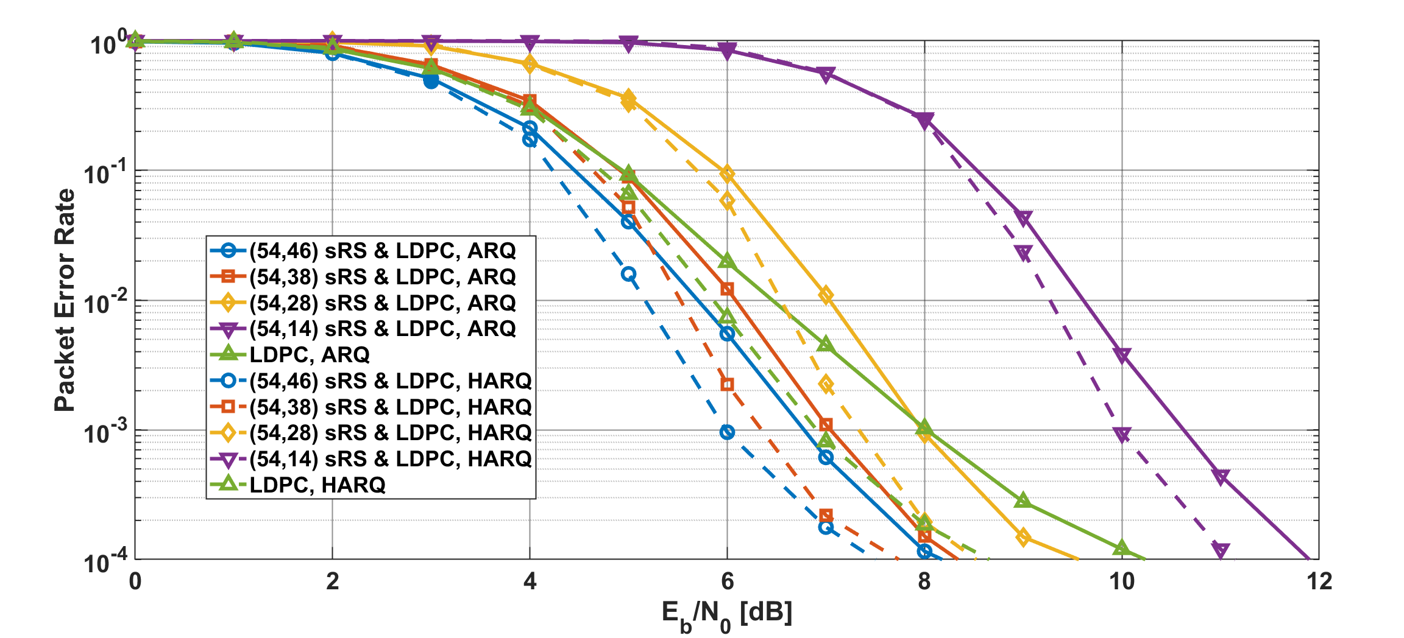
Results
Packet error ratio as a function of $E_{b}/N_{0}$ in the case of LDPC, $p_{e}=30$%
Notes:
Under on body to on body channel model case, compared with ARQ and HARQ, the HARQ has a several dB better performance. CM4

Slide 14
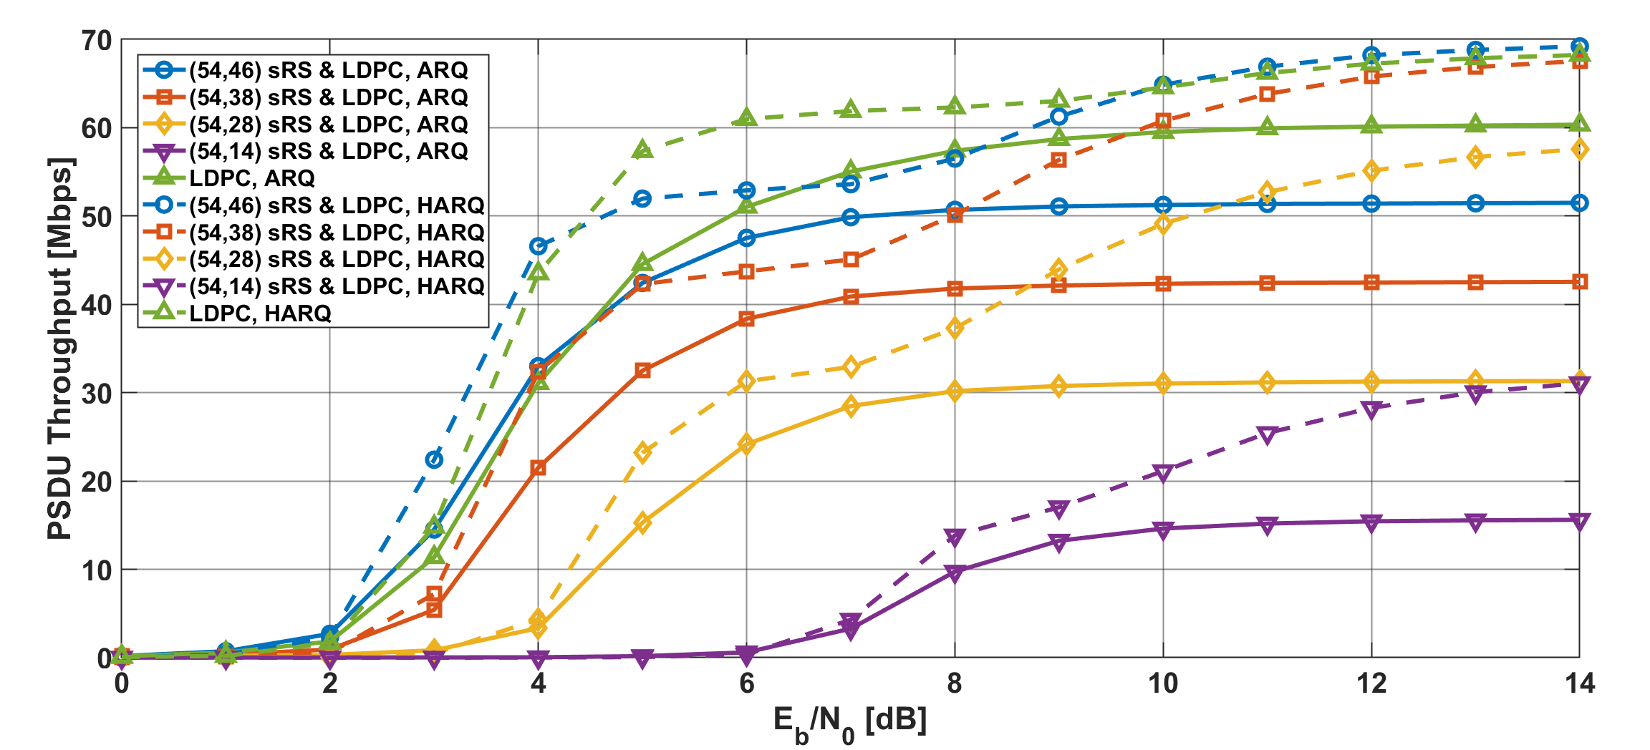
Results
PSDU Throughput as a function of $E_{b}/N_{0}$ in the case of LDPC, $p_{e}=30$%
Notes:
And next, the PSDU throughput of HARQ is also better that of ARQ in the case, especially high SNR areas.
In particular, except for the lowest RS code rate, a PSDU throughput of more than 50 Mbps is achieved. CM4

Slide 15
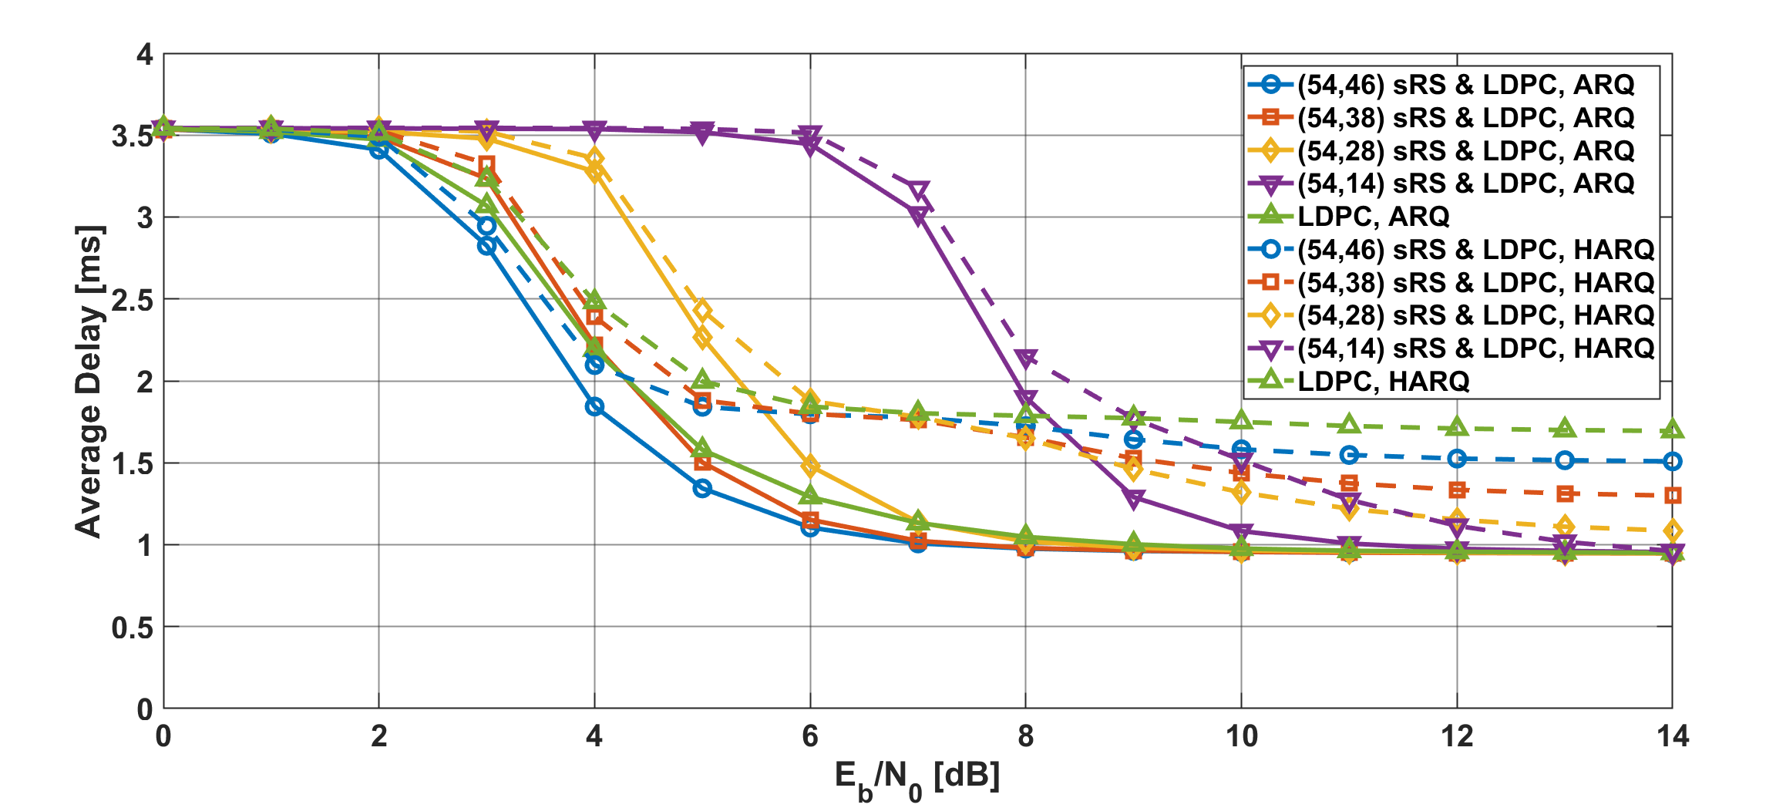
Results
Average delay as a function of $E_{b}/N_{0}$ in the case of LDPC, $p_{e}=30$%
Notes:
On the other hand, the average delay of HARQ has worse performance than ARQ in that case.
The reason is that in the case of HARQ, if the coding rate of the RS code is high or RS code is not used, at least one retransmission is required. CM4

Slide 16
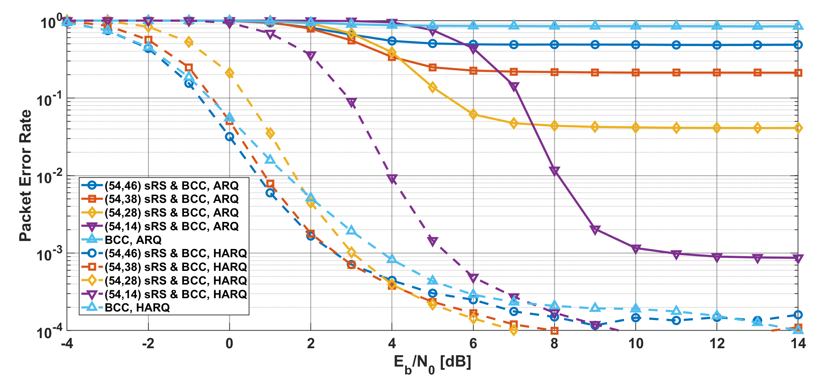
Results
Packet error ratio as a function of $E_{b}/N_{0}$ in the case of BCC, $p_{e}=30$%
Notes:
Next, in the BCC case, the PER of HARQ has much better improved than that of ARQ.
In other words, simple ARQ cannot provide high dependability under this condition. CM4

Slide 17
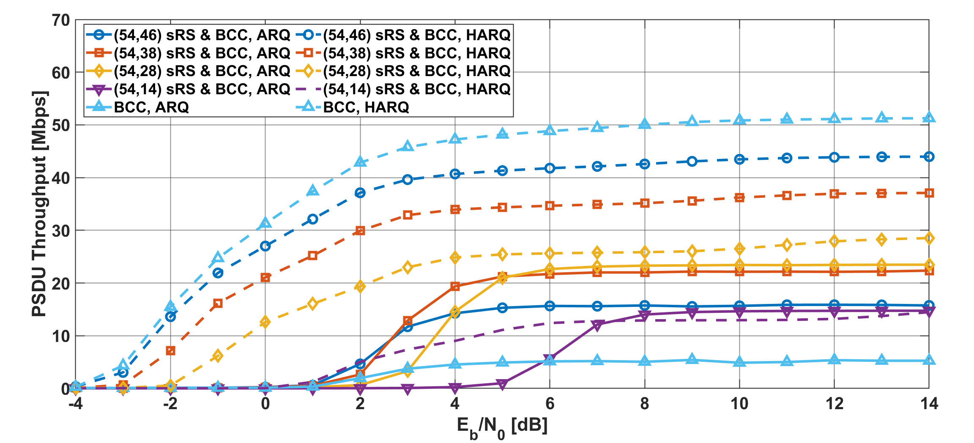
Results
PSDU Throughput as a function of $E_{b}/N_{0}$ in the case of BCC, $p_{e}=30$%
Notes:
Additionally, the PSDU throughput of HARQ is also much better that of ARQ in the case.
By adjusting the coding rate, it is possible to reach 50Mbps. CM4

Slide 18
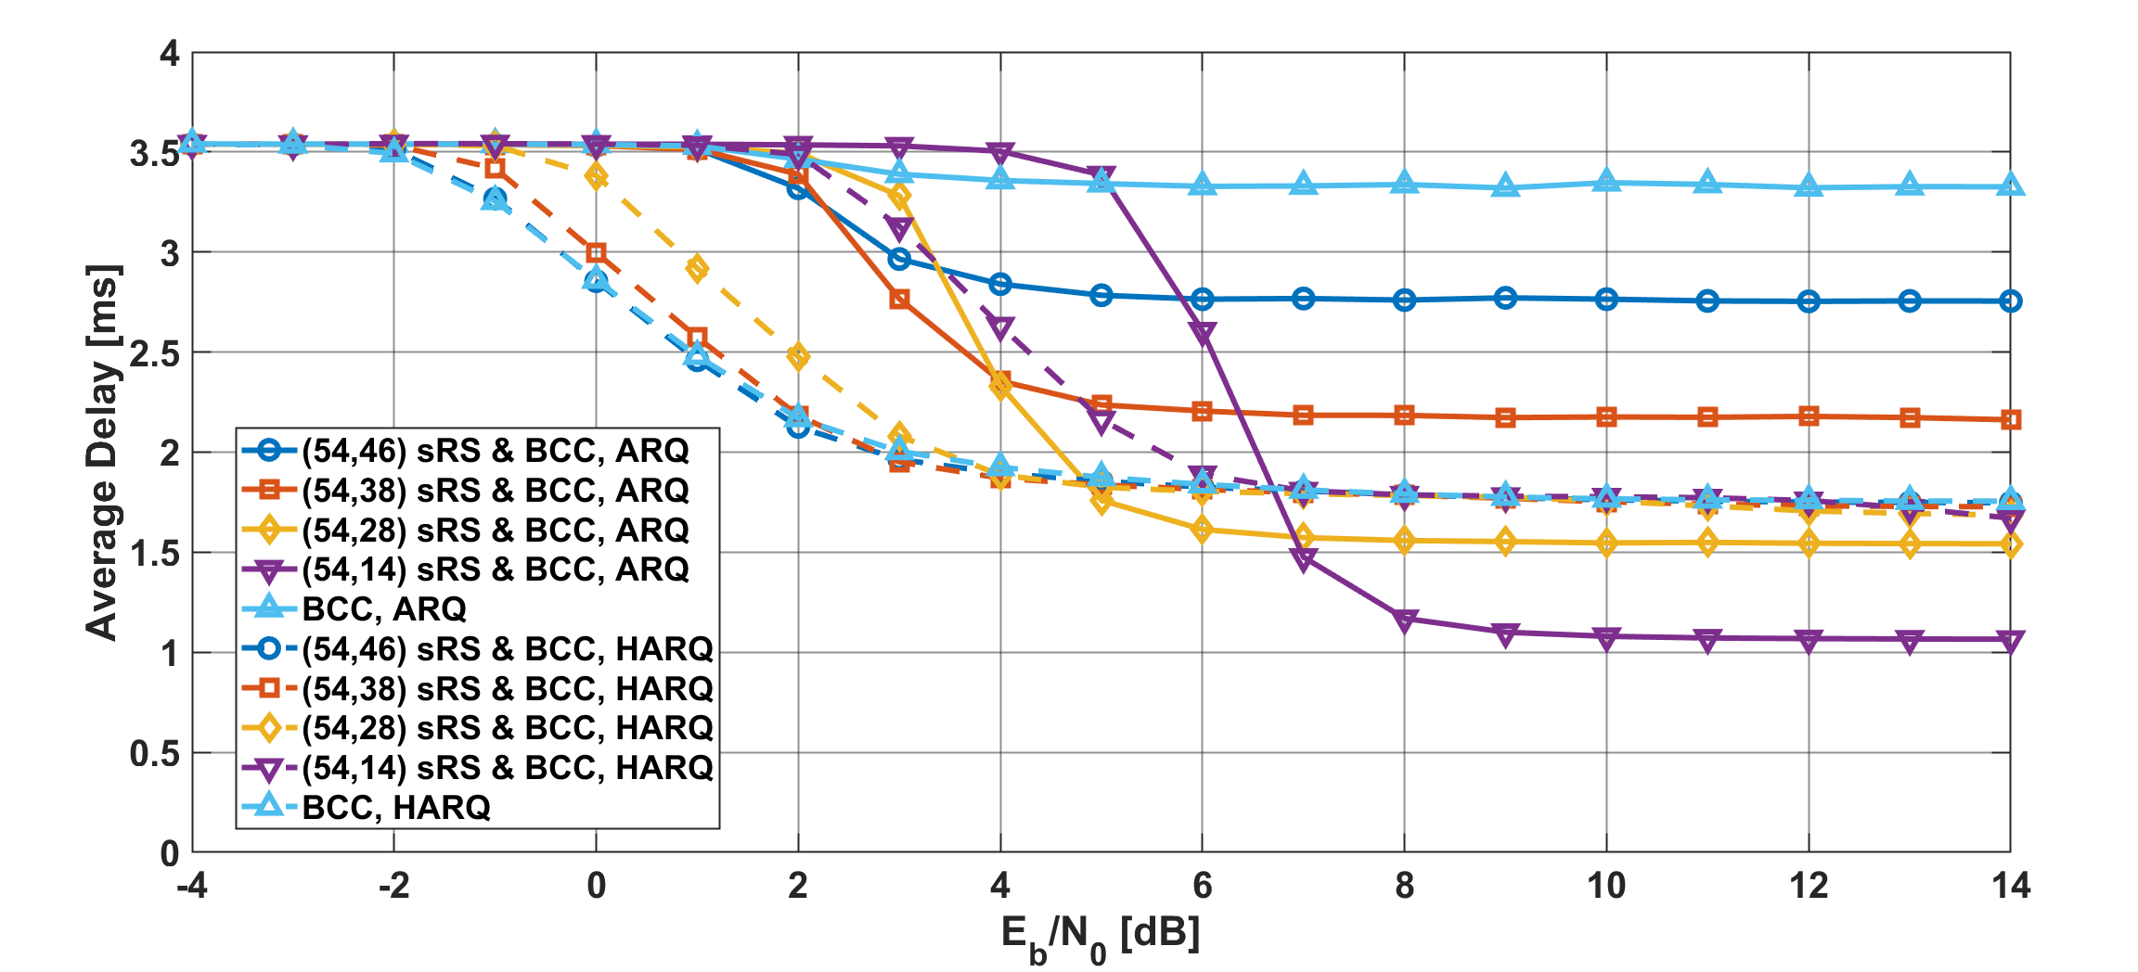
Results
Average delay as a function of $E_{b}/N_{0}$ in the case of BCC, $p_{e}=30$%
Notes:
On the other hand, the average delay of HARQ has basically better performance in that condition, especially low SNR areas.
In the high SNR region, the average delay is longer than that of simple ARQ with a low RS code due to one retransmission, but it still maintains a low delay, several ms or less.
CM4

Slide 19
Conclusion
In this presentation, the performance of HARQ when applying an on-body to an external decive channel model based on the scenario assumed in IEEE802.15.6ma was evaluated
In this channel model, HARQ was significantly superior in terms of PER and PSDU throughput, and HARQ also maintained a low average delay
In addition, in terms of reliability, HARQ using BCC produced better results than LDPC
  This is because HARQ using BCC can improve error correction capability with each retransmission
We also plan to evaluate the performance when applying channel models in other scenarios (Example: VBAN case)

Slide 20
Thank you for your attention ! ! !

Slide 21
Concept of Hybrid ARQ mechanism
Advantages of the hybrid ARQ mechanism
  The coding rate is very wide
    Bit errors are sufficiently eliminated at the high coding rate under very good channel conditions
    Very low coding rates remove bit errors under bad channel conditions
    A coding rate at the first transmission may be changed according to channel conditions
  In the case of the small number of retransmissions, it is sufficient to transmit the small number of redundant bits
    This characteristic leads to improvement of energy efficiency and reduction of transmission delay at retransmission

Slide 22
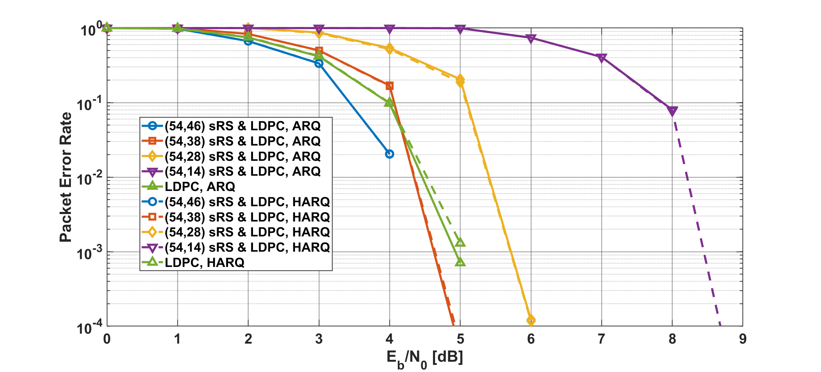
Results
Packet error ratio as a function of $E_{b}/N_{0}$ in the case of LDPC, $p_{e}=10$%
Notes:
Under on body to on body channel model case, compared with ARQ and HARQ, the HARQ has a several dB better performance.

Slide 23
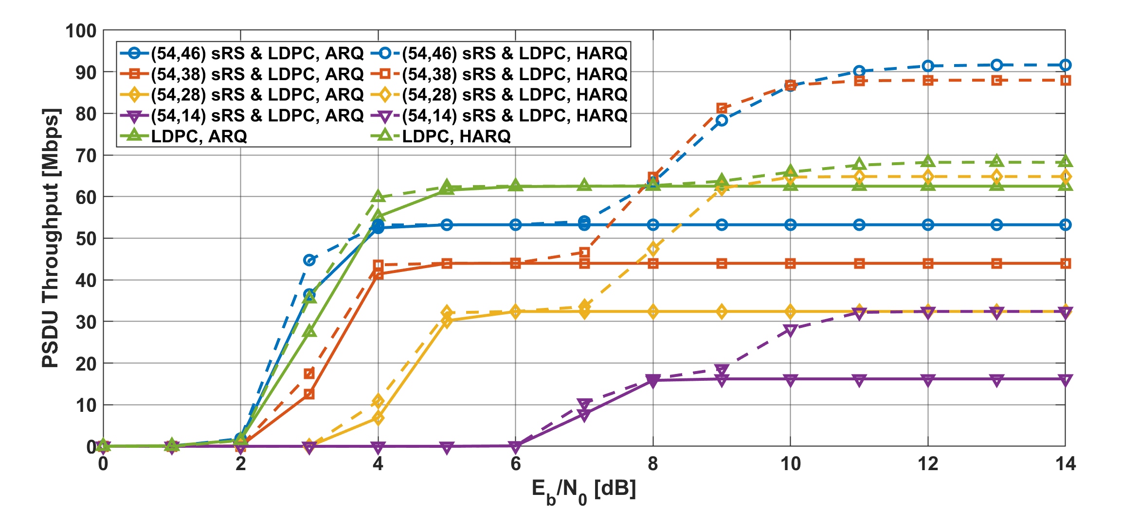
Results
PSDU Throughput as a function of $E_{b}/N_{0}$ in the case of LDPC, $p_{e}=10$%
Notes:
And next, the PSDU throughput of HARQ is also better that of ARQ in the case, especially high SNR areas.
In particular, except for the lowest RS code rate, a PSDU throughput of more than 50 Mbps is achieved.

Slide 24
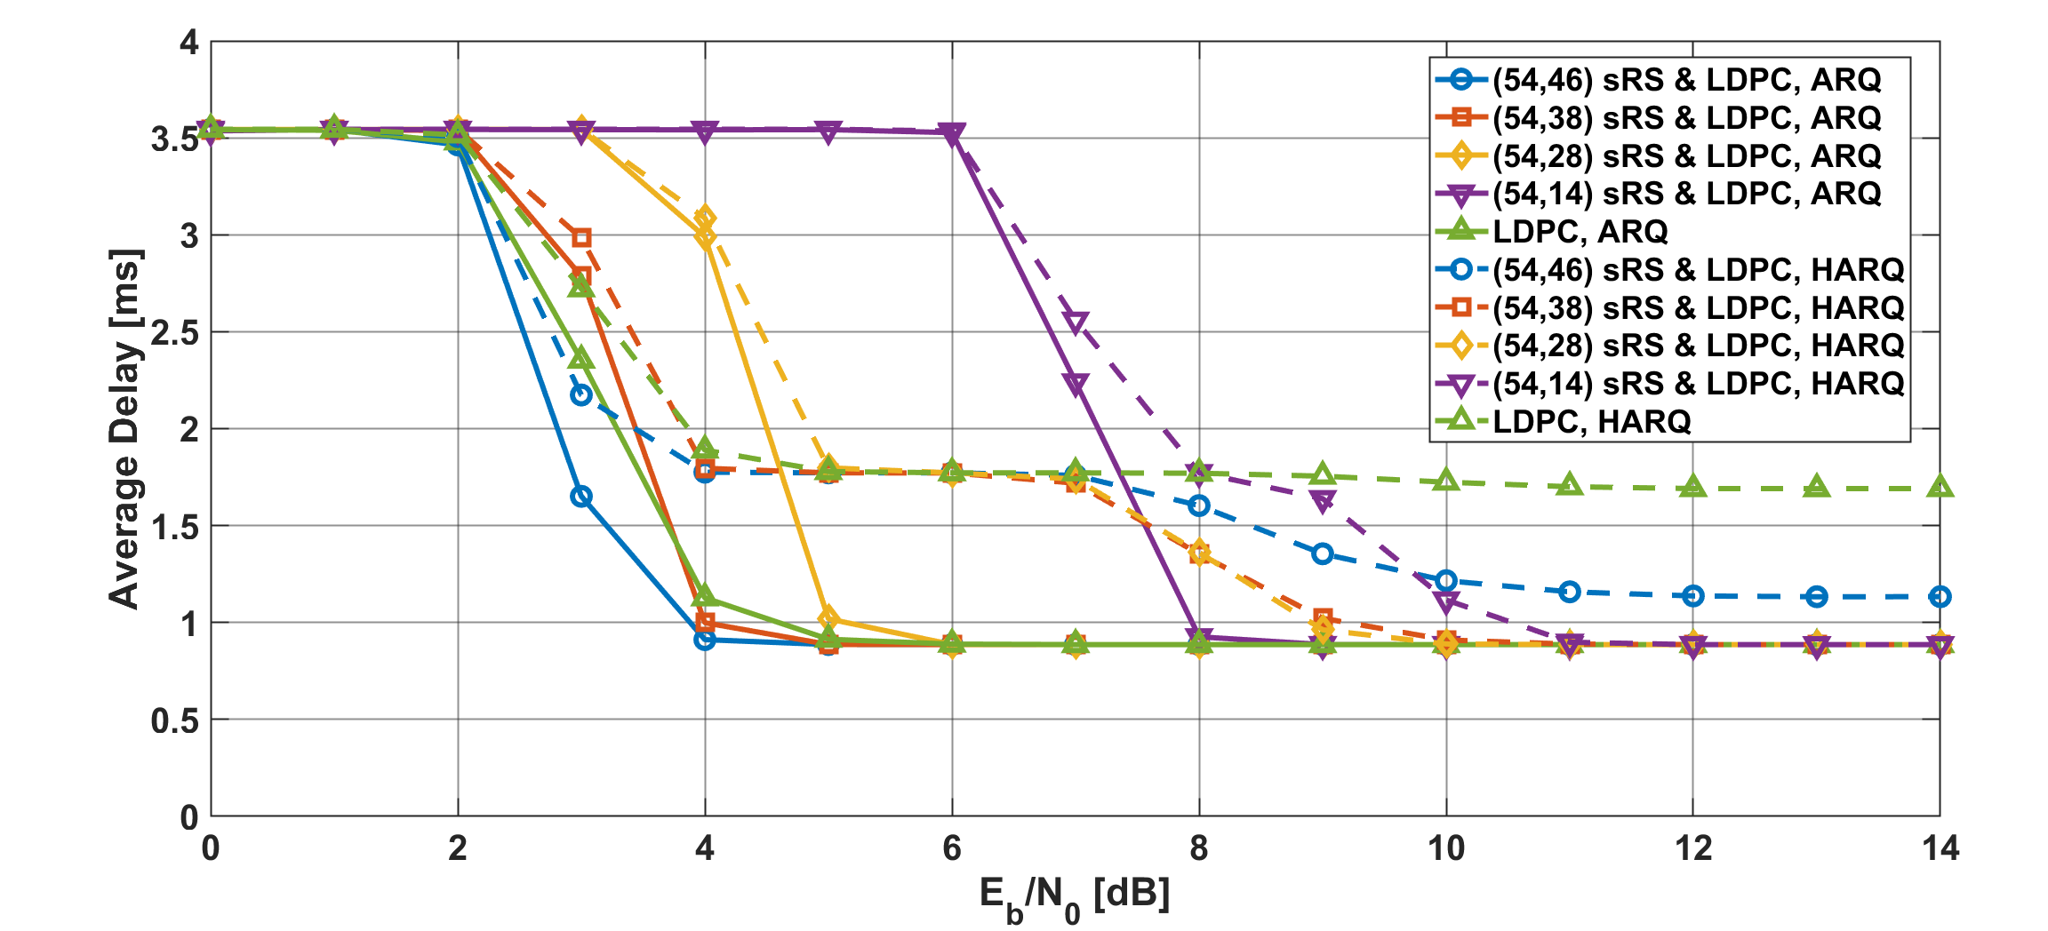
Results
Average delay as a function of $E_{b}/N_{0}$ in the case of LDPC, $p_{e}=10$%
Notes:
On the other hand, the average delay of HARQ has worse performance than ARQ in that case.
The reason is that in the case of HARQ, if the coding rate of the RS code is high or RS code is not used, at least one retransmission is required.

Slide 25
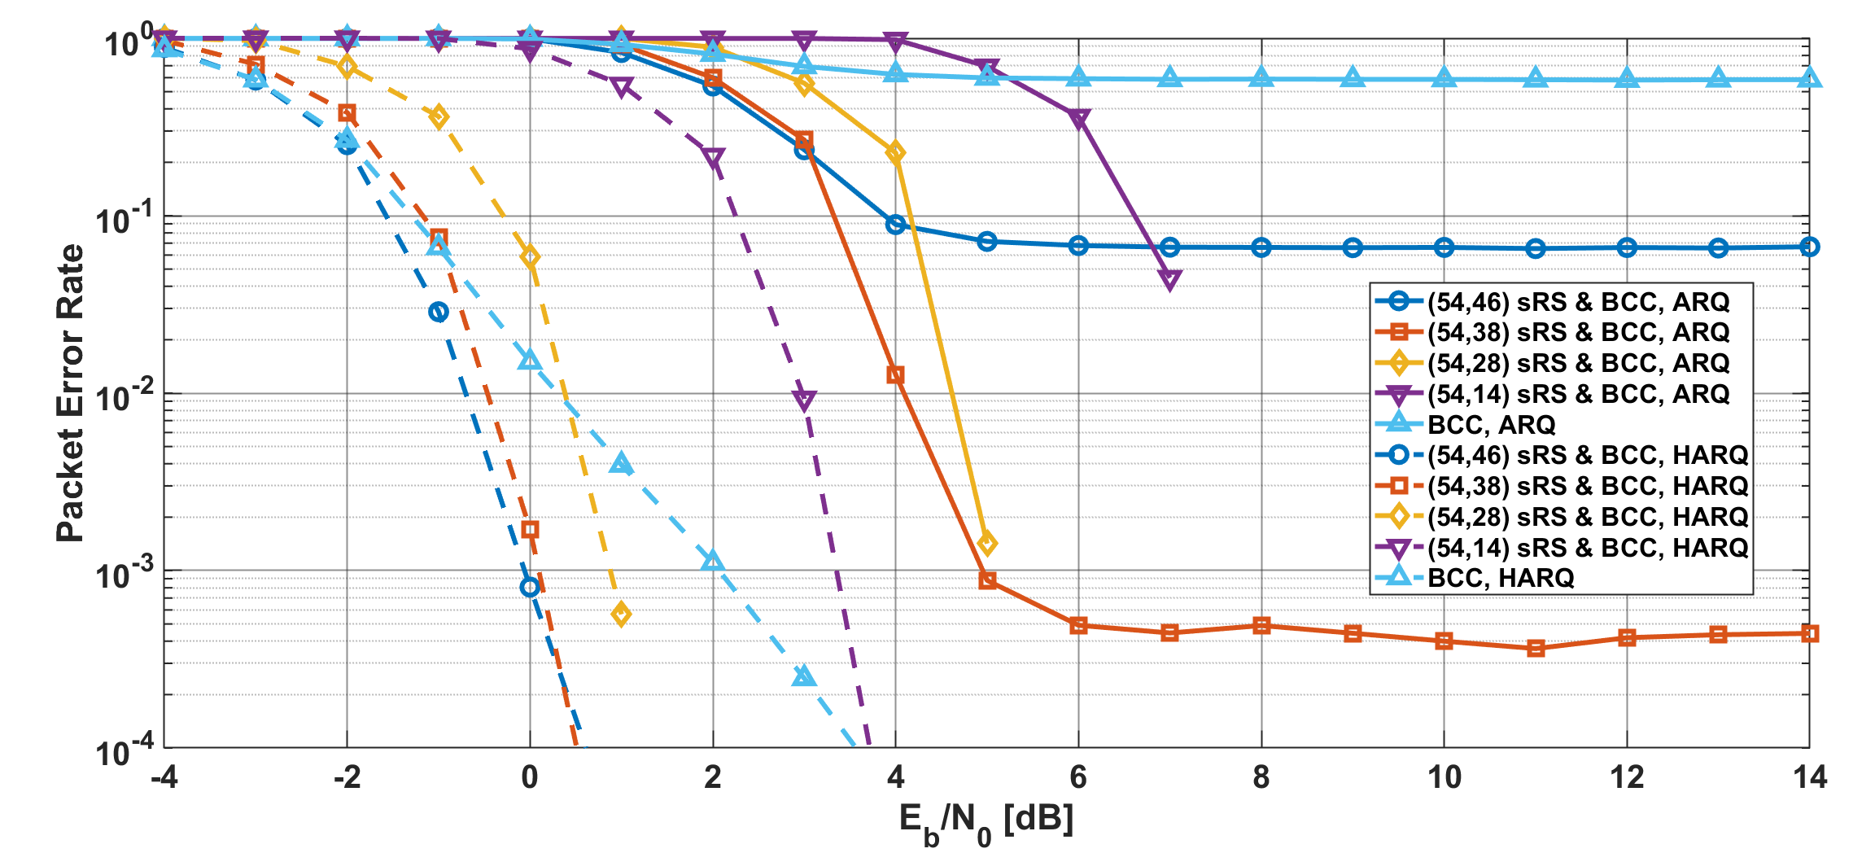
Results
Packet error ratio as a function of $E_{b}/N_{0}$ in the case of BCC, $p_{e}=10$%
Notes:
Next, in the BCC case, the PER of HARQ has much better improved than that of ARQ.
In other words, simple ARQ cannot provide high dependability under this condition.

Slide 26
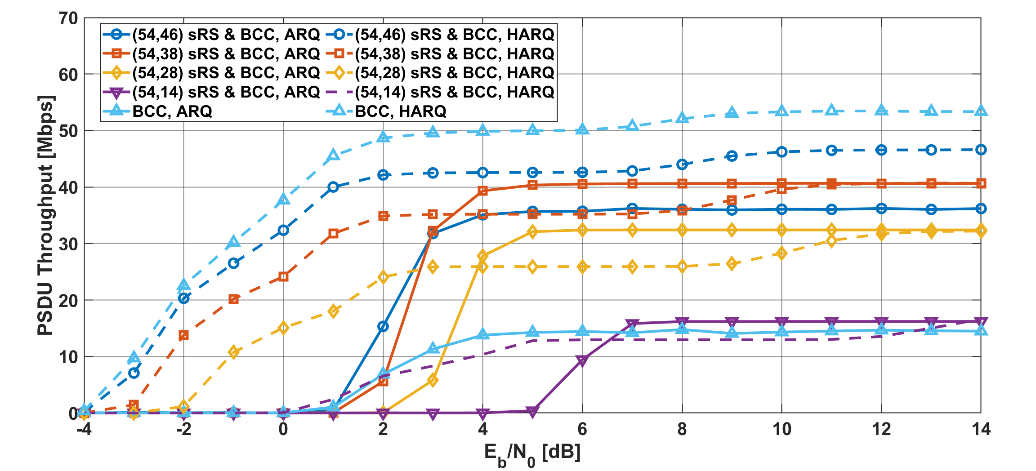
Results
PSDU Throughput as a function of $E_{b}/N_{0}$ in the case of BCC, $p_{e}=10$%
Notes:
Additionally, the PSDU throughput of HARQ is also much better that of ARQ in the case.
By adjusting the coding rate, it is possible to reach 50Mbps.

Slide 27
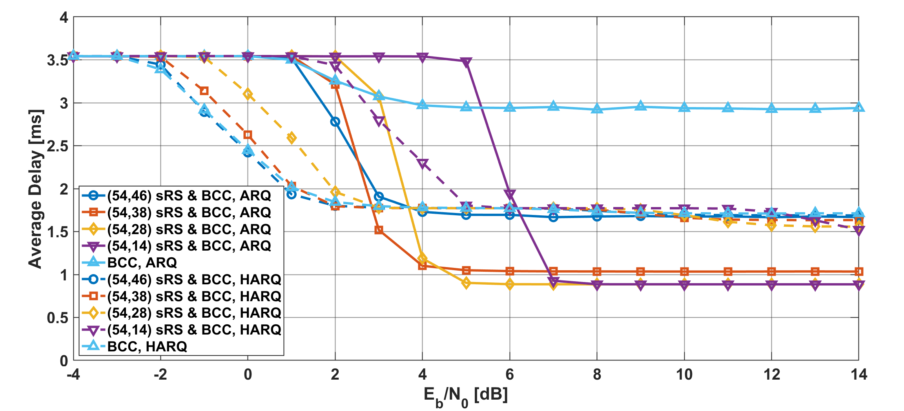
Results
Average delay as a function of $E_{b}/N_{0}$ in the case of BCC, $p_{e}=10$%
Notes:
On the other hand, the average delay of HARQ has basically better performance in that condition, especially low SNR areas.
In the high SNR region, the average delay is longer than that of simple ARQ with a low RS code due to one retransmission, but it still maintains a low delay, several ms or less.

Slide 28
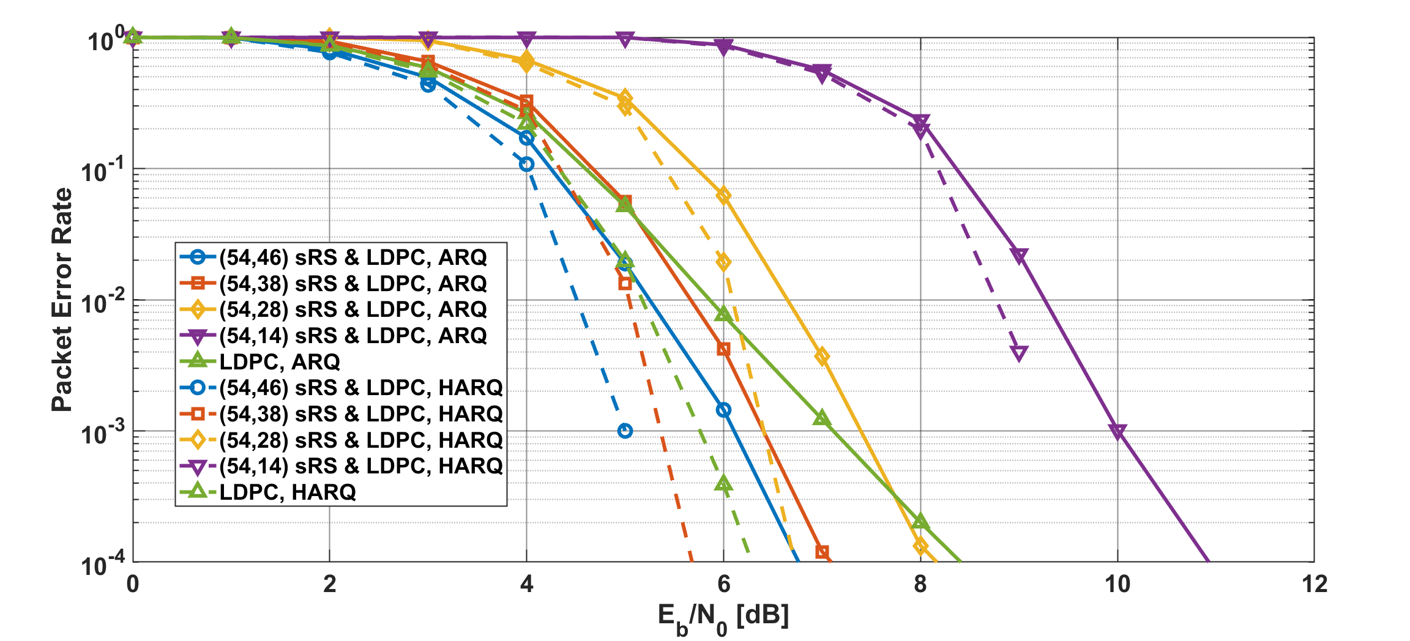
Results
Packet error ratio as a function of $E_{b}/N_{0}$ in the case of LDPC, $p_{e}=30$%
Notes:
Under on body to on body channel model case, compared with ARQ and HARQ, the HARQ has a several dB better performance.

Slide 29
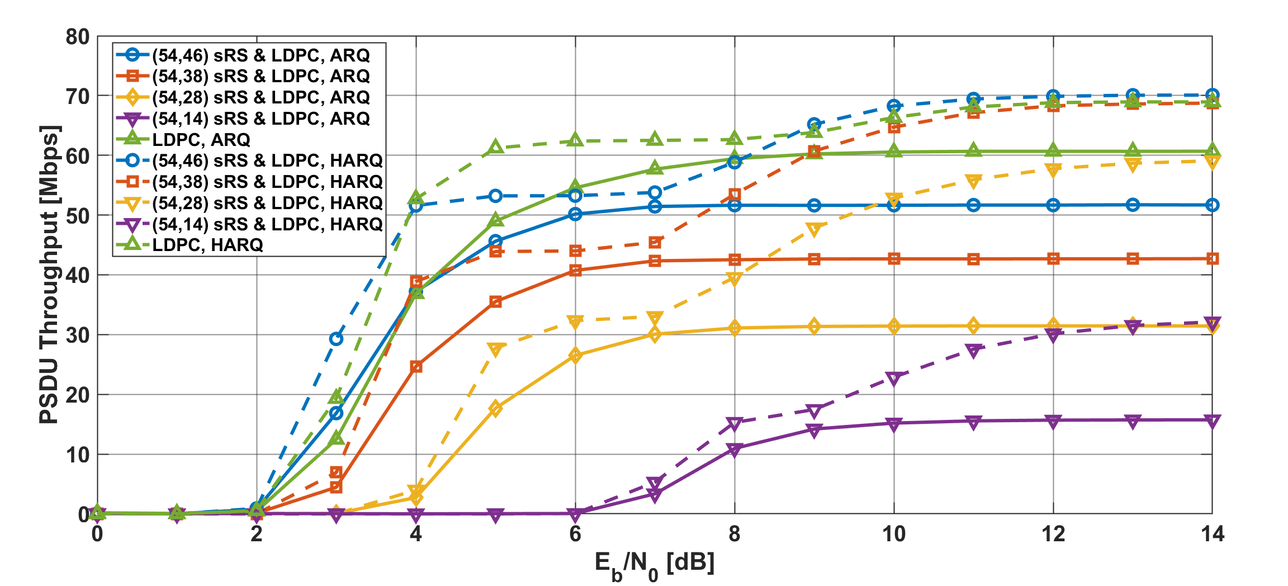
Results
PSDU Throughput as a function of $E_{b}/N_{0}$ in the case of LDPC, $p_{e}=30$%
Notes:
And next, the PSDU throughput of HARQ is also better that of ARQ in the case, especially high SNR areas.
In particular, except for the lowest RS code rate, a PSDU throughput of more than 50 Mbps is achieved.

Slide 30
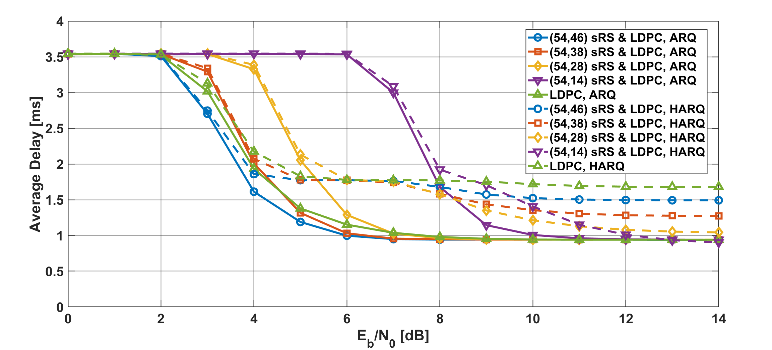
Results
Average delay as a function of $E_{b}/N_{0}$ in the case of LDPC, $p_{e}=30$%
Notes:
On the other hand, the average delay of HARQ has worse performance than ARQ in that case.
The reason is that in the case of HARQ, if the coding rate of the RS code is high or RS code is not used, at least one retransmission is required.

Slide 31
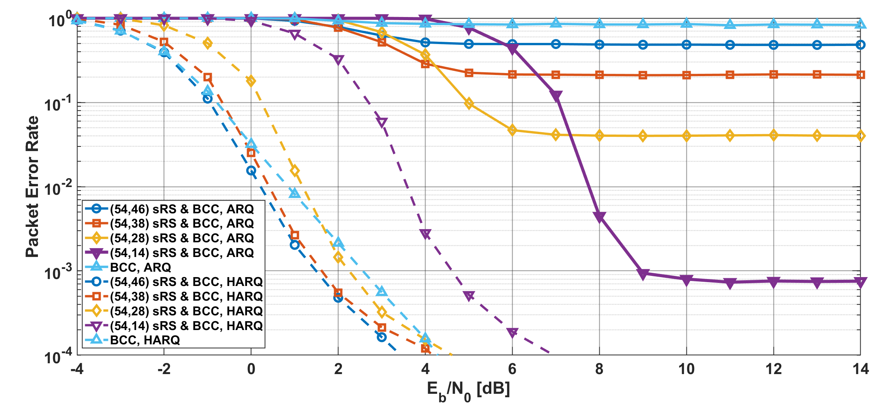
Results
Packet error ratio as a function of $E_{b}/N_{0}$ in the case of BCC, $p_{e}=30$%
Notes:
Next, in the BCC case, the PER of HARQ has much better improved than that of ARQ.
In other words, simple ARQ cannot provide high dependability under this condition.

Slide 32
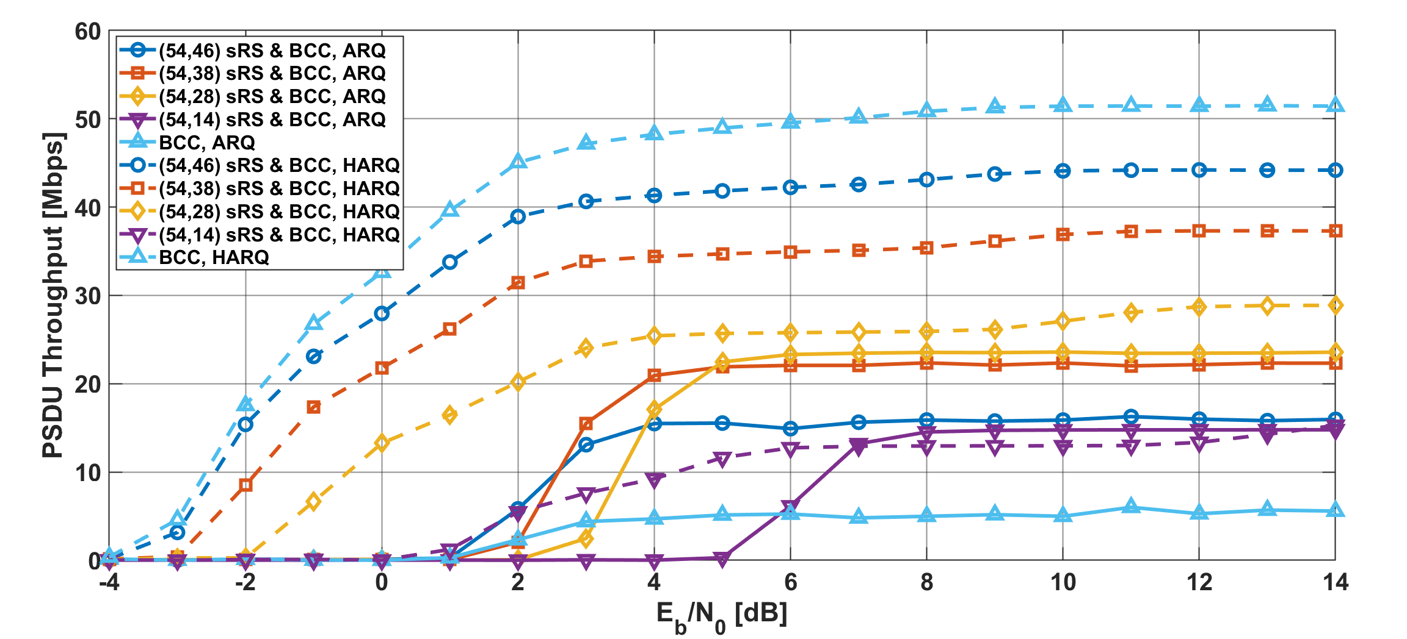
Results
PSDU Throughput as a function of $E_{b}/N_{0}$ in the case of BCC, $p_{e}=30$%
Notes:
Additionally, the PSDU throughput of HARQ is also much better that of ARQ in the case.
By adjusting the coding rate, it is possible to reach 50Mbps.

Slide 33
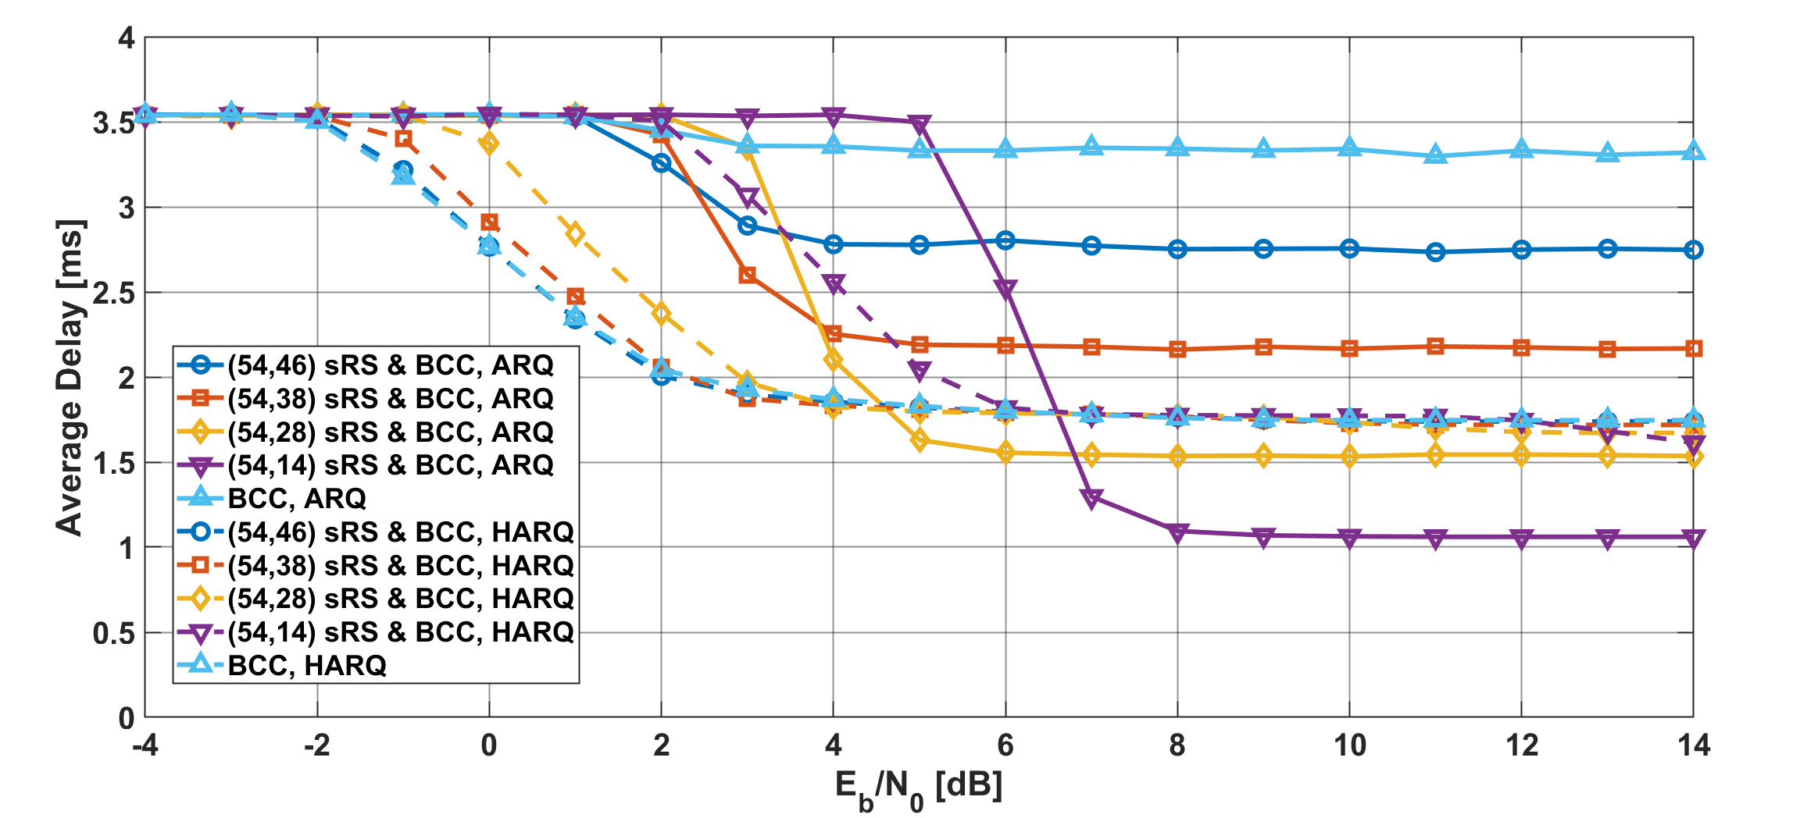
Results
Average delay as a function of $E_{b}/N_{0}$ in the case of BCC, $p_{e}=30$%
Notes:
On the other hand, the average delay of HARQ has basically better performance in that condition, especially low SNR areas.
In the high SNR region, the average delay is longer than that of simple ARQ with a low RS code due to one retransmission, but it still maintains a low delay, several ms or less.

