Slide 1

146th Session of meetings of the
IEEE 802.15 Working Group for Wireless Specialty Networks (WSN)
Opening Report
November 12-17, 2023
Held in Honolulu & Hybrid via Webex

Slide 2
802.15 WG Org. Chart

Slide 3
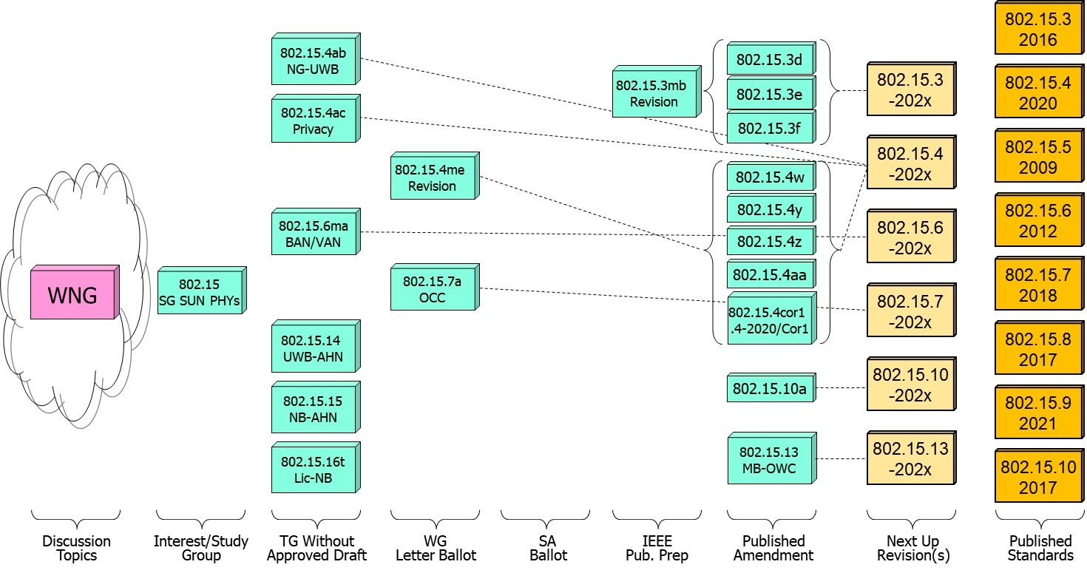
802.15 WG Standards Pipeline

Slide 4
802.15 WG Administrative
Voting members: 137
Nearly voting members: 10
Aspirant voting member: 22
802.15 WG Officer Elections
Clint Powell - Chair (elected March 2022)
Phil Beecher - 1st Vice-Chair (elected March 2022)
Ann Krieger - 2nd Vice-Chair (elected Nov. 2022)
Thomas Almholt - Secretary (appointed May 2023)
James Gilb - Tech. Editor (appointed March 2023)
Ben Rolfe - Treasurer (appointed March 2023)

Slide 5
Meeting Slots for 802.15 WG Sept. Interim

Slide 6
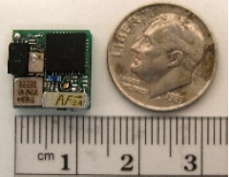

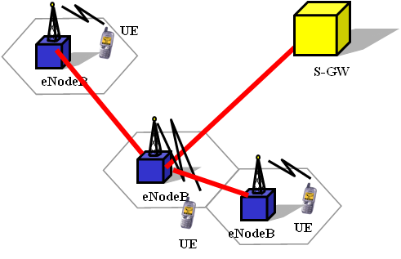

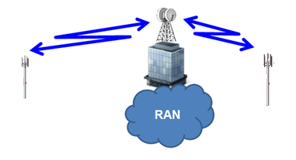







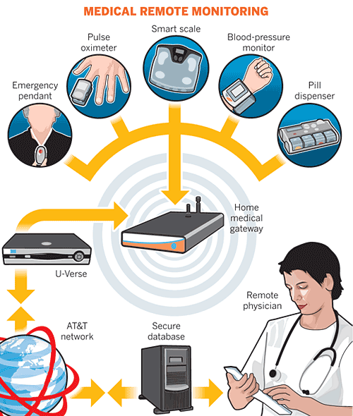
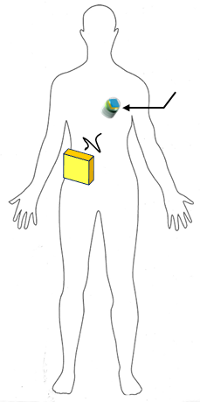

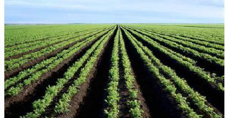

IEEE 802.15 Standards & their Applications
802.15.16
802.15.4
Locating and Tracking
Ultra-low Power Sensors
Automotive
FAN/MAN/RAN
802.15.4
Multi-media networks
&
High Speed
Interconnect
802.15.3
Industrial Networks
802.15.7
802.15.13
Medical
802.15.6
Critical Infrastructure Networks
Consumer Devices
Optical
Communications
Agricultural Sensing
Structural Monitoring
Slide 6

Slide 7
802.15 WG Subgroups/Objectives
TG 3mb – Revision b, Maintenance (mb)
Objective: revision for 802.15.3, extension of the frequency range to 300 GHz and review the 802.1D references and replace them with 802.1Q as appropriate
TG 4ab – Next Generation Ultra WideBand (NG-UWB) Amendment
Objective: enhancements to 802.15.4 Ultra Wideband (UWB) physical layers (PHYs) media access control (MAC), and associated ranging techniques while retaining backward compatibility with enhanced ranging capable devices (ERDEVs)
TG 4ac – Privacy Amendment
Objective: modifications to the IEEE Std 802.15.4 medium access control (MAC) specification to specify mechanisms that address and improve user privacy

Slide 8
802.15 WG Subgroups/Objectives
TG 4me – Revision e, Maintenance (me)
Objective: revision to 802.15.4-2020, rolling up amendments 802.15.4w, 802.15.4y, 802.15.4z, and 802.15.4aa and work on errors, omissions, updates, etc.
TG 6ma – Revision a, Maintenance (ma)
Objective: enhancements to the BAN Ultra Wideband (UWB) physical layer (PHY) and media access control (MAC) to support enhanced dependability to a human BAN (HBAN) and adds support for vehicle body area networks (VBAN), a coordinator in a vehicle with devices around the vehicular cabin
TG 7a – Optical Camera Communication (OCC) Amendment
Objective: high-rate OCC Physical Layer (PHY) using light wavelengths from 10,000 nm to 190 nm delivering data rates up to 100 Mb/s for point-to-point and point-to-multipoint communication

Slide 9
802.15 WG Subgroups/Objectives
TG 14 – Impulse Radio Ultra Wideband Wireless Ad Hoc Networks (UWB-AHN) ---IN HIBERNATION---
Objective: focused on impulse radio (IR) Ultra Wideband (UWB) PHY and MAC providing precision ranging capability that is accurate to the centimeter level by including (via. referencing) the 802.15.4 IR UWB functionality into a simple focused specification
TG 15 – Narrow Band Wireless Ad Hoc Networks (NB-AHN)
---IN HIBERNATION---
Objective: focused on narrow band ad hoc network PHY and MAC by including (via referencing) functionality and features of 802.15.4 into a simple focused specification
TG 16t – Licensed Narrowband (Lic-NB)
Objective: specify new PHY in licensed spectrum with channel bandwidths greater than or equal to 5 kHz and less than 100 kHz focusing on spectrum less than 2 GHz.

Slide 10
802.15 WG Subgroups/Objectives
SG Next Generation SUN PHYs
Objective: Develop a PAR & CSD for extending the SUN PHYs

Slide 11
802.15 WG Subgroups/Objectives
SC Maintenance/Rules
Objective: review errors noted in published standards providing a response/proposal to the 802.15 WG; review the 802.15 WG operations manual and general P&P and suggest changes to 802.15 WG; review PARs submitted by other WGs
SC IETF – Internet Engineering Task Force standing committee
Objective: provides an 802.15 liaison to IETF for projects associated with 802.15 standards
SC THz – Terahertz (THz)
Objective: communicate THz communications developments, providing input to the regulatory framework for THz comms. in close cooperation IEEE 802.18 TAG; trigger the start of projects to amend existing and develop new standards for THz comms.
SC WNG – Wireless Next Generation (WNG)
Objective: provides an opportunity to individuals to make technical presentations to the 802.15 WG on new technologies and/or proposals for new projects

Slide 12
Session Objectives Nov. 12-17, 2023
TG 3mb (Revision)
  Not meeting – at IEEE Editors
TG 4ab (NG-UWB)
  Identify draft missing pieces and determine work assignments
  Resolve comments and address feedback on pre draft
  Preparation to start Initial Letter Ballot
TG 4ac (Privacy)
  Continue preparing draft
TG 4me (Revision)
  Conduct comment resolution from 1st Letter Ballot Recirc
  Assess readiness to start 2nd Letter Ballot Recirc
TG 6ma (Revision + BAN/VAN)
  Resolve comments from pre ballot review

Slide 13
Session Objectives Sept. 11-14, 2023
TG 7a (OCC)
  Conduct comment resolution for 4th Letter Ballot Recirc
  Prepare package to go to WG and LMSC to start Sponsor Ballot
TG 14 (UWB-AHN) – in hibernation, no meetings
TG 15 (NB-AHN) – in hibernation, no meetings
TG 16t (Lic-NB)
  Finalize resolving comments from pre ballot review
  Start Initial Letter Ballot
Joint 802.1/802.15
  Address comments/feedback received on PAR for 802.1 project supporting TG6ma

Slide 14
Session Objectives Sept. 11-14, 2023
SG NG-SUN PHYs
  Address comments/feedback received on PAR and CSD submitted for Nov. LMSC approval
SC MAINTENANCE
  Review draft of detailed development process steps checklist
  Identify list of all templates for WG15 Subpage
  Review any PARs/CSDs submitted for Nov. LMSC approval and provide feedback/comments
SC IETF
  Discuss IETF activities related to 802/802.15 at WG15 mid-week
SC THz
  Not meeting
SC WNG
  Hearing presentations on WSN related topics

