Slide 1
Project: IEEE P802.15 Working Group for Wireless Specialty Networks (WSN)
Submission Title: TG 15.4ab September 2023 Meeting Slides
Date Submitted: 11 Sept 2023
Source: Benjamin A. Rolfe (Blind Creek Associates)
Contact:
Voice: +1 408 395 7207, E-Mail: ben.rolfe @ ieee.org
Re: Task Group 4ab: 802.15.4 UWB Next Generation
Abstract: Meeting Slides for the July 2023 802 Plenary Session
Purpose: Continue project progress
Notice: This document has been prepared to assist the IEEE P802.15. It is offered as a basis for discussion and is not binding on the contributing individual(s) or organization(s). The material in this document is subject to change in form and content after further study. The contributor(s) reserve(s) the right to add, amend or withdraw material contained herein.
Release: The contributor acknowledges and accepts that this contribution becomes the property of IEEE and may be made publicly available by P802.15.
Notes:
Jul 12, 2010
Page 1

Slide 2
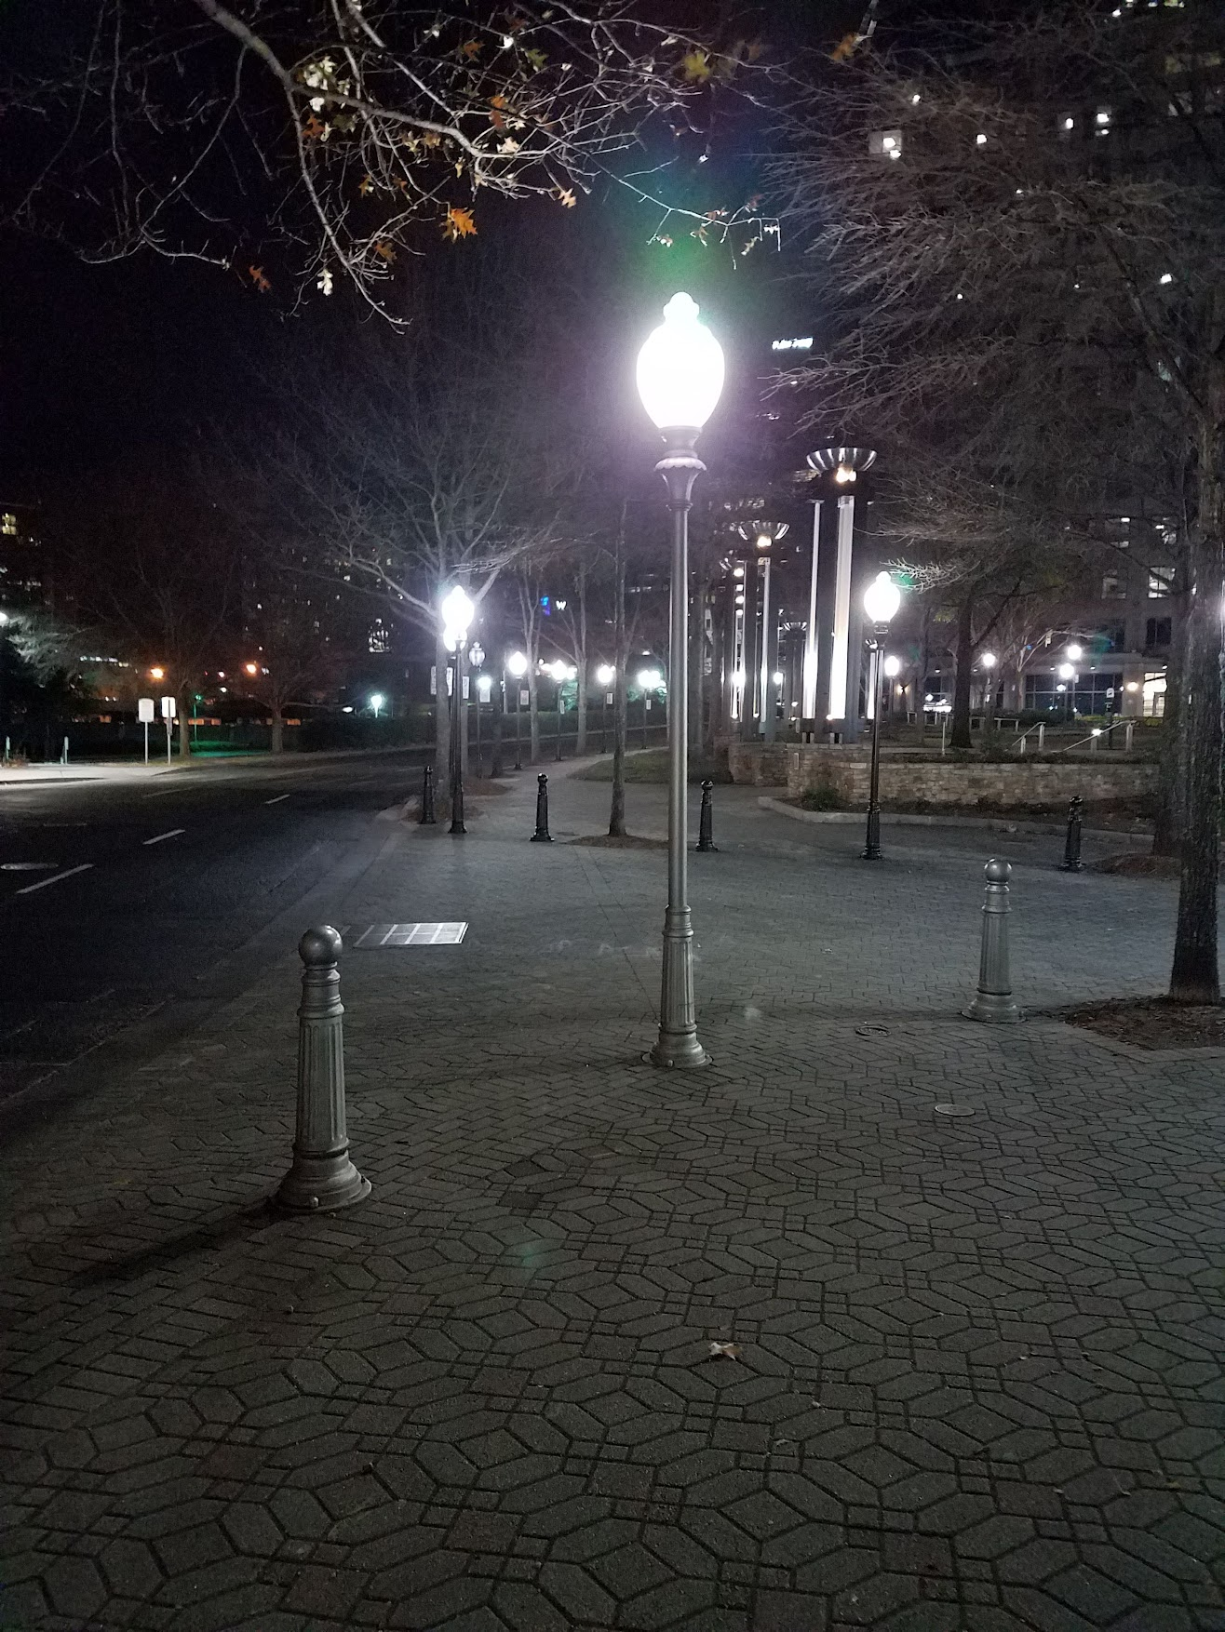
Task Group 15.4ab Next Generation UWB Amendment
September 2023 802 Wireless Interim Session
Mixed Mode
Live from Atlanta, GA, USA

Slide 3
Meeting Preamble
Stuff you need to know before we get to the meeting content

Slide 4
Mixed Mode Logistics
Head table will project (one computer all day)
Local: queue to speak a microphone; remember remote attendees will hear you only if you use the microphone!
Remote attendees please queue via chat window
Local attendees do not need to join WebEx except to present
Local attendees when joining WebEx connect without audio!
In-room Webex with audio enabled will disrupt the meeting!
Presenters, both local and remote, will present via WebEx
For those Remote Attendees connecting to Webex, Configure Webex Audio to use “Music Mode”.
Makes sure “mute on entry” is set in WebEx
Please do not turn on video.

Slide 5
Registration for 802 LMSC Plenaries and 802 Wireless Interims
This 802.15 meeting is part of the IEEE 802 Wireless Interim session
You must pay the registration fee in order to attend virtually or in person
If you have not already done so please register:
Session Information & Registration Website:
Registration Link
If you do not intend to register for this session you must leave this meeting and, if you have logged attendance on IMAT, email the appropriate WG chair or vice chairs to have your attendance cancelled

Slide 6
Deadbeat Consequences (Deadbeat: in default of paying registration fee for a prior mtg.)
No participation credit will be granted for said session.
Any participation credit acquired before said session toward membership in any IEEE 802 LMSC group is revoked.
Membership in any IEEE 802 LMSC group is terminated.
No participation credit will be granted for attendance at any subsequent IEEE 802 LMSC session until the individual has complied with the registration requirements for all previously attended IEEE 802 LMSC sessions by the start of said subsequent session.

Slide 7
Task Group Rules
Discussion: Everyone present is welcome
Straw polls: Everyone present may vote
Formal motions: WG voters
To make, second and vote
Patent policy for PAR activities applies
All the usual rules of conduct
Please identify yourself on first contact with name and affiliation

Slide 8
IEEE-SA Patent, Copyright, and Participation Policies
See: https://grouper.ieee.org/groups/802/sapolicies.shtml
IEEE-SA Patent Slides for Standards Development Meetings (.pdf)
https://development.standards.ieee.org/myproject/Public/mytools/mob/slideset.pdf
IEEE-SA Standards Board Patent Committee (PatCom) home page
https://standards.ieee.org/content/ieee-standards/en/about/sasb/patcom/index.html
IEEE-SA Participation Policy meeting slide set - individual method (.pdf)
https://standards.ieee.org/content/dam/ieee-standards/standards/web/documents/other/Participant-Behavior-Individual-Method.pdf
Working Group Copyright Materials
https://standards.ieee.org/ipr/copyright-materials.html
https://standards.ieee.org/content/dam/ieee-standards/standards/web/documents/other/ieee-sa-copyright-policy-2019.pdf

Slide 9
Participants have a duty to inform the IEEE
Participants shall inform the IEEE (or cause the IEEE to be informed) of the identity of each holder of any potential Essential Patent Claims of which they are personally aware if the claims are owned or controlled by the participant or the entity the participant is from, employed by, or otherwise represents
Participants should inform the IEEE (or cause the IEEE to be informed) of the identity of any other holders of potential Essential Patent Claims
Early identification of holders of potential Essential Patent Claims is encouraged

Slide 10
Ways to inform IEEE
Cause an LOA to be submitted to the IEEE SA (patcom@ieee.org); or
Provide the chair of this group with the identity of the holder(s) of any and all such claims as soon as possible; or
Speak up now and respond to this Call for Potentially Essential Patents
If anyone in this meeting is personally aware of the holder of any patent claims that are potentially essential to implementation of the proposed standard(s) under consideration by this group and that are not already the subject of an Accepted Letter of Assurance, please respond at this time by providing relevant information to the WG Chair
08 June 2021 – Slide 2

Slide 11
Other Guidelines for IEEE Working Group Meetings
All IEEE SA standards meetings shall be conducted in compliance with all applicable laws, including antitrust and competition laws.
Don’t discuss the interpretation, validity, or essentiality of patents/patent claims.
Don’t discuss specific license rates, terms, or conditions.
Relative costs of different technical approaches that include relative costs of patent licensing terms may be discussed in standards development meetings.
Technical considerations remain the primary focus.
Don’t discuss or engage in the fixing of product prices, allocation of customers, or division of sales markets.
Don’t discuss the status or substance of ongoing or threatened litigation.
Don’t be silent if inappropriate topics are discussed. Formally object to the discussion immediately.
---------------------------------------------------------------
For more details, see IEEE SA Standards Board Operations Manual, clause 5.3.10 and Antitrust and Competition Policy: What You Need to Know at http://standards.ieee.org/develop/policies/antitrust.pdf

Slide 15
IEEE SA Copyright Policy
By participating in this activity, you agree to comply with the IEEE Code of Ethics, all applicable laws, and all IEEE policies and procedures including, but not limited to, the IEEE SA Copyright Policy.
Previously Published material (copyright assertion indicated) shall not be presented/submitted to the Working Group nor incorporated into a Working Group draft unless permission is granted.
Prior to presentation or submission, you shall notify the Working Group Chair of previously Published material and should assist the Chair in obtaining copyright permission acceptable to IEEE SA.
For material that is not previously Published, IEEE is automatically granted a license to use any material that is presented or submitted.

Slide 16
IEEE SA Copyright Policy
The IEEE SA Copyright Policy is described in the IEEE SA Standards Board Bylaws and IEEE SA Standards Board Operations Manual
IEEE SA Copyright Policy, see Clause 7 of the IEEE SA Standards Board Bylaws https://standards.ieee.org/about/policies/bylaws/sect6-7.html#7 Clause 6.1 of the IEEE SA Standards Board Operations Manual https://standards.ieee.org/about/policies/opman/sect6.html
IEEE SA Copyright Permission
https://standards.ieee.org/content/dam/ieee-standards/standards/web/documents/other/permissionltrs.zip
IEEE SA Copyright FAQs
https://standards.ieee.org/faqs/copyrights/
IEEE SA Best Practices for IEEE Standards Development
http://standards.ieee.org/content/dam/ieee-standards/standards/web/documents/other/best_practices_for_ieee_standards_development_051215.pdf
Distribution of Draft Standards (see 6.1.3 of the SASB Operations Manual)
https://standards.ieee.org/about/policies/opman/sect6.html

Slide 17
IEEE 802 Ground Rules
Respect … give it, get it
NO product pitches
NO corporate pitches
NO prices
NO restrictive notices – (no confidentially notices in email)
Presentations must be openly available

Slide 18
Agenda
Document:
https://mentor.ieee.org/802.15/dcn/23/15-23-0441-02-04ab-tg4ab-agenda-september-2023.xlsx

Slide 19
Agenda
Motion to approve agenda contained in document 15-23-0441-0[3].
Moved by Clint Chaplin (SRA)
Second by Clint Powell (HID)
Discussion:

Slide 20
Approvals of Minutes
Motion to approve minutes contained in documents 15-23-0427-00 and 15-23-0459-00
Moved by: David Xun Yang (Huawei)
Second by: Clint Chaplin
July Plenary session minutes:
https://mentor.ieee.org/802.15/dcn/23/15-23-0427-00-04ab-tg4ab-jul-plenary-mins.docx
Interim telecon minutes:
https://mentor.ieee.org/802.15/dcn/23/15-23-0459-00-04ab-tg4ab-conf-call-mins-jul-to-sep-2023.docx

Slide 21
Session Objectives
Complete the draft
Provide TE with details to update
Commence informal comment collection following interim session

Slide 22
Hybrid Meeting Conduct: Other
In room breakouts:
We have the TG4ab Meeting room (physical and virtual)
We have a 2nd breakout room (physical and virtual)
In may be difficult for remote attendees – keep them in mind.
Loop in remote attendees in inconvenient time zones when able (email reflector, etc)
We will do the best we can and keep learning as we go!

Slide 23
Reminders
You are reminded NOW that all the 802 and IEEE rules you heard at the opening plenary apply to every meeting. This is your final reminder!
Meetings will start ON TIME as shown on the schedule – arrive early, finish nesting, get comfortable
Questions and discussions time may be limited: Use the email reflector to continue discussion!
Take advantage of coffee breaks and other ad hoc time as well as the reflector, and
Don’t forget about remote attendees!

Slide 24
Time Management
We will need to stay within the allocated time to get through everything
If less than the allocated time is used in a time slot, we’ll start the next time slot (accumulate any unused time to the end of the meeting)
Accumulated time will be used to continue discussion where needed

Slide 25
Recap

Slide 26
5.2.b Scope of the project (As approved):
This amendment enhances the Ultra Wideband (UWB) physical layers (PHYs) medium access control (MAC), and associated ranging techniques while retaining backward compatibility with enhanced ranging capable devices (ERDEVs). Areas of enhancement include:
additional coding, preamble and modulation schemes to additional coding, preamble and modulation schemes to support improved link budget and/or reduced air-time relative to IEEE Std 802.15.4 UWB;
additional channels and operating frequencies;
interference mitigation techniques to support greater device density and higher traffic use cases relative to the IEEE Std 802.15.4 UWB;
improvements to accuracy, precision and reliability and interoperability for high-integrity ranging; schemes to reduce complexity and power consumption;
definitions for tightly coupled hybrid operation with narrowband signaling to assist UWB;
enhanced native discovery and connection setup mechanisms;
sensing capabilities to support presence detection and environment mapping;
and mechanisms supporting low-power low-latency streaming as well as high data-rate streaming allowing at least 50 Mb/s of throughput.
Support for peer-to-peer, peer-to-multi-peer, and station-to-infrastructure protocols are in scope, as are infrastructure synchronization mechanisms. This amendment includes safeguards so that the high throughput data use cases do not cause significant disruption to low duty-cycle ranging use cases.
https://development.standards.ieee.org/myproject-web/app#viewpar/9081

Slide 27
Project Schedule (working baseline)
Proposed project schedule | Nov -22 | Dec-22 | Jan-23 | Feb-23 | Mar-23 | Apr-23 | May-23 | Jun-23 | Jul-23 | Aug-23 | Sep-23 | Oct-23 | Nov-23 | Dec-23 | Jan-24 | Feb-24 | Mar-24 | Apr-24 | May-24 | Jun-24 | Jul-24 | Aug-24 | Sep-24 | Oct-24 | Nov24 | Dec 24 | Jan 25 | Feb 25 | Mar 25 | Apr 25 | May 25 | June 25 | July 25
Integrate poposals/contributions into TFD
Develop draft from TFD
Draft 0
TG draft review and revision
Working group pre-ballot review
Pre-ballot review and comment resolution
First letter ballot
LB Comment Resolution
WG Recirculatoin
Comment resolution, 1st recirc
Conditional approval for SA ballot
WG Recirculatoin
Comment resolution, 2nd recirc and final recirc
First SA ballot
Comment resolution, first SA ballot
SA Resirculation
Comment resolution, SA recirculation
SA Resirculation
Comment resolution, 2nd SA recirc
Conditional or unconditional approval to RevCom
Optional 3rd SA recirc if needed
 |  |  |  |  |  |  |  |  |  |  |  |  |  |  |  |  |  |  |  |  |  |  |  |  |  |  |  |  |  |  |  |  |  |  |  |  |  | `
You are Here

Slide 28
Schedule Major Milestones
Near Term Working Milestones
 | Original Schedule | Current Schedule
Call for proposals | November 2021
Cut-off for new features (high level feature set), PHY | May 2022
Cut-off for new features (high level feature set), MAC | July 2022
Draft 0 | Post-January 2023 | Post March July 2023
TG draft review and revision complete | February - March 2023 | Mar-June 2023 Sept 2023
Working group pre-ballot review commence | March – May 2023 (following March meeting) | July August Sept 2023
First letter ballot | June 2023 (following meeting) | Oct Nov 2023
…

Slide 29
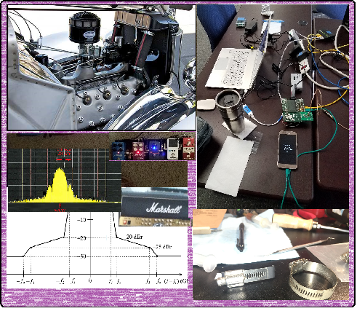
Completing the Draft

Slide 30
Overview
Pre-draft draft
Current draft: P802.15.4ab™/D (pre-ballot) B
Following this session: Will create (pre-ballot) C
Goal create a technically complete draft
Complete:
NO TBDs
Not perfect
Identify and fill holes
Resolve remaining content to be technically complete
Approve changes to pre-ballot B to create C
Initiate informal comment collection by 22-Sept
Initiate comment resolution via TC prior to November

Slide 31
Time-line
Comment collection:
Open by 22-Sept (following interim) and Close 22-Oct
November meeting starts: 13-Nov
Provides for 3 calls to begin comment resolution
We’ll know better by Thursday of the interim!
Ideal:
we can use the extra time to make the draft better
Still hit first LB after November meeting

Slide 32
Discussion: This session
Some people sent comments to draft B (and A)
Consolidated comments being assembled
Will triage, divide and resolve
Contributions to complete draft
Topic specific via presentation and discussion
Identify and approve changes for TE to apply (document changes)
Announce contributions via the reflector
USE REFLECTOR FOR DISCUSIONs
Where possible, post and announce ahead of presentation please
Use ad-hoc time to work specific areas where possible
Working directly with TE
Multi-cast results (mentor and reflector)
ALL MEETINGS (formal and ad-hoc) are open to ALL registered attendees

Slide 33
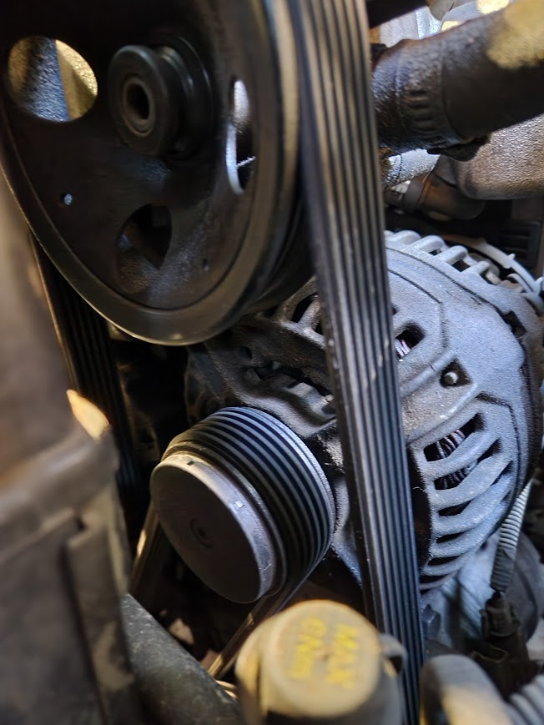
Comment resolution reports and drafting contributions

Slide 34
Documents to update the Draft (Draft 0 C)
“Drafting List” tab of agenda document 15-23-0441-11
Motion
Move to instruct the technical editor to apply the documents identified in the “Drafting List” in document 15-23-0411-11 to update Draft 0
Moved by:
Second by:

Slide 35
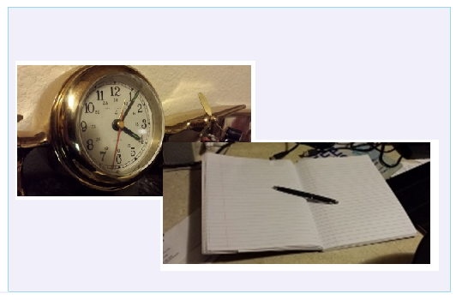
Editor’s Corner

Slide 36
Next Steps

Slide 37
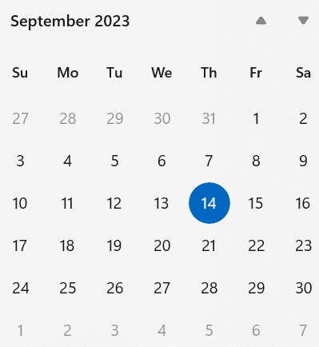
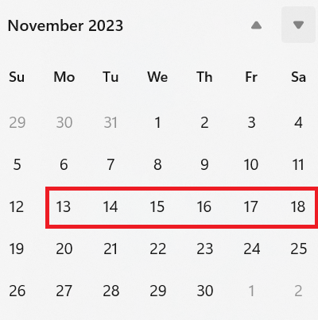
Target: A Technically Complete Draft
Where do we go from here?

Slide 38
Completing the Draft
Complete draft 0 defined:
Ready for review and comment collection
Is not YET technically complete (can have TBDs)
Complete draft 1 defined:
Technically complete (no TBDs or major holes we know about)
Not necessarily technically correct
Consensus defined
Sufficient majority (not unanimous)
Doesn’t make the content correct or consistent with reality
However correct and realizable are necessary to be useful
Useful requires (necessary but not sufficient):
Complete and correct enough
Can be implemented and verified
Finite probability 2 implementers would achieve equivalent behavior (enables interoperability)

Slide 39
Next Step Options
Continue comment collection with Draft 0 B
Collect more comments as-is
Resolve comments on TC and in November
Create Draft 0 C from what we have
Quite a lot of revised, more complete, possibly more correct content available now
Continue to address unresolved comments on interim TCs
Document and submit as comments on Draft C
Resolve all comments on Draft 0 B before creating Draft 0 C
Defer draft review and comment collection
Continue comment resolution on interim TCs
Initiate review and CC on Draft 0 C when able

Slide 40
Consideration of Time
Comment Collection |  | Interim telecon/Webex opportunities
Open | Close | 19-Oct | 26-Sep | 3-Oct | 10-Oct | 17-Oct | 24-Oct | 31-Oct | 7-Nov
21-Sept | 22-Oct | Ad hoc | --- | --- | --- | --- | CR | CR | CR
28-Sept | 29-Oct | Ad hoc | Work | -- | --- | --- | --- | CR | CR
5-Oct | 5-Nov | Ad hoc | Work | Work | --- | --- | --- | --- | CR
8-Oct | 8-Nov | Ad hoc | Work | Work | --- | --- | --- | --- | ---
When we start -> when we can finish (linear concept of time)
5-Oct last chance to start CC and finish by November session
Call time after CC starts can be used for CAD work

Slide 41
Coexistence Assessment Document
Required before WG ballot can start
Potential to be both interesting and useful
Key word is “assessment”
Must identify frequencies used and what other 802 standards use the same frequencies (minimum requirement)
Should identify features that affect coexistence (good and otherwise)
Can identify need for further work (e.g. coexistence recommendations)
Current status
Rough outline available
Multiple volunteers
Suggestion: work on it via interim TCs and email reflector

Slide 42
Interim telecon/Webex schedule
Plenary
Weekly on Tuesday commencing 26-September
06:00 PT (Green)
20:00 PT (Orange)

Slide 43
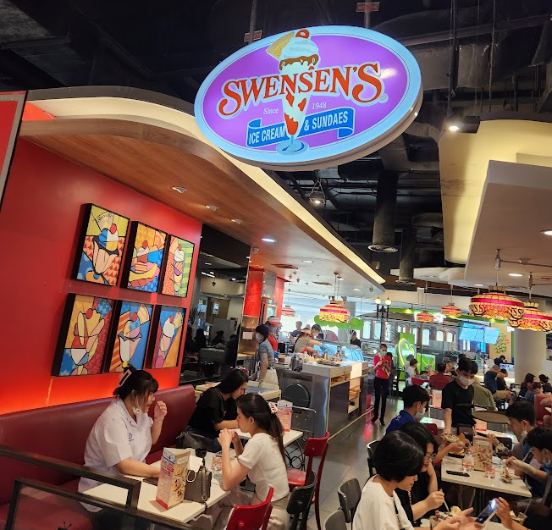
Other Business

Slide 44
Adjourned Thanks

