Slide 1
Ultra-Wide Band (UWB) and IEEE 802.15™ Activities
IEEE 802.15.4TM Ultra-Wide Band: Precisely What is Needed
July 12th, 2023
Notes:
Welcome & Preface by Edward

Slide 2
Participants
Speakers & Panelists:
    Clint Powell, Director - Global Standards Alliances of PACS Mobile, HID | Chair, IEEE 802.15™ Wireless Specialty Networks Working Group, https://www.linkedin.com/in/clintpowell/
    Benjamin Rolfe, Managing Director and Principal Technologist, Blind Creek Associates | Chair, IEEE 802.15.4ab Task Group on Next Generation UWB, https://www.linkedin.com/in/ben-rolfe-214740/
    Jim Lansford, Principal of Farafir (a wireless consultancy based in Timisoara, Romania),
    https://www.linkedin.com/in/jimlansford/
    Dries Neirynck, Director and Chief Engineer, Ultra Radio Ltd, https://www.linkedin.com/in/dries-neirynck-09222b23/
    Riku Pirhonen, Technical Director, Wireless Standards, NXP Semiconductors, https://www.linkedin.com/in/rikupirhonen/
Moderator:
Edward Au, Huawei Technologies | Chair, IEEE 802.18 Radio Regulatory TAG, https://www.linkedin.com/in/edwardau

Slide 3
Disclaimer
This presentation should be considered as the personal view of the presenter, not as a formal position, explanation, or interpretation of IEEE.
Per IEEE-SA Standards Board Bylaws
  “At lectures, symposia, seminars, or educational courses, an individual presenting information on IEEE standards shall make it clear that his or her views should be considered the personal views of that individual rather than the formal position of IEEE.”

Slide 4
Introduction to IEEE 802.15.4TM
and Ultra-Wide Band (UWB)
Notes:
Intro by Clint

Slide 5
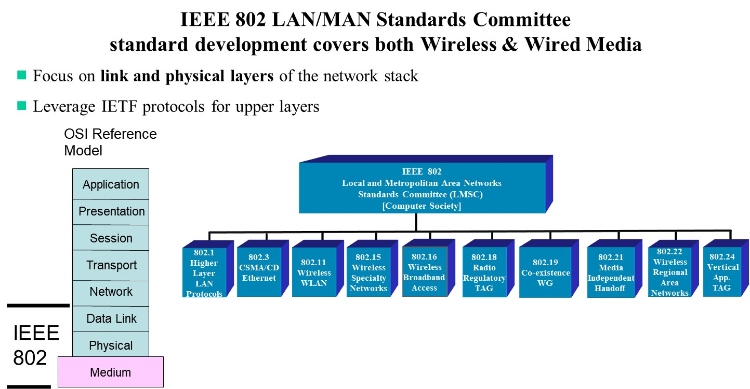
IEEE 802 LAN/MAN Standards Committee
802 standards development covers both Wireless & Wired Media
OSI Reference Model
IEEE 802.15 covers a wide breadth and depth of wireless technologies that are implemented in products that you may not even realize are using 802.15.
    “… if it’s not Wi-Fi or Cellular it’s probably IEEE 802.15”

Slide 6
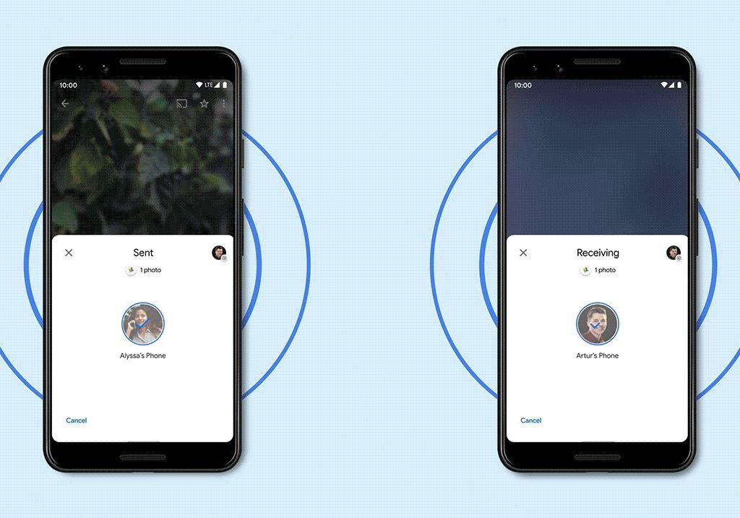
Did You Know?
Apple’s AirDrop and Google’s Nearby Share both use 802.15.4 UWB

Slide 7
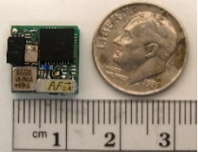
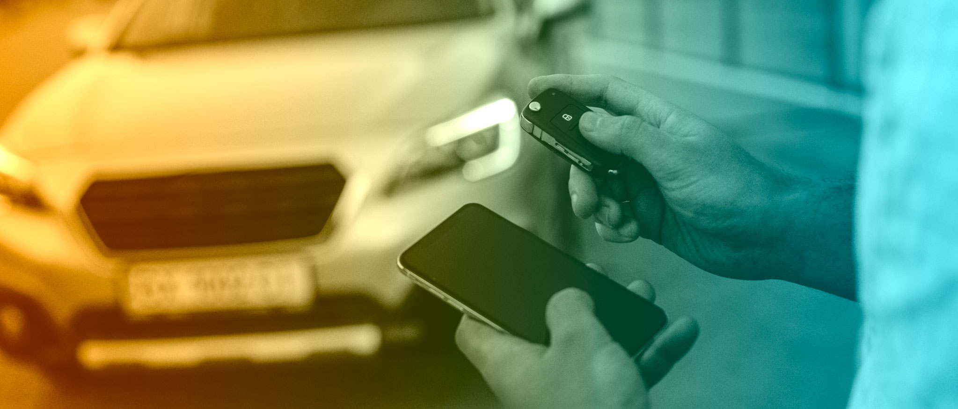
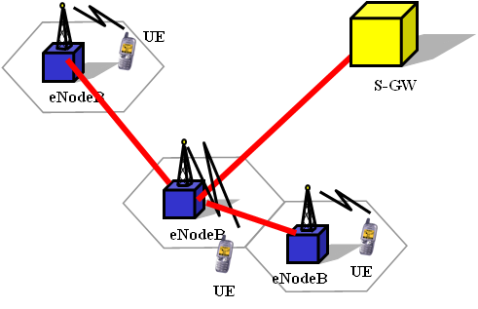

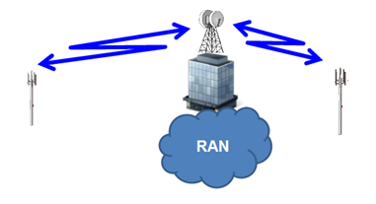



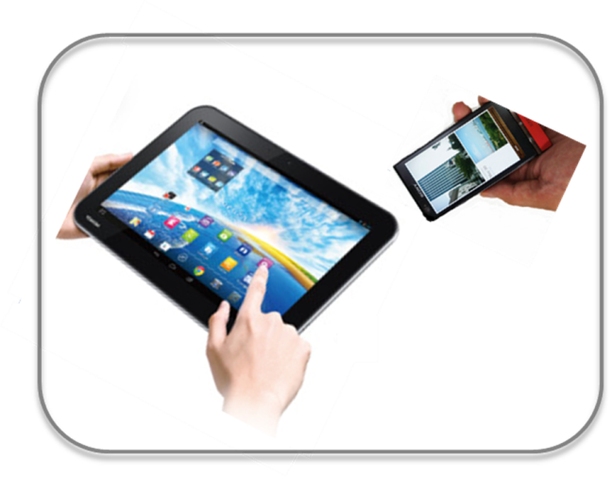


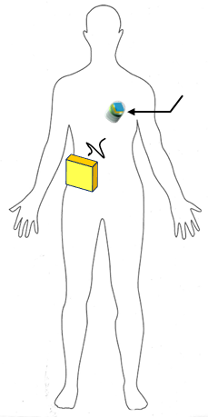
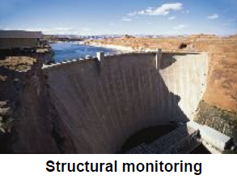
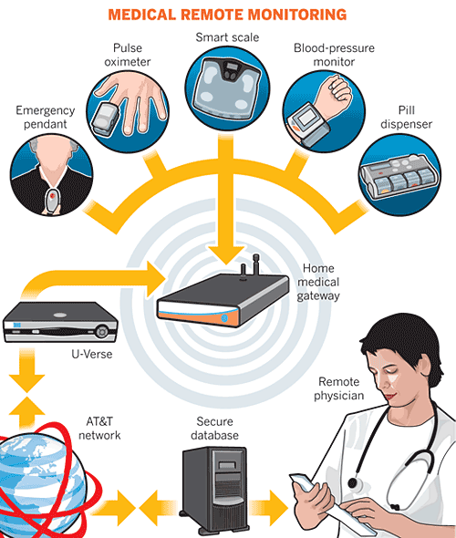

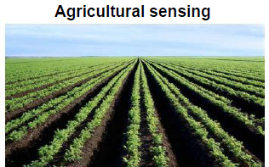

IEEE 802.15 Wireless Specialty Networks & their Applications
802.15.16
802.15.4
Ultra-low Power Sensors
Locating and Tracking
Automotive
FAN/MAN/RAN
802.15.4
Multi-media networks
&
High Speed
Interconnect
802.15.3
Industrial Networks
802.15.7
802.15.13
Medical
802.15.6
Critical Infrastructure Networks
Consumer Devices
Optical Communications

Slide 8
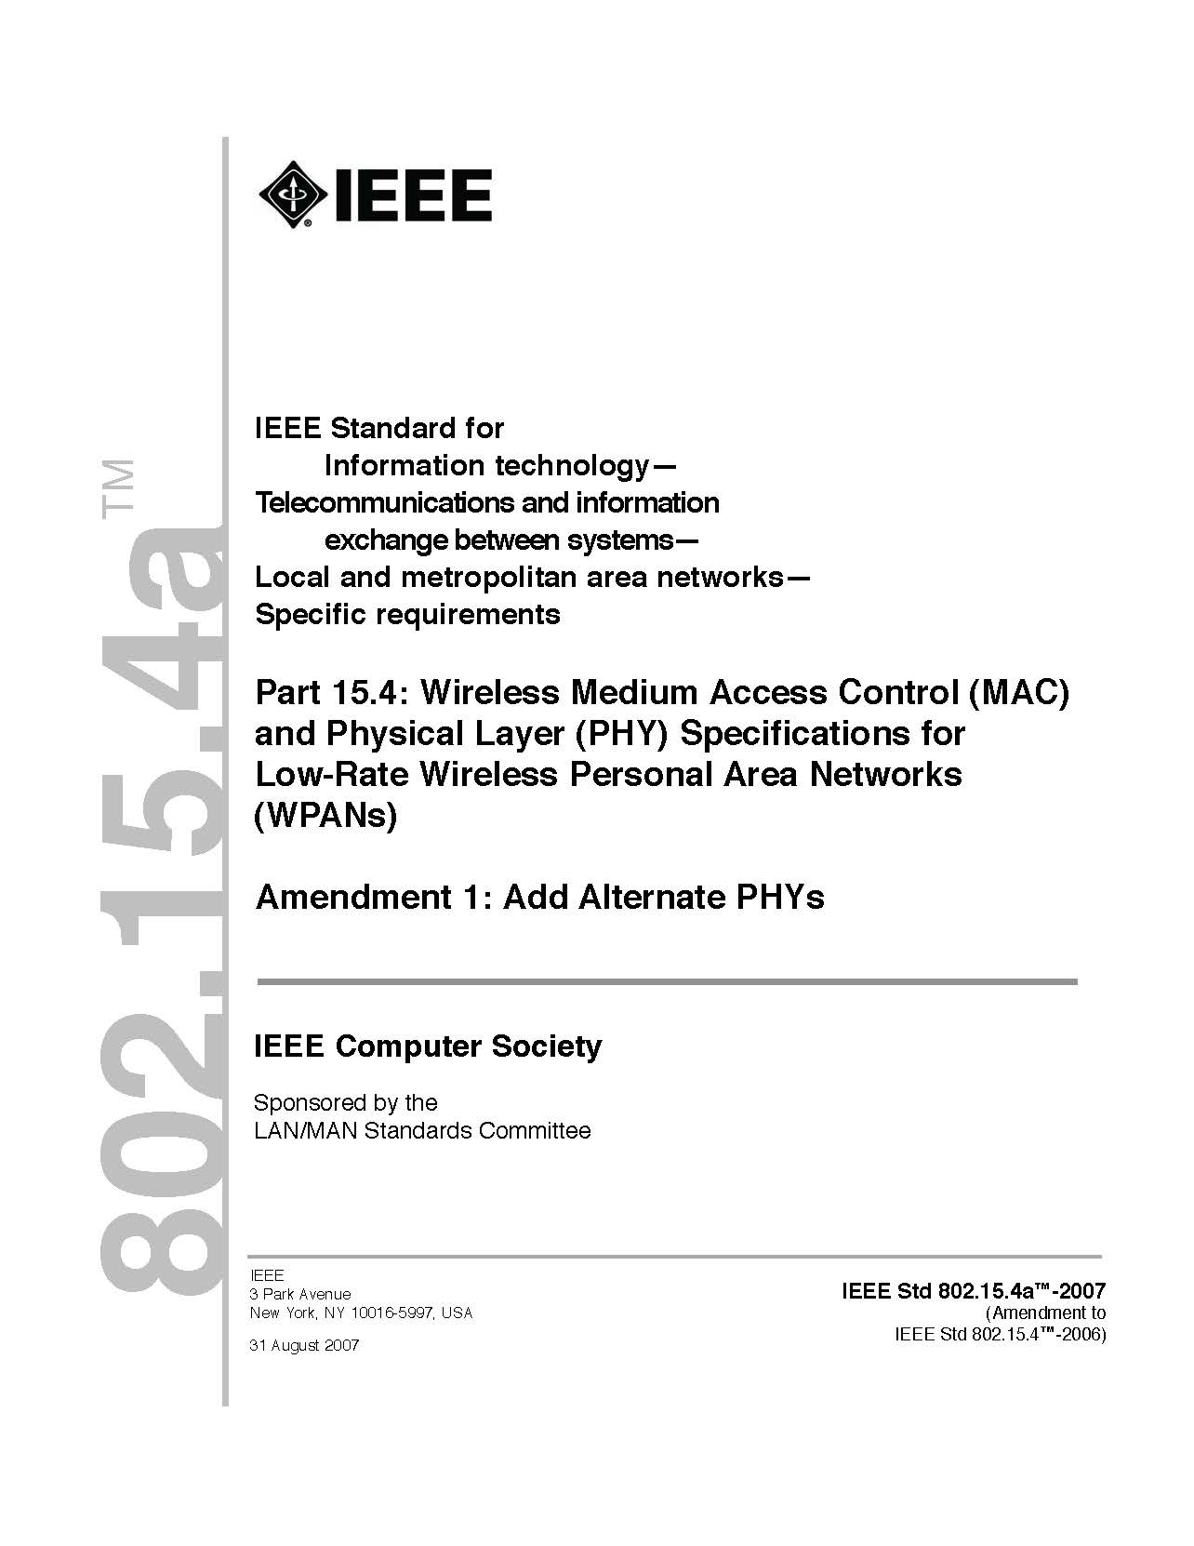
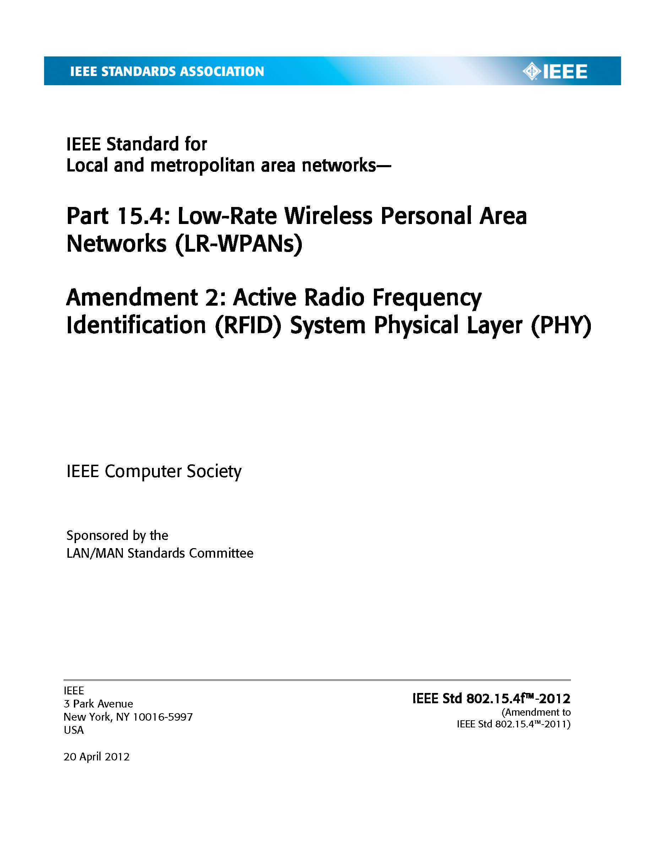


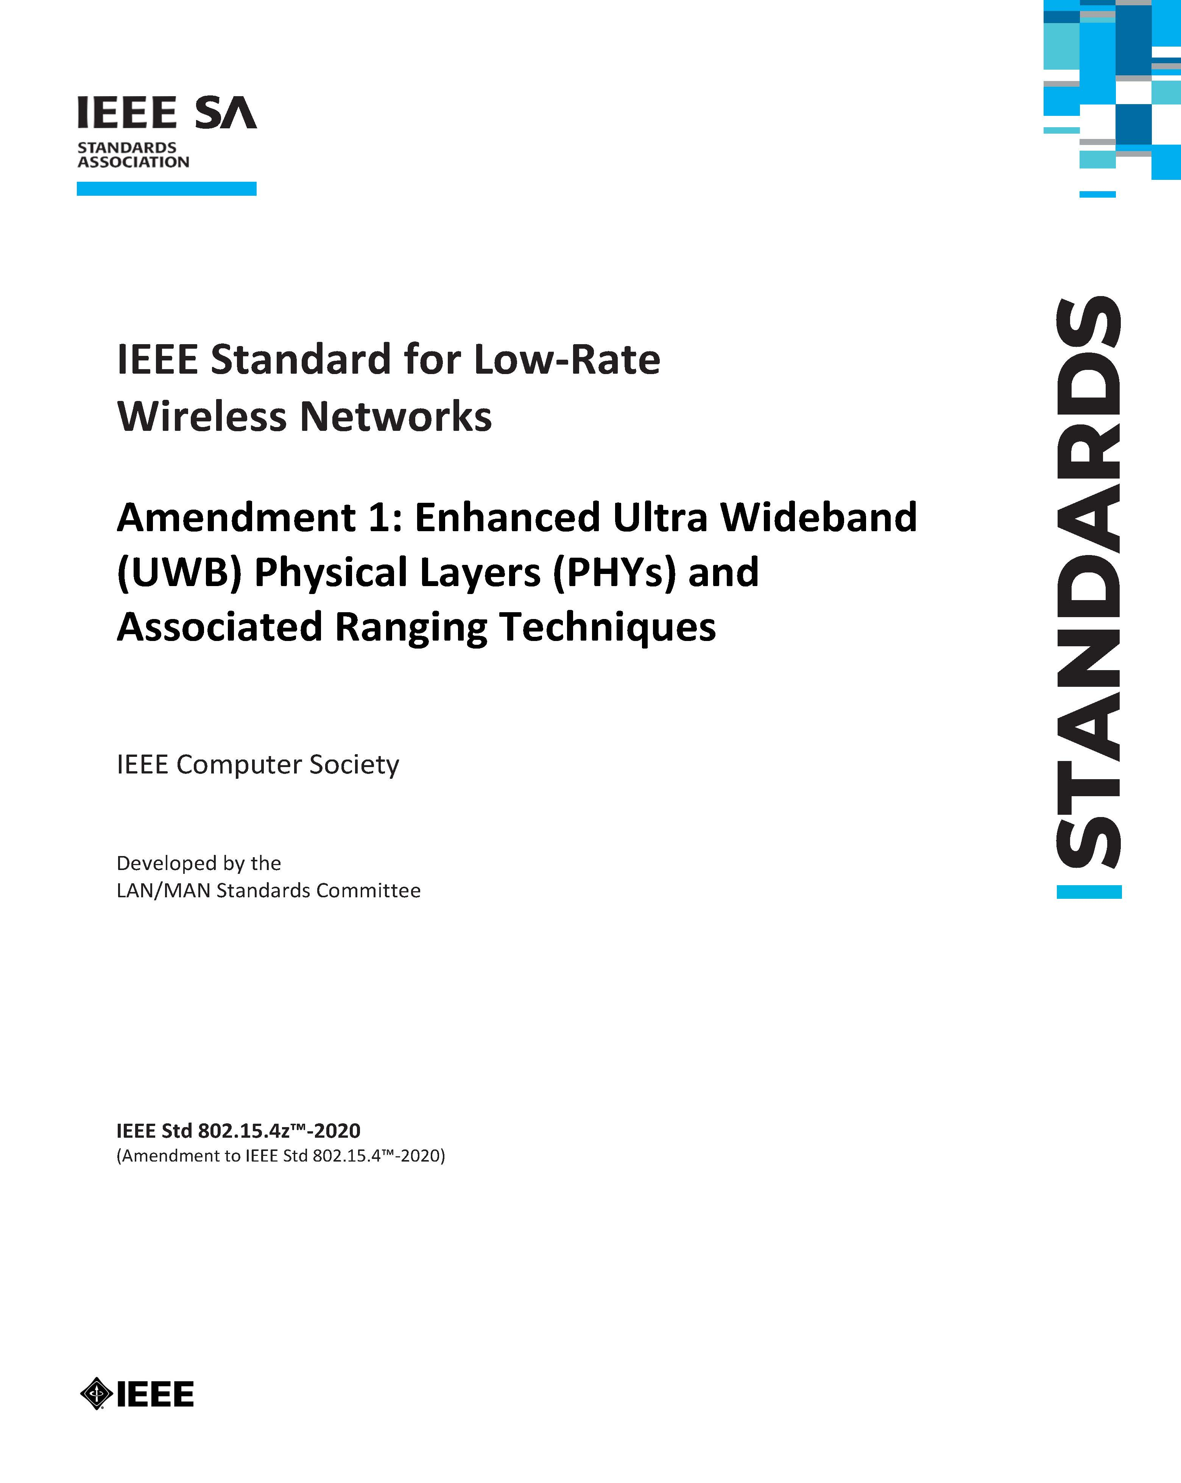

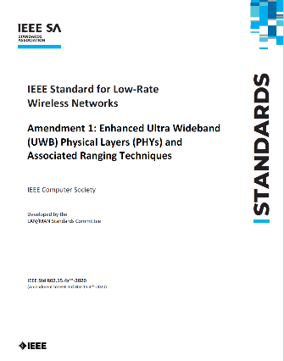


IEEE Std 802.15.4 is the Solid foundation for a Robust Ecosystem Supporting UWB Product Developers and Consumers
UWB Standards Progression
.4a-2007
Industry Consortia
.4f-2012
.4z-2020
.4ab-202x
Amendment: Enhanced Ultra Wide-Band (UWB) Physical Layers (PHYs) and Associated MAC Enhancements
Future amendment in progress

Slide 9
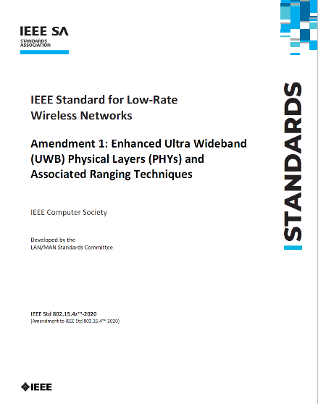
Next Generation UWB Standard – IEEE Std 802.15.4ab
Items Under Development, Driven by Consortia/Market Needs
Ranging
  Link budget improvements
  Improvements to accuracy, precision and reliability
Sensing
  Pulse shape improvements
  Channel impulse response reporting to support multistatic sensing
  To better support presence detection, environment mapping and other uses
Data
  Higher data rates for shorter transmission duration and power savings
  Channel coding and packet format improvements for robustness
  Additional options for even greater power savings
  Protocol enhancements to support very low latency, low energy communications
  Interference mitigation techniques to support:
  Greater device density
  Coexistence in the presence of other users
Builds on top of existing the 15.4 standard and 15.4z amendment
4ab-202x
Amendment: Enhanced Ultra Wide-Band (UWB) Physical Layers (PHYs) and Associated MAC Enhancements
Next generation standardization work ongoing, with contributions from industry leading companies
Final specification expected 2024 - 2025

Slide 10
Q1. What are the Use Cases and Value for Users
Notes:
Directed question to Riku

Slide 11
Global Adoption of UWB
Social Benefits to the Public
    Automotive (every major auto manufacturer)
        Secure entry
        Occupancy detection
    Consumer
        Locating and finding things
        Enhancing Virtual Reality and Augmented Reality
        (e.g. high resolution low latency audio)
        Secure access to vehicles & buildings from your phone
    Security, Public Safety, and Convenience
        Secure entry
        Presence detection
        Personnel location and tracking
    Manufacturing
        Locating and Tracking assets and people
    Healthcare
        Locating patients, personnel and equipment
        Contact tracing (infectious disease control)
Images courtesy of UWB Alliance
Notes:
UWB makes other things work better and more efficiently both in terms of spectrum and environmental impact.

Slide 12

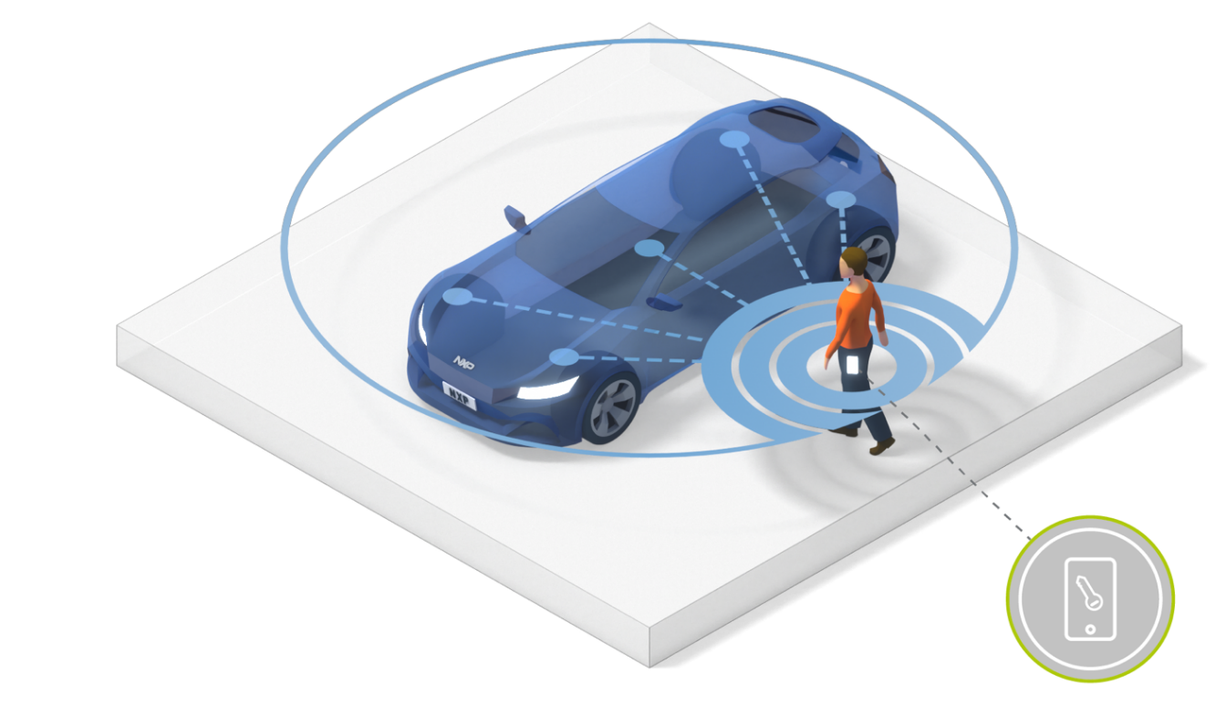


Secure Car Access: Catalyst for First Adoption Wave
Resistant to relay (theft/security) attacks
Robust in every environment
Precise key localization
Complete freedom of movement
Multiple Digital Key use-cases
Content courtesy of NXP and CCC
12
Notes:
Talk to what a relay attack is if queried. Explain that prior non-UWB generation does not prevent this.

Slide 13
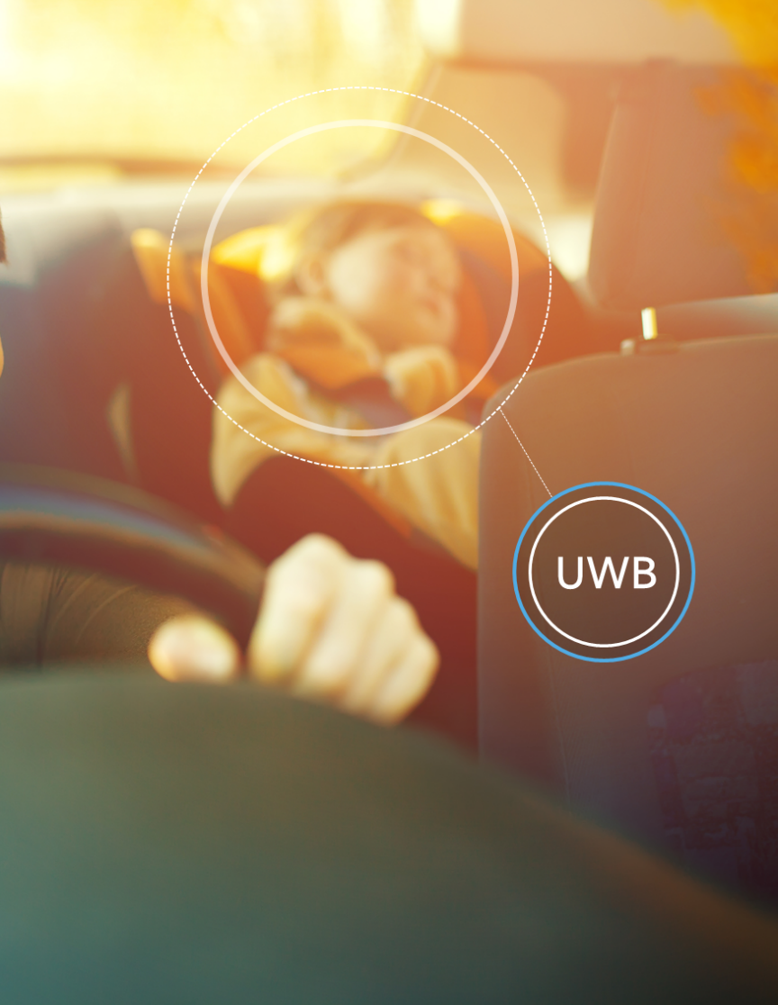


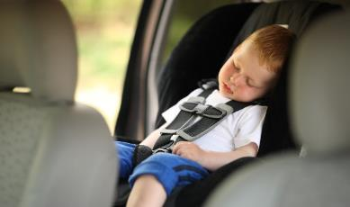
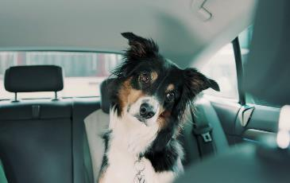
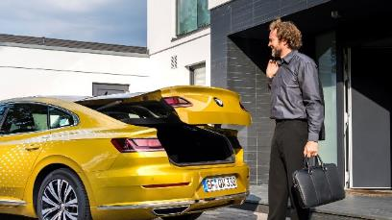
Automotive: In-cabin UWB Sensing
HIGH MOTION SENSITIVITY
UNMATCHED ACCURACY WITH UWB
LOW POWER EMISSION
THROUGH SHORT PULSE SIGNALS
A child presence detection system known as Rear Occupant Alert (ROA) is a high interest feature for automobile safety organizations.
UWB’s unique sensing capabilities allows devices to detect in-car passenger presence and monitor passenger’s vital signs, such as the respiration rate.
Seat Occupancy Detection
Vital Sign Detection
Kick Sensor
Notes:
Talk to point of very low power, non-harmful emission.

Slide 14




UWB Ecosystem: Build-up Momentum is Growing
Smart home
3rd party
uwb devices
IoT
Find my item
Hands free access
Home control
Gaming
Automotive
MOBILE
Smart
enterprises
Integration of UWB into mobile devices unlocks IoT devices
Secure car
access
spatial awareness for mobile devices
Access
Indoor navigation
Factory automation
Catalyst for
uwb adoption
UWB is an extension of the
mobile wallet
Smart retail
RTL Services
Asset tracking
Hands free payment
Automotive and Mobile use cases triggered IoT innovation, UWB enables new ways to use

Slide 15






UWB Ecosystem will Continue to Develop Fast
CUMULATIVE UWB DEVICES
IoT
More IoT devices
With UWB
2025
≥ 3B smart devices
Mobile
2023
> 10M cars
> 800M mobile devices
More mobiles
with UWB
2022
> 100M IoT devices
Automotive
2021
> 400M mobiles devices
More cars and
more UWB anchors/car

Slide 16
Q2. What are the Technology Advantages of UWB
Notes:
Directed question to Ben

Slide 17





UWB has Unmatched Technical Attributes for Secure Ranging
Accuracy | +/- 10 cm distance – very precise distance +/- 3° of angle – very precise direction
Robustness | Strong multipath environment performance that ensures position accuracy
Range | 100 meters of range under Line-of-Sight conditions
Security | Every position measurement is essentially protected with a unique cryptographic key
Real-time | Minimum latency: measurements in <10ms
Source: FiRaTM Consortium, IEEE 802.15.4z-2020
Notes:
Note accuracy in real time
Very low energy consumption – low environmental (carbon) footprint (Ref: Spark slide w/carbon footprint comparing power consumption, latency, etc.)

Slide 18
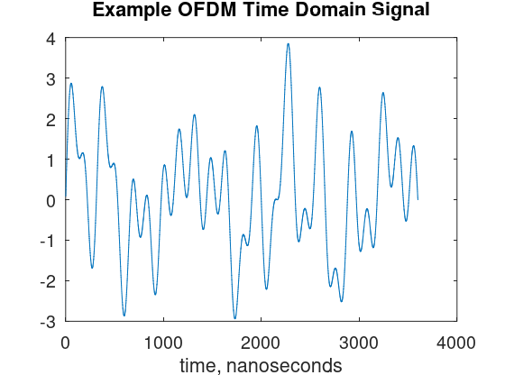
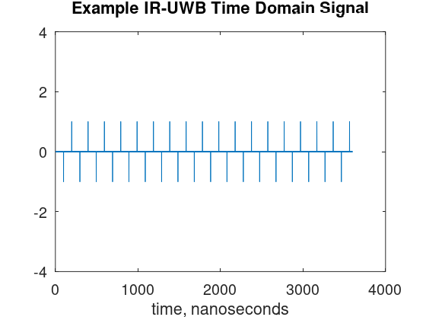
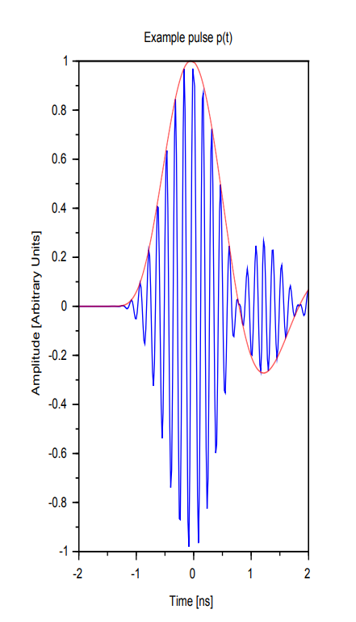
Impulse Radio UWB: Extremely Low Power, Very Low Energy, with Support for many simultaneous users
Extremely Tiny Pulses
Continuous Signal
Composite of many continuous carrier signals
Typical power up to +23 dBm/MHz
Extremely narrow pulses: 1-2 ns Pulse every 8 ns or 16 ns with a lot of space in between pulses.
>= 500 MHz channels
Typical power of pulse sequence < -41.3 dBm/MHz EIRP

Slide 19

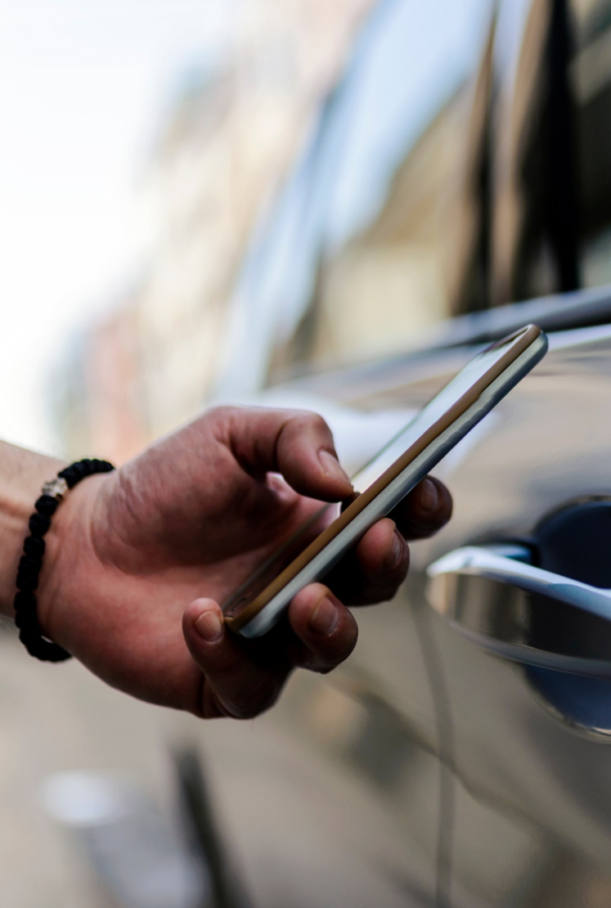
UWB is a Spectrum Underlay Technology
UWB recycles spectrum at power levels that do not impact other spectrum users
Inherently low power transmissions
  UWB transmit power level (-41.3 dBm/MHz) = Class B unintended emission limits
  The same RF radiation as from your refrigerator
Large bandwidth enables
  Resistance to noise, interference and multipath, thus reliable in many environments
  Ranging accuracy down to centimeter level
  Precise sensing
  Low latency, moderate throughput communications
  Distance based secure authentication
High density deployments
  Low power means high spectral reuse (high density of users)
  Impulse radio spread spectrum supports concurrent transmissions
19
Notes:
Refer to Wi-Fi, Bluetooth and Cellular w.r.t. the other users.

Slide 20


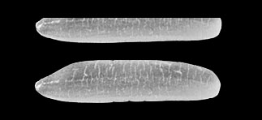
UWB is Quiet Compared to More Traditional Technologies
UWB recycles spectrum at power levels that do not impact other spectrum users
+23 dBm/MHz
Mt Everest @ 8,849 meters
Wi-Fi
Power Represented
as Height
Emitted Signal Power
-41 dBm/MHz
1.6 Rice Grains (2mm ea.)
UWB

Slide 21
Large Bandwidth Compensates for Low Power Spectral Density
And allows steep rising edges and short pulses,
… allows UWB to determine time of arrival more precisely than other technologies

Slide 22
Q3. What is the Current Regulatory
Environment and What are the Needs Going Forward
Notes:
Directed question to Dries

Slide 23
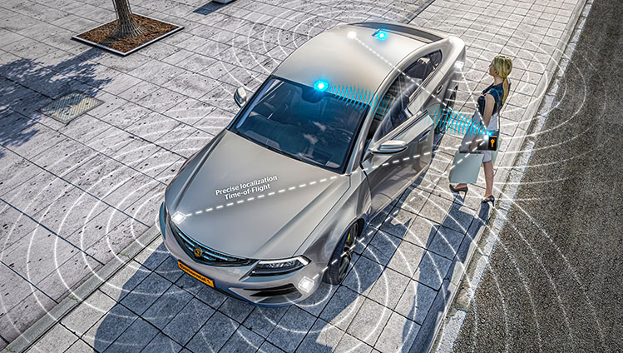

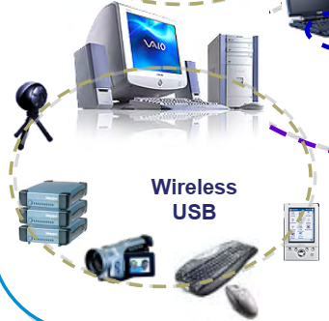
UWB Regulations: >20 Years of Experience
Early use cases for UWB have evolved – current products leverage the unique properties of UWB
UWB dates back to Hertz and Marconi!
FCC formalized US rules in Feb 2022
Early UWB
FCC
2002
Secure, high accuracy location & sensing
High
speed
Since 2002, the market has adopted UWB for secure, high accuracy positioning and sensing
ALREADY in all new generations of major smartphone platforms
After over 20 years of deployment, no significant interference problems reported
Original UWB regulations expected high speed data use cases to be prevalent
Market moved in a different direction
Impulse radio – underlay
Millions of impulse radio devices now in use
Low duty cycle, low radiated power
Excellent frequency and spatial reuse
Early use cases envisioned very high speed communication
This has not gained market traction, however

Slide 24
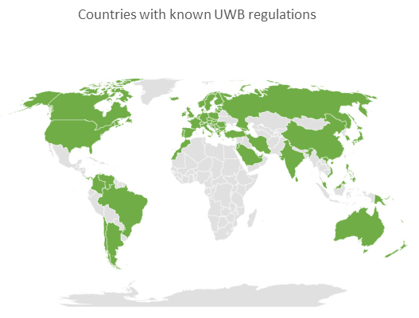
ETSI Overview of UWB Regulations Worldwide in TR 103 181-3
Latest version v2.1.1 from January 2019
  Recent wave of UWB consumer devices has prompted many countries to introduce regulations since 2019
  Revision under preparation by ETSI ERM TGUWB
Most countries implement either CEPT or FCC framework
  CEPT framework mainly in Europe, Africa and Asia
  FCC framework mainly in North and South America
  FCC rules appear simpler but many waivers and waiver requests
But wide variations exist in
  Allowed frequency ranges
  Allowed applications
  Required mitigation techniques
Notes:
Addressing the current regulatory environment by referencing ETSI TR 103 181-3.

Slide 25
Main Points of US/FCC and European CEPT Regulatory Framework
FCC rules appear simpler but many waivers and waiver requests
FCC - 47 CFR Subpart F - Ultra-Wideband Operation
Since 2002, no significant changes since
Indoor and handheld devices operation
Explicit prohibition of fixed outdoor transmissions
Unclear status vehicular use
Between 3.1 – 10.6 GHz
-41.3 dBm/MHz average power
0 dBm peak power in 50 MHz
CEPT – ECC/DEC/(06)04 & ECC/DEC/(07)01
Since 2006, with regular updates since
Many different regulations for different applications
Latest update allows fixed outdoor transmissions
3 sets of regulations for vehicular applications
6 – 8.5 GHz and with mitigation 3.1 – 4.8 GHz
-41.3 dBm/MHz average power
0 dBm peak power in 50 MHz
Currently investigating changes in 8.5 – 10.6 GHz

Slide 26
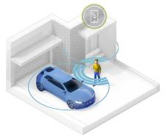
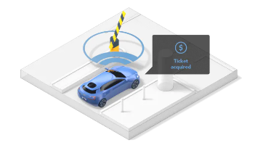
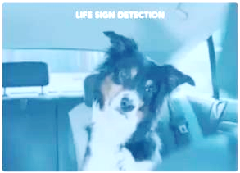


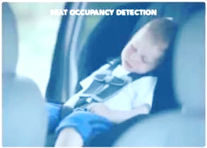


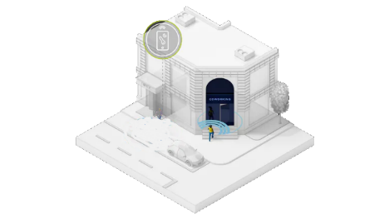
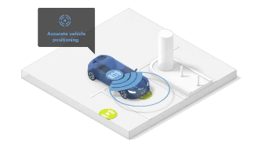

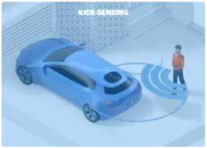
UWB Addresses the Growing Need for Sensing, Ranging and Location
Regulatory frameworks should take this into account
Ranging Applications
Sensing Applications
UWB
Sensor fusion
Vital sign
detection
digital car key
smart parking & payment
Seat
occupancy
detection
Fusion
hands-free access
precise parking alignment
wireless EV charger alignment
UWB is the prime candidate for child presence detection
Gesture
sensing
Notes:
UWB brings new and unique capabilities in the fields of sensing, ranging and location.

Slide 27
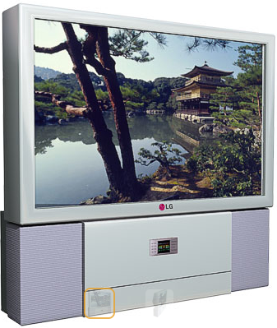

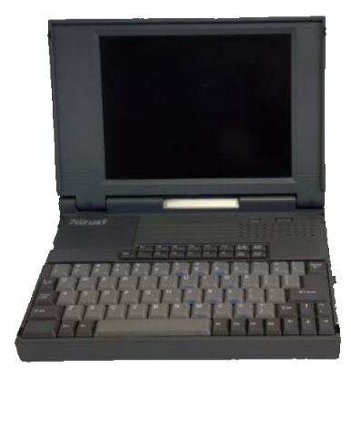
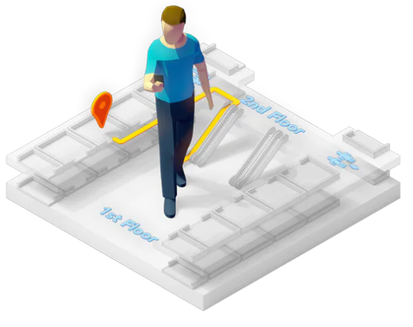
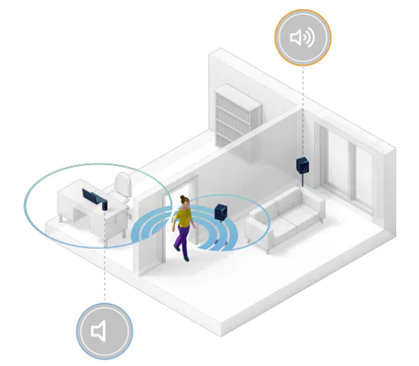
UWB Needs Regulatory Support to Realize its Full Potential
Internationally harmonized regulations
Allow industry and consumer to benefit from economy of scale
Taking into account ranging and sensing use
Both are very low duty cycle activities
Allow fixed outdoor transmissions
Address the automotive industry needs
Spectrum policy that takes low power, underlay nature into account
Preserve sufficient bandwidth with ‘friendly’ neighbours
2002 applications:
Video, LAN, wireless USB
2022 applications: Secure position, location, sensing
indoor navigation
item tracking
Notes:
To continue its growth, UWB needs support from administrations.

Slide 28
Preserving Usability of Spectrum
Consider current and future uses of unlicensed tech when making new rules
Good spectrum and environmental curator
  Disrupting what works isn’t good
  Lower power is better
  High reuse and diversity of use value
  UWB makes other technologies more efficient (airdrop)
UWB is Eco Friendly!
UWB is proven non-disruptive, promotes sharing of spectrum and invisible to licensed users
MHz | 3100-4800 |  |  |  |  |  |  |  |  |  |  |  |  |  |  |  |  | 4800-5925 |  |  |  |  | 5150-5925 |  |  |  |  |  |  |  |  | 5925-7125 |  |  |  |  |  |  |  |  |  |  |  | 7125-8500 |  |  |  |  |  |  |  |  |  |  |  |  |  | 8500-9500 |  |  |  |  |  |  |  |  |  | 9500-10600
802.15.4 Channels |  | 1 |  |  |  |  | 2 |  |  |  |  | 3 |  |  |  |  |  |  |  |  |  |  |  |  |  |  |  |  |  |  |  |  |  | 5 |  |  |  |  | 6 |  |  |  |  | 8 |  |  |  |  | 9 |  |  |  |  | 10 |  |  |  |  | 12 |  |  |  |  | 13 |  |  |  |  | 14 |  |  |  |  |  |  |  |  |  | HRP
 |  |  | 4 |  |  |  |  |  |  |  |  |  |  |  |  |  |  |  |  |  |  |  |  |  |  |  |  |  |  |  |  | 7 |  |  |  |  |  |  |  |  |  |  |  |  | 11 |  |  |  |  |  |  |  |  |  |  |  |  |  |  | 15
Notes:
Mention that there are no documented instances of UWB disrupting a licensed service.

Slide 29
Closing Points
Notes:
Closing by Jim

Slide 30






Timeline: Evolution into Consumer Electronics
UWB in iPhone 12, iWatch 6, Xiaomi Mi 10 Series and Samsung Note 20U
2020
16 Years
IEEE 802.15.4a Standard Released
2006
IEEE 802.15.4z Standard starts
2018
IEEE 802.15.4z Standard released
2020
UWB
UWB Rulesets created in USA & ETSI mandated by EU
2003
Big Technology companies start to adopt UWB technology
2015
Thriving Industrial UWB market established
2010
Car Manufacturers recognize value of UWB
2016
UWB incorporated in all models of iPhone 11
2019
1985
FCC opens unlicensed bands
1998-9
Bluetooth SIG formed
and First Specification
Launched
2001
First handsets shipped with Bluetooth
T39 Sony Ericsson
2007
Bluetooth included on original iPhone
Bluetooth
16 Years
Bluetooth source: Bluetooth SIG
802.11/Wi-Fi
22 Years
Notes:
Relates to maturity and the growth curve.
The rules for other unlicensed have been revised since 1985 many times.

Slide 31
Summary of Current Regulatory Hurdles (Current UWB Rules)
Fixed outdoor
  Many small UWB devices require fixed installation, for example door locks, parking lot anchors
  Current rules do not differentiate between towers and external antennas vs small devices near the ground
Sensing
  Acknowledgement from other party required every 10 seconds
Vehicular use cases
  UWB inside and around the vehicle
Indoor deployments with higher power to support real time location services
  Large warehouses, stores, malls, venues
International Harmonization has Many Values

Slide 32
Final Remarks
UWB transmissions are extremely low to no impact:
Very low Duty Cycle
Very low Activity Factor
Very low Transmit Power
UWB provides excellent sharing allows for very high density of devices in a given space
There is more to life than broadband data (mobile and RLAN) and it is all good and needed
UWB is an important enabler of economic growth
Ensuring effective sharing is how to get the most value per MHz - maximum value comes from maximum diversity of uses
Considering impacts on and value provided by UWB when looking to allow new services in the same spectrum is a good idea

Slide 33
Open Q&A with Panel -
Moderated by Edward
Notes:
Open Q&A Panel Chaired by Edward

Slide 34
PANEL Participants
Panelists:
Clint Powell, Director - Global Standards Alliances of PACS Mobile, HID | Chair, IEEE 802.15™ Wireless Specialty Networks Working Group
Benjamin Rolfe, Managing Director and Principal Technologist, Blind Creek Associates | CTO UWB Alliance | Chair, IEEE 802.15.4ab Task Group
Jim Lansford, Principal of Farafir (a wireless consultancy based in Timisoara, Romania
Dries Neirynck, Director and Chief Engineer, Ultra Radio Ltd
Riku Pirhonen, Technical Director, Wireless Standards, NXP Semiconductors
Moderator:
Edward Au, Huawei Technologies | Chair, IEEE 802.18 Radio Regulatory TAG

Slide 35
BIOS

Slide 36
Clint Powell,
Director - Global Standards Alliances of PACS Mobile, HID | Chair, IEEE 802.15™ Wireless Specialty Networks Working Group
Clint Powell is also a member of the IEEE 802™ LAN/MAN Standards Committee and Vice-Chair of the 802.15.4ab Task Group. He has 30+ years of in-depth experience and knowledge in driving leading-edge wireless technologies. Over the past 20 years, Clint has participated (as Chair, Vice-Chair, Technical Editor, Contributor, and Reviewer) for numerous 802.15 standards. During this time, he has held and continues to hold numerous roles within the Connectivity Standards Alliance (f.k.a. Zigbee Alliance). Before this, he was the Global Systems Architecture Manager for the Wireless Connectivity Operations, a Member of the Technical Staff, and a Scientific Advisory Board Associate at Freescale (f.k.a. Motorola). Over the last few years he has become more involved in UWB technology including both the CCC, FiRa, and CSA Consortiums, with roles in all three.
Clint received his B.S. and M.S. degrees in Electrical Engineering from the University of Miami. He consults regularly to Emerging Wireless IoT and Smart Energy Communications Industries, including chip makers, product manufacturers, end customers, and system deployers on a variety of concerns, system definitions, standards clarifications, and real-world product deployment performance issues. He has authored many internal papers, and several conference papers, and holds 36 US patents in wireless communications.

Slide 37
Benjamin A. Rolfe,
Managing Director and Principal Technologist, Blind Creek Associates | Chair, IEEE 802.15.4ab Task Group
Ben Rolfe is also the Chief Technology Officer and Comptroller of the UWB Alliance, Treasurer for the IEEE 802.15 Working Group, Vice chair of the IEEE 802.24 Technical Advisor Group, and has been a contributor to IEEE Standards development for over 20 years. Ben received his B.S. degree in information and computer science from the University of California at Irvine, Irvine, USA, with graduate studies from the University of California at Los Angeles, Los Angeles, and the University of Southern California with a focus on control systems and signal processing. His industry experience spans the development of technologies for imaging systems, aerospace, wireless communication, the IoT, and energy systems.
Ben’s current interests include multiple wireless communication technologies and usage spaces with a focus on coexistence strategies for efficient spectrum usage; Ben is active in promoting spectrum policy and regulatory affairs and continues to be active in the development and application of standards.

Slide 38
Jim Lansford,
Principal of Farafir (a wireless consultancy based in Timisoara, Romania)
Jim Lansford has over 40 years of experience in communications systems, digital signal processing, and strategic business development. His most recent experience was as a Director of Technical Standards at Qualcomm, where he was a leader in standards efforts in V2X, 802.11/Wi-Fi, and UWB. Prior to that, he was Chief Technical Officer of three wireless startup companies, including one of the early UWB startups, Alereon. Dr. Lansford is currently chair of the Wireless Next Generation Standing Committee in IEEE 802.11 as well as Chair of the Cellular-V2X Technical Committee in SAE International. Previously, he was co-chair of the IEEE 802.15.3a Task Group (high speed UWB) and he was chair of the Automotive Market Segment Task Group, the DSRC Task Group, and the Long Range Strategy Group in the Wi-Fi Alliance. He also served as Co-chair of the FiRa Consortium Regulatory Working Group. He was the founder of the 802.19 Coexistence Working Group in IEEE as well as holding several leadership positions in the WiMedia Alliance, focused on UWB.
In addition to his industrial experience, Dr. Lansford is currently active as an Adjunct Professor in the Computer Science Department at the University of Colorado – Boulder. Dr. Lansford has a Ph.D. in Electrical Engineering from Oklahoma State, an MSEE from Georgia Tech, and a BSEE from Auburn University.

Slide 39
Dries Neirynck,
Director and Chief Engineer, Ultra Radio Ltd
Dries has been working with and for various ultra-wideband pioneers for the past fifteen years. He started as a researcher in IMEC and was system architect for Decawave, now part of Qorvo, before starting Ultra Radio Ltd. In addition to his work on UWB algorithm and system design, he became an expert on UWB regulations. He currently serves as ETSI ERM TGUWB Secretary, is Technical advisor and European representative of the UWB Alliance, and Co-chair of the Regulatory Working Group of the FiRa Consortium. Dries is also an active participant in the Car Connectivity Consortium (CCC), omlox, and IEEE 802.15.4ab.
Dries holds a PhD from the University of Bristol (UK) and is a named inventor on 9 UWB related patents.

Slide 40
Riku Pirhonen,
Technical Director, Wireless Standards, NXP Semiconductors
Riku Pirhonen joined NXP three years ago and has 30 years of experience doing research and developing cellular wireless standards in ETSI, TIA, 3GPP and IEEE. He has been participating IEEE802 standardization in various working groups since 2002, and is currently active in developing IEEE802.15.4ab, the next generation of UWB technology. His special interests include receiver and transmitter technologies for UWB, and regulatory requirements. Riku holds M.Sc. degree in Electrical Engineering from Helsinki University of Technology.

Slide 41
Edward Au,
Huawei Technologies | Chair, IEEE 802.18 Radio Regulatory TAG
Edward Au, Ph.D. is a Distinguished Engineer in Huawei Technologies Canada Co., Ltd. where he works on product certification, test bed development, and standardization of Wi-Fi. He is the Vice Chair and member-at-large of IEEE Technical Activities Board Committee on Standards that oversees the advancement and evangelization of technical standards activities across all IEEE Societies and Councils. He is currently the Chair of Computer Society Standards Activities Board standards committee that manage working groups and standards development projects that are under the purview of the Society and for new lines of work or for standards for which a viable standards committee has not been identified. He also actively participates and contributes to IEEE 802™ LAN/MAN Standards Committee. He is currently the Chair of IEEE 802.18™ Radio Regulatory Technical Advisory Group supports the work of the IEEE 802™ LAN/MAN Standards Committee by actively monitoring and participating in radio regulatory matters worldwide as an advocate for IEEE 802™. He is also the founding Chair of IEEE 802.11ay™, which is aimed at developing an amendment for next generation unlicensed millimeter wave technologies for Wi-Fi, a co- editor of the IEEE 802.11™ maintenance task group, which is chartered to develop revisions for the IEEE 802.11™ standards, and an editor of the IEEE 802.11be™, which focuses on developing a new major amendment for next generation Wi-Fi (a.k.a. Wi-Fi 7).
Edward is a recipient of the IEEE SA Standards Medallion “For exceptional leadership and skill in driving the development of IEEE 802.11™ Wireless LAN standards” in 2021, and he was awarded the IEEE Transactions on Vehicular Technology Top Editor Award in recognition of outstanding performance for articles reviews in both quantity and quality for the journal, in 2013 and 2016.

Slide 42
BACKUP

Slide 43
BACKUP to Intro

Slide 44

802.15.4 Standard
A foundation for many diverse uses - A well-equipped toolbox
  A rich set of parts to assemble many different networks (Multiple PHYs and a flexible, adaptable MAC)
Vast flexibility and adaptability for applications such as:
    Home Energy management
        Moderate data rates
        Low latency
        Small mesh networks
    Field area network support
        Need for low to moderate data rates (1kbit/sec to 2.4 Mbit/sec)
        Networks may be very large with mesh topologies scaling to thousands of nodes with multiple border routers
    UWB for precision location and communication
        Peer to peer ranging: one to a few with no infrastructure gateways or need for infrastructure (fixed) devices
        Infrastructure based (TDOA): Network of fixed anchors and mobile tags (phones or other devices)
        850 kbit/sec to ~50 Mbit/sec
        May combine ranging with data delivery

Slide 45
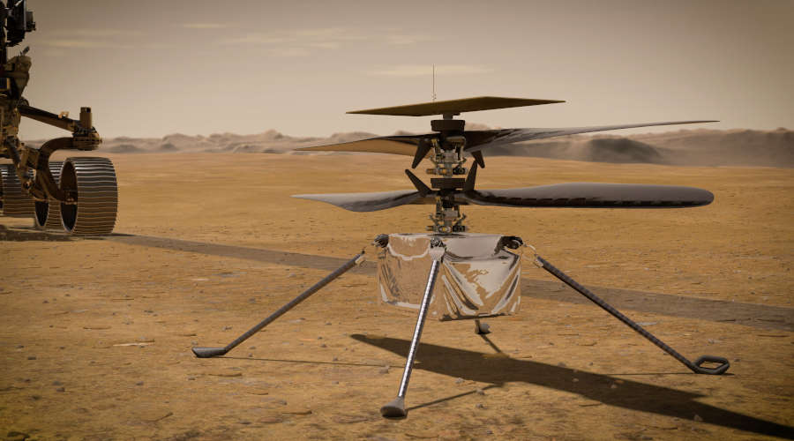
802.15.4 and Ad-Hoc Networks
802.15.4 Supports many network topologies to address many applications
An Ad-Hoc network can be many things
    Network Scale - from a few devices to many thousands
    May not be infrastructure based
    May be formed without a single control point
    Supports peer-to-peer communication
        May support single hop peer-wise communication
        (e.g. Phone to Phone)
        May support multi-hop peer to one or more peers (mesh)
    May be formed dynamically and change rapidly
    May be relatively static once formed
  There are many different scales and types of
  Ad-Hoc network and many uses
        … including RC Helicopter control on Mars

Slide 46
802.15.4 Standard at the Next Level –
NB (Narrow Band) & UWB (Ultra-Wide Band)
Large Consortium Adoption
802.15.4 PHY and MAC components are used as the underlying communications technology by many industry consortia including:
CCC
CSA
ETSI TG28
ETSI TG34
FiRa
IEEE 1901.1+2
IETF: 6lo
IETF: 6tisch
IETF: Roll
ISA100
ISO/IEC JTC1/ SC31/WG4
JUTA
omlox
Thread Group
TIA TR-51
UWB Alliance
WIA
Wi-SUN Alliance

Slide 47
BACKUP to Q1. (Use Cases)

Slide 48
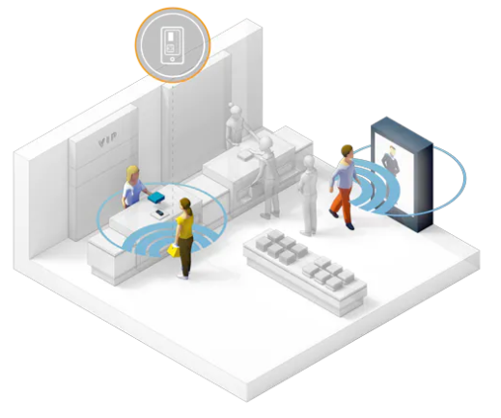

UWB Use Cases are Very Different than Envisaged in 2002 when Initial Rules were Formulated
IEEE 802.15.4z
2002 → 2022
Item Tracking
Indoor Navigation
Hands-Free Payment
Secure Hands-Free Access
2002 applications: Video, LAN, wireless USB (>400Mbit/sec)
2022 applications: Secure position, location, sensing

Slide 49
The Ability to Sense Location Adds a New Dimension to IOT
Accurate, real-time location enables
  Indoor location and navigation
  Contextual decision making
  Process efficiency
  Safety augmentation
And location has become a security credential
  Enabled by IEEE 802.15.4z
  Leveraged by FiRa Consortium, Car Connectivity Consortium, omlox, CSA, …

Slide 50
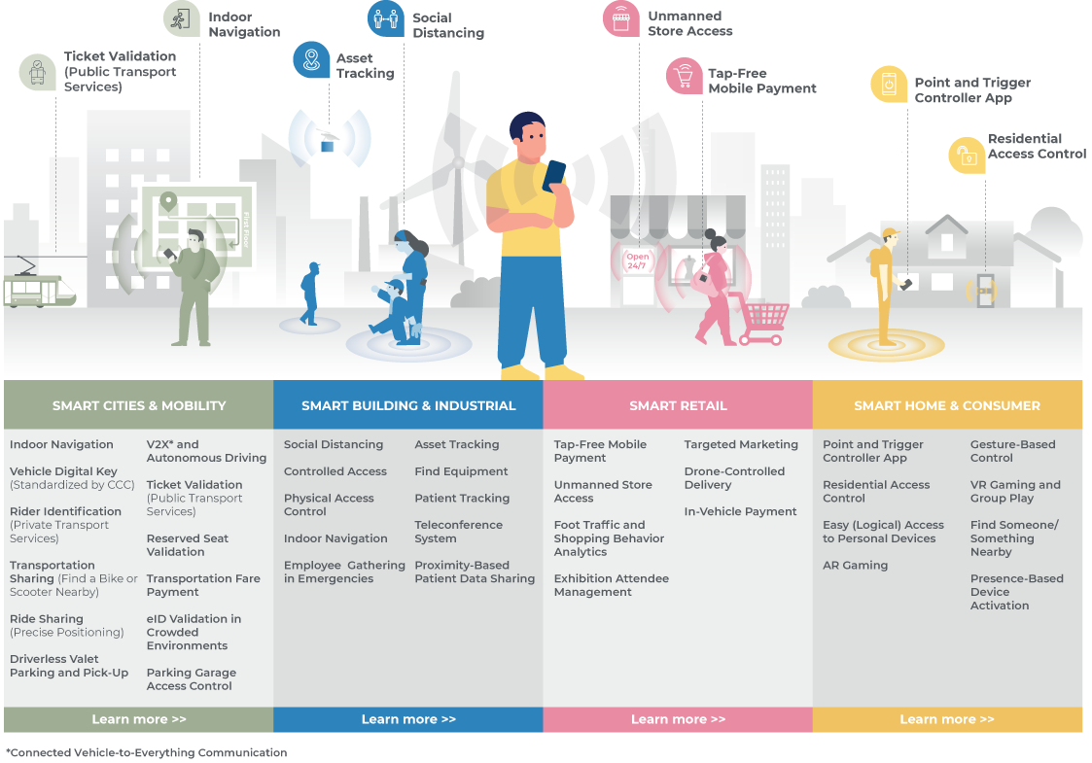
UWB Responds to Market Demand for Precision Location
(User Experiences)
https://www.firaconsortium.org/discover/use-cases
2020
IEEE 802.15.4z responded to market demand for secure, low-power, high precision location

Slide 51
Precise Ranging Use Case Examples

Slide 52
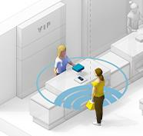
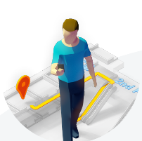

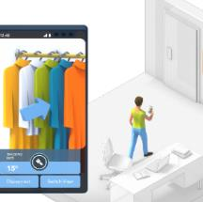
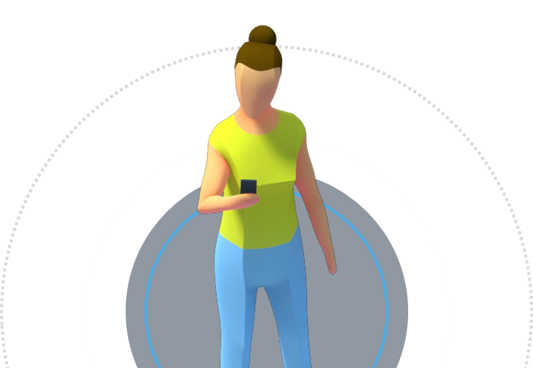
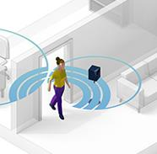
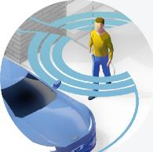
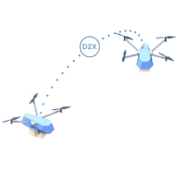
UWB and Global Industry Adoption
HANDS-FREE PAYMENT
INDOOR
NAVIGATION
SMART BUILDING ACCESS
ITEM
TRACKING
OBJECT DETECTION
SECURE CAR ACCESS
OBJECT-TO-OBJECT DETECTION

Slide 53
BACKUP to Q2. (Tech Advantages)

Slide 54

UWB: Providing a Solution to an Unresolved Problem
Accurate real-time positioning information of objects
Position granularity enables new use cases
Point-to-point communication with low latency
Proximity sensing with privacy
Content courtesy of NXP and CCC

Slide 55







802.15.4 UWB Ad-Hoc Network’s Broad Range of Uses
802.15.4 UWB (802.15.4z) being used widely
You’ve probably got it in your phone!
    For ranging and location services, precision to a few centimeters
    Exceptional coexistence
        Short impulse with a lot of space in between
        Multiple transmissions does not mean collisions (failure)
        Very low power (thousands to millions of times lower than typical radio) means low interference impact
    Low latency moderate data rate very low energy communications
    Accurate sensing using very low energy
    Enables a diversity of uses within the same spectrum

Slide 56






Robust Indoor Performance
Make ranging robust
Make RTLS robust
tag
blocking
blocking
blocking
blocking

Slide 57
Impulse Radio UWB: Low Power, Low Energy, Multi-User
Basic unit of transmission is short wideband pulse
  Pulse polarity + and - maps to 0 and 1
Pulse repetition frequency up to 499.2 MHz (2 ns intervals)
Typical pulse rate for measurements is 62.4 MHz or 124.8 MHz
  Pulses sent every 8 ns or 16 ns (travels 30 cm per 1 ns)
Bandwidth >500 MHz @ -10 dB
  500 MHz channels defined with center frequencies from 3.1 to 10 GHz
  Wide bandwidth signal resilient to frequency selective fading, relatively low carrier frequency big advantage
Average power of pulse sequence max -41.3 dBm/MHz EIRP
  -14.3 dBm/500 MHz over 1 ms
Consecutive, very low power pulse sequences with a lot of space in bare used by a correlator receiver to cumulate energy for Channel Impulse Response (CIR) estimate
Ref: H.J. Pirch, F. Leong, Introduction to Impulse Radio UWB Seamless Access Systems
https://www.firaconsortium.org/sites/default/files/2020-10/introduction-to-impulse-radio-uwb-seamless-access-systems-102820.pdf

Slide 58

UWB Prevents Relay Attacks in Passive Keyless Entry Systems
Conventional wireless key fobs can be fooled by listening and repeating the encrypted door-open message that is regularly transmitted by the key.
Ultra-wideband is able to prevent these relay attacks by measuring the time-of-flight of the signal

Slide 59


Physical Level Security using Scrambled Timestamp Sequence
Packet configurations
SP0: No STS, data payload
Used for data transfer
SP1: STS and data payload
- Used for combined measurement, data
and authentication
SP3: STS, no data payload
- Used for measurements
SYNC = Synchronization sequence
SFD = Start of Frame Delimiter
STS = Scrambled Timestamp Sequence
PHR = PHY Header
UWB PHY packet can contain optional Scrambled Timestamp Sequence (STS)
The pseudorandom sequence is used for channel estimation and first path detection
  Typical length 64 x 64 bits (4096 pseudorandom bits), but can be longer
Link budget limited by the data mode for measurement reporting

Slide 60
Large Bandwidth Compensates for Low Power Spectral Density
And allows steep rising edges and short pulses,
… making it easier to distinguish individual multipath components

Slide 61

First Path Detection
First path detection necessary for correct Time of Arrival and Angle of Arrival measurement
Channel impulse response evaluated for first path
In non-line-of-sight conditions first path can be weaker than a reflected path

Slide 62


Distance Measurement by Two-Way Ranging
Device 1
Device 2
Device 1
Device 2
Single-Sided Two-Way Ranging (SS-TWR)
Double-Sided Two-Way Ranging (DS-TWR)
Distance is measured using Time of Flight (TOF)
Roundtrip times and Reply times are reported to the other device for TOF calculation
  In SS-TWR Device 2 can calculate TOF after Device 1 reports T₁‘, or Device 1 after Device 2 reports T₁
  DS-TWR can provide higher accuracy with an extra measurement
Clock differences corrected and TOF calculated

Slide 63

Example of UWB Activity – Door lock
Each ranging round with
a 5-packet sequence
Each packet ~150 us
Around 20 ranging rounds / s
for 2 seconds
(example - approaching a door)
Pulses
10 ms
Spectrum used very sparsely in time:
Activity factor: One transaction every hour, 2 s / 3600 s = 0.06%
Duty cycle during transaction: 20 x 5 x 150 us / s = 1.5%
Average one pulse every 16 ns
0.0009% activity

Slide 64
BACKUP to Q3. (Regulatory)

Slide 65








Example Industry Need: Seamless Ranging allowed in Europe, but Not in US, making it Hard for Industry to Follow
FCC regulation status:
within rules
waiver or interpretation (unclear) ?
at tension (not allowed)
Indoor access
Indoor sales
UWB ranging transmissions are extremely constrained:
Very low Duty Cycle
Very low Activity Factor
Very low Transmit Power
Car access
Outdoor access/payment
Outdoor access

Slide 66
Regulator Need for Change – Fixed Outdoor Transmissions
UWB transmissions from fixed outdoor transmissions have historically been forbidden
Originally, by the FCC, to prevent outdoor UWB communication networks that might interfere with critical radar systems (high mounted antennas)
These days, it prevents efficient down-link time-difference-of-arrival positioning and smart lock applications
CEPT now allows fixed outdoor UWB transmissions between 6.0 and 8.5 GHz
FCC has approved a number of waivers enabling fixed outdoor UWB transmissions
Outdoor DL-TDOA is a key enabler for smart parking and traffic applications

Slide 67
Regulator Need for Change – Vehicular Applications
Keyless entry and child presence detection are major UWB applications but the regulatory status of UWB in vehicles is unclear
FCC only has regulations for indoor and handheld devices
CEPT originally updated its regulations for communication applications
  Required an ‘exterior limit’ – extra power reduction above the horizon
  In 2019, ‘trigger-before-transmit’ for keyless entry applications
  In 2022, removal of exterior limit for duty cycles below 5% in 6.0 – 8.5 GHz

