Slide 1
Project: IEEE P802.15 Working Group for Wireless Personal Area Networks (WPANs)
Submission Title: [Basic transmission characteristics of SUN-FSK and SUN-OFDM and future extensions]
Date Submitted: 12 July 2023
Source: Hiroshi Harada (Kyoto University)
Address Yoshidahonmachi. Sakyo, Kyoto, 606-8501, Japan
Voice: +81-75-753-5317 , E-Mail: hiroshi.harada@i.kyoto-u.ac.jp
Re: [Wireless Next Generation, Long Range extension enhancements to 802.15.4-2020]
Abstract: Introduce basic transmission characteristics of IEEE 802.15.4 SUN-FSK and SUN-OFDM and their deployment in various applications with improved reception schemes, and show items necessary for future extensions. A part of this contribution was supported from the commissioned research (No.05101) by National Institute of Information and Communications Technology (NICT) , Japan.
Purpose: Provide basic information for extending SUN-FSK and SUN-OFDM
Notice: This document has been prepared to assist the IEEE P802.15. It is offered as a basis for discussion and is not binding on the contributing individual(s) or organization(s). The material in this document is subject to change in form and content after further study. The contributor(s) reserve(s) the right to add, amend or withdraw material contained herein.
Release: The contributor acknowledges and accepts that this contribution becomes the property of IEEE and may be made publicly available by P802.15.

Slide 2
Basic transmission characteristics of SUN-FSK and SUN-OFDM and future extensions
July 12, 2023
Hiroshi Harada, Ph.D.

Slide 3
Background
IEEE 802.15.4 SUN FSK is spreading around the world with smart meters and has already installed more than tens of millions of units.
Many chip vendors have developed SUN FSK chips and are commercially available.
Interoperability test specifications have been established by the Wi-SUN Alliance and other organizations, and certification tests are being conducted by many certification organizations.
IEEE 802.15.4 SUN OFDM chips have been developed by several vendors, interoperability test specifications have been established by the Wi-SUN Alliance, and certification testing has begun.

Slide 4
Background
Target applications have shifted from data-centric applications such as smart meters to demand for applications using still and moving images.
The demand is growing not only for fixed communications, but also for mobile communications such as V2X.
In Japan, the bandwidth per channel in the sub-1 GHz band has been expanded to a maximum of 4 MHz in multiples of 200 kHz.
Need to expand SUN FSK and SUN OFDM to meet the requirements of new usage models (fixed, mobile), new applications (image and video), etc.
Before we begin the discussion on the extensions, let’s first look at the current SUN FSK and the SUN OFDM transmission characteristics.

Slide 5
Expected use cases of IEEE 802.15.4 SUN
H. Harada, K. Mizutani, J. Fujiwara, K. Mochizuki, K. Obata, and R. Okumura, “IEEE 802.15.4g based Wi-SUN Communication Systems,” IEICE Transactions on Communications, E100-B, No. 07, pp. 1032–1043, Jul. 2017.

Slide 6
Expected use cases of IEEE 802.15.4 SUN
H. Harada, K. Mizutani, J. Fujiwara, K. Mochizuki, K. Obata, and R. Okumura, “IEEE 802.15.4g based Wi-SUN Communication Systems,” IEICE Transactions on Communications, E100-B, No. 07, pp. 1032–1043, Jul. 2017.

Slide 7
Specification of SUN-FSK

Slide 8
Packet Error Rate (PER) performance of SUN-FSK
Experimental transmission performance
  Prototype IC Lapis ML7421
  Support data rates of 50 kbps ~ 600 kbps by 2-FSK
  Support IEEE 802.15.4-compliant FEC
  Certified by a certification body in Japan
    Meet the requirements of ARIB STD-T108 under the proposed parameters
Required PER
Y. Xiang, R. Okumura, K. Mizutani, H. Harada, “Data Rate Enhancement of FSK Transmission Scheme for IEEE 802.15. 4-Based Field Area Network”, IEEE Sensors Journal,Jan. 2021

Slide 9
SUN-OFDM
S. Kadoi, H. Ochiai, R. Okumura, K. Mizutani, H. Harada, “IEEE 802.15. 4g/4x-based Orthogonal Frequency Division Multiplexing Transmission Scheme for Wide Area and Mobile IoT Communication Systems”, IEEE Internet of Things Journal, Dec. 2021

Slide 10
OFDM pilot data mapping
S. Kadoi, H. Ochiai, R. Okumura, K. Mizutani, H. Harada, “IEEE 802.15. 4g/4x-based Orthogonal Frequency Division Multiplexing Transmission Scheme for Wide Area and Mobile IoT Communication Systems”, IEEE Internet of Things Journal, Dec. 2021

Slide 11
Specification of SUN-OFDM (IEEE 802.15.4-2020)

Slide 12
Specification of SUN-OFDM (IEEE 802.15.4-2020)

Slide 13
PER performance of SUN-FSK and SUN-OFDM
Compared to 100 kbps FSK, OFDM can provide about 18 dB of gain
Required PER
S. Kadoi, H. Ochiai, R. Okumura, K. Mizutani, H. Harada, “IEEE 802.15. 4g/4x-based Orthogonal Frequency Division Multiplexing Transmission Scheme for Wide Area and Mobile IoT Communication Systems”, IEEE Internet of Things Journal, Dec. 2021

Slide 14
Maximum transmission length to achieve required PER of 10%
S. Kadoi, H. Ochiai, R. Okumura, K. Mizutani, H. Harada, “IEEE 802.15. 4g/4x-based Orthogonal Frequency Division Multiplexing Transmission Scheme for Wide Area and Mobile IoT Communication Systems”, IEEE Internet of Things Journal, Dec. 2021

Slide 15
Improvement of channel estimation scheme
Proposed channel estimation scheme 1
S. Kadoi, H. Ochiai, R. Okumura, K. Mizutani, H. Harada, “IEEE 802.15. 4g/4x-based Orthogonal Frequency Division Multiplexing Transmission Scheme for Wide Area and Mobile IoT Communication Systems”, IEEE Internet of Things Journal, Dec. 2021

Slide 16
PER performance
Receive scheme | Channel estimation scheme | Diversity in Frequency domain | remarks
LE-DAC | LTF only | EGC
PE-DAC | Proposed scheme 1 | EGC | conventional
PE-MRC | Proposed scheme 1 | MRC
ePE-MRC | Proposed scheme 2 | MRC
Simulation parameters
 | Parameter | Value
Common | PSDU length | 250 octets
 | Oversampling | 16
 | SNR (AWGN level) | 37.8 dB
 | Channel model | GSM Typical Urban
 | Carrier frequency | 920 MHz
 | Moving speed | 0–200 km/h
SUN-FSK | Modulation scheme | 2-GFSK
 | Preamble length | 15 octets
 | Data rate | 100 kbps
 | Modulation index | 1.0
 | Gaussian filter BT | Tx: 0.5, Rx: 0.5
 | Encoding scheme | w/o FEC
SUN-OFDM | Option / MCS | 3 / 2
 | Decoding scheme | Viterbi (Soft decision)
GSM typical urban model
H. Ochiai, Y. Morikawa, K. Mizutani, H. Harada, “An Enhanced Channel Estimation for IEEE 802.15. 4 OFDM Receiver in High-speed Mobile IoT Communication Systems”, IEEE Internet of Things Journal, Feb. 2023.
Parameter | Path 1 | Path 2 | Path 3 | Path 4 | Path 5 | Path 6
Delay time (µs) | –0.2 | 0 | 0.3 | 1.4 | 2.1 | 4.8
Relative power (dB) | –3 | 0 | –2 | –6 | –8 | –10

Slide 17
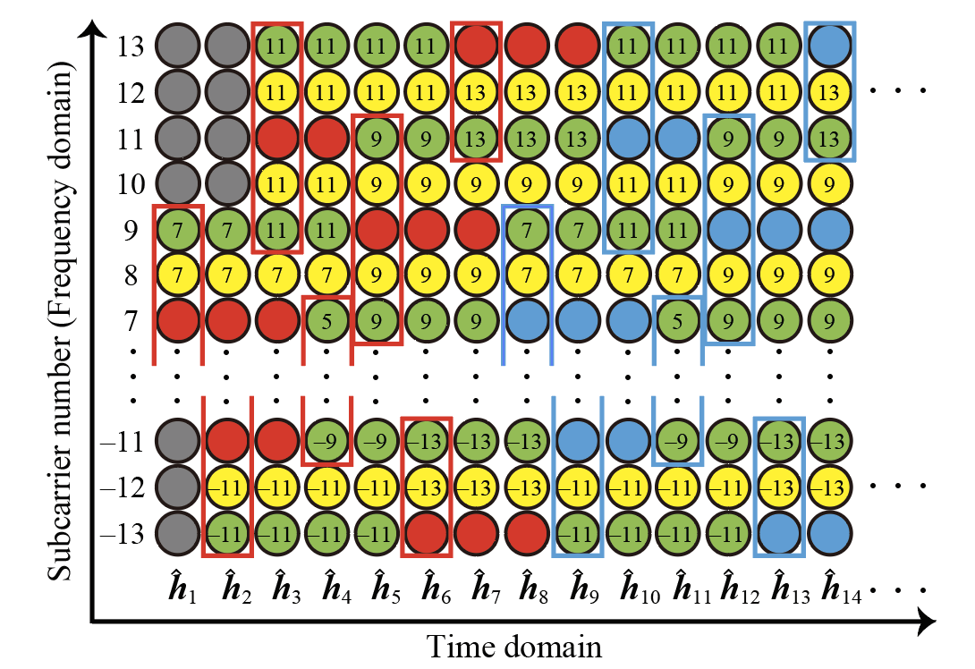
Improvement of channel estimation scheme2
Proposed channel estimation scheme 2
H. Ochiai, Y. Morikawa, K. Mizutani, H. Harada, “An Enhanced Channel Estimation for IEEE 802.15. 4 OFDM Receiver in High-speed Mobile IoT Communication Systems”, IEEE Internet of Things Journal, Feb. 2023.

Slide 18
PER performance 2
SUN OFDM has the potential to realize 200 km/h mobile communications
H. Ochiai, Y. Morikawa, K. Mizutani, H. Harada, “An Enhanced Channel Estimation for IEEE 802.15. 4 OFDM Receiver in High-speed Mobile IoT Communication Systems”, IEEE Internet of Things Journal, Feb. 2023.
18

Slide 19
Future extension proposal
SUN OFDM
  Consider lower transmission rates by varying the spread factor or time and frequency repetition
  Support up to 4 MHz/ch bandwidth
  Increase modulation level: 64 QAM, 256 QAM …
  Use strong FEC: LDPC and Polar code
  Consider MIMO transmission
SUN FSK
  Support up to 4 MHz/ch bandwidth
  Use of convolutional codes with long constraint lengths
  Increase interleave size to achieve mobile communications
  Use stronger FEC: LDPC and Polar code

