Slide 1
Project: IEEE P802.15 Working Group for Wireless Personal Area Networks (WPANs)
Submission Title: Summary on Multiple Transmission in a slot
Date Submitted: July 11, 2023
Source: [Taeyoung Ha, Mingyu Lee, Youngwan So, Aniruddh Rao Kabbinale, Ankur Bansal, Clint Chaplin] Company [Samsung Electronics]
E-Mail: ty1115.ha@samsung.com
Abstract: Summary on Multiple RSF Transmissions in a Slot Scenario
Purpose: Increase air time efficiency by allowing the multiple MMRS transmission in a slot.
Notice: This document has been prepared to assist the IEEE P802.15. It is offered as a basis for discussion and is not binding on the contributing individual(s) or organization(s). The material in this document is subject to change in form and content after further study. The contributor(s) reserve(s) the right to add, amend or withdraw material contained herein.

Slide 2
Motivation
There could be a time limit to meet the requirement of certain ranging applications
  An application needs additional devices (e.g., controllers of VR device) to ranging
  The number of required ranging slots which are accommodating the certain number of devices may exceed the time limit
  Enhanced preamble codes are proposed [1][2]
  To support the application, multiple transmission in a ranging slot should be considered

Slide 3
Multiple RSF Transmission without NBA
In order to control the schedule of Multiple RSF Transmission, Scheduling IE can be used [3]
For Ranging report, current ranging report format (which is defined in 7.4.4.46 of 802.15.4z) can be used

Slide 4
NBA Multiple RSF Transmission
In order to schedule and trigger of Multiple RSF Transmission, Poll (one-to-many) message can be used
Scheduling and Trigger phase can be divided into two phase according to the purpose
Note that this procedures are not related with Multi-millisecond Ranging (MMR), even though these have almost same procedures of MMR operation

Slide 5
Aligned NB Message Format
Message ID | Message Control | MessageConetents
0x10 (i.e., POLL (one-to-many) | 0x80 | Number of Responders[1], Request Bitmap[1], Presence Bitmap[1], List of {Responder Address[3], If Bit 0 of Presence Bitmap == 1 then {NbaChannelMap[6]}, If Bit 1 of Presence Bitmap == 1 then {NB PHY Config[1]}, If Bit 2 of Presence Bitmap == 1 then {NB MAC Config[7]}, If Bit 3 of Presence Bitmap == 1 then {UWB PHY Config[3]}, If Bit 4 of Presence Bitmap == 1 then {UWB MAC Config[2]}, If Bit 5 of Presence Bitmap == 1 then {StartSlotIndex[2], EndSlotIndex[2]}}
In order to control the schedule of Multiple RSF Transmission, Poll (one-to-many) message can be used
For Ranging report, ranging report of NB (which is defined in [4]) can be used

Slide 6
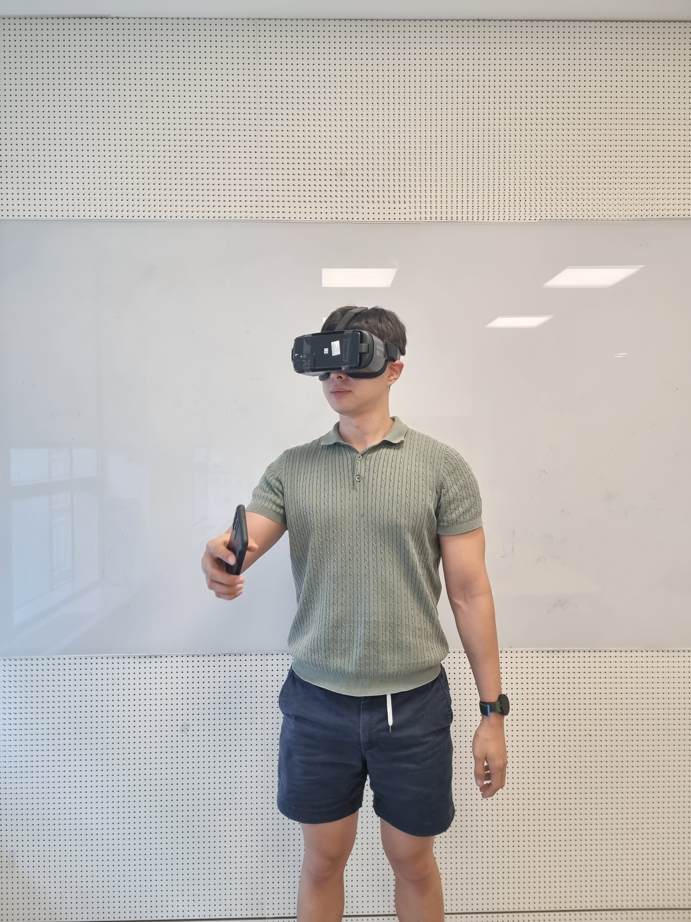
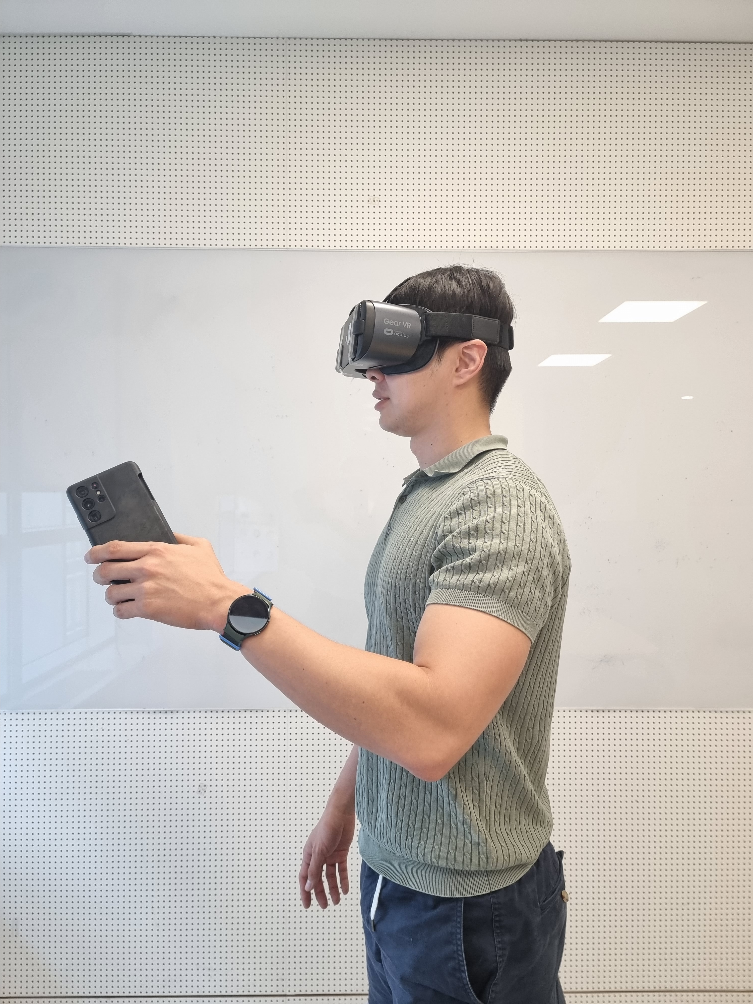
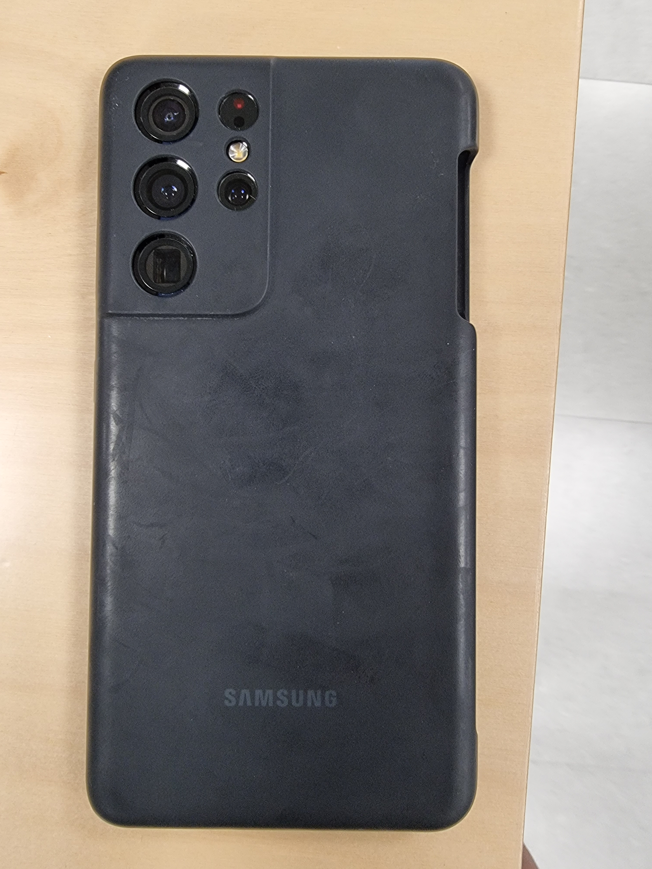
Experimental Environment
In order to address the power control concerns from members, RSSI values are measured
The experimental environment is for the proposed VR use cases
RSSI values are measured in many cases (i.e., related location of antenna and blocking status of antenna)
Antenna
Initiator
Responder

Slide 7
Experimental Results
Below figure shows the probability that the RSSI difference between Responder 1 and Responder 2 exceeds the 30 dB
  The worst case is that
  1) the antenna of Initiator is located at the lower left and not blocked
  2) Responder 1 is blocked by hand and Responder 2 is not blocked
  (i.e., yellow bar at the CASE 3)
  In this case, the probability that the RSSI difference between Responder 1 and Responder 2 exceeds the 30 dB is about 0.006

Slide 8
Ranging Experimental Environment
In order to check the feasibility of the Multiple Transmission scenario in the VR scenario additional experiments were conducted
  Due to the limitations in MAC protocol, Poll-Response method is used
  (i.e., if slot based MAC protocol can be implemented, this will be used)
  Due to the limitations, current 4ab Ipatov sequences are used
  (i.e., if Golay sequences are provided, these will be used)

Slide 9
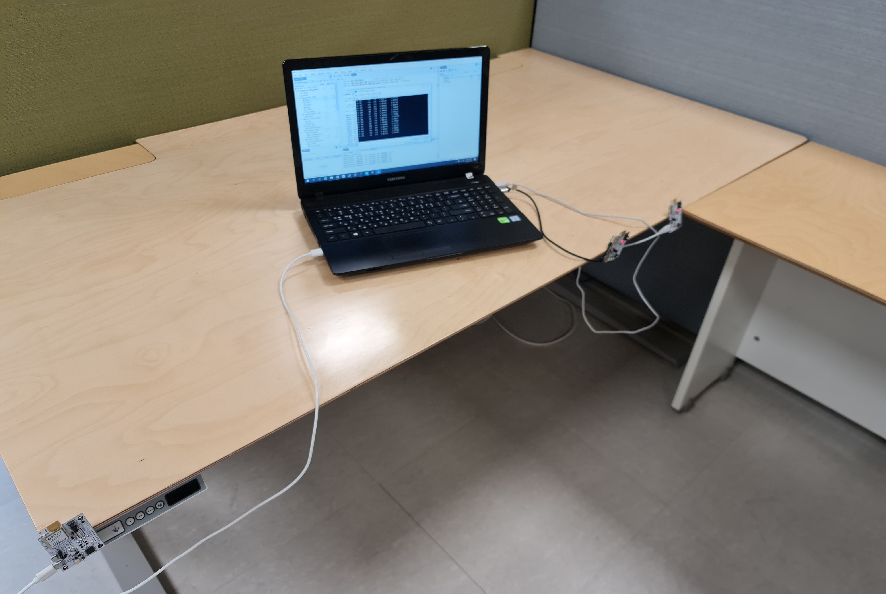
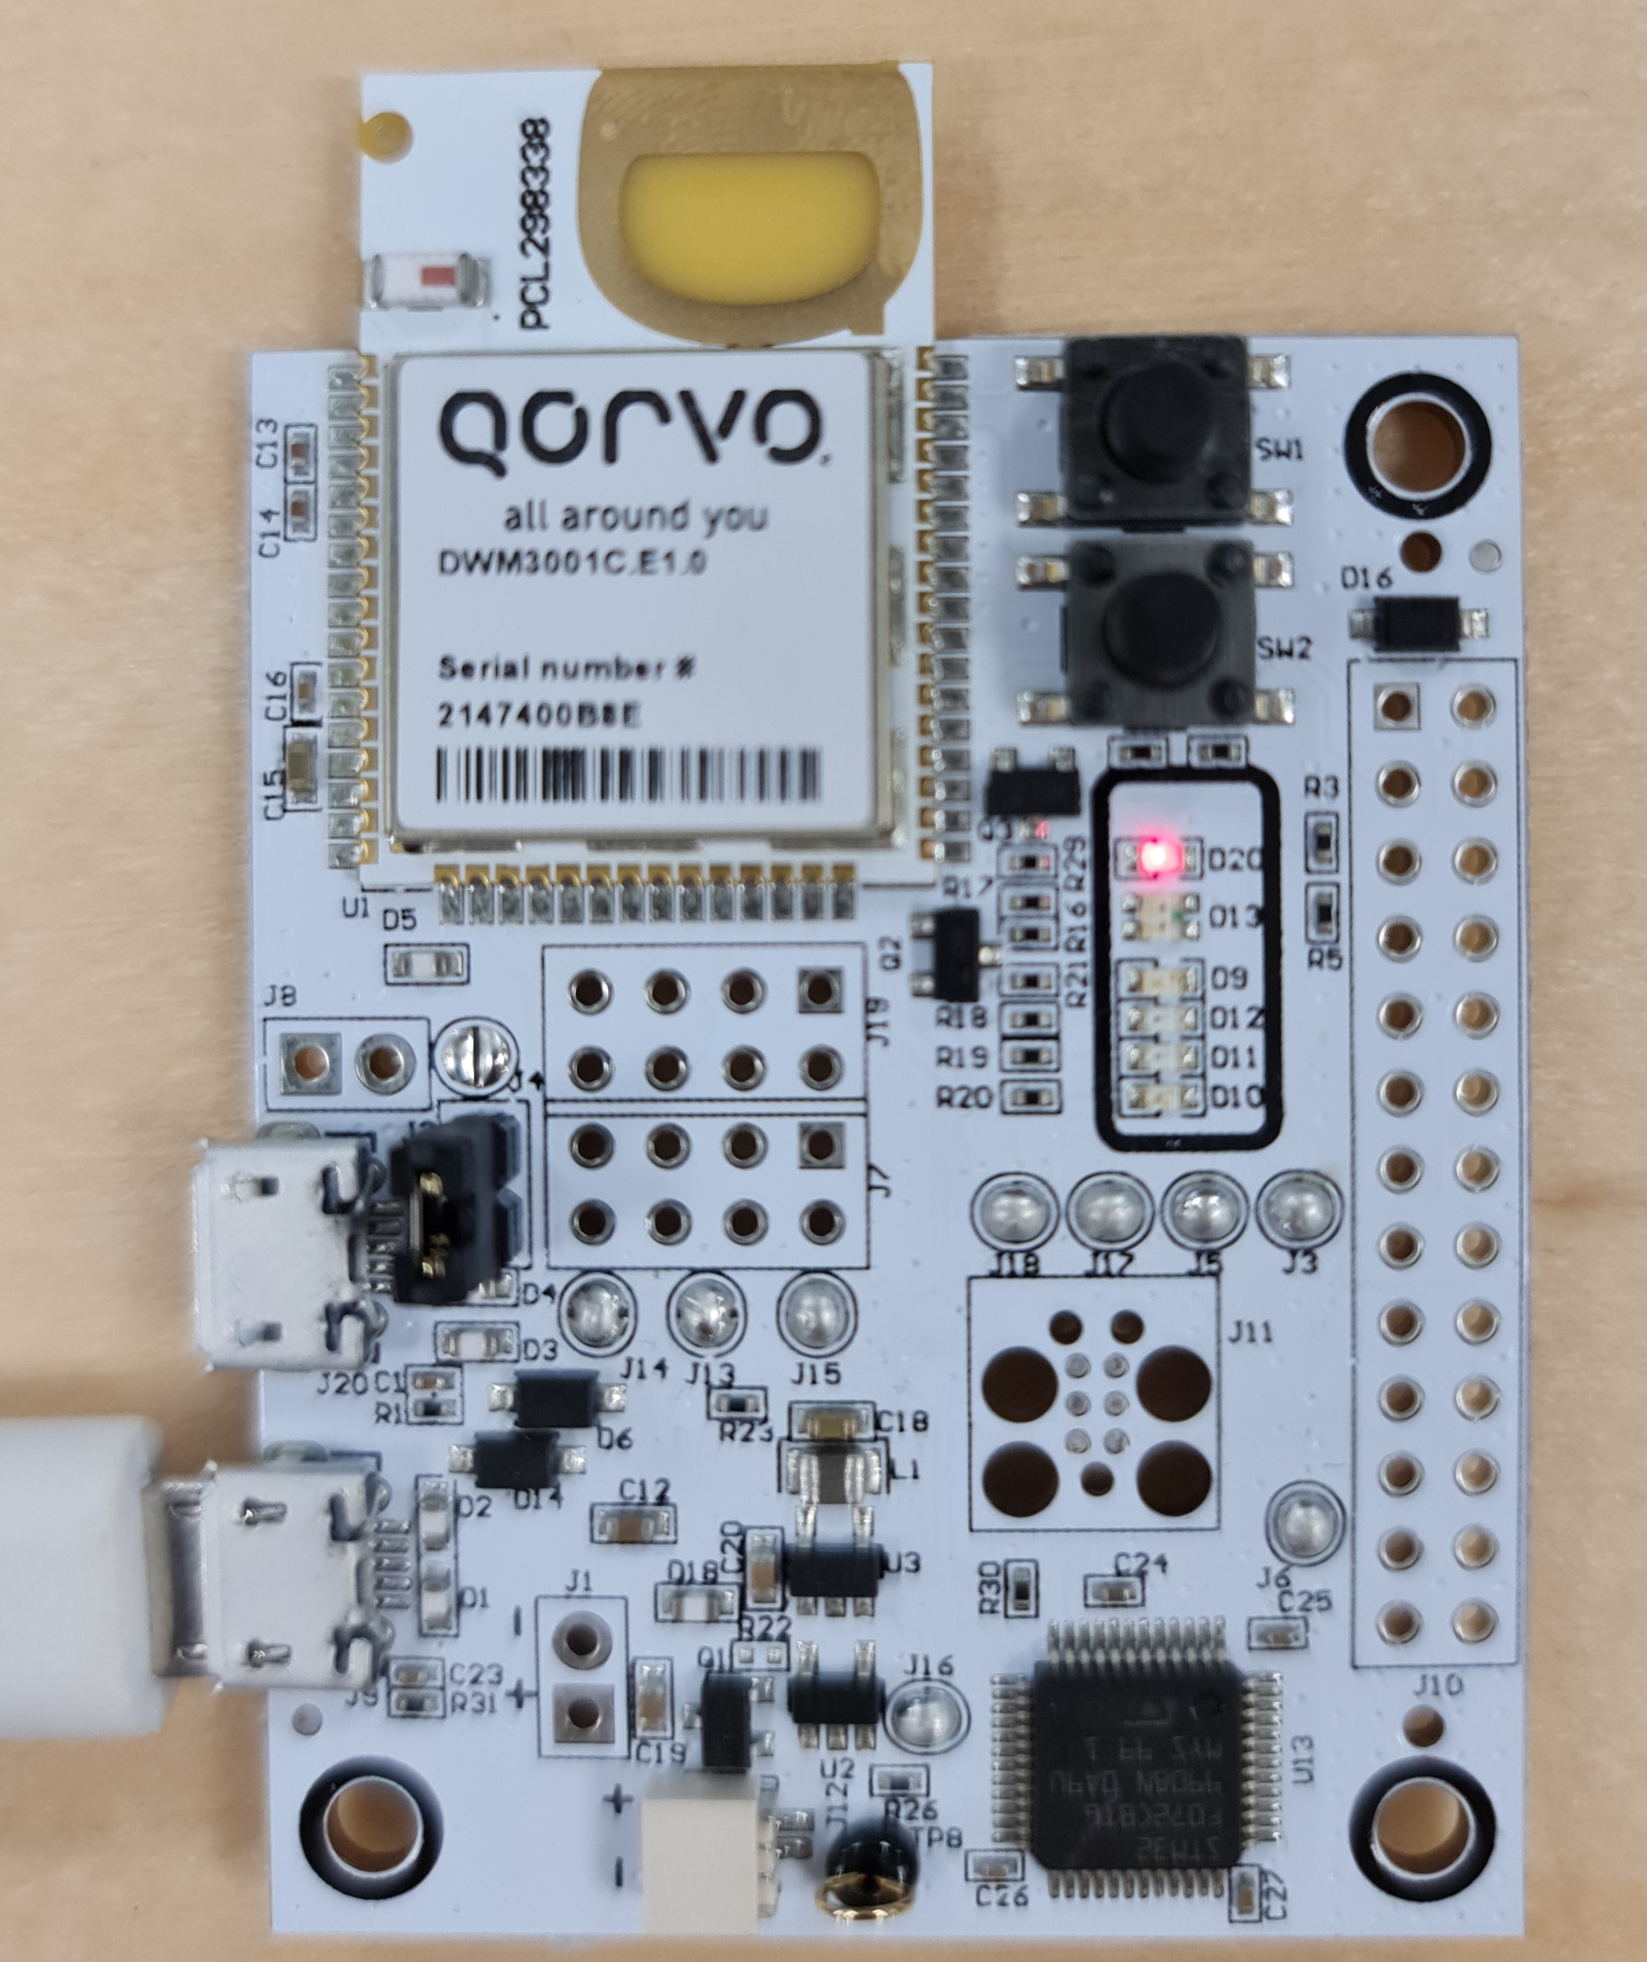
Ranging Experimental Environment
In order to check the feasibility of the Multiple Transmission scenario in the VR scenario additional experiments were conducted
  Experiments were proceeded according to the distance between Initiator and Responder 2 (i.e., Left Transmitter)
  The distance between Initiator and Responder 1 (i.e., Right Transmitter) is fixed as 90 cm
  Reference case means that there is only Responder 1 (i.e., Responder 2 do not transmit any signals)
Responder 2
Initiator
10 ~ 30 cm
Responder 1
90 cm

Slide 10
Ranging Experimental Results
Below figure shows the probability that the Initiator successfully receives the packet of Responder 1 (i.e., Right Transmitter)
  For Reference case (i.e., no Responder 2), the probability of successfully receiving is 1.0 (i.e., No packet drop)
  As the distance between the Initiator and Responder 2 (i.e., Left Transmitter) decrease, the probability of successfully receiving packet decrease (Probability is about 0.95 when the distance between the Initiator and Responder 2 is 10 cm)

Slide 11
Ranging Experimental Results
Below figure shows the average measured distance between the Initiator and Responder 1 (i.e., Right Transmitter)
  The exact distance between the Initiator and Responder 1 (i.e., Right Transmitter) is 90 cm
  As the distance between the Initiator and Responder 2 (i.e., Left Transmitter) decrease, the average measured distance increase (Average measured distance is about 95.6 cm when the distance between the Initiator and Responder 2 is 10 cm)

Slide 12
Conclusion
In order to reduce the air time, Multiple RSF Transmission in a slot scheme is proposed
Experimental results show the feasibility of proposed scheme

Slide 13
References
[1] 15-21-0377-02 Preamble codes for Data Communications in 802.15.4ab
[2] 15-22-0405-03 Way Forward on Preamble Sequences beyond 4z Ipatov
[3] 15-23-0062-93 Text for Scheduling IE
[4] 15-23-0363 One-to-Many Ranging using NBA-MMS Technical Framework Proposal

