Slide 1
Project: IEEE P802.15 Working Group for Wireless Personal Area Networks (WPANs)
Submission Title: NB Coexistence
Date Submitted: July 2023
Source: Rojan Chitrakar, Lei Huang, Bin Qian, David Xun Yang (Huawei Technologies)
Email: rojan.chitrakar@huawei.com
Abstract: enhancements for NB Coexistence
Purpose:
Notice: This document has been prepared to assist the IEEE P802.15. It is offered as a basis for discussion and is not binding on the contributing individual(s) or organization(s). The material in this document is subject to change in form and content after further study. The contributor(s) reserve(s) the right to add, amend or withdraw material contained herein.
Release: The contributor acknowledges and accepts that this contribution becomes the property of IEEE and may be made publicly available by P802.15.

Slide 2
PAR Objective | Proposed Solution (how addressed)
Safeguards so that the high throughput data use cases will not cause significant disruption to low duty-cycle ranging use cases
Interference mitigation techniques to support higher density and higher traffic use cases
Other coexistence improvement
Backward compatibility with enhanced ranging capable devices (ERDEVs)
Improved link budget and/or reduced air-time
Additional channels and operating frequencies
Improvements to accuracy / precision / reliability and interoperability for high-integrity ranging
Reduced complexity and power consumption
Hybrid operation with narrowband signaling to assist UWB | Enhancements for NB Coexistence
Enhanced native discovery and connection setup mechanisms
Sensing capabilities to support presence detection and environment mapping
Low-power low-latency streaming
Higher data-rate streaming allowing at least 50 Mbit/s of throughput
Support for peer-to-peer, peer-to-multi-peer, and station-to-infrastructure protocols
Infrastructure synchronization mechanisms

Slide 3
Background: NBA-UWB MMS Compressed PSDU
[1], [2] introduces NBA-UWB MMS Compressed PSDU:
Keeping NB packets shorter than 1ms; NB O-QPSK 250k has limited PSDU capacity (~25 bytes/ms)
Compressed PSDU specific to NBA-UWB MMS control frames:
1-octet message ID (0x00=Poll, 0x01=Response, 0x02=Report, …)
3-octet private address, 3 octet optional prand field
1 octet Message control field (subtypes)
ID specific message content (variable length)
2-octet CRC16
ADV-RESP / ADV_CONF / RESP / SOR / RPRT
Octets: 1 | 3 | 1 | variable | 2
ID | RPA_hash | Message Control | Message Content | CRC
ADV-POLL / POLL
Octets: 1 | 3 | 3 | 1 | variable | 2
ID | RPA_hash | RPA_prand | Message Control | Message Content | CRC
[1] 15-22/0604r0, NBA-MMS-UWB Compressed PSDU, [2] 15-22/0381r5, NBA-MMS-UWB ranging text proposal for 15.4ab TFD

Slide 4
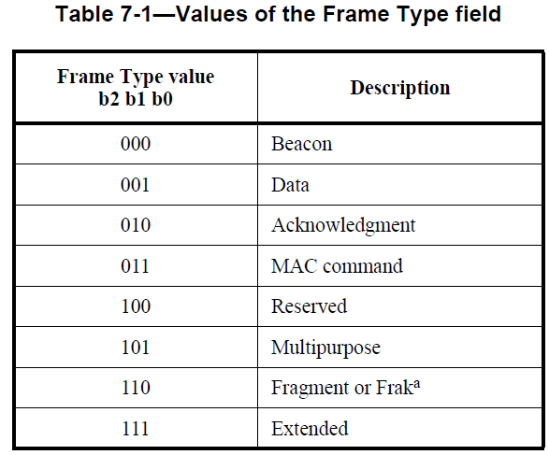
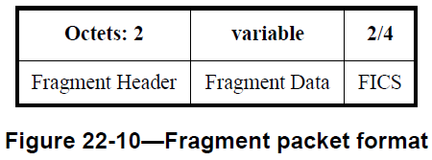
Background: 802.15.4 frame formats
General frame format (other than Fragment & Extended):

Slide 5
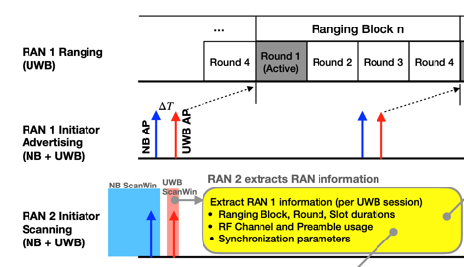
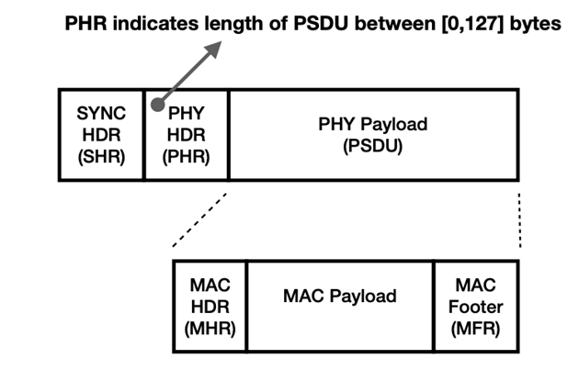
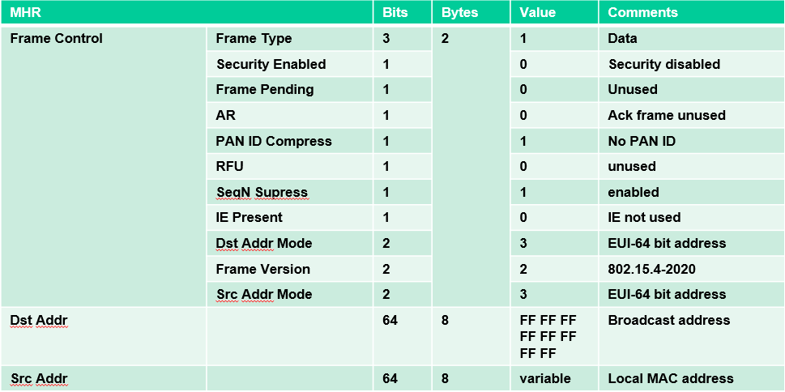
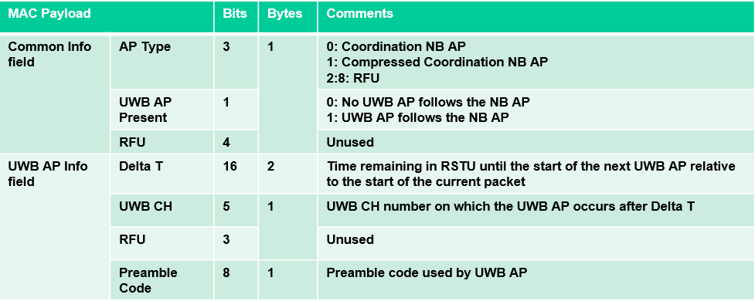
Background: NB Acquisition Packet (AP)
[3] introduces NB AP packets to advertise RAN information such as CH, Preamble, and Block duration to enable the observing RAN to intelligently configure itself to minimize interference effects.
Data frame (without any IEs) is used for NB AP message
How does receiving device know this is an AP packet?
[3] 15-22/0573r1, Follow-up on UWB Channel Usage Coordination

Slide 6
Discussion
Both compressed PSDUs and the NB AP message are transmitted in the NB initialization channels. How to ensure the NB message and the compressed PSDU can coexist on the same channel? I.e., how can a receiving device differentiate a compressed PSDU from a NB AP message?
1) Compressed PSDU
Preamble | SFD | PHR | Payload
Octets: 1 | 3 | 0 or 3 | 1 | variable | 2/4/8/16
ID | RPA_hash | RPA_prand | Message Control | Message Content | CRC / MIC
2) NB AP Message (or any other legacy 802.15.4 frame)
Preamble | SFD | PHR | Data frame
Notes:
Assuming a common IRK is used for both responders.

Slide 7
Option-1A
The first 3 bits of the ID space of compressed PSDU is set to a fixed value (b100) for coexistence with legacy frame types.
The 802.15.4 frame type value (b100) is reserved for coexistence with compressed PSDU.
NB AP packets carried in 802.15.4 frame as proposed in [3].
Compressed PSDU
Bits: 0-2 | 3-10 | Octets: 3 | 0 or 3 | 1 | variable | 2/4/8/16
Set to b100 | ID | RPA_hash | RPA_prand | Message Control | Message Content | CRC / MIC
Values of The Frame Type field
Frame Type b2 b1 b0 | Description
000 | Beacon
001 | Data
010 | Acknowledgment
011 | MAC Command
100 | Used for coexistence with Compressed PSDU
101 | Multipurpose
110 | Fragment of Frak
111 | Extended
Original message ID values
Backward compatible while maintaining the original compressed PSDU format.
Only 3 bits longer than current format.

Slide 8
Option-1B
Same as Option-1A except ID field is reduced to 5 bits to align with octet boundary.
Compressed PSDU
Bits: 0-2 | 3-7 | Octets: 3 | 0 or 3 | 1 | variable | 2/4/8/16
Set to b100 | ID | RPA_hash | RPA_prand | Message Control | Message Content | CRC / MIC
Values of The Frame Type field
Frame Type b2 b1 b0 | Description
000 | Beacon
001 | Data
010 | Acknowledgment
011 | MAC Command
100 | Used for coexistence with Compressed PSDU
101 | Multipurpose
110 | Fragment of Frak
111 | Extended
5 bits can indicate up to 32 PSDU types.
Backward compatible while maintaining the original compressed PSDU format.
Same size as current format.
Con: ID space is smaller (total 32 types)

Slide 9
Compressed PSDU to carry generic NB data
A new compressed PSDU is defined to carry generic NB data such as NB AP message etc.:
A unique ID (e.g., 0x70) represents a compressed data PSDU (or legacy 802.15.4 frame).
Transmitter address may be a randomly generated 3-octet address or a private address representing the transmitter.
Optional prand field present only in the first frame carrying a new private address. Private address is only used in directed NB AP messages (to a particular device or a network).
Message Control field indicates the type of NB data (e.g., NB AP message).
The NB data (e.g., AP MAC payload) is carried in the Message Content field.

Slide 10
Summary
We discussed coexistence issue between compressed PSDUs and legacy 802.15.4 frames
We a potential solution:
The first 3 bits of the ID space of compressed PSDU is set to a fixed value (b100) for coexistence with legacy frame types.
New compressed PSDUs are defined to carry generic NB data such as NB AP message.

