Slide 1
Project: IEEE P802.15 Working Group for Wireless Personal Area Networks (WPANs)
Submission Title: Grouped responders
Date Submitted: July 2023
Source: Rojan Chitrakar, Lei Huang, Bin Qian, David Xun Yang (Huawei Technologies)
Email: rojan.chitrakar@huawei.com
Abstract: Efficient UWB operation for grouped responders
Purpose: Enable efficient UWB operation for grouped responders
Notice: This document has been prepared to assist the IEEE P802.15. It is offered as a basis for discussion and is not binding on the contributing individual(s) or organization(s). The material in this document is subject to change in form and content after further study. The contributor(s) reserve(s) the right to add, amend or withdraw material contained herein.
Release: The contributor acknowledges and accepts that this contribution becomes the property of IEEE and may be made publicly available by P802.15.

Slide 2
PAR Objective | Proposed Solution (how addressed)
Safeguards so that the high throughput data use cases will not cause significant disruption to low duty-cycle ranging use cases
Interference mitigation techniques to support higher density and higher traffic use cases
Other coexistence improvement
Backward compatibility with enhanced ranging capable devices (ERDEVs)
Improved link budget and/or reduced air-time
Additional channels and operating frequencies
Improvements to accuracy / precision / reliability and interoperability for high-integrity ranging
Reduced complexity and power consumption
Hybrid operation with narrowband signaling to assist UWB | Enabling efficient UWB operation for grouped responders
Enhanced native discovery and connection setup mechanisms | Enabling efficient UWB operation for grouped responders
Sensing capabilities to support presence detection and environment mapping
Low-power low-latency streaming
Higher data-rate streaming allowing at least 50 Mbit/s of throughput
Support for peer-to-peer, peer-to-multi-peer, and station-to-infrastructure protocols
Infrastructure synchronization mechanisms

Slide 3
Background: One-to-many SS-TWR NBA-MMS Ranging [1]
One-to-many SS-TWR NBA-MMS Ranging is introduced in [1].
A ranging round is made up of several access slots.
Initiator performs MMS ranging with multiple responders, performing an one-to-one ranging with one responder in each access slot.
[1] 15-23/015r2, one to many ranging using MMR technical framework proposal, Jinjing Jiang

Slide 4
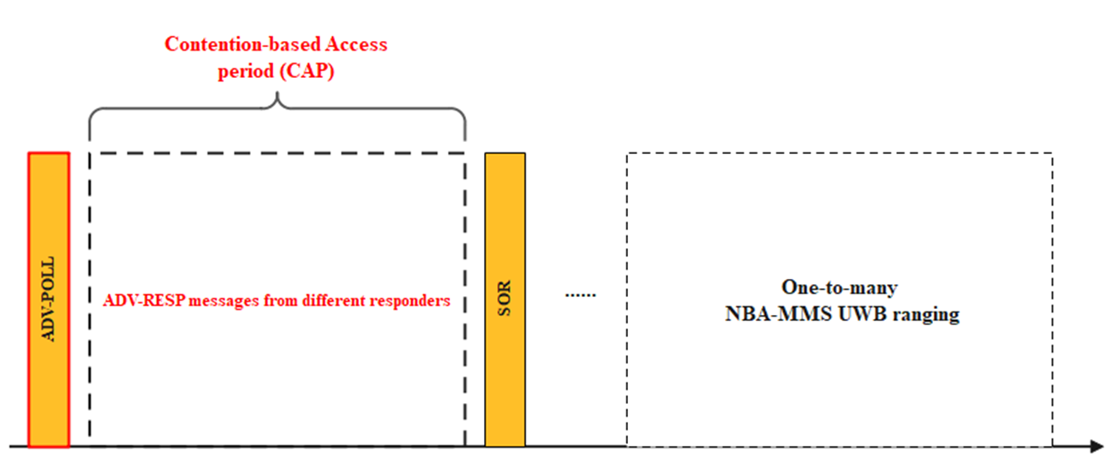
Background: one-to-many NBA-MMS UWB ranging initialization and setup
In one-to-many NBA-MMS UWB ranging initialization and setup, following considerations are discussed [2]
During the initialization and setup phase, initiator shall specify a contention access based period (CAP) to collect ADV-RESP messages from multiple responders
The broadcast ADV-POLL packet shall indicate the time duration to define the CAP.
[2] 23-0125r1 “Follow up on one-to-many NBA-MMS UWB”, Kuan Wu

Slide 5
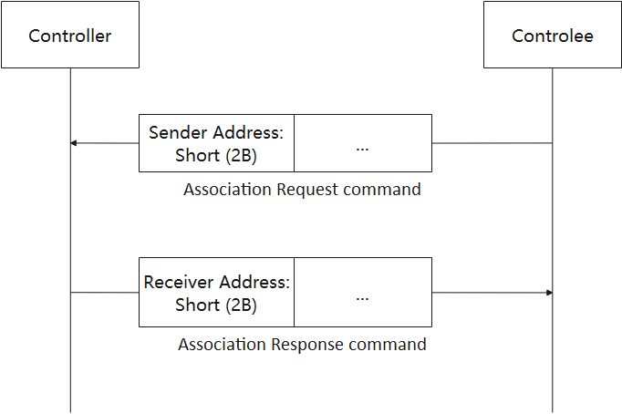
Background: HRP UWB Association Request and Response
[3] describes the Device discovery and association procedure for HRP UWB including:
Controlee generating 2-octets short address during Association
Controller using the 2-octets address to identify the controlee unless the address is duplicated
When the short address chosen by the controlee already exists, the controller may send Association Response command whose content field contains the Updated Short Address field whose value is unique in the session.
.
Association Response Command Content
Octets: 1 | 0/1 | 0/2
Association Status (0x04) | Session Configuration | Updated Short Address
Valid values of the Association Status field
Association Status | Description
0x00 | Association successful.
0x01 | Session at capacity.
0x02 | Short address duplication.
0x03 | Association denied by other reason
0x04 | Association successful with updated short address
0x05-0xff | Reserved.
[3] 23-0174r2 “Text for Discovery and Association for HRP UWB”, Kangjin Yoon

Slide 6
Motivation
There are one-to-many UWB application scenarios in which the responders may be part of a group of devices, with means of communicating amongst themselves. The initialization and setup, or the discovery and association process can be simpler in such applications.
Car digital key use case (with MMS ranging)
UWB Indoor Positioning use case

Slide 7
Proposal-1
One-to-many NBA-UWB MMS ranging (synchronized responders):
One of the responders (in the group of responders) acts as a proxy responder (or group leader).
During the Initialization and Setup phase, only the proxy responder transmit the ADV-RESP frames upon receiving the ADV-POLL frame from the initiator.
The ADV-RESP frame indicates the number of responders (n) that will participate in the MMS ranging.
Upon receiving the ADV-RESP frame, the initiator transmits the SOR frame.
The SOR frame confirms the number of responders (m <= n) that will participate in the MMS ranging.
The proxy responder may be selected based on the received signal strength of the ADV-POLL. For example, the responder that receives the ADV-POLL with the highest Rx power may act as the proxy-responder. Or the proxy may be a designated responder.
The number of responders may be determined based on how many responders received the ADV-POLL frame.
Proxy responder

Slide 8
Proposal-1
Example:
The initialization and setup protocol for one-to-one MMS ranging can be re-used for one-to-many as well.

Slide 9
Proposal-2
HRP UWB discovery and association procedure for grouped responders:
One of the responder (in a group of responders) acts as a proxy-responder (or group leader) and indicates it in the Association Request frame.
The proxy responder performs association request on behalf of the group.
The proxy responder generates short address for itself and all members of the group. E.g., if the short address of the proxy is A, then addresses A+1, A+2, …, A+ N-1 are allocated for the other controlees of the group, N being size of the group.
The proxy responder also includes the common capabilities of all member responder as well as individual capabilities of any member responder that are different from the common capabilities.
If the short address of any of the responders is already in use, the initiator provides updates short address to the proxy responder in the Association Response frame.

Slide 10
Proposal-2
Example flow with a group of N responders:

Slide 11
Summary
We discussed one-to-many UWB application scenarios in which the responders are part of a group of devices, with means of communicating amongst themselves.
We proposed simplification of the initialization and setup phase (for NBA-UWB MMS), or the discovery and association phase (for HRP UWB):
One of the responders (in the group) acts as a proxy responder (or group leader) and performs the initialization and setup, or the association on behalf of the group.
For HRP UWB, the proxy responders also generates short address for itself and all members of the group.

