Slide 1
Project: IEEE P802.15 Working Group for Wireless Personal Area Networks (WPANs)
Submission Title: DS-TWR with MMS Ranging
Date Submitted: May, 2023
Source: Rojan Chitrakar, Lei Huang, Bin Qian, David Xun Yang (Huawei Technologies)
Email: rojan.chitrakar@huawei.com
Abstract: Enabling double-sided two-way ranging (DS-TWR) with MMS ranging
Purpose: Enable double-sided two-way ranging (DS-TWR) with MMS ranging
Notice: This document has been prepared to assist the IEEE P802.15. It is offered as a basis for discussion and is not binding on the contributing individual(s) or organization(s). The material in this document is subject to change in form and content after further study. The contributor(s) reserve(s) the right to add, amend or withdraw material contained herein.
Release: The contributor acknowledges and accepts that this contribution becomes the property of IEEE and may be made publicly available by P802.15.

Slide 2
PAR Objective | Proposed Solution (how addressed)
Safeguards so that the high throughput data use cases will not cause significant disruption to low duty-cycle ranging use cases
Interference mitigation techniques to support higher density and higher traffic use cases
Other coexistence improvement
Backward compatibility with enhanced ranging capable devices (ERDEVs)
Improved link budget and/or reduced air-time
Additional channels and operating frequencies
Improvements to accuracy / precision / reliability and interoperability for high-integrity ranging | Enabling double-sided two-way ranging (DS-TWR) with MMS ranging for higher accuracy.
Reduced complexity and power consumption
Hybrid operation with narrowband signaling to assist UWB
Enhanced native discovery and connection setup mechanisms
Sensing capabilities to support presence detection and environment mapping
Low-power low-latency streaming
Higher data-rate streaming allowing at least 50 Mbit/s of throughput
Support for peer-to-peer, peer-to-multi-peer, and station-to-infrastructure protocols
Infrastructure synchronization mechanisms

Slide 3
Background: One-to-many SS-TWR NBA-MMS Ranging [1]
One-to-many SS-TWR NBA-MMS Ranging is introduced in [1].
A ranging round is made up of several access slots.
Initiator performs MMS ranging with multiple responders, performing an one-to-one ranging with one responder in each access slot.
[1] 15-23/015r2, one to many ranging using MMR technical framework proposal, Jinjing Jiang

Slide 4
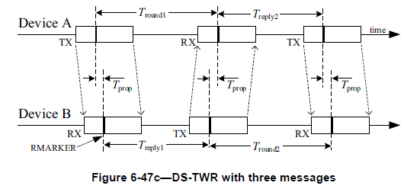
Background: Double-Sided Two-Way Ranging (DS-TWR)
DS-TWR (802.15.4z):
DS-TWR is an extension of SS-TWR in which two round-trip time measurements are used and combined to give the time-of-flight (TOF) result with a reduced error in the presence of uncorrected clock frequency offset even for quite long response delays.
T_{prop} is the propagation time of the RMARKER between the devices.

Slide 5
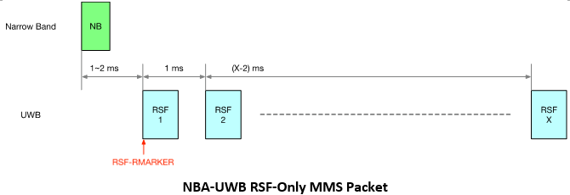
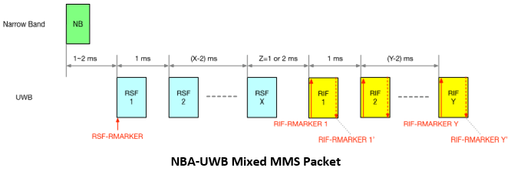
Background: NBA-UWB MMS Packet
Three types of NBA-UWB MMS Packet are defined [2]:
A single RSF-RMARKER, defined as the peak of the 1st pulse in the 1st RSF, is present in an RSF-Only MMS Packet.
RIF-RMARKERs are defined as the peak of the first pulse and the peak of the last pulse in each RIF
At least two RMARKERs are present in the Mixed MMS Packet and RIF-Only MMS Packet.
[2] 15-23\0100r2, NBA-UWB Technical Framework, Xiliang et. al.

Slide 6
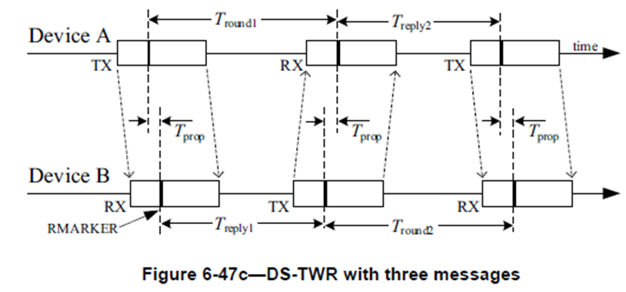
Motivation
The addition of a third (final) message extends the traditional Single-Sided TWR (SS-TWR) to Double-Sided TWR (DS-TWR) and mitigates the effect of relative clock drifts removing the need for carrier offset estimation as in SS-TWR.
While the carrier offset estimation is expected to be much more accurate in MMS ranging, enabling DS-TWR with MMS ranging is still beneficial.
[3] mentions that SS-TWR may be vulnerable to Mix-Down (MD) Attacks.
We explore how DS-TWR can be achieved with MMS ranging with minimal modifications.
[3] 15-23\0274r0, More on clock-related attacks against UWB ranging, Claudio Anliker et. al.

Slide 7
Example
Let us take an example of a one-to-many NBA-UWB MMS ranging with 8 responders:
Two fragments per MMS packets.
Only initiator transmits measurement reports (RPRT frame).

Slide 8
MMS Packets with two or more fragments with RMARKERs
Three MMS fragments with RMARKERs are required to compute the timing measurements for DS-TWR: 1st and 3rd are based on initiator’s MMS Packets while the 2nd is based on the responders’.
Mixed MMS Packet or RIF-only MMS Packet with at least two fragments have at least two RMARKERS that can be used to compute the timing measurements for DS-TWR.
=> A single MMS packet exchange between the initiator and the responder is sufficient for DS-TWR timing measurements.
Example: Mixed MMS Packet: 1 RSF + 1 RIF, or RIF-only MMS Packet: 2 RIFs.

Slide 9
MMS Packets with a single fragment with RMARKER
– Option 1
A RIF-Only MMS Packet with a single fragment or a RSF-Only MMS packet has a single fragment with RMARKER(s).
For a responder n except the last responder, the first fragment of the initiator’s MMS packet to responder n and the first fragment of the initiator’s MMS packet to the next responder (responder n+1) can be used as the 3rd RMARKER to compute the timing measurements for DS-TWR.
However, this is not possible for the last responder since there is no next responder.
Option 1: When MMS packets with a single fragment with RMARKER are used, the initiator transmits one extra MMS packet to enable the DS-TWR timing measurement.
2nd Responder
Last Responder
1st Responder

Slide 10
MMS Packets with a single fragment with RMARKER
– Option 2
Option 2: When MMS packets with a single fragment with RMARKER are used, the final ranging fragments are transmitted by the initiator. i.e., the fragment interleaving is reversed (responder transmits first, followed by the initiator).
DS-TWR timing measurements for the last responder is different: the first fragment of the initiator’s MMS packet to the previous responder is used as the 1st RMARKER while the first fragment of the initiator’s MMS packet to the last responder is used as the 3rd RMARKER.
2nd last Responder
Last Responder

Slide 11
Measurement Report
When applicable, it may be beneficial to consolidate the measurement reports for/from multiple responders in a single RPRT frame and transmit at the end of the ranging round.
Report Size: Size of the Reply time field and Turn Around Time fields:
(0: 1 octet; 1: 2 octets; 2: 4 octets; 3: 5 octets)
DS-TWR: Indicates that both Reply Time and Turn Around Time fields are present.
If the Consolidated Measurement Report bit is 1, the Number of Reports field is present and indicates the number of measurement reports in the Measurement Report List, each report carries the measurement report for/from one responder and are arranged in the same order as the transmission order of the corresponding MMS packets in the ranging phase.
Measurement Report
RPRT
Octets: 1 | 3 | 1 | variable | 2
ID | RPA_hash | Message Control | Message Content | CRC
Octets: 0, 1, 2, 4 or 5 | 0, 1, 2, 4 or 5
Reply Time | Turn Around Time
Bits: 0 - 1 | 2 | 3 | 4-7 | Octets: 1 | variable | 0 or 1 | Variable
Report Size | DS-TWR | Consolidated Measurement Report | RFU | PTDataLength | PTData | Number of Reports | Measurement Report List

Slide 12
Summary
We discussed how DS-TWR can be achieved with MMS ranging with minimal modifications.
We proposed two options to enable DS-TWR for MMS Packets with a single fragment with RMARKER:
Option 1: the initiator transmits one extra MMS packet at the end of the raging round to enable the DS-TWR timing measurement.
Option 2: The final ranging fragments are transmitted by the initiator. i.e., the fragment interleaving is reversed in the last access slot.
We also proposed to consolidate the measurement reports for/from multiple responders in a single RPRT frame.

