Slide 1
Project: IEEE P802.15 Working Group for Wireless Personal Area Networks (WPANs)
Submission Title: [UWB wake-up burst modulation method]
Date Submitted: [July, 2023]
Source: [Chenchen Liu, Bin Qian, Lei Huang, David Xun Yang] Company [Huawei Technologies]
Address [Huawei Bantian Base, Longgang District, Shenzhen, 518129 China]
E-Mail:[liuchenchen1@Huawei.com]
Re: [Task Group 4ab: UWB Next Generation]
Abstract: [A new wake-up burst (WUB) modulation method is proposed, which can work well under interference]
Purpose: [ ]
Notice: This document has been prepared to assist the IEEE P802.15. It is offered as a basis for discussion and is not binding on the contributing individual(s) or organization(s). The material in this document is subject to change in form and content after further study. The contributor(s) reserve(s) the right to add, amend or withdraw material contained herein.
Release: The contributor acknowledges and accepts that this contribution becomes the property of IEEE and may be made publicly available by P802.15.

Slide 2
Background
The wake-up message is based on millisecond spaced bursts of BPSK modulated UWB pulses at the 62.4 MHz PRF of the HRP UWB PHY, with each wakeup burst (WUB) consisting of 500 ±5% pulses (i.e., 4000 chips±5%), which is approximately 8.0 µs in duration.
Each WUB signals one bit using OOK where presence of the WUB is a binary 1 and absence of the WUB is a binary 0

Slide 3
Background
Since the WUB is at the PRF of 62.4 MHz with unknown sequence, any UWB signal at the mean PRF of 62.4*k MHz will be misinterpreted as WUB.
The transmission of binary 0 is susceptible to the interference

Slide 4
Background
The demodulation of WUB requires calculation of detector threshold based on SYNC signal
The balance of 0 →1 and 1 →0 error probability will have a great impact on the decoding performance

Slide 5
Proposed WUB modulation method
Each WUB contains two candidate time intervals for the BPSK modulated UWB pulses
The BPSK modulated UWB pulses are transmitted only in one of the two interval based on the coded wake-up ID bit to send
Binary 0
Binary 1

Slide 6
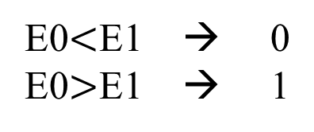
Propose WUB demodulation method
The receiver demodulate the WUB by comparing the accumulated energy during two candidate time intervals
Demodulation metric as follows, where E0 and E1 are the corresponding accumulated energy of the two intervals
E0$<$E1 → 0
E0$>$E1 → 1

Slide 7
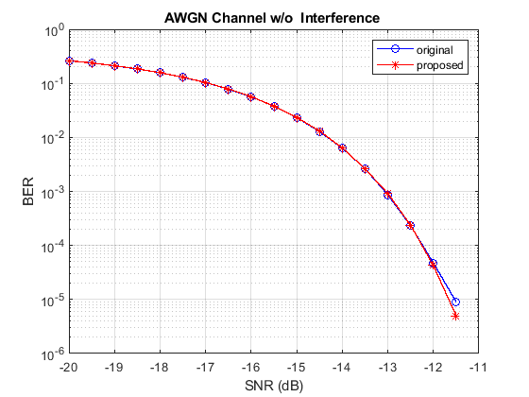
Simulations
The demodulation threshold is set to $\frac{E}{2}+P_{n}$, where E is the power of WUB and $P_{n}$ is the power of AWGN noise
OSR=4, m-sequence of length 511 and 255, Butterworth pulse, 1 M bits tested for each SNR

Slide 8
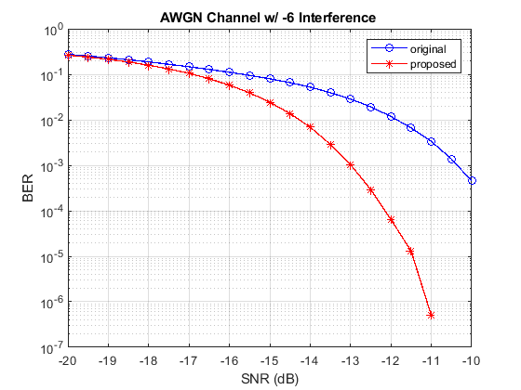
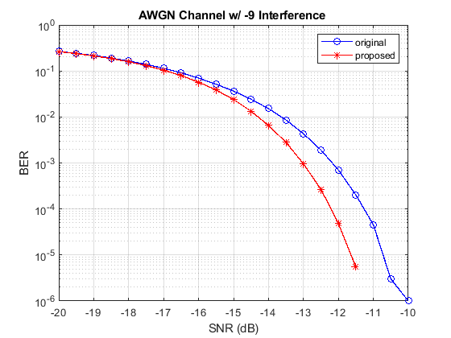
Simulations
The interference power is 6dB or 9dB less with respect to the signal through the whole WUB

Slide 9
Advantages of the proposed modulation
Works well under interference (the abs value of E0 and E1 may both increase, but the relative relationship may keep still)
No need to estimate detector threshold
No bias in bit errors since 0 →1 and 1 →0 error probability are equal
Avoid long periods of all zero waveform

Slide 10
References
[1] 15-22-0654-00-04ab-draft-text-for-uwb-wake-up-radio
[2] 15-21-0557-01-04ab-uwb-wake-up-signaling
[3] 15-22-0282-01-04ab-the-advantages-of-uwb-wakeup
[4] P802.15.4z, Draft Standard for Low-Rate Wireless Networks

Slide 11
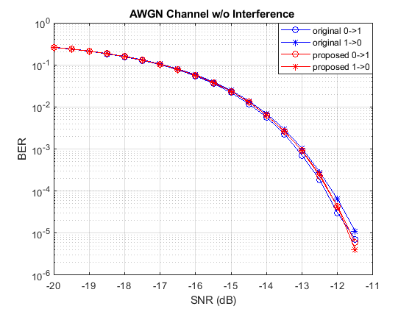
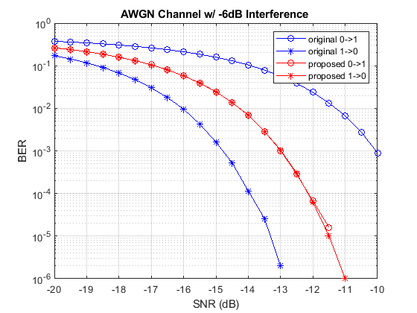
Appendix

Slide 12
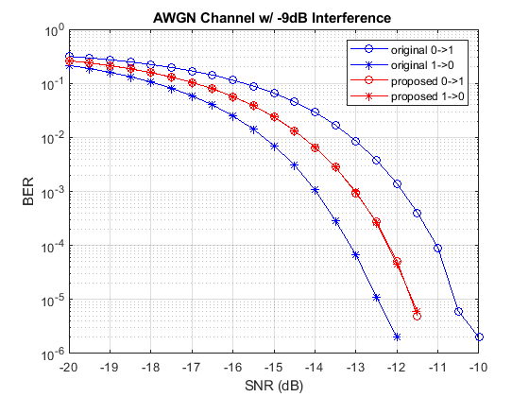
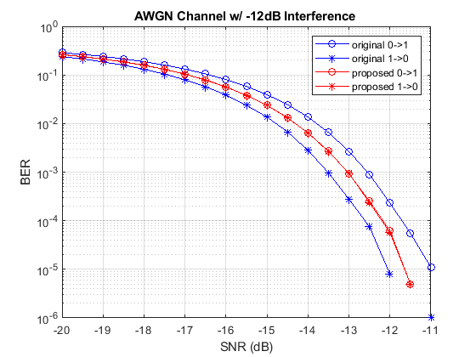
Appendix

